Slide 1
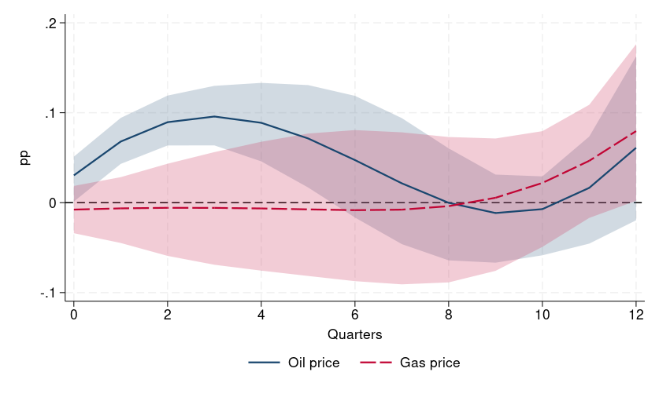
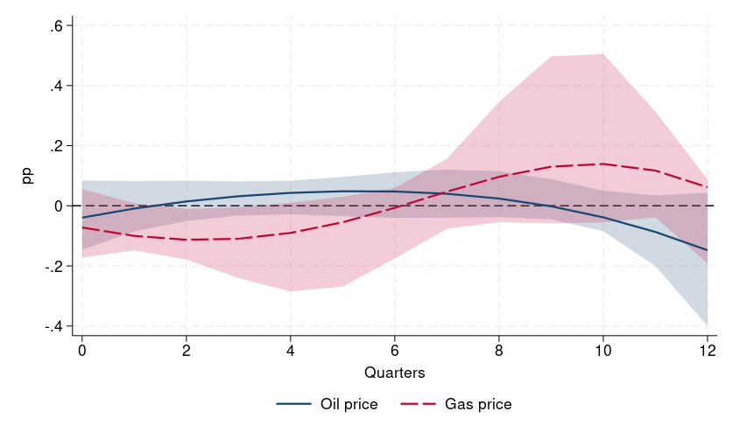
Euro area: wage response to oil and gas supply shocks (IV)
Takeaway: [TO BE COMPLETED: response of euro-area negotiated and hourly wages to oil and gas price increases driven by supply shocks]
Negotiated wages
Gross wages per hour worked
Response (percentage points) of year-on-year wage growth to a 10% increase in the oil and natural gas prices; 90% confidence bands. Smooth 2SLS local projections (Barnichon–Brownlees; bands by undersmoothing): the oil price is instrumented with the Mori–Peersman oil supply news shocks, the gas price with the Alessandri–Gazzani gas supply shocks (quarterly average of the monthly shocks). Euro-area time series, Newey–West standard errors. Sample (shock dates): negotiated wages, oil 2000q3–2025q4; gas 2006q4–2025q4; hourly wages, oil 2000q3–2025q4; gas 2006q4–2025q4.

Slide 2
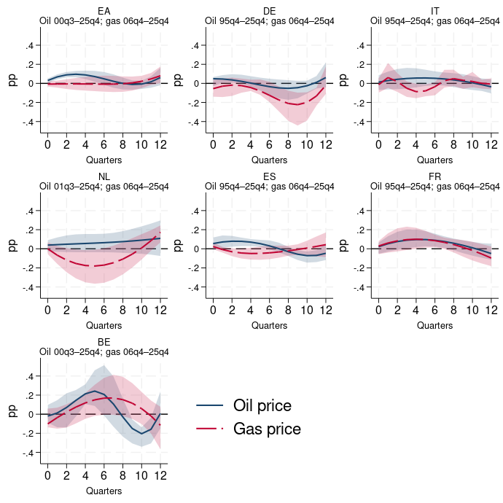
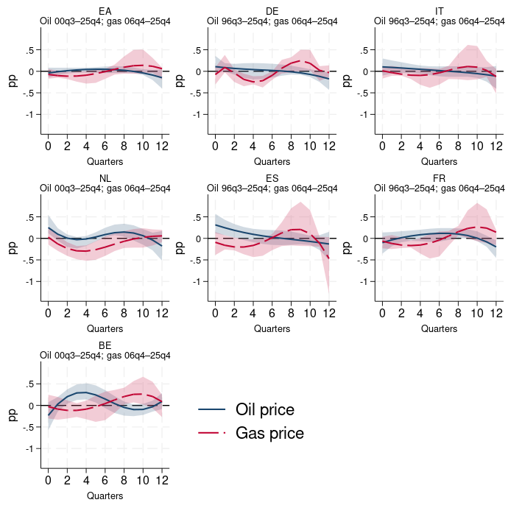
Countries: wage response to oil and gas supply shocks (IV)
Takeaway: [TO BE COMPLETED: cross-country differences in the IV responses and oil versus gas]
Negotiated wages
Gross wages per hour worked
Response (percentage points) of year-on-year wage growth to a 10% increase in the oil and natural gas prices; 90% confidence bands. Smooth 2SLS local projections (Barnichon–Brownlees; bands by undersmoothing): the oil price is instrumented with the Mori–Peersman oil supply news shocks, the gas price with the Alessandri–Gazzani gas supply shocks (quarterly average of the monthly shocks). Time series for the euro area and each country, Newey–West standard errors; same vertical scale in all panels unless the widths of the confidence bands differ by more than 1.6 pp (then each panel has its own scale, with the same spacing between labels); the sample period (shock dates) of each panel is shown under its name.

