Slide 1
RETAIL PERFORMANCE REVIEW
Profitable growth, 2019–2022:
where it came from and where it went
A dbt + DuckDB pipeline over a single denormalised extract — cleaned, normalised, and turned into decisions.
Net sales 2022
Gross margin 2022
Gross profit 2022
Operating profit 2022
$12.7M
37.3%
$4.73M
$1.39M
+10.5% YoY
−3.8 pts YoY
+0.4% YoY
−9.0% YoY
Bottom line: sales hit a record, but profit stalled. The cause is specific and fixable — and the single biggest
upside is pricing, not cost.
Prepared for the CEO · 20 July 2026

Slide 2
EXECUTIVE SUMMARY
Record sales, stalled profit — and a clear way back
1
Growth turned unprofitable in 2022
Net sales rose +10.5% to $12.7M, but gross margin fell 3.8 pts (41.1%→37.3%). Gross profit was flat (+0.4%) and operating profit fell 9.0%.
2
One cause: a Furniture cost shock
Furniture landed cost jumped +36% on 1 Jan 2022 with no price change. That alone cut gross profit by $490k — wiping out the +$509k every other category added.
3
Biggest lever is pricing, not cost
Non-West regions sell identical products (same cost) at 40–55% lower prices. Closing part of this gap is worth millions in margin at no volume risk.
4
Profit is highly concentrated
The West is 60% of sales at ~2× the margin of every other region; the top 25 of 287 stores are half of revenue. The winning playbook is known — scale it.
Retail Performance Review · dbt + DuckDB · Confidential
2

Slide 3
PIPELINE · 1 OF 3
From one messy extract to decision-ready marts
SOURCE
STAGING
INTERMEDIATE
MARTS — CORE
raw.consolidated_transactions
stg_consolidated_transactions
int_transactions_cleaned
dim_product · dim_store · fct_sales
509,480 rows · 24 cols
wide, denormalised, contaminated
snake_case · cast types
non-destructive DQ flags
dedup (latest ingest)
per-unit cost + economics
normalised star schema
tested keys + relationships
SEED
seed_state_region
canonical state → region map
CEO MARTS (built only from the star schema)
sales
annual
sales
monthly
region
performance
product
performance
store
performance
growth
drivers
2022
data
quality
✓ uv run dbt build → 1 seed · 2 views · 8 tables · 34 tests PASS=47 ERROR=0
Retail Performance Review · dbt + DuckDB · Confidential
3

Slide 4
PIPELINE · 2 OF 3
Data contamination found — and how each was fixed
Detected by diffing the extract against reproducible logic; every issue is quantified in mart_data_quality (nothing dropped silently).
Issue
Rows
How it was handled
Duplicate re-ingested transactions
9,815
Keep latest ingested_at per transaction_id (sales-ops rule)
Clone duplicates with fresh ids
1,308
Exact economic copies (only landed cost survived); detected & excluded
Per-pack vs per-unit cost mix-up
75,274
Use landed_unit_cost (per-unit, = actual paid); unit/standard are per-PACK
Product-name corruption (Vanities→Cosmetics)
11,498
Canonical name = modal product_name_catalog
Region mislabelled (MD→NE) / 'Unknown'
2,190
Derive region from state_code via canonical seed
Null product/store keys (orphans)
2,618
Excluded from fact; counted in DQ scorecard
Restated store with 10× inflated opex
174
Modal attribute per store removes the restated row
Sentinel '99901' garbage rows
100
Excluded (not a real product/store)
Returns (negative quantity)
4,907
Kept and netted → all figures are net of returns
Unreliable product SCD dates
6,624
Ignored for the fact (inconsistent with actual sales)
Retail Performance Review · dbt + DuckDB · Confidential
4

Slide 5
PIPELINE · 3 OF 3
Key modelling decisions (and what I rejected)
COST BASIS FOR MARGIN
REGION SOURCE OF TRUTH
landed_unit_cost — the actual per-unit cost paid.
Derive from state_code via a canonical US-Census seed.
unit_cost / standard_unit_cost are per-PACK (= landed × pack_size). Using them raw understates margin by ~10 pts. Standard/pack_size kept for budget-margin sensitivity.
region_name in the extract is corrupted (Maryland split ~50/50 to 'Northeast'; ~100 'Unknown'). Majority-vote fails on a 50/50 split, so a seed is more robust.
DUPLICATE RESOLUTION
RETURNS
Keep the latest ingested_at per transaction_id.
Keep negative quantities; report net of returns.
9,815 re-ingested rows share identical economics. Lineage breaks the tie; Transaction Date stays the economic truth.
Returns are real economic events (4,907 rows, valid prices). Gross-of-returns available as a sensitivity.
STORE OPEX CADENCE
GRAIN & KEYS
Treat direct_store_operating_costs as ANNUAL.
fct_sales = one row per de-duplicated transaction.
A monthly reading would be ~3.5× total revenue — economically impossible. Used only for an operating-profit lens.
Unique, not-null transaction_id; relationship tests to dim_product & dim_store. Star schema, not re-aggregated raw.
Retail Performance Review · dbt + DuckDB · Confidential
5

Slide 6
PIPELINE · DEEP DIVE
De-duplication done properly — and the assumptions behind the numbers
The headline swing hinges on two things: catching every duplicate, and a few explicit accounting choices. Both are shown here.
TWO KINDS OF DUPLICATE — ONE IS INVISIBLE TO id-DEDUP
ACCOUNTING ASSUMPTIONS & THEIR SENSITIVITY
Re-ingestion — same transaction_id
9,815
Assumption
Choice
If changed
Same sale loaded twice on different ingested_at dates. Keep the latest ingest (−2.0% of raw sales).
Cost basis
landed (actual)
standard ÷ pack ≈ same margin
Returns
net of returns
exclude → +~$0.13M/yr (gross)
Clone copies — fresh transaction_ids
1,308
Exact economic copies appended above the organic id range. id-dedup can't see them; their tell is that only landed_unit_cost survived (per-pack costs NULL).
Store opex
annual
monthly = 3.5× revenue (impossible)
Clone dupes
removed
keep → sales +0.25% overstated
Rejected — de-dup on the economic key
241k
Region
state_code seed
trust raw region_name → MD wrong
Same product/store/month/qty/price repeats are legitimate (241k in the clean baseline). That rule would delete ~half of real sales.
✓ Validation: after cleaning, sales reconcile to the pre-contamination baseline to the dollar ($45.34M over 4 years) — confirming no duplicate was missed and no real sale was dropped.
Retail Performance Review · dbt + DuckDB · Confidential
6

Slide 7
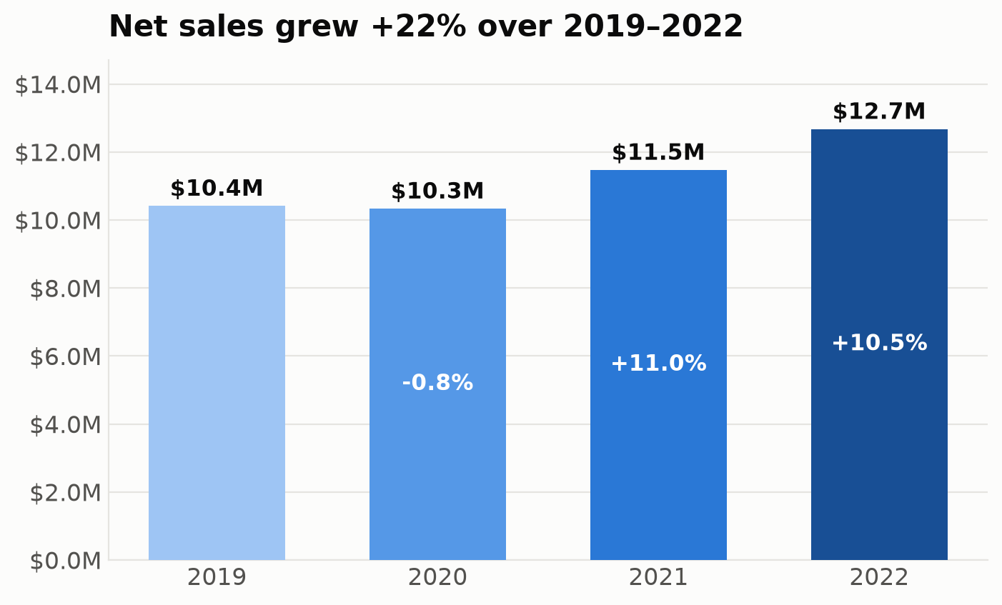
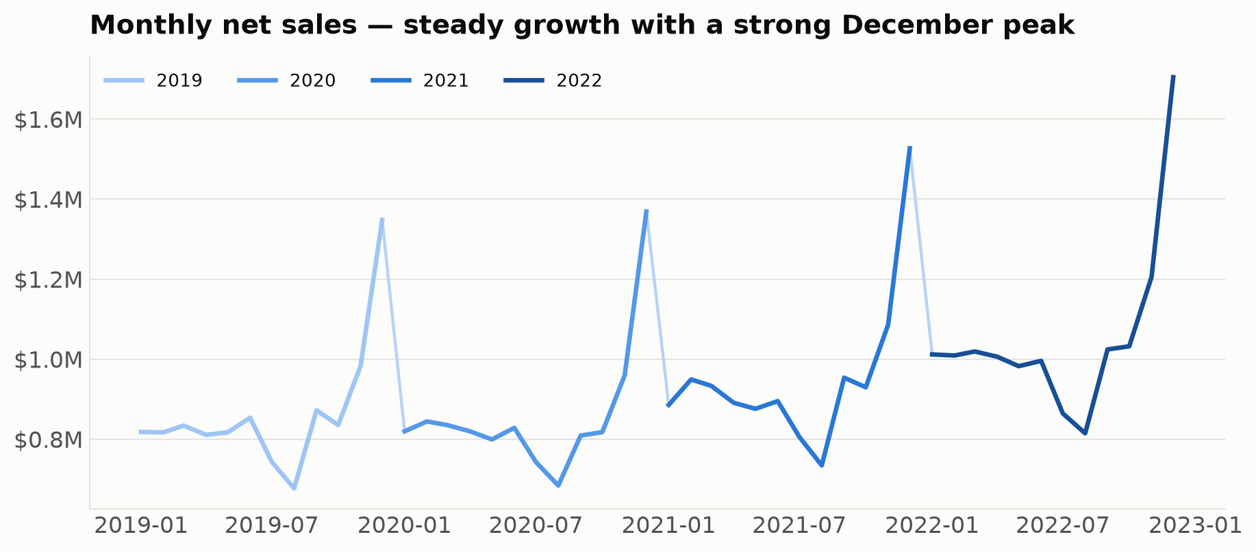
INSIGHT · Q1 — ARE WE GROWING?
Yes — steady double-digit top-line growth
Net sales grew from $10.4M (2019) to $12.7M (2022): flat through COVID (2020), then +11.0% and +10.5%. December is the clear seasonal peak every year — plan inventory and staffing around it.
Retail Performance Review · dbt + DuckDB · Confidential
7

Slide 8
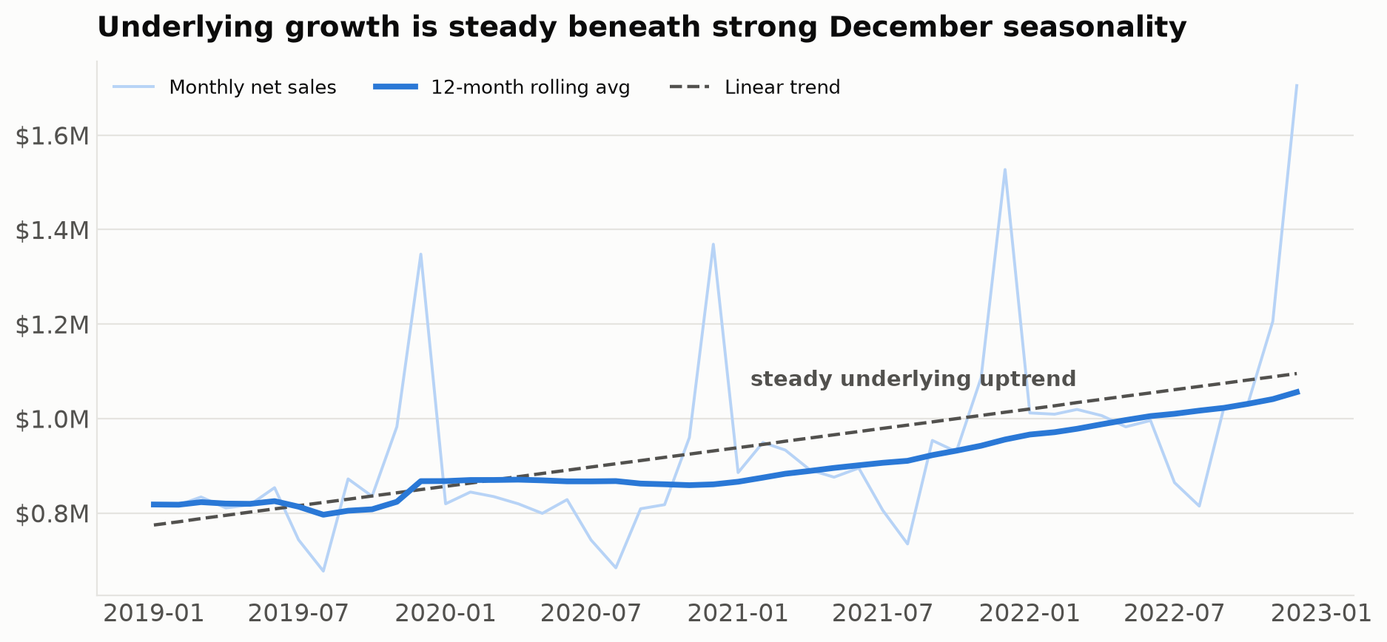
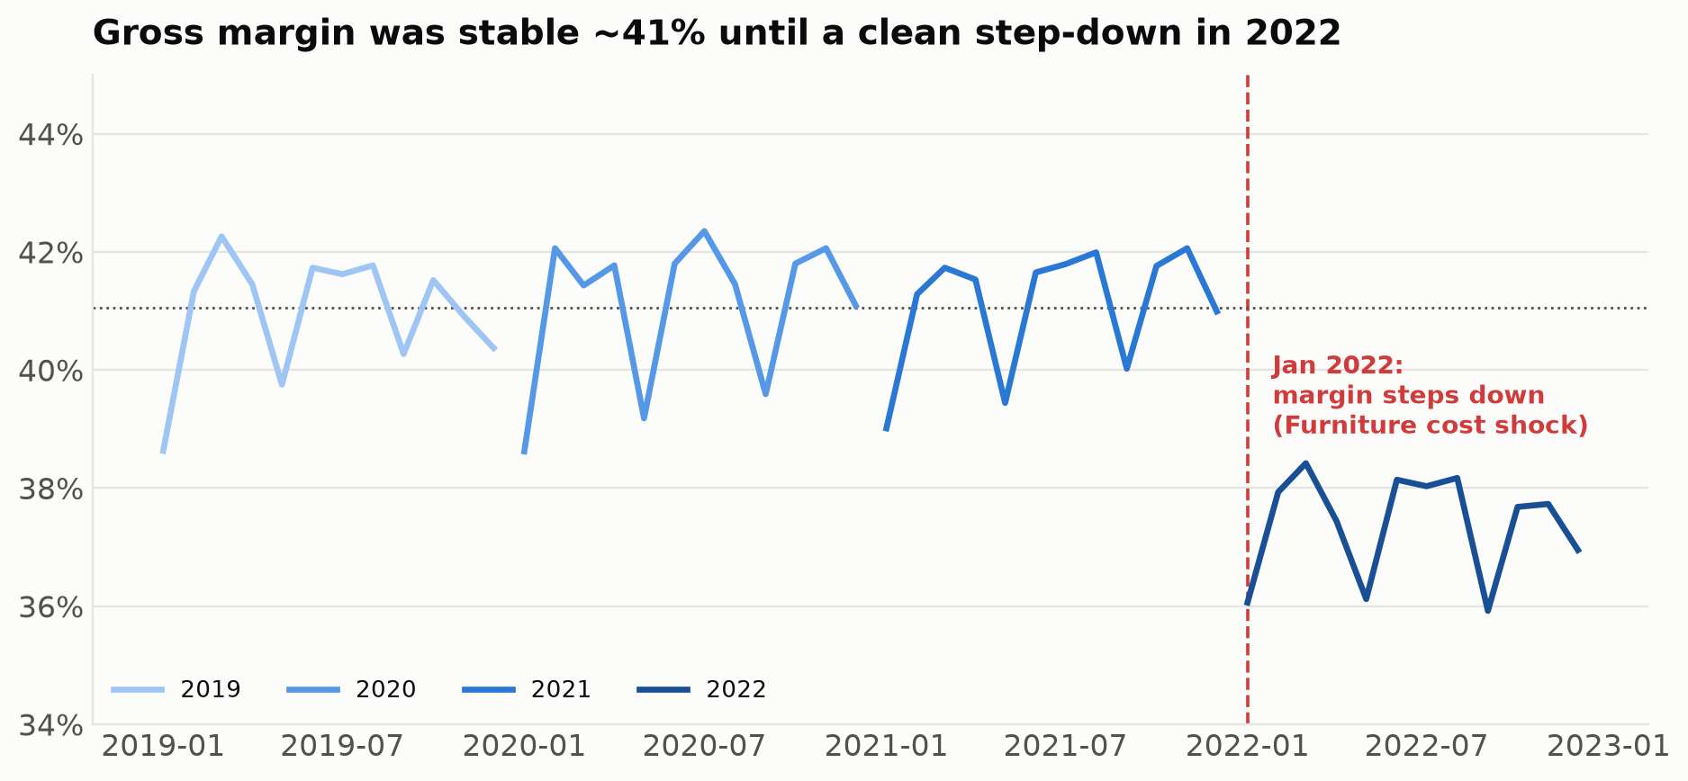
INSIGHT · Q1 — MONTHLY EVALUATION
Steady underlying growth; a clean margin break in 2022
Stripping out seasonality, the 12-month average climbs steadily — annual net sales rose ~$0.75M/year on average ($10.4M→$12.7M) — real, broad-based demand growth. But monthly gross margin, stable at ~41% for three years, steps down abruptly in Jan 2022 and stays there — the Furniture cost shock, visible to the month.
Retail Performance Review · dbt + DuckDB · Confidential
8

Slide 9
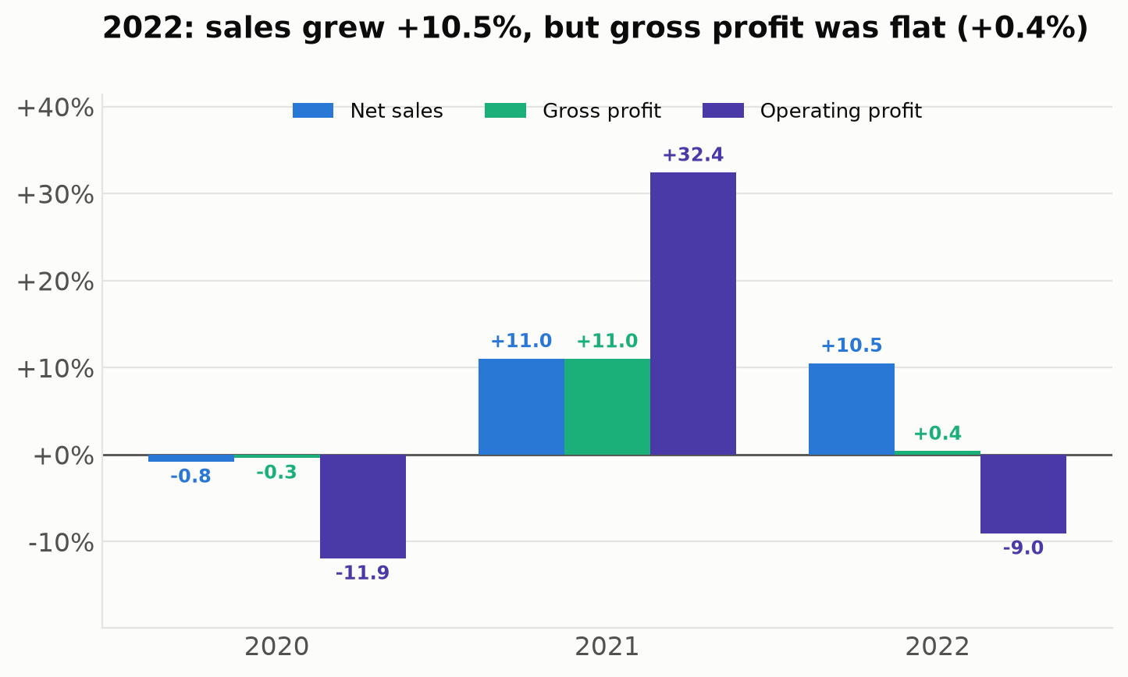
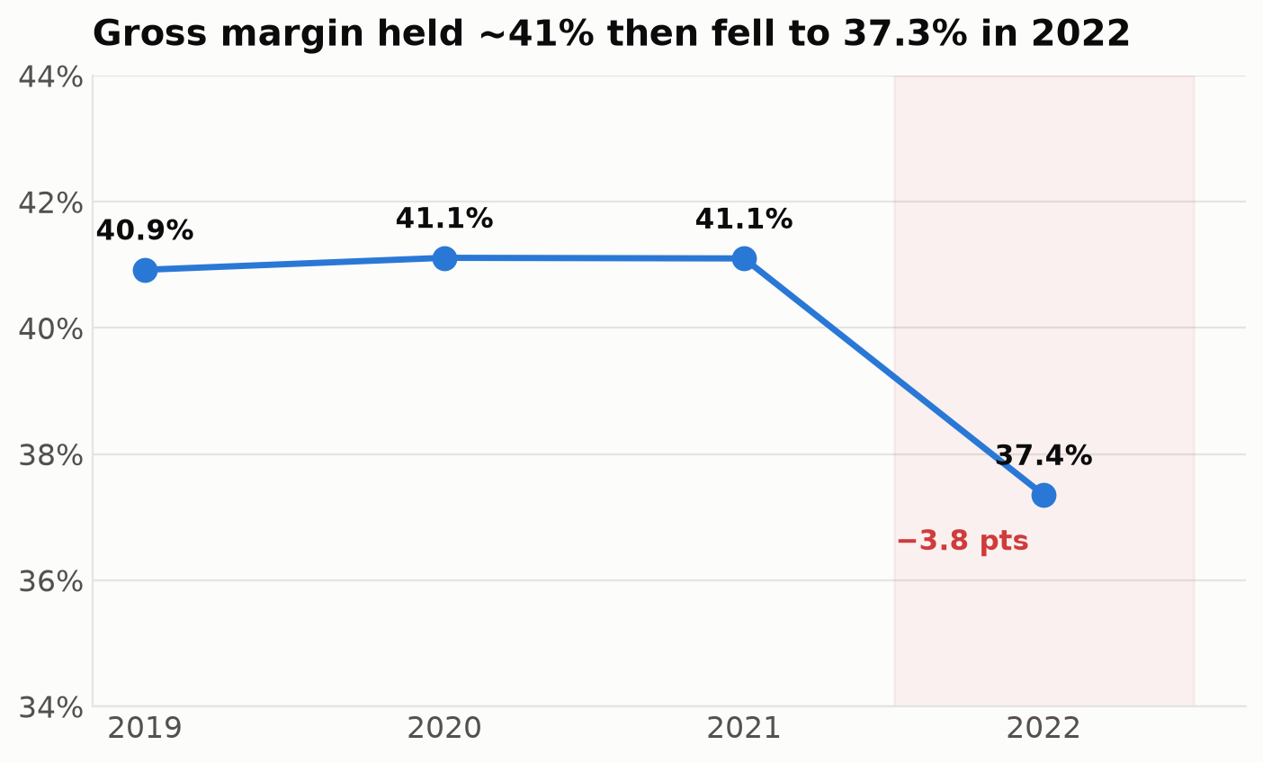
INSIGHT · Q1 / Q4 — ARE WE GROWING PROFITABLY?
No — 2022 growth did not reach the bottom line
Net sales grew +10.5% but gross profit grew just +0.4% and operating profit fell 9.0%. The gap is entirely gross margin, down 3.8 pts to 37.3% — the business worked harder in 2022 for the same profit. Why? → next slide.
Retail Performance Review · dbt + DuckDB · Confidential
9

Slide 10
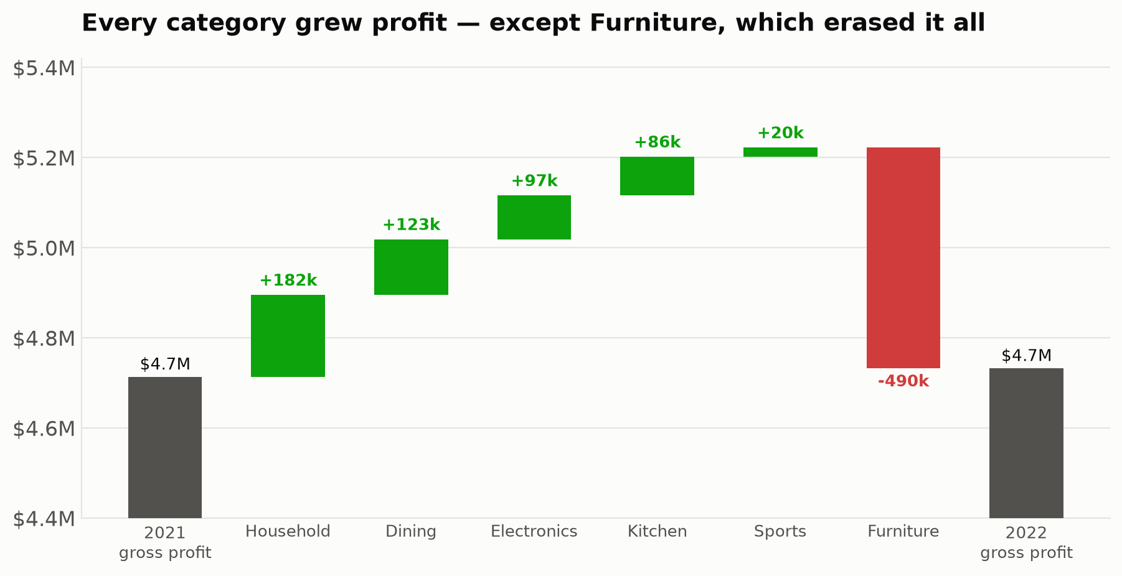
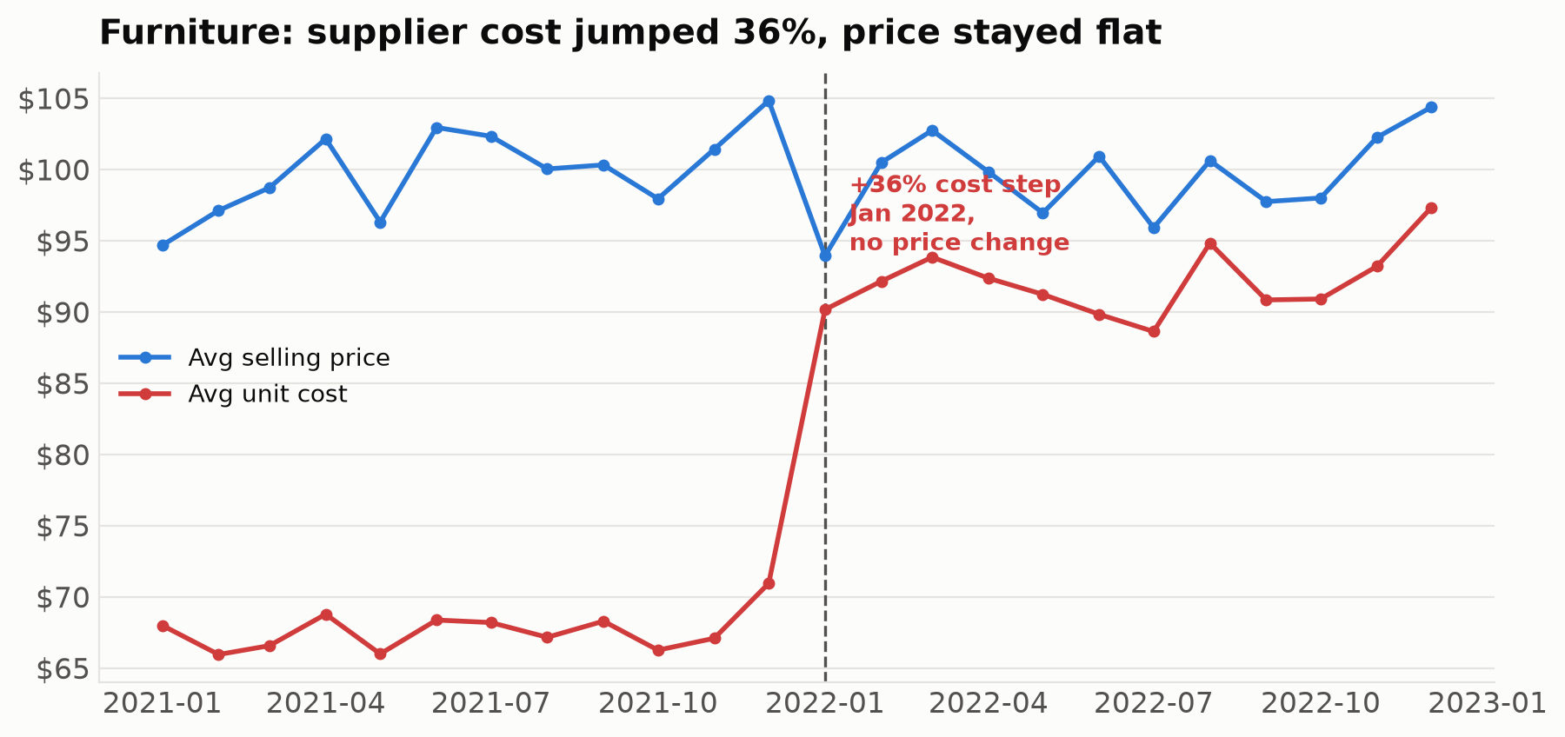
INSIGHT · Q3 — WHAT DROVE (AND DRAINED) 2022?
A single Furniture cost shock erased the gains
THE MECHANICS
• Furniture landed cost +36% on 1 Jan 2022
• Selling price unchanged → margin 32%→7%
• Furniture gross profit: −$490k
• All other categories: +$509k combined
• Net effect: profit flat
Retail Performance Review · dbt + DuckDB · Confidential
10

Slide 11
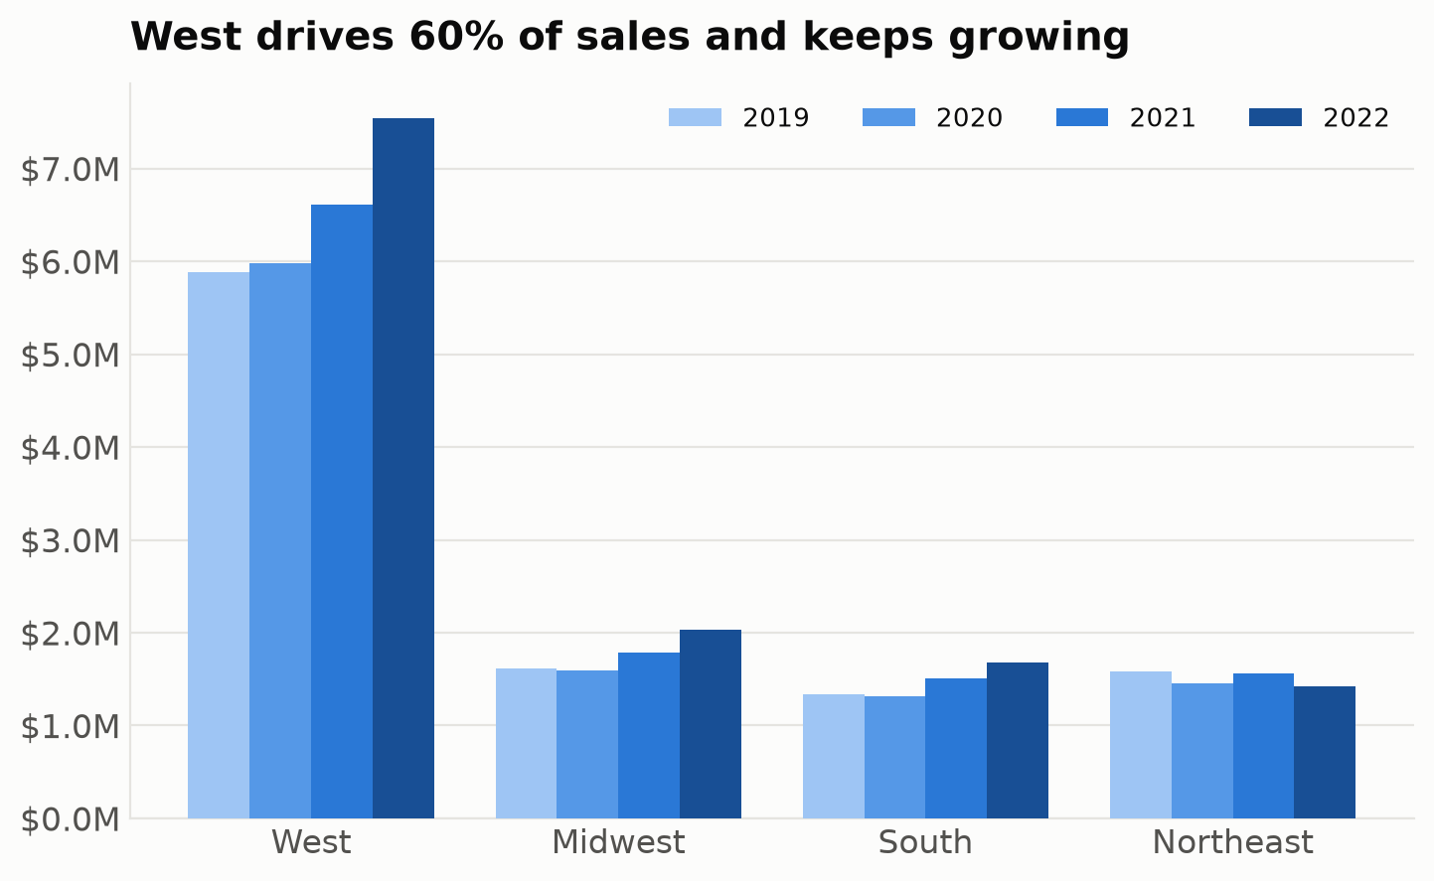
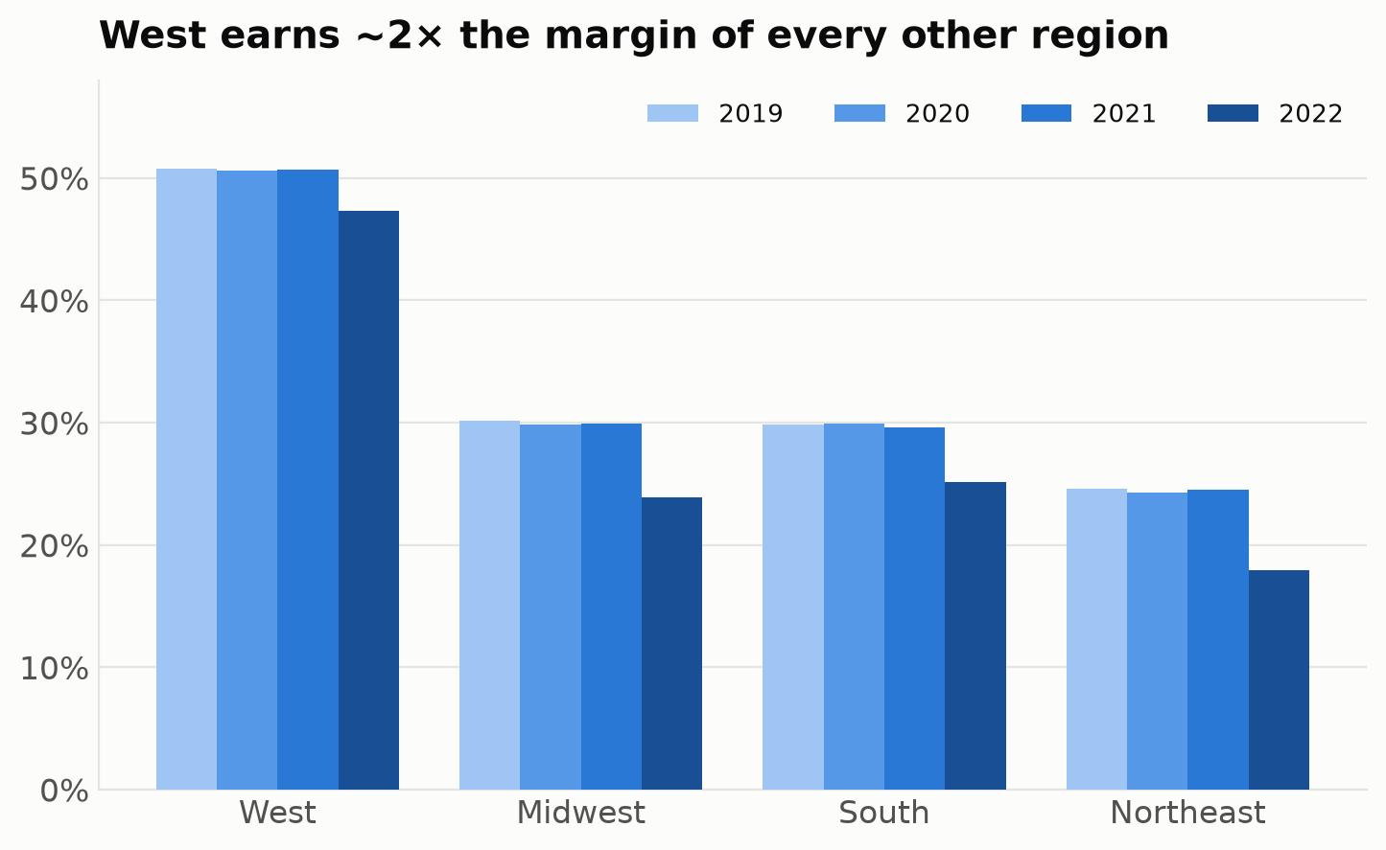
INSIGHT · Q2 — REGIONAL PERFORMANCE
The West carries the business
West = 60% of sales AND ~47% margin (2× the rest). Northeast is smallest, shrinking (−8.8%) and least profitable (18%). Every region's margin fell in 2022 — the Furniture shock is nationwide.
Retail Performance Review · dbt + DuckDB · Confidential
11

Slide 12
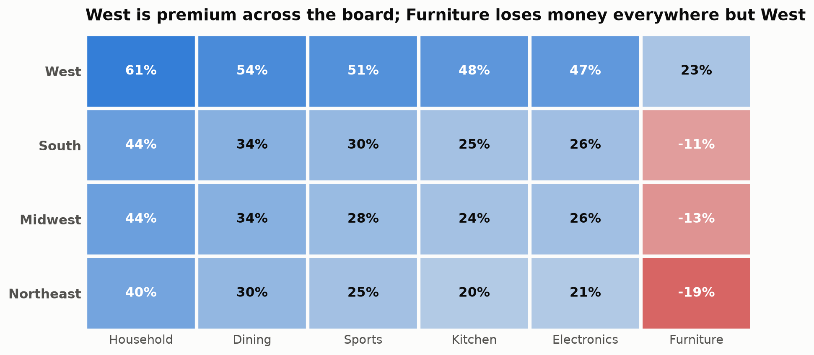
INSIGHT · Q2 — REGIONAL × CATEGORY PROFITABILITY
Two problems in one view: a Western premium and a Furniture hole
Read across each row: the West earns a premium in every single category on the same catalogue (Household 61% vs ~41% elsewhere). Read down the Furniture column: it is loss-making in the Midwest, South and Northeast — those regions were under-pricing furniture even before the 2022 cost shock pushed it below water.
Retail Performance Review · dbt + DuckDB · Confidential
12

Slide 13
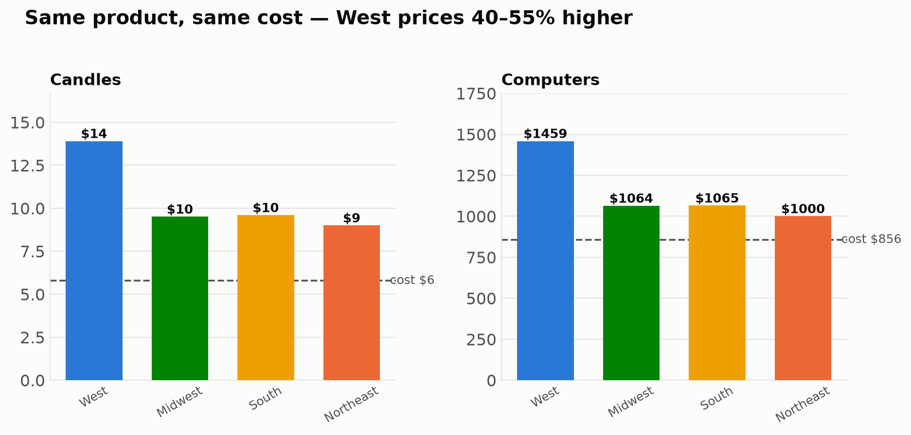
INSIGHT · Q4 — THE BIGGEST PROFIT LEVER
Non-West regions under-price identical products
Cost is identical across regions (it's a product attribute), so this is pure pricing. Candles cost $5.78 everywhere yet sell for $14 in the West vs $9 in the Northeast; Computers cost $856 yet range $1,458 → $1,000. Closing even part of this gap adds margin with no extra volume — the single largest, lowest-risk profit opportunity.
Retail Performance Review · dbt + DuckDB · Confidential
13

Slide 14
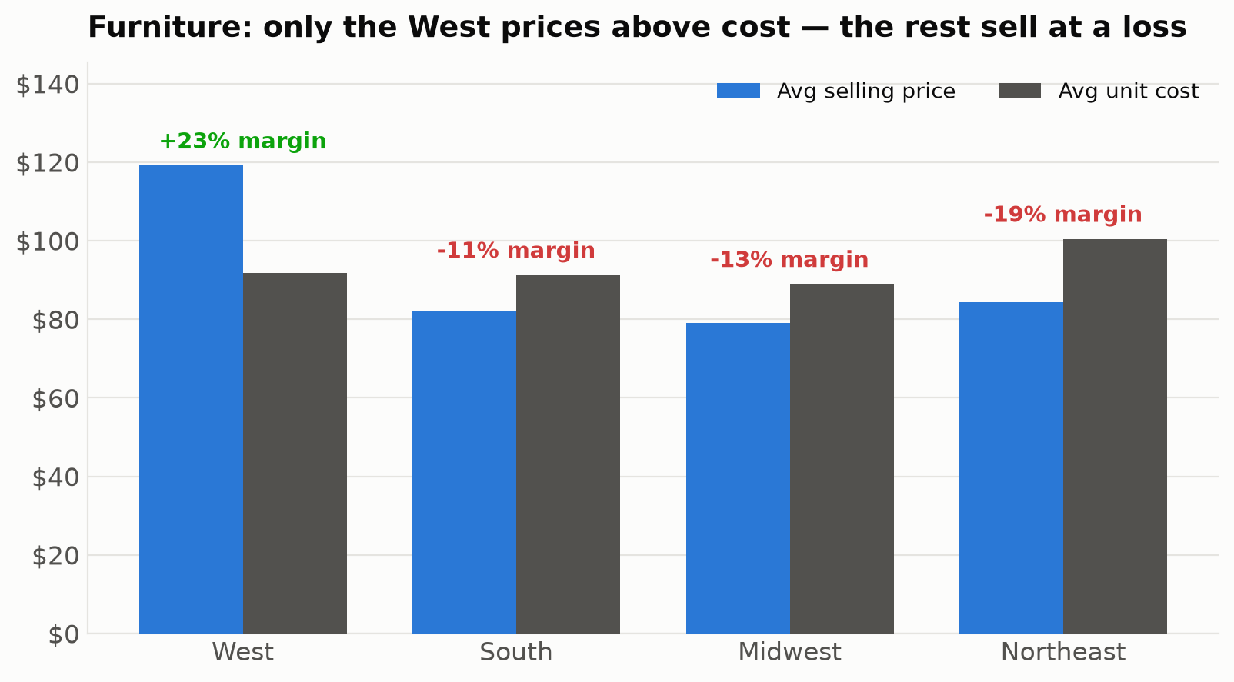
INSIGHT · Q4 — PRICING THE PROBLEM SEGMENT
Furniture: the pricing gap turned a cost shock into losses
FURNITURE GROSS PROFIT: 2021 → 2022
West
+$500k
→
+$297k
Northeast
+$44k
→
−$53k
Midwest
+$62k
→
−$48k
South
+$49k
→
−$31k
All three non-West regions flipped to a loss; only the West stayed profitable.
The West prices furniture at $119 (23% margin); everyone else sells it below cost. The fix is regional pricing, not just supplier cost.
Retail Performance Review · dbt + DuckDB · Confidential
14

Slide 15
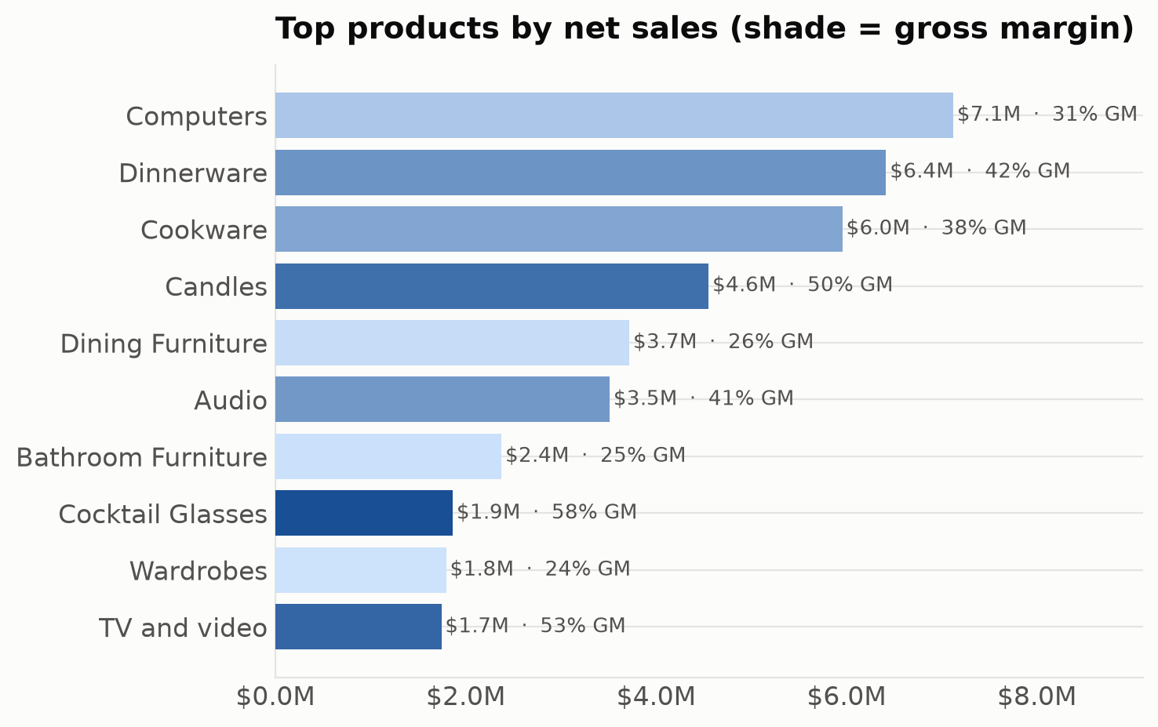
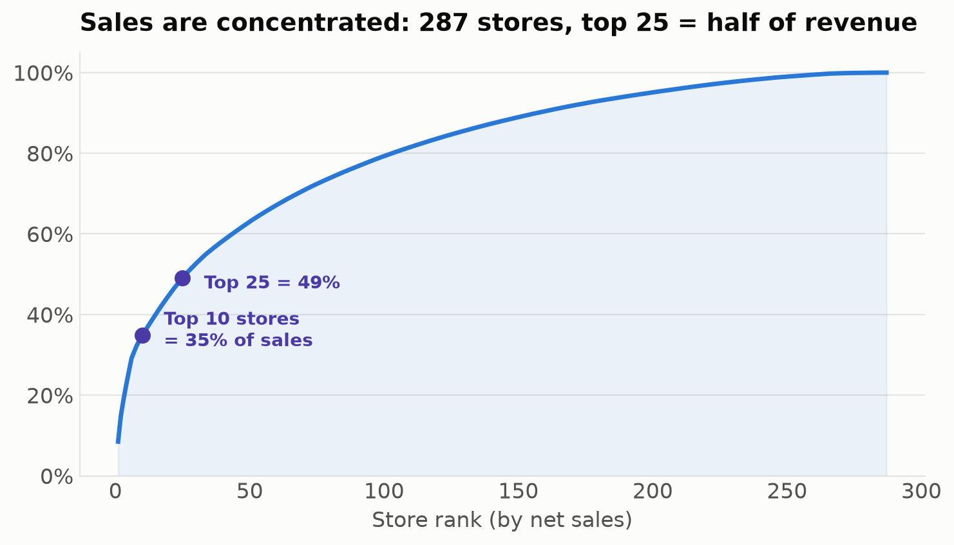
INSIGHT · Q2 — PRODUCTS & CONCENTRATION
A few products and stores drive the result
Computers, Dinnerware & Cookware lead sales; highest-margin lines are Home Fragrances (75%), Vanities (66%) & Cocktail Glasses (58%). The top 25 of 287 stores are ~half of revenue — Los Angeles alone is $3.8M at 58% margin.
Retail Performance Review · dbt + DuckDB · Confidential
15

Slide 16
RECOMMENDATIONS
Four moves to restore profitable growth
1
Fix Furniture economics — now
≈ $0.5M GP
Reprice Furniture and/or renegotiate the supplier to reverse the +36% cost step. Restoring 2021 margins recovers ≈$490k of gross profit.
Highest / fastest
2
Close the regional pricing gap
Multi-$M margin
Test raising non-West prices toward Western levels on identical SKUs. Even a partial convergence on Electronics & Household adds margin with no volume added.
Highest value
3
Scale the West playbook
Structural
West delivers 2× margin on the same catalogue. Codify its pricing/assortment and extend to Midwest & South; review the loss-making store tail.
Medium term
4
Institutionalise data quality
Risk control
Keep the dbt tests + mart_data_quality as a standing monitor so cost shocks, dupes and mis-mappings are caught automatically, not months later.
Ongoing
Assumptions: margin = landed cost; opex annual; figures net of returns. With more time: price-elasticity test design, fully-loaded store P&L, and a Furniture supplier deep-dive.
Retail Performance Review · dbt + DuckDB · Confidential
16

