Slide 1
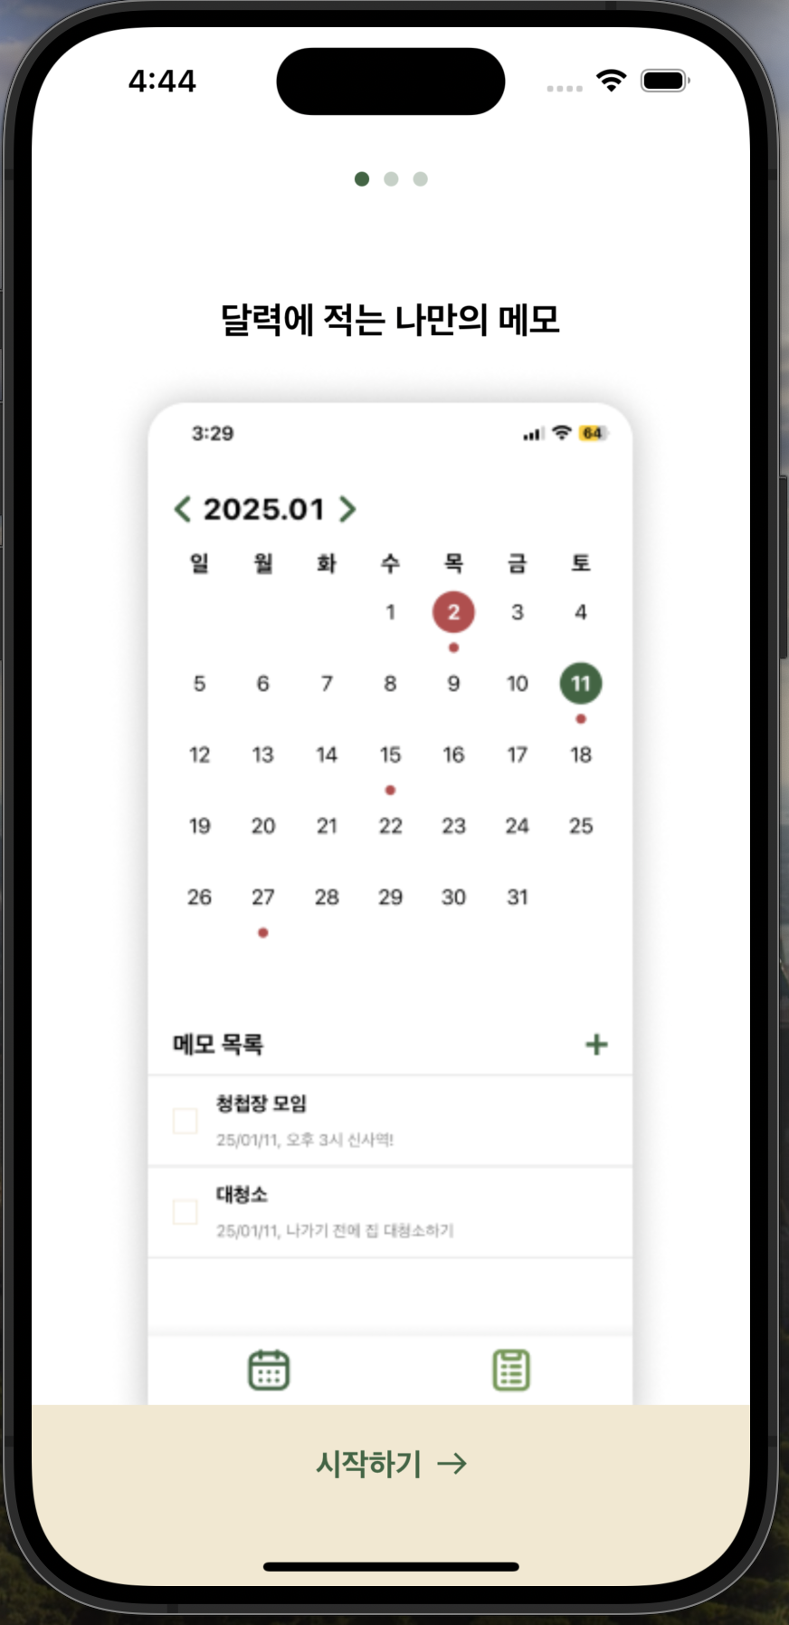
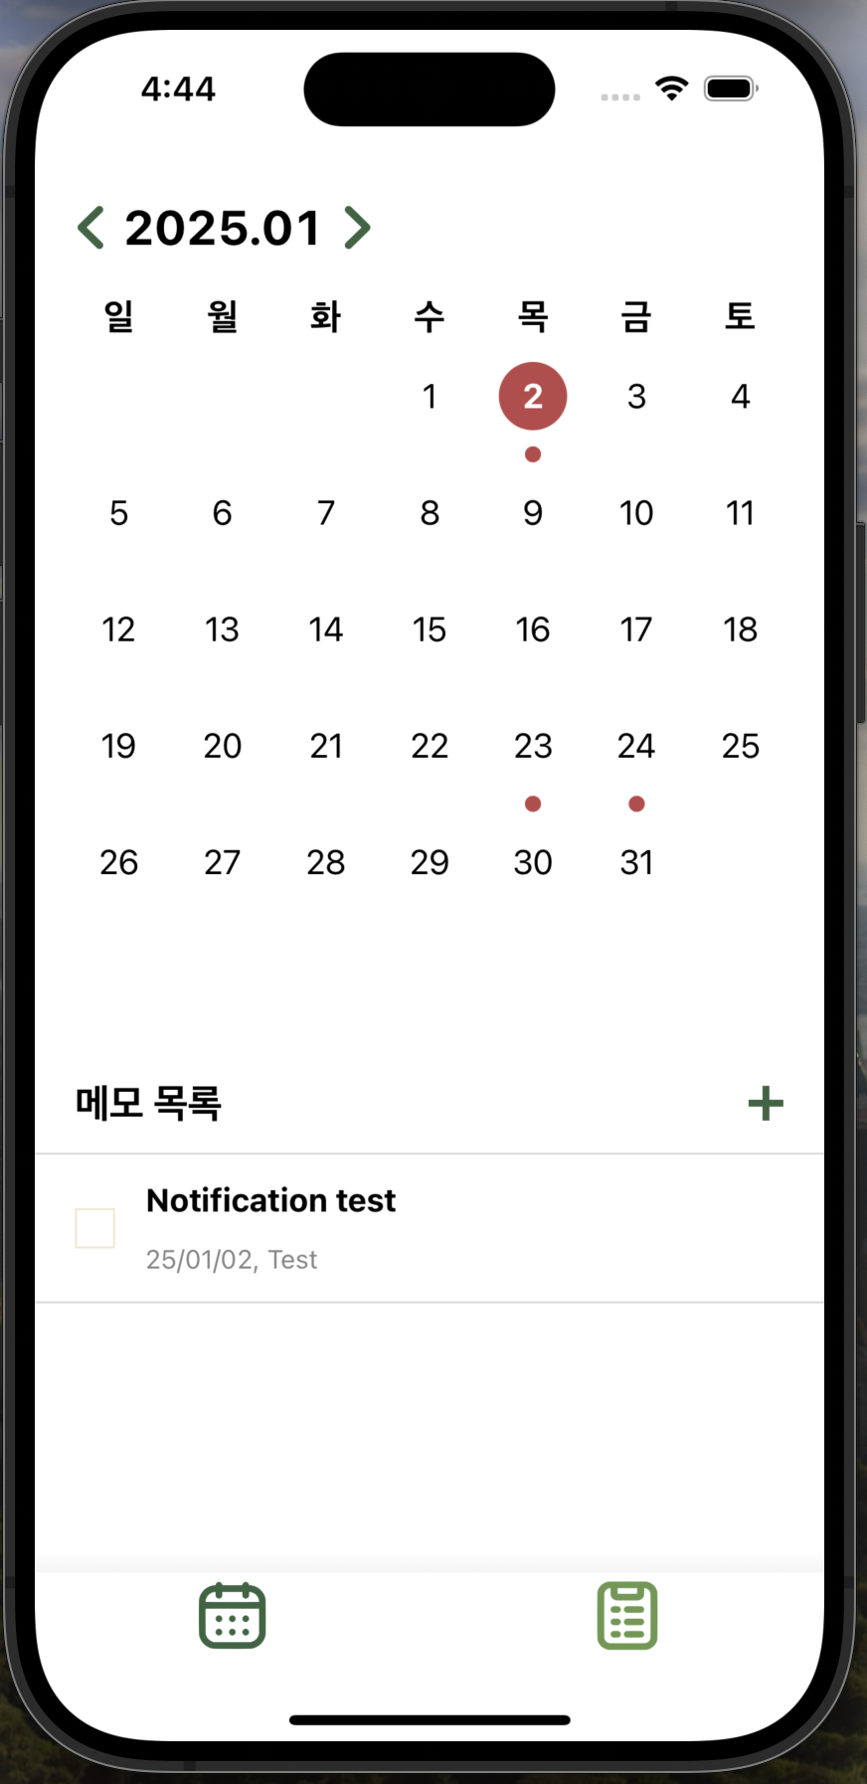
PathModel
@Published paths: [PathType]
OnboardingView
HomeView(CalendarView)
MemoListViewModel
CalendarViewModel
HomeViewModel
OnboardingViewModel
OnboardingModel
HomeModel

Slide 2
캘린더
CalendarView
CalendarViewModel
PathModel
@Published paths: [PathType]
MemoListViewModel
@Published memos: [memoData]

Slide 3
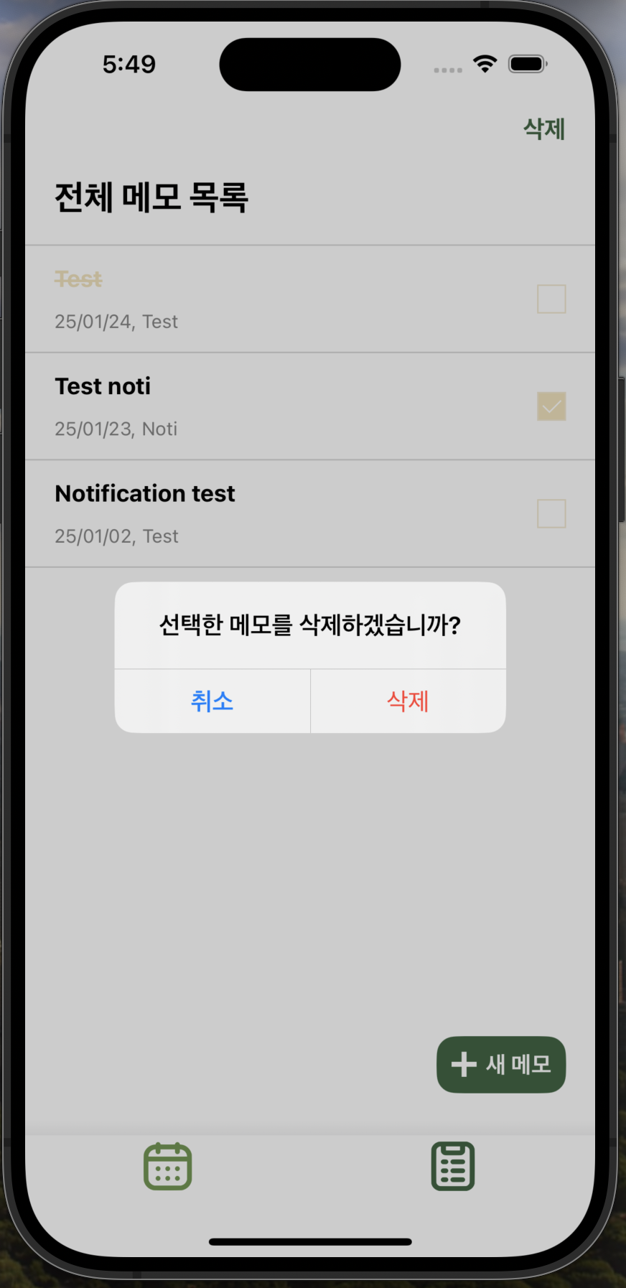
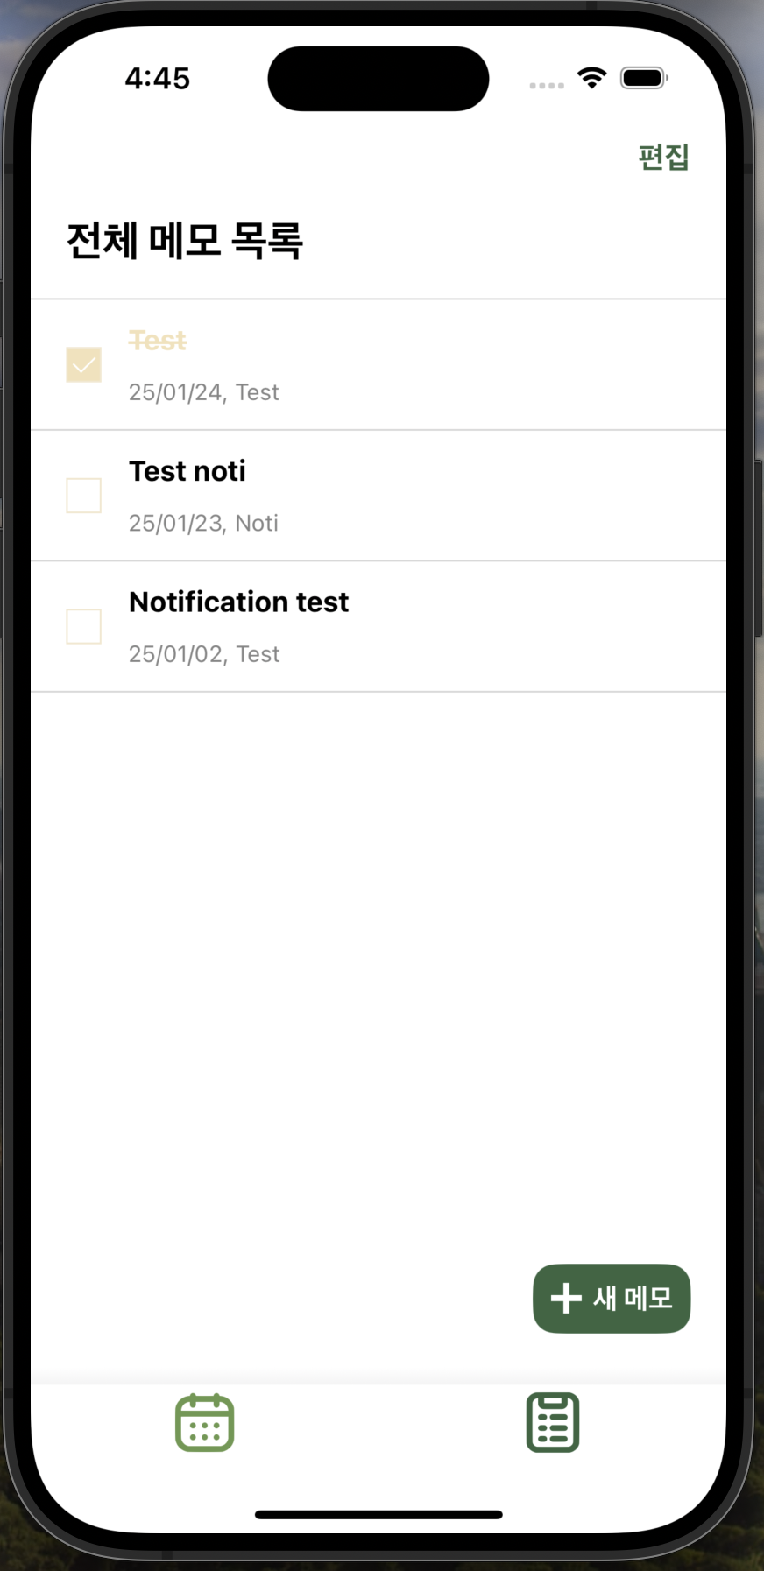
CalendarListView
(Editmode: true)
CalendarListView
(Editmode: false)
MemoListViewModel
@Published memos: [memoData]
MemoView
PathModel
@Published paths: [PathType]

Slide 4
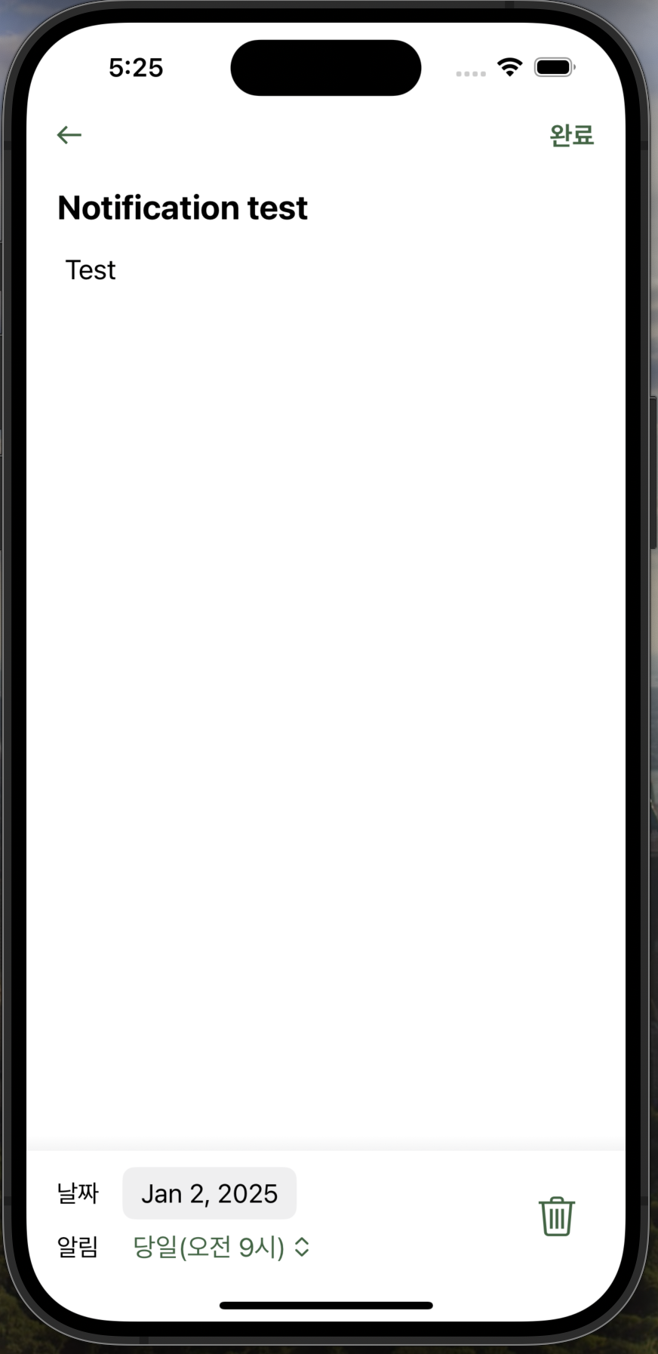
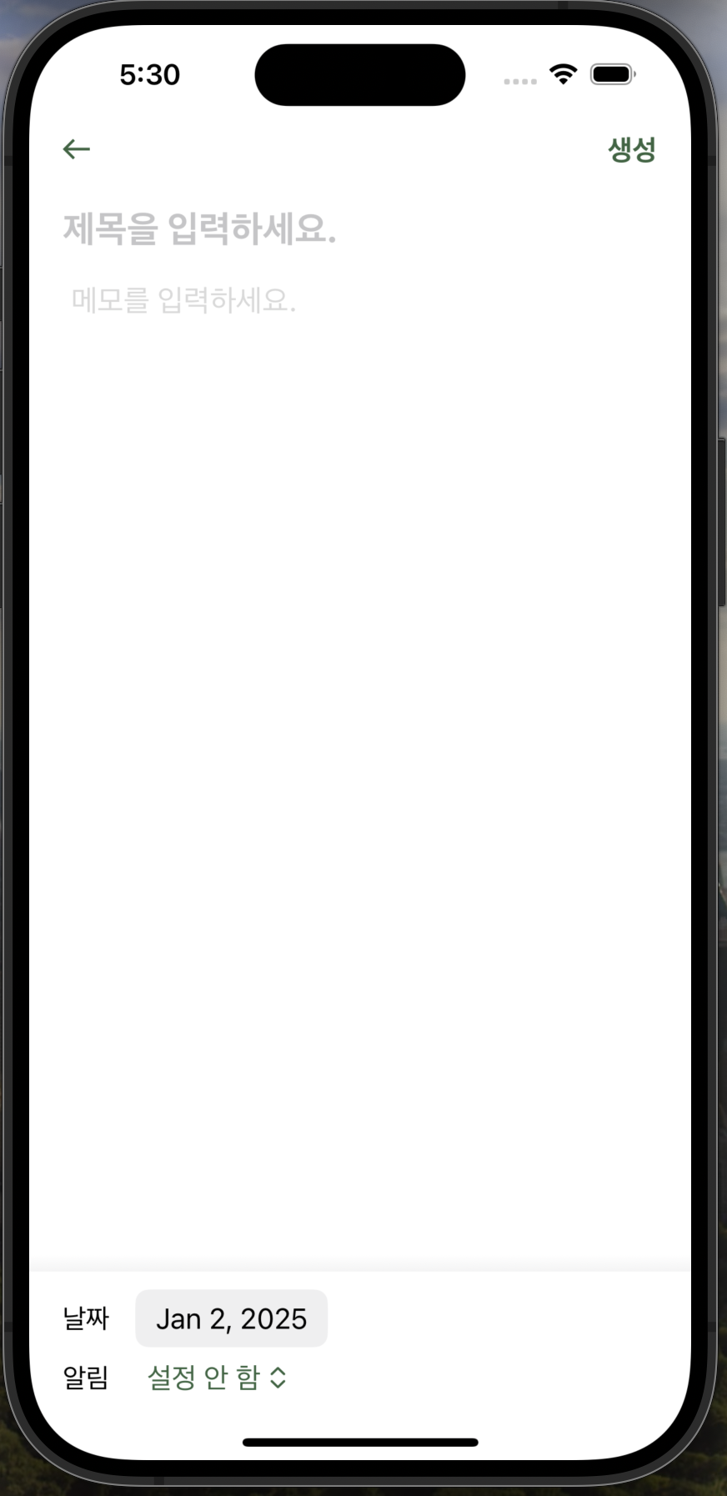
MemoView
(createMode: false)
MemoView
(createMode: true)
PathModel
@Published paths: [PathType]
MemoViewModel
MemoModel

Slide 5
MemoView
(createMode: false)
MemoView
(createMode: true)
PathModel
@Published paths: [PathType]
MemoViewModel
NotificationService
MemoModel

