Slide 1


GMR Institute of Technology, Rajam
31-Jan-25
1
31-Jan-25
1

Slide 2

A Multi-Model ensemble technique for SQL injection attack detection
B. Brindavathi
22341DAK01
Under the guidance of
Dr. A. V. Ramana
Professor, HOD-CSE
GMR Institute of Technology

Slide 3
Abstract
SQL (Structured Query Language) injection attack is one of the most dangerous vulnerabilities in digital world particularly for web pages. It is a type of code injection attacks. This kind of attacks basically breaches the virtual portion of the databases. Many web applications accept to store the user’s private information (e.g., login credentials, credit card and other account details etc.,) in the database over the internet. The detection of SQL injection attack is going to be a tough task for everyone because of an attacker can deploy various new type of SQL injections in day-to-day life. So, the researchers have required an innovative and never-before seen mechanisms for detecting these types of attacks. In this proposed method, novel multi-model ensemble approach has utilizing a preprocessed dataset containing various SQL query statements in the form "SELECT FROM" and related variations. This work was implemented using three different models: hyper-tuning DistilBERT, XL-NET, and a combination of 2D-CNN and Bi-LSTM along with ensemble algorithms. We trained on 80% of the dataset and reserved the remaining 20% for testing. Extensive experimental evaluation shows that the XL-NET model surpasses existing studies, achieving an impressive accuracy score of 99.56% for SQL injection detection.
Keywords: SQL Injection attacks, Normalization, Tokenization, FastText, distilBERT, XL-NET, 2D-CNN and Bi-LSTM.

Slide 4
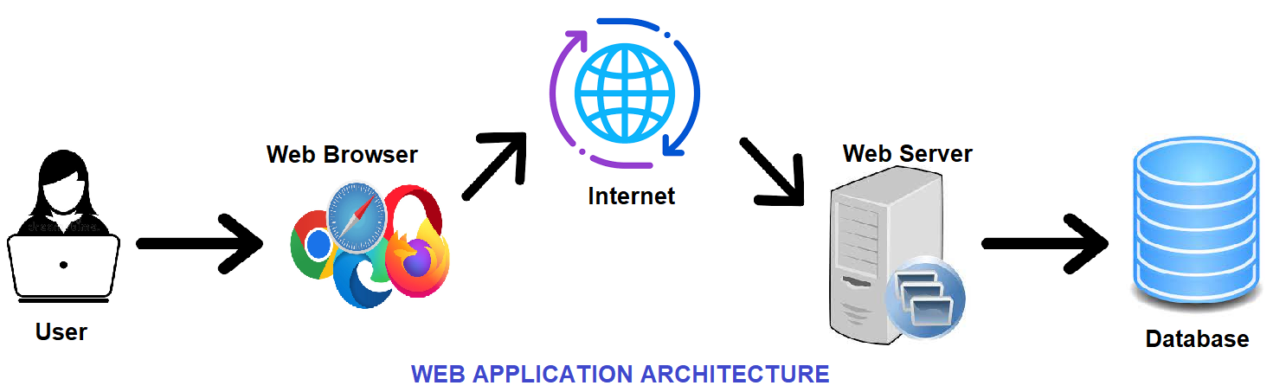
Introduction
In digital world, many of the organizations have used web-based applications for accessing the data over the Internet to perform various kinds of online transactions.
All the data entered by the users during these transactions on web applications or websites is stored in some kind of a database. Relational Databases can be communicated with a language called Structured Query Language (SQL). Any web application accepts the user’s data and produces SQL statements as output.

Slide 5
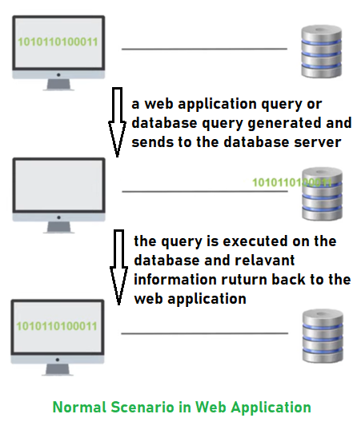
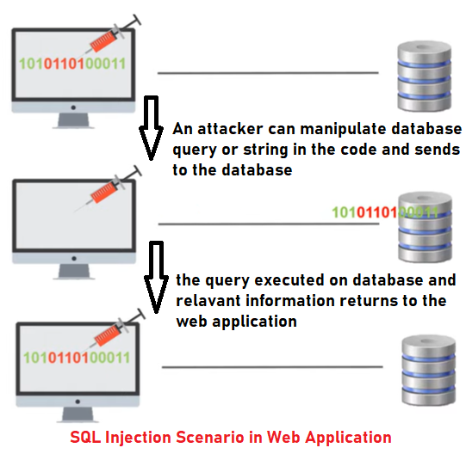
What is SQL Injection Attack
SQL injection attack is one of the most web-based attack and third most serious web application security risk in 2021 as per Open Web Application Security Project analysis.
SQL injection (SQLi) is a cyberattack that injects malicious SQL code into an web application, allowing the attacker to view or modify a database.
A successful SQL injection attack can result in unauthorized access to sensitive data, such as passwords, credit card details, or personal user information.

Slide 6
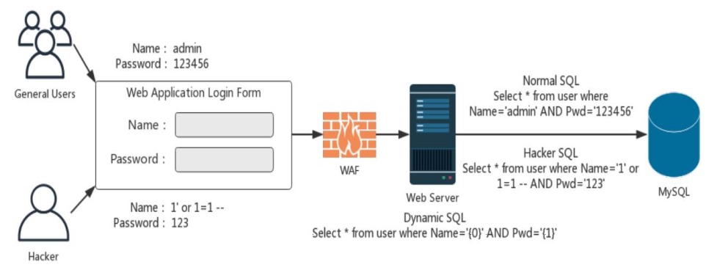
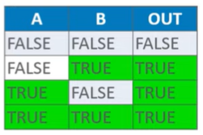
How SQL Injection works
As per OR function, if any one of the input statement is true then the irrespective of the other input, the result output is always TRUE.
The attacker can give the input userID value as
SELECT * FROM USERS WHERE user_id = ‘ ‘ OR ‘1’=‘1’-- ’;
Then the server will execute the malicious query and as a result, sensitive data of all the users will be revealed to him.

Slide 7
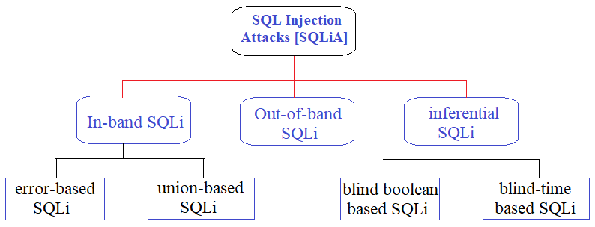
Types of SQL Injection Attacks
SQL Injection, an attacker could bypass authentication, access, modify and delete data within a database.
In some cases, SQL Injection can even be used to execute commands on the operating system, potentially allowing an attacker to increase more damaging attacks inside of a network.
SQL Injection can be classified into three major categories – In-band SQLi, Out-of-band SQLi and Inferential SQLi.

Slide 8
How to prevent SQL Injection
It is manually impossible to check every page and every application on the website. Especially when updates are frequent and user-friendliness is the top priority.
Security analysts and research developers recommend that a number of the subsequent points guarantee your database is well protected inside the server.
Continuous Scanning and Penetration Testing – it involves regularly running automated vulnerability scanning tools to identify and assess any vulnerabilities existed in a system.
Penetration testing, also known as “pen testing,” involves simulating an attack on a system to identify and exploit vulnerabilities.
Restrict Privileges - This involves limiting the access and permissions of users and applications to the database and its components.
Use Query Parameters - Using query parameters, you can separate user input from the SQL query, making it much more difficult for an attacker to inject malicious code into the query.
Instant Protection with Web Application Firewall (WAF) - It can detect and block malicious traffic before it reaches the web application. A WAF can be configured to detect, and block known SQL injection payloads.

Slide 9
Motive
There are many traditional techniques or tools avail for identifying or mitigating SQLi attacks. But still there are some organizations fails to detect these attacks because, the most of organizations fail the problems like outdated code, scarcity of resources to test and make changes, no knowledge of application security, and also no frequent updates in the web-application.
For these, we need to solve those attacks by early identification of SQLi attacks by using statistical and artificial intellectual mechanisms such as machine learning, deep learning and etc.,
This proposed work is for identifying SQL injection attacks through a multi-model ensemble technique. Before going to implement, we need to get some existing knowledge of various mechanisms through literature survey.
In Literature Survey we are going to explain the recent and major impact mechanisms elaborately.

Slide 10
Analysis of Exiting Methodologies
S. No. | Paper Title / Technique Details | Authors details & Year of Publish | Dataset Details | Preprocessing and AI-based technique | Performance Details
[1] | AE-Net: Novel Autoencoder-Based Deep Features for SQL Injection Attack Detection | Thalji, N., Raza, A., Islam, M. S., Samee, N. A., & Jamjoom, M. M. (2023) | 46, 392 SQL Queries https://www.kaggle.com/datasets/syedsaqlainhussain/ sql-injection-dataset | BoW & TF-IDF KNC, LR, RF and XGB | 99% of Accuracy
[2] | DL-Based Detection Technology for SQL Injection Research and Implementation | Sun, H., Du, Y., & Li, Q. (2023) | 10,052 SQLi Queries https://github.com/client9/libinjection | TF-IDF & word2vec TextCNN, Bi-LSTM & Attention mechanism | 99.57% of Accuracy
[3] | SQL Injection Detection Using RNN Deep Learning Model | ALAzzawi, A. (2023) | 30,919 SQL Queries https://www.kaggle.com/sajid576/sqlinjection-dataset | word2vec LSTM & RNN | 90% of Accuracy for LSTM 84.89% for GRU
[4] | ML Advancements in SQL Injection Detection: NLP and Feature Engineering Strategies | Rattrout, A., Jaradat, M., & Jayousi, R. (2023) | 23,000 SQL Queries | Tokenization, part of speech (POS), named entity recognition (NER) SVM, DT & ANN | 99.4% of Accuracy 98.9% of Precision 100% of Recall 99.5% of F1-score
[6] | DL architecture for detecting SQL injection attacks based on RNN autoencoder model | Alghawazi, M., Alghazzawi, D., & Alarifi, S. (2023) | 30,919 SQL Queries https://www.kaggle.com/sajid576/sqlinjection-dataset | Several classifiers have compared with RNN autoencoder | 94% of Accuracy 95% of Precision 90% of Recall 92% of F1-score
[7] | Enhancing the Performance of SQLi Attack Detection through Probabilistic Neural Networks | Alarfaj, F. K., & Khan, N. A. (2023) | 6000 SQL Queries it was not publicly not available (Lib-injection) | Count vectorization Chi-square test Probabilistic Neural Networks (PNN) | 99.19% of Accuracy 99.5% of Precision 98.1% of Recall 92.8% of F1-score
[8] | A Semantic Learning-Based SQL Injection Attack Detection Technology | Lu, D., Fei, J., & Liu, L. (2023) | 6091 samples from various databases (MySQL, Oracle, SQL Server, PostgreSQL) | Statistical features TF-IDF, word2vec BERT | 94.35% of Accuracy for 796 samples
[9] | SSQLi: A Black-Box Adversarial Attack Method for SQL Injection Based on Reinforcement Learning | Guan, Y., He, J., Li, T., Zhao, H., & Ma, B. (2023) | 34,395 SQLi Queries [Ref. A CNN-based Approach to the Detection of SQL Injection Attacks] | 8 various ML & DL based models have examined. SafeDog & ModSecurity | Performance have analyzed based on time consumption for identifying attacks
[10] | An Improved LSTM-PCA Ensemble Classifier for SQL Injection and XSS Attack Detection | Stiawan, D., Bardadi, A., Afifah, N., Melinda, L., Heryanto, A., Septian, T. W., & Budiarto, R. (2023) | the dataset contains 19,59,747 normal samples out of these 11,074 samples of SQLi Queries | phpMyAdmin tool LSTM, LSTM+PCA & Gated Recurrent Unit (GRU) | 96.85% of Accuracy with LSTM+PCA

Slide 11
Analysis of Exiting Methodologies
[12] | Comparison study for NLP using ML techniques to detecting SQL injection vulnerabilities | AL-Maliki, M. H. A., & Jasim, M. N. (2023) | 4200 SQL Queries | Normalization Count vectorization 7 ML algorithms have examined | Out of 7 ML algorithms, Naïve Bayes gets high accuracy with 99%
[13] | SQL Injection Detection Using ML Techniques | Akhtar, C. G., Reddy, M. H., Keerthana, P., Likitha, P., & Sri, S. (2022) | They have collected a dataset that contains both legitimate and injected queries | Count vectorization DNN with multiple hidden layers | 97.61% of Accuracy 92.96% of Precision 99.60% of Recall
[15] | An Analysis of AI-based SQL Injection (SQLi) Attack Detection | Brindavathi, B., Karrothu, A., & Anilkumar, C. (2023) | It’s a review paper for total 16 articles | Survey on both ML and DL models | They have concluded that DL models gives high accuracy
[16] | Predicting input validation vulnerabilities based on minimal SSA features and machine learning | Marashdih, A. W., Zaaba, Z. F., & Suwais, K. (2022) | 9144 SQL Queries (Ref. Stivalet et al., 2016) | Minimal SSA form LSTM and Bi LSTM But LSTM is quicker than Bi-LSTM | 97.9% of Accuracy 98.1% of Precision 97.97% of Recall 98.67% of F1-score
[17] | Detection of SQL Injection Attacks Using ML in Cloud Computing Plat-form | Alkhathami, J. M., & Alzahrani, S. M. (2022) | Dataset have taken from Kaggle database | Count vectorization KNN, MNB, DT and SVM | SVM have given high accuracy among four algorithms 99.42% with SVM
[18] | Semantic query-featured ensemble learning model for SQL-injection attack detection in IoT-ecosystems | Gowtham, M., & Pramod, H. B. (2022) | https://www.kaggle.com/syedsaqlainhussain/sqlinjection-dataset | Count vectorization Word2vec, CBoW & N-skip gram MVE ensemble model | 98% of Accuracy 98.9% of F1-score 99.9% of AUC
[19] | Development of a compressive framework using ML approaches for SQL injection attacks | Deriba, F., Salau, A. O., Mohammed, S. H., Kassa, T. M., & Demilie, W. B. (2022) | 11,847 SQL Queries | static and dynamic analysis used for feature extraction then ML algorithms have examined | Out of selected models both ANN and Hybrid are given best accuracy with 99.16% & 99.60%
[20] | Detection and prevention of SQLI attacks and developing compressive framework us-ing ML and hybrid techniques | Demilie, W. B., & Deriba, F. G. (2022) | 54,306 SQL Queries | static and dynamic analysis used for feature extraction 6 ML algorithms have examined | Hybrid (SVM & ANN) model have given best performance than other ML algorithms with an accuracy 99.54%
[21] | Deep neural network-based SQL injection detection method | Zhang, W., Li, Y., Li, X., Shao, M., Mi, Y., Zhang, H., & Zhi, G. (2022) | 30,919 SQL Queries https://www.kaggle.com/sajid576/sqlinjection-dataset | TF-IDF DNN model (SQLNN) | 96.16% of Accuracy 97.28% of Precision 92.23% of Recall 94.68% of F1-score
[24] | SQLi attack detection using ML algorithm | Muhammad, T., & Ghafory, H. (2022) | It is an analysis of few articles published between 2012-2020 | 8 ML based algorithms to identify SQLi attacks | The authors have analyzed the best performer based on various metrics (accuracy, sensitivity, specificity and etc.)

Slide 12
Observations and Research Gaps
OBSERVATIONS:
There are many traditional techniques or tools avail for identifying or mitigating SQLi attacks.
But still there are some organizations fails to detect these attacks because, the most of organizations fail the problems like outdated code, scarcity of resources to test and make changes, no knowledge of application security, and also no frequent updates in the web-application.
So, in recent years, researchers have applied machine-learning and deep learning approaches for SQL injection detection.
RESEARCH GAPS:
Through a comprehensive analysis of the existing literature, we have identified the following research gaps and limitations that we have addressed in our proposed research:
Classical feature extraction approaches were employed to represent SQL query textual data.
Also, classical machine learning-based techniques were used for SQL injection attack detection.

Slide 13
Objective of this Work
The objective of this project is to solve those attacks by early identification of SQLi attacks by using statistical and artificial intellectual mechanisms such as machine learning, deep learning and Transformers etc.,
To implement a multi-model ensemble technique for identification SQLi attacks
1. Through Distil BERT model
2. Through XL-NET model
3. Through the fusion of 2D-CNN and Bi-LSTM along with ensemble of ML

Slide 14
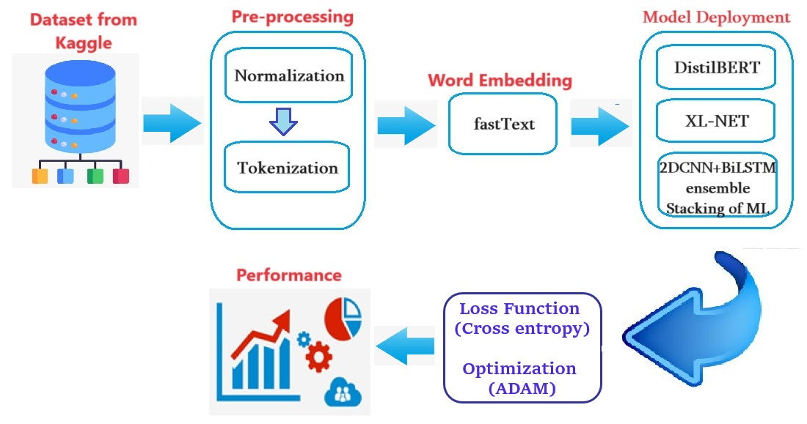
Proposed Architecture

Slide 15
Proposed Model
The proposed model split into THREE Modules.
Data Pre-processing
Word Embedding
Model Deployment
Dataset Information: The dataset is retrieved from the Kaggle website.
https://www.kaggle.com/datasets/sajid576/sql-injection-dataset
The dataset contains 30,919 Queries (both malicious and genuine)
In this,
11,382 Queries are represents True (Malicious) → label -1
19,537 Queries are represents False (Normal) → label – 0
1. Data Pre-processing: In this we are using
Normalizing: we are balancing both labels (i.e. 0s and 1s)
Tokenizing: the textual data is broken down into smaller units called tokens. The larger token converts into small tokens.

Slide 16
Proposed Model
2. Word Embedding: In this we are using Fasttext
FastText: : FastText is an extension of Word2Vec that considers sub-word information. It represents words as bags of character n-grams.
3. Model Deployment: The deployment model have categorized into two different ways Transformer Model and Customized DL Model
Through Transformer Model we are going to implement Hyper-tuning Distil BERT and XL-NET
Through Customized DL Model, we are going to do implement Fusion of 2D-CNN and Bi-LSTM then we are implementing by using ensemble with stacking of various ML algorithms like Light GBM, Cat Boost, Random Forest (RF) and Support Vector Machine (SVM).
Then finally, we are adding Loss function (Cross entropy) and Optimizer (Adam) for better performance.

Slide 17
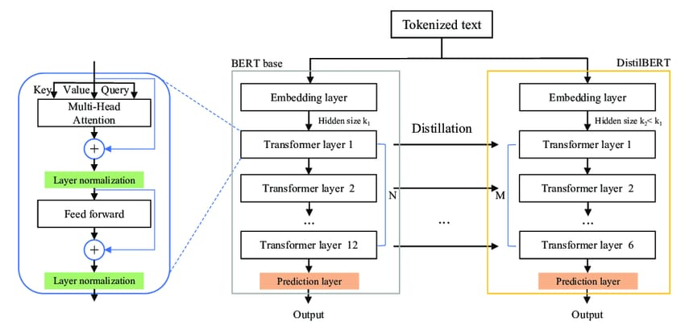
Hyper-tuning DistilBERT
DistilBERT:
DistilBERT is a distilled version of BERT. It is a small, fast, cheap and light transformer model based on the BERT architecture.
It is 60% faster than BERT. It has 44M fewer parameters & in total is 40% smaller than BERT and it retains 97% of BERT performance.
In this work used hyper-tuning DistilBert. The hyper-parameter-tuning allows data scientist to tweak model performance for optimal results.
Architecture of DistilBERT

Slide 18
Performance of DistilBERT
Dataset
Pre
processing
Word
Embedding
DistiBERT
Model
Loss Fun
&
Optimizer
Performance
Model Name / Metrics | Accuracy (%) | Precision (%) | Recall (%) | F1-Score (%)
DistilBERT | 98.27 | 98.88 | 96.24 | 97.55

Slide 19
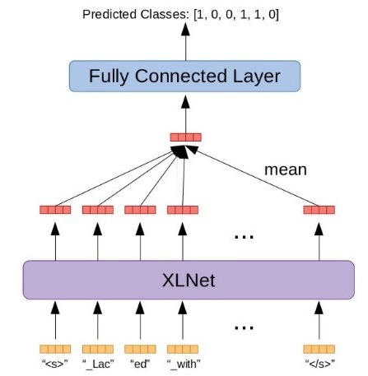
XL-Net
XLNet:XLNet is a generalized autoregressive model where next token is dependent on all previous tokens.
XLNet comprises input embedding's, multiple Transformer blocks with self-attention, position-wise feedforward networks, layer normalization, and residual connections. Its multi-head self-attention differs by allowing each token to attend to itself, enhancing contextual understanding compared to other models.

Slide 20
Performance of XL-NET
Dataset
Pre
processing
Word
Embedding
XL-NET
Model
Loss Fun
&
Optimizer
Performance
Model Name / Metrics | Accuracy (%) | Precision (%) | Recall (%) | F1-Score (%)
XL-NET | 99.56 | 99.55 | 99.23 | 99.39

Slide 21
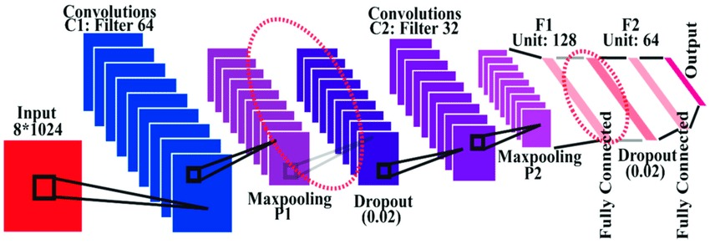
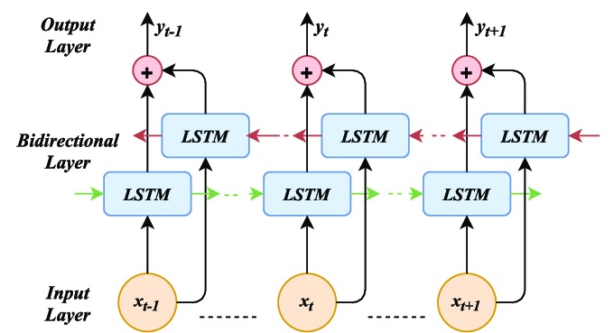
Fusion of 2D-CNN &Bi-LSTM
Through Customized DL Model, we are going to do implement Fusion of 2D-CNN and Bi-LSTM then we are implementing by using ensemble with stacking of various ML algorithms like Light GBM, Cat Boost, Random Forest (RF) and Support Vector Machine (SVM).
Then finally, we are adding Loss function (Cross entropy) and Optimizer (Adam) for better performance.
Bi-LSTM
2D-CNN

Slide 22
Performance of 2D-CNN & Bi-LSTM
Dataset
Pre
processing
Word
Embedding
Fusion of
2D-CNN
Bi-LSTM
ensemble of
ML
algorithms
Loss Fun
&
Optimizer
Performance
Model Name / Metrics | Accuracy (%) | Precision (%) | Recall (%) | F1-Score (%)
Model-3 | 99.19

Slide 23
Comparison with Existing models
Ref. No. |  | Accuracy (%) | Precision (%) | Recall (%) | F1-Score (%)
[3] | RNN+LSTM | 90.11 | 91.24 | 67.46 | 80.51
 | RNN+GRU | 84.89 | 86.65 | 46.29 | 63.38
[6] - RNN autoencoder |  | 94 | 95 | 90 | 92
[21] - SQLNN |  | 96.16 | 97.28 | 92.23 | 94.68
2D-CNN+BiLSTM+ensemble |  | 99.19 | - | - | -
DistilBERT |  | 98.27 | 98.88 | 96.24 | 97.55
XL-NET |  | 99.56 | 99.55 | 99.23 | 99.39

Slide 24
Results and Discussions
Evaluation Metrics
This project employs several well-known performance evaluation metrics to evaluate the performance of ML/DL models. In particular, accuracy, precision, recall, and F1 score are used with the following confusion matrix.
A confusion matrix is a matrix that summarizes the performance of a machine learning model on a set of test data. It is a means of displaying the number of accurate and inaccurate instances based on the model’s predictions.
True Positive (TP): The model correctly predicted a positive outcome (the actual outcome was positive).
True Negative (TN): The model correctly predicted a negative outcome (the actual outcome was negative).
False Positive (FP): The model incorrectly predicted a positive outcome (the actual outcome was negative). Also known as a Type I error.
False Negative (FN): The model incorrectly predicted a negative outcome (the actual outcome was positive). Also known as a Type II error.

Slide 25
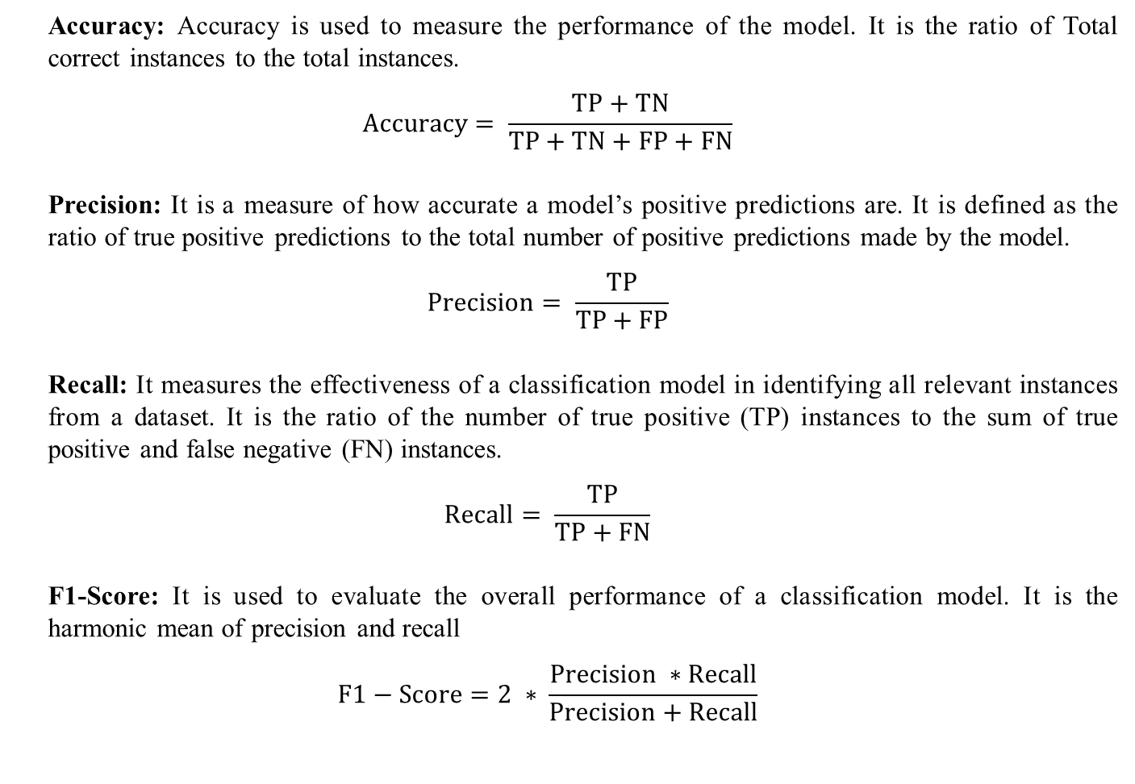
Metrics based on Confusion Matrix Data
Accuracy: Accuracy is used to measure the performance of the model. It is the ratio of Total correct instances to the total instances.
$$Accuracy= \frac{TP+TN}{TP+TN+FP+FN}$$
Precision: It is a measure of how accurate a model’s positive predictions are. It is defined as the ratio of true positive predictions to the total number of positive predictions made by the model.
$$Precision= \frac{TP}{TP+FP}$$
Recall: It measures the effectiveness of a classification model in identifying all relevant instances from a dataset. It is the ratio of the number of true positive (TP) instances to the sum of true positive and false negative (FN) instances.
$$Recall= \frac{TP}{TP+FN}$$
F1-Score: It is used to evaluate the overall performance of a classification model. It is the harmonic mean of precision and recall
$$F1−Score=2 ∗ \frac{Precision ∗Recall}{Precision+Recall}$$

Slide 26
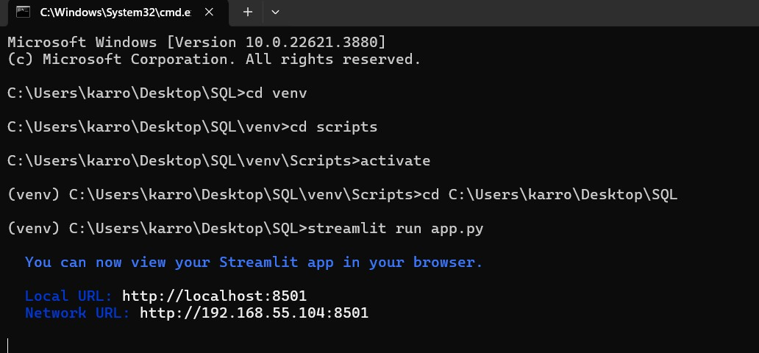
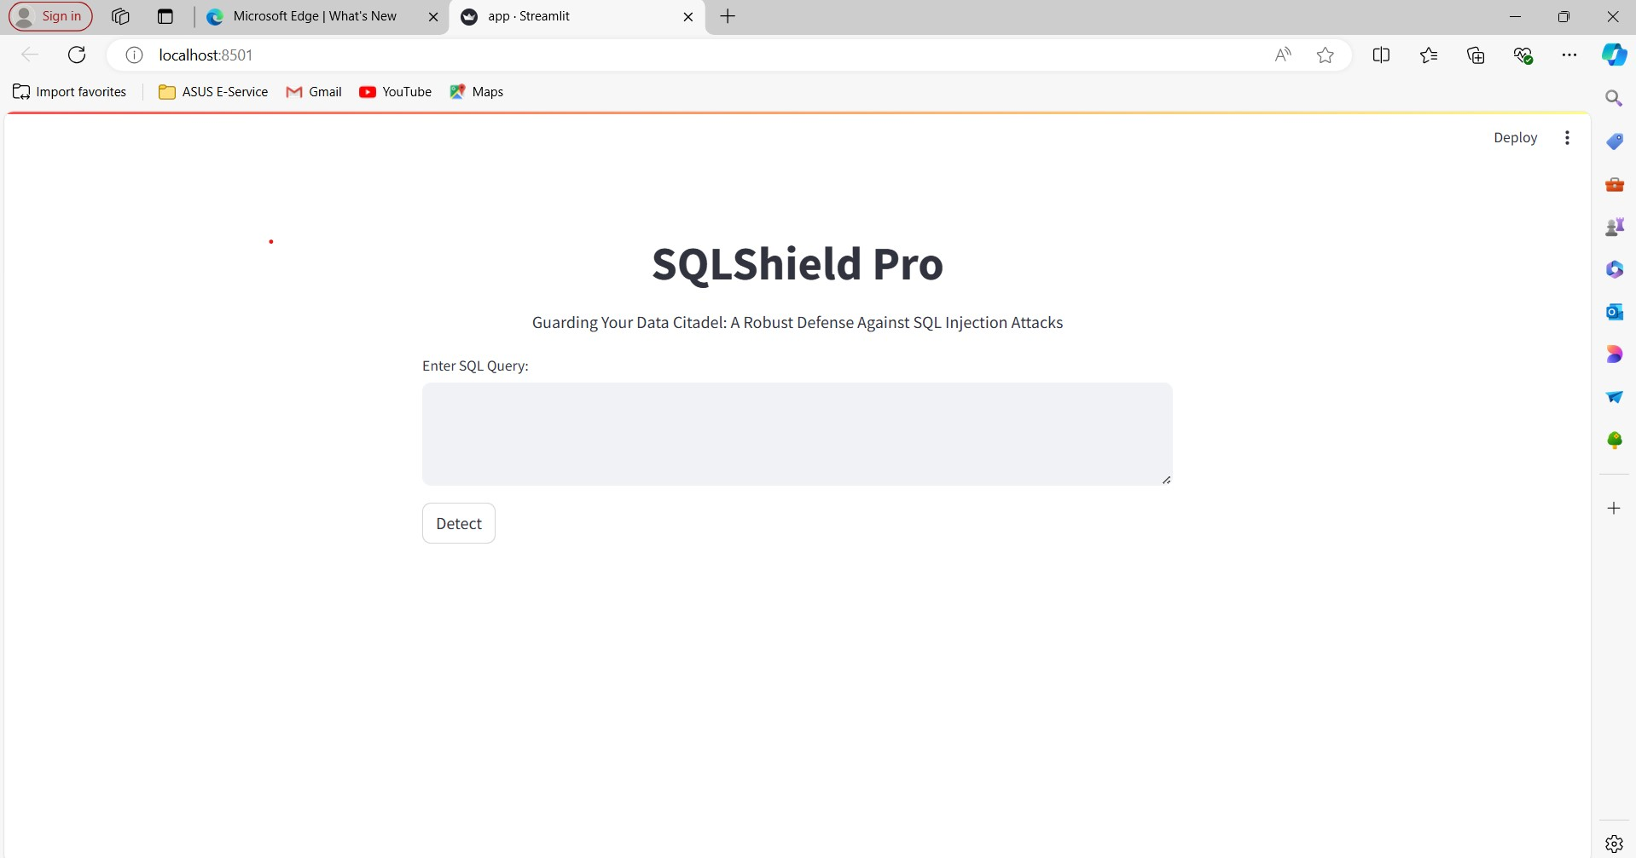
Execution Steps

Slide 27
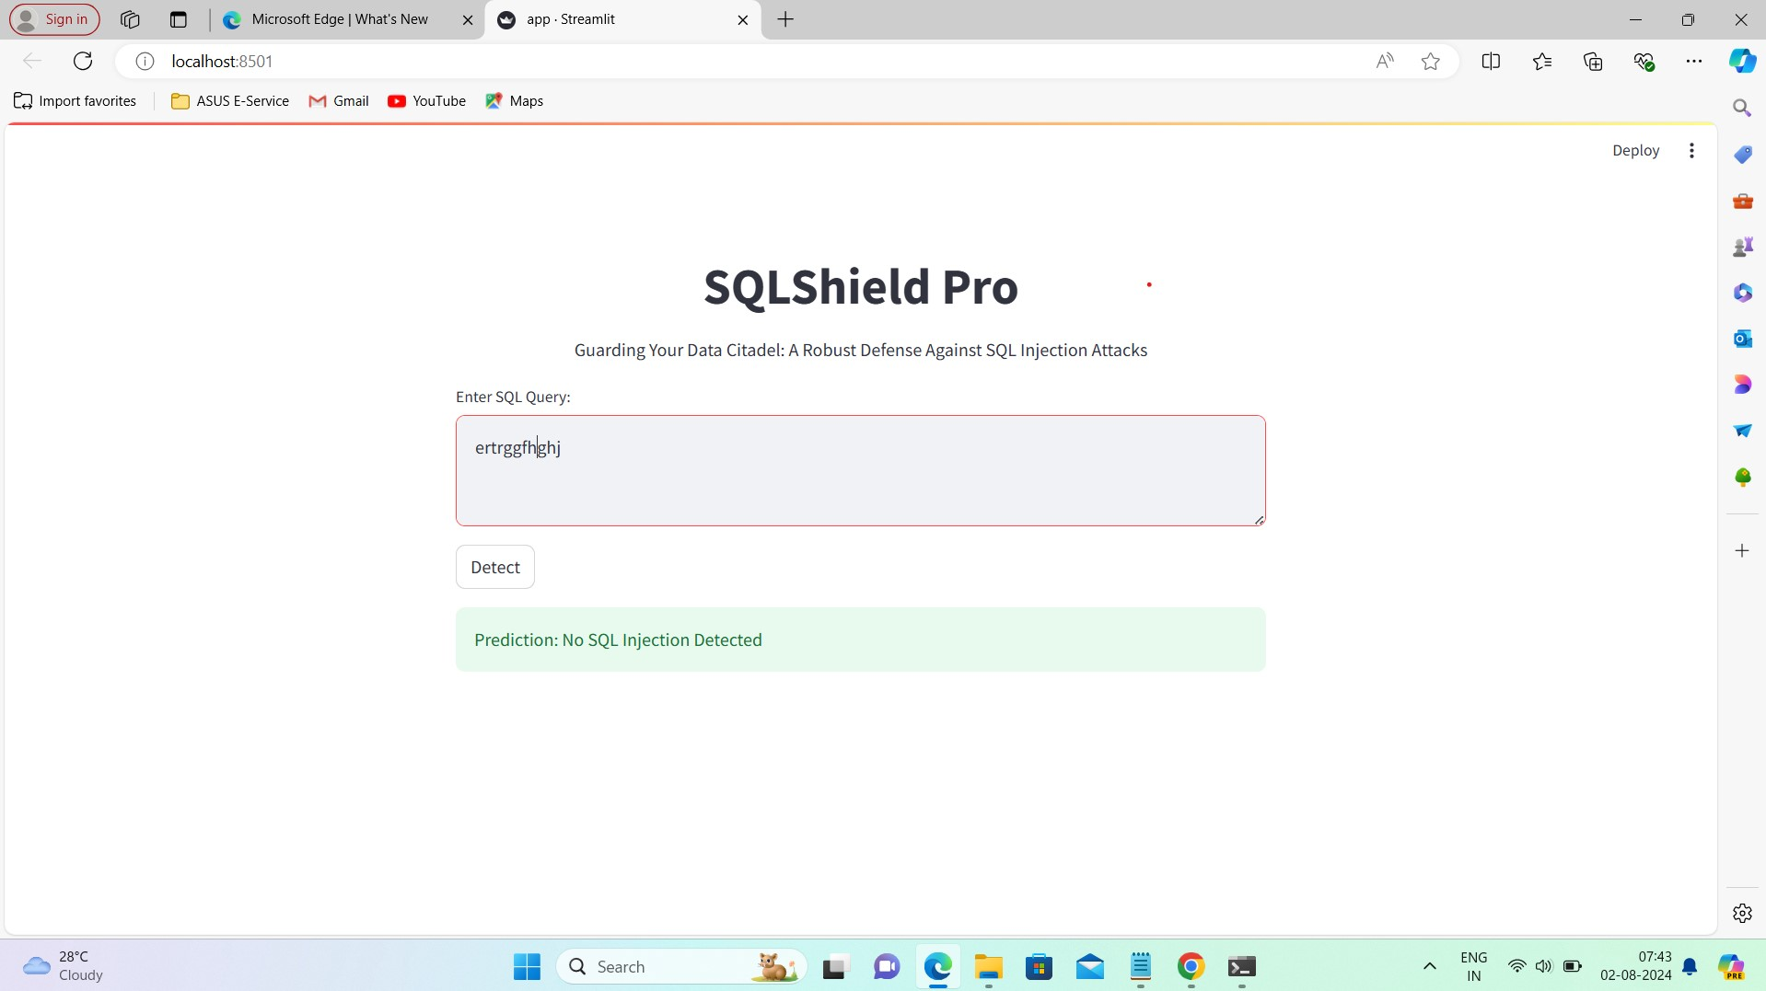
Identification of SQLi attack
In this case, we have given a normal string (ertrggfhghi) as a user request and it was considered as a genuine query

Slide 28
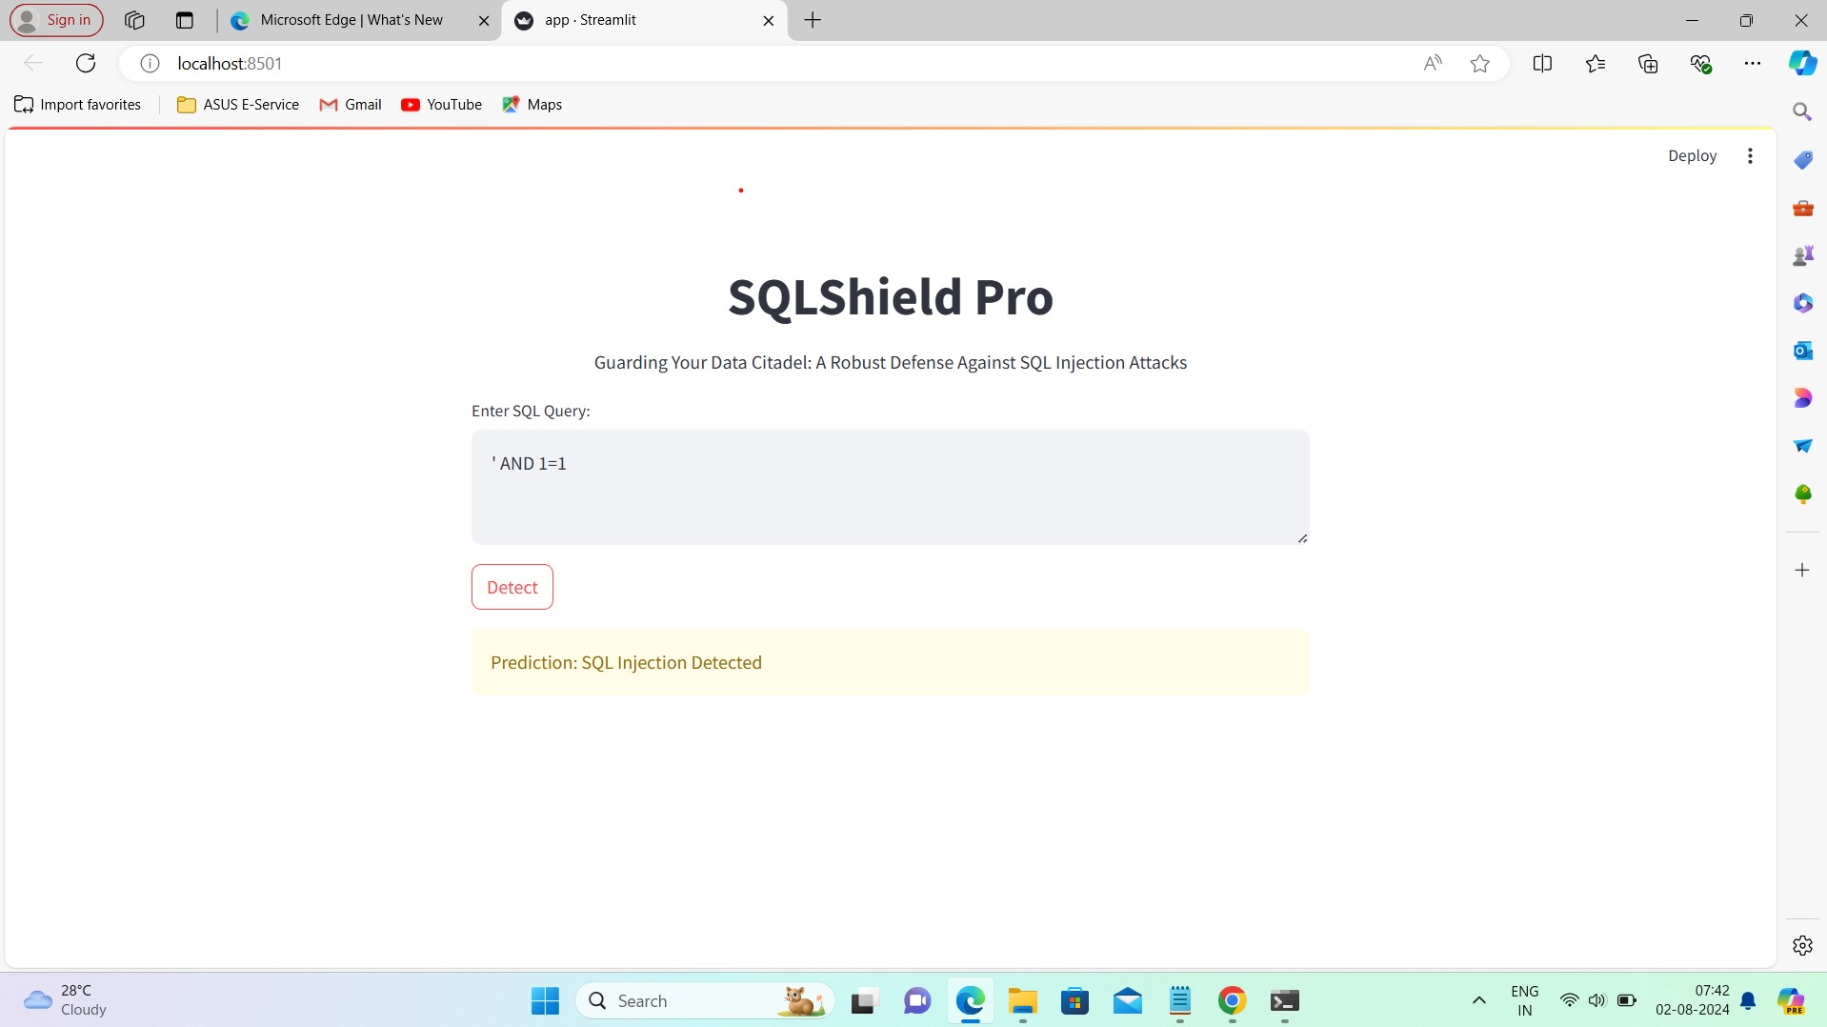
Identification of SQLi attack
In this case, we have given a query ‘1’ OR ‘1’= ‘1’--’ and it was considered as Injected Query

Slide 29
Conclusion
Detecting SQL injection attacks presents a significant challenge due to the constant emergence of new attack types. Researchers are therefore exploring innovative, unprecedented methods to identify these attacks. The proposed method utilizes a novel multi-model ensemble approach and relies on a preprocessed dataset containing 30,919 SQL query statements in various "SELECT FROM" formats. This study introduces a multi-model ensemble technique for detecting SQL injection attacks, extracting high-level deep features from SQL textual data, which are then fed into multiple machine learning (ML) and deep learning (DL) models for performance evaluation. Three advanced ML/DL approaches are used in these evaluations. Extensive experiments show that XL-NET outperforms existing methods, achieving an impressive accuracy of 99.56% in SQL injection detection.

Slide 30
References
Thalji, N., Raza, A., Islam, M. S., Samee, N. A., & Jamjoom, M. M. (2023). AE-Net: Novel Autoencoder-Based Deep Features for SQL Injection Attack Detection. IEEE Access, 11, 135507-135516.
Sun, H., Du, Y., & Li, Q. (2023). Deep Learning-Based Detection Technology for SQL Injection Research and Implementation. Applied Sciences, 13(16), 9466.
ALAzzawi, A. (2023). SQL Injection Detection Using RNN Deep Learning Model. Journal of Applied Engineering and Technological Science (JAETS), 5(1), 531-541.
Rattrout, A., Jaradat, M., & Jayousi, R. (2023). Machine Learning Advancements in SQL Injection Detection: NLP and Feature Engineering Strategies.
Crespo-Martínez, I. S., Campazas-Vega, A., Guerrero-Higueras, Á. M., Riego-DelCastillo, V., Álvarez-Aparicio, C., & Fernández-Llamas, C. (2023). SQL injection attack detection in network flow data. Computers & Security, 127, 103093.
Alghawazi, M., Alghazzawi, D., & Alarifi, S. (2023). Deep learning architecture for detecting SQL injection attacks based on RNN autoencoder model. Mathematics, 11(15), 3286.
Alarfaj, F. K., & Khan, N. A. (2023). Enhancing the Performance of SQL Injection Attack Detection through Probabilistic Neural Networks. Applied Sciences, 13(7), 4365.
Lu, D., Fei, J., & Liu, L. (2023). A Semantic Learning-Based SQL Injection Attack Detection Technology. Electronics, 12(6), 1344.
Guan, Y., He, J., Li, T., Zhao, H., & Ma, B. (2023). SSQLi: A Black-Box Adversarial Attack Method for SQL Injection Based on Reinforcement Learning. Future Internet, 15(4), 133.
Stiawan, D., Bardadi, A., Afifah, N., Melinda, L., Heryanto, A., Septian, T. W., ... & Budiarto, R. (2023). An Improved LSTM-PCA Ensemble Classifier for SQL Injection and XSS Attack Detection. Computer Systems Science & Engineering, 46(2).
AL-Maliki, M. H. A., & Jasim, M. N. (2023). Comparison study for NLP using machine learning techniques to detecting SQL injection vulnerabilities. International Journal of Nonlinear Analysis and Applications.
Akhtar, C. G., Reddy, M. H., Keerthana, P., Likitha, P., & Sri, S. N. (2023) SQL Injection Detection Using Machine Learning Techniques.
Alghawazi, M., Alghazzawi, D., & Alarifi, S. (2022). Detection of sql injection attack using machine learning techniques: a systematic literature review. Journal of Cybersecurity and Privacy, 2(4), 764-777.
AL-Maliki, M. H. A., & Jasim, M. N. (2022). Review of SQL injection attacks: Detection, to enhance the security of the website from client-side attacks. International Jour-nal of Nonlinear Analysis and Applications, 13(1), 3773-3782.
Brindavathi, B., Karrothu, A., & Anilkumar, C. (2023, August). An Analysis of AI-based SQL Injection (SQLi) Attack Detection. In 2023 Second International Conference on Augmented Intelligence and Sustainable Systems (ICAISS) (pp. 31-35). IEEE.

Slide 31
Marashdih, A. W., Zaaba, Z. F., & Suwais, K. (2022). Predicting input validation vulnerabilities based on minimal SSA features and machine learning. Journal of King Saud University-Computer and Information Sciences, 34(10), 9311-9331.
Alkhathami, J. M., & Alzahrani, S. M. (2022). Detection Of Sql Injection Attacks Using Machine Learning In Cloud Computing Platform. Journal Of Theoretical And Applied Information Technology, 100(15).
Gowtham, M., & Pramod, H. B. (2022). Semantic query-featured ensemble learning model for SQL-injection attack detection in IoT-ecosystems. IEEE Transactions on Reliability, 71(2), 1057-1074.
Deriba, F., Salau, A. O., Mohammed, S. H., Kassa, T. M., & Demilie, W. B. (2022). Development of a compressive framework using machine learning approaches for SQL injection attacks. PRZEGLĄD ELEKTROTECHNICZNY, 1(7), 183-189.
Demilie, W. B., & Deriba, F. G. (2022). Detection and prevention of SQLI attacks and developing compressive framework using machine learning and hybrid techniques. Journal of Big Data, 9(1), 124.
Zhang, W., Li, Y., Li, X., Shao, M., Mi, Y., Zhang, H., & Zhi, G. (2022). Deep neural network-based SQL injection detection method. Security and Communication Networks, 2022.
Abdulhamza, F. R., & Al-Janabi, R. J. S. (2022, November). SQL Injection Detection Using 2D-Convolutional Neural Networks (2D-CNN). In 2022 International Conference on Data Science and Intelligent Computing (ICDSIC) (pp. 212-217). IEEE.
Jiang, J., Xu, M., Pan, S., & Zhu, L. (2022, October). A SQL Injection Attack Recognition Model Based on 1D Convolutional Neural Network. In International Symposium on Artificial Intelligence and Robotics (pp. 281-289). Singapore: Springer Nature Singapore.
Muhammad, T., & Ghafory, H. (2022). Sql injection attack detection using machine learning algorithm. Mesopotamian journal of cybersecurity, 2022, 5-17.
Erdődi, L., Sommervoll, Å. Å., & Zennaro, F. M. (2021). Simulating SQL injection vulnerability exploitation using Q-learning reinforcement learning agents. Journal of Information Security and Applications, 61, 102903.
Kasim, Ö. (2021). An ensemble classification-based approach to detect attack level of SQL injections. Journal of Information Security and Applications, 59, 102852.
Zhuo, Z., Cai, T., Zhang, X., & Lv, F. (2021). Long short‐term memory on abstract syntax tree for SQL injection detection. IET Software, 15(2), 188-197.
Azman, M. A., Marhusin, M. F., & Sulaiman, R. (2021). Machine learning-based technique to detect SQL injection attack. Journal of Computer Science.
Chen, D., Yan, Q., Wu, C., & Zhao, J. (2021). Sql injection attack detection and prevention techniques using deep learning. In Journal of Physics: Conference Series (Vol. 1757, No. 1, p. 012055). IOP Publishing.
Meduri, V. V., Chowdhury, K., & Sarwat, M. (2021). Evaluation of machine learning algorithms in predicting the next SQL query from the future. ACM Transactions on Database Systems (TODS), 46(1), 1-46.
Kumar, M. N. A., & Sujatha, B. (2022). Early Detection and Mitigation Methods for SQL Injection Attacks Using Adaptive Free Algorithm. Journal of Positive School Psychology, 6(8), 6315-6326.

Slide 32


