Slide 1
Smarter Reconciliation and Anomaly Detection Using Gen AI
By: Data Sync Guardians
Date: 25-03-2025
Team Members:
Roopa M
Swathi Dhanraj
Gafoor Katika
Kannan Balasubramanian

Slide 2
Overview
Financial reconciliation is critical for ensuring data integrity across multiple systems.
Challenges: Manual effort, delayed anomaly detection, and complex matching rules.
AI-powered approach automates reconciliation using:
Machine Learning (ML) for anomaly detection
Generative AI for explanation and alerts

Slide 3
Reconciliation Challenges and Solution Details
Manual Reconciliation Challenges:
Late Anomaly Detection: Delays in identifying discrepancies
Inconsistent Data: Differences in formats, missing values
Complex Matching: Requires domain expertise
Impact: Financial risk, compliance issues, and operational inefficiencies

Slide 4
Solution Details:
How Our AI Solution Works
Extract Data: Load historical & current transaction records
Feature Engineering: Calculate quantity & price differences
Anomaly Detection:
Use statistical thresholds (mean, std deviation)
Apply ML models (Isolation Forest, Z-score)
AI-Generated Explanation
Automated Alerts via Email

Slide 5
Architecture
Workflow Overview:
Data Source: GL,IHUB,Trading data-Catalyst and Impact
Processing:
Convert data to numeric format
Compute Quantity & Price differences
Anomaly Detection:
Expected vs. Anomalous breaks
Pattern-based & ML-driven detection
Alerts & Reports:
Email notifications to Catalyst/Impact teams
Export anomalies to an Excel report

Slide 6
Logic:
Processing:
Convert data to numeric format
Compute Quantity & Price differences for Trading data
Amount difference for GL and IHUB
Anomaly Detection:
Expected vs. Anomalous breaks
Pattern-based & ML-driven detection
Alerts & Reports:
Detect if it is anomaly or not in the current data
Email notifications to Catalyst/Impact teams
Export anomalies to an Excel report

Slide 7
Sample Data
Case1: GL v/s IHub reconciliation
Input:
Current Data:
Attaching the history data for the accounts.
Output Data:
Account_id | GL_balance | Ub_balance | Balance_diff
1001 | 14290.7 | 13925.56 | 365.14
1002 | 13630.83 | 13594.49 | 36.34
1003 | 19920.75 | 19722.97 | 197.78
1004 | 9090.12 | 8696.85 | 393.27
1017 | 9452.06 | 8690.35 | 761.71
Account_id | Gl_balance | Ub_balance | Balance_diff | Status | Is_Anomaly
1001 | 14290.7 | 13925.56 | 365.14 | Match | No
1002 | 13630.83 | 13594.49 | 36.34 | Match | No
1003 | 19920.75 | 19722.97 | 197.78 | Break | No
1004 | 9090.12 | 8696.85 | 393.27 | Match | No
1017 | 9452.06 | 8690.35 | 761.71 | Break | Yes

Slide 8
Cont…
Case2: Catalyst v/s Impact reconciliation
Find the anomaly and send the email notification to the respective source system.
Sample Data:
Current Data:
History Data:
Trade_ID | Inventory_Code | CUSIP | Trade_Date | Settlement_Date | Buy/Sell | Catalyst_Quantity | Catalyst_Price | Impact_Quantity | Impact_Price | Quantity_Difference | Price_Difference
T001 | INV001 | 12345678 | 2025-03-01 | 2025-03-03 | Buy | 100 | 50.25 | 100 | 50.25 | 0 | 0
T002 | INV002 | 87654321 | 2025-03-02 | 2025-03-04 | Sell | 200 | 48.75 | 80 | 48.75 | 120 | 0
Trade_ID | Inventory_Code | CUSIP | Trade_Date | Buy/Sell | Catalyst_Quantity | Catalyst_Price | Impact_Quantity | Impact_Price | Match_Status | Comment
T001 | INV001 | 12345678 | 2025-02-01 00:00:00 | Buy | 100 | 50.25 | 100 | 50.25 | Match | Trade details are perfectly matching between Catalyst and Impact.
T001 | INV001 | 12345678 | 2025-01-01 00:00:00 | Buy | 101.4996 | 50.65595 | 102.9579 | 51.03391 | Match | Catalyst and Impact systems are in line with historical data.
T001 | INV001 | 12345678 | 2024-12-01 00:00:00 | Buy | 98.37995 | 49.99992 | 95.93982 | 50.40734 | Match | Catalyst and Impact systems are in line with historical data.
T001 | INV001 | 12345678 | 2024-11-01 00:00:00 | Buy | 95.35942 | 50.18085 | 100.4264 | 49.82095 | Match | Significant deviation detected between Catalyst and Impact systems.
T002 | INV002 | 87654321 | 2025-02-01 00:00:00 | Sell | 200 | 48.75 | 198 | 48.75 | Quantity_Break | Factor rounding is causing a minor delta in quantity, but other systems are in line.
T002 | INV002 | 87654321 | 2025-01-01 00:00:00 | Sell | 201.8167 | 47.83448 | 188.8395 | 49.37907 | Quantity_Break | Significant deviation detected between Catalyst and Impact systems.
T002 | INV002 | 87654321 | 2024-12-01 00:00:00 | Sell | 197.2038 | 48.02277 | 198.4404 | 49.27649 | Quantity_Break | Catalyst and Impact systems are in line with historical data.
T002 | INV002 | 87654321 | 2024-11-01 00:00:00 | Sell | 194.3164 | 48.98964 | 189.7899 | 47.87578 | Quantity_Break | Catalyst and Impact systems are in line with historical data.

Slide 9
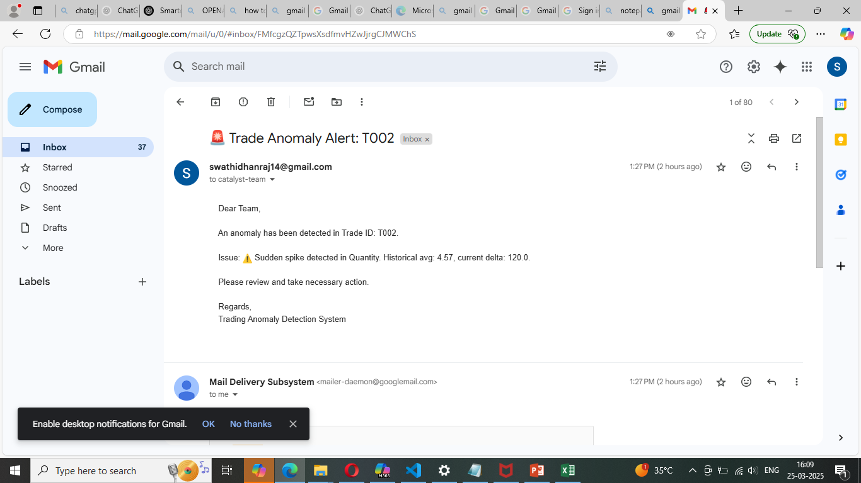
Cont..
Output Data:
Email Notification for the Trade which is flagged as Anomaly.
Trade_ID | Inventory_Code | CUSIP | Trade_Date | Settlement_Date | Buy/Sell | Catalyst_Quantity | Catalyst_Price | Impact_Quantity | Impact_Price | Quantity_Difference | Price_Difference | Match_Status | Comment | Anomaly
T001 | INV001 | 12345678 | 2025-03-01 | 2025-03-03 | Buy | 100 | 50.25 | 100 | 50.25 | 0 | 0 | Match | Trade details are in line with historical data. | No
T002 | INV002 | 87654321 | 2025-03-02 | 2025-03-04 | Sell | 200 | 48.75 | 80 | 48.75 | 120 | 0 | Quantity_Break | ⚠️ Sudden spike detected in Quantity. Historical avg: 4.57, current delta: 120.0. | Yes

Slide 10
Business Benefits
Reduction in manual reconciliation time
Automated Detection reduces financial risk
Explainable AI improves transparency
Iinstant Email Alerts enable faster resolution
Business Value: Improved compliance, efficiency, and reduced errors

