Slide 1
ADHD Cingulate Lobe
ICM Final Project
Group 9
Anh Truong, Laurie Huang, Peijia Ye, Jialu Li, Asimina Zoitou
10/18/2023

Slide 2
Location & Shape of Cingulate Lobe
Arch-shaped structure
In the medial wall of each hemisphere
Above corpus callosum
Notes:
The cingulate lobe is an arch-shaped structure located in the medial wall of each hemisphere and on top of the corpus callosum.
References:
https://www.cambridge.org/core/books/brain-and-behavior/limbic-system-cingulate-cortex/92BDF7C35A6789DE677813B2E4EEEA9D
https://neuro.psychiatryonline.org/doi/10.1176/jnp.23.2.jnp121#F1

Slide 3
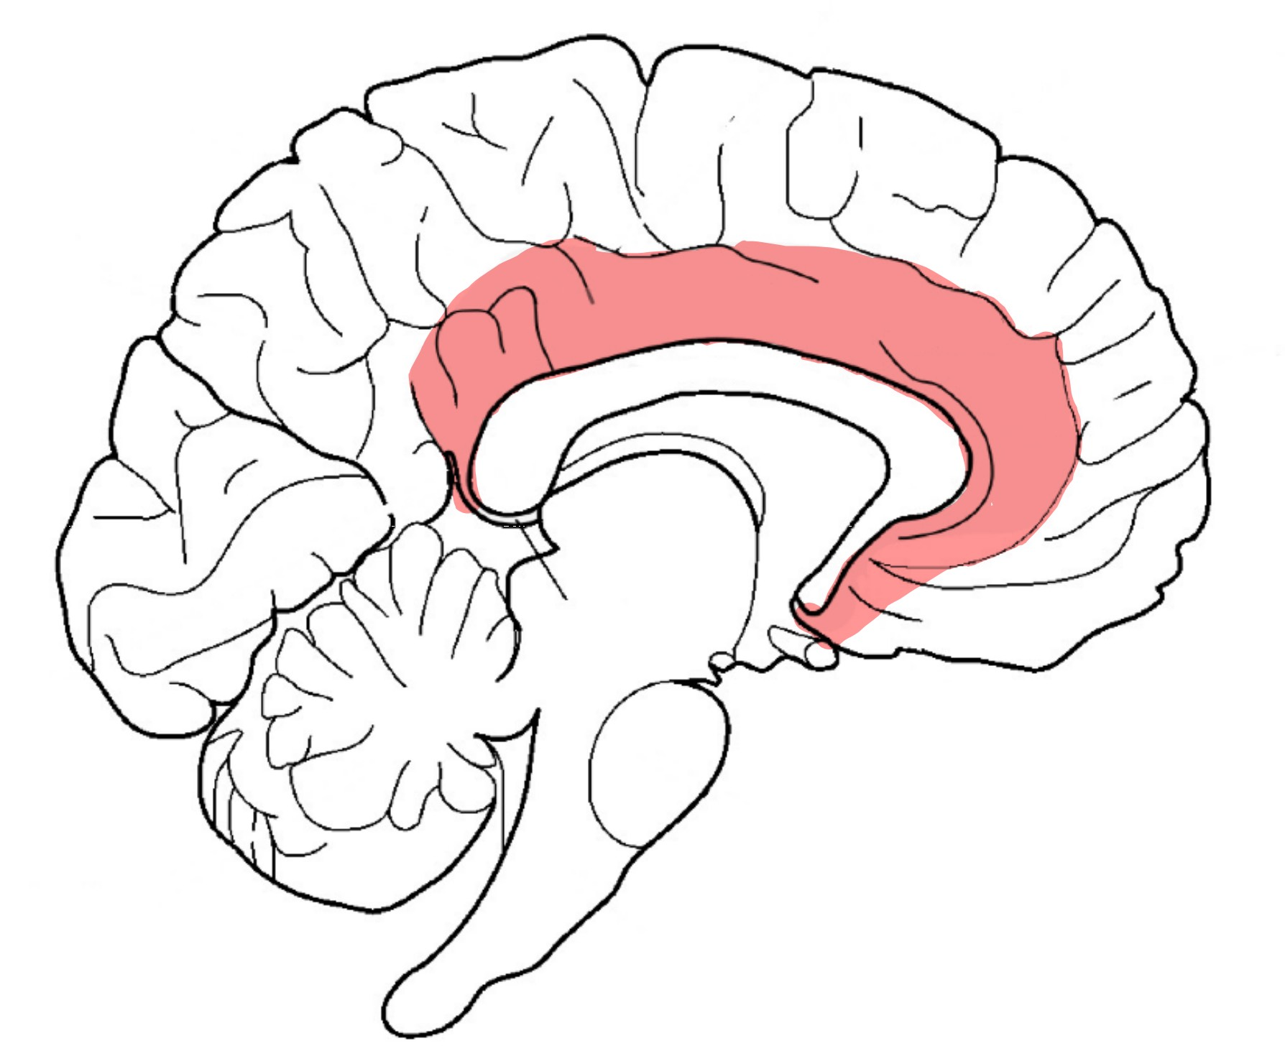
Function of Cingulate Lobe
Cingulate Lobe
Clark et al. (annotated)
Notes:
Different regions of the cingulate lobe have different connections, which usually indicate different functions.
References:
https://www.cambridge.org/core/books/brain-and-behavior/limbic-system-cingulate-cortex/92BDF7C35A6789DE677813B2E4EEEA9D
https://neuro.psychiatryonline.org/doi/10.1176/jnp.23.2.jnp121#F1

Slide 4
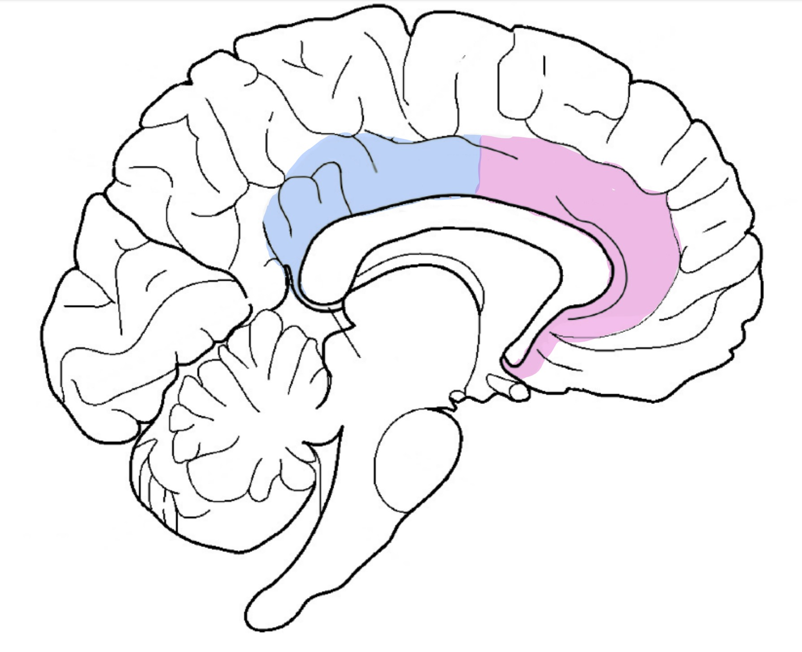


Function of Cingulate Lobe
Cingulate Lobe
Posterior Cingulate Cortex (PCC)
Anterior Cingulate Cortex (ACC)
Clark et al. (annotated)
Notes:
The cingulate cortex is divided into the Posterior Cingulate Cortex (PCC) shown in blue and the Anterior Cingulate Cortex (ACC) shown in pink.
References:
https://www.cambridge.org/core/books/brain-and-behavior/limbic-system-cingulate-cortex/92BDF7C35A6789DE677813B2E4EEEA9D
https://neuro.psychiatryonline.org/doi/10.1176/jnp.23.2.jnp121#F1

Slide 5
Function of Cingulate Lobe
Cingulate Lobe
PCC
Function:
visuospatial orientation in response to somatosensory stimuli, memory retrieval and attention
Clark et al. (annotated)
Notes:
The PCC is involved in visuospatial orientation in response to somatosensory stimuli, memory retrieval, and attention.
References:
https://www.cambridge.org/core/books/brain-and-behavior/limbic-system-cingulate-cortex/92BDF7C35A6789DE677813B2E4EEEA9D
https://neuro.psychiatryonline.org/doi/10.1176/jnp.23.2.jnp121#F1
More Details about the PCC:
Posterior Cingulate Cortex (PCC)
The PCC is strongly linked to saccade circuitry and is involved in visuospatial orientation in response to somatosensory input.
The PCC receives input from the anterior thalamic nucleus and frontal, occipital and posterior parietal cortices. It receives heavy input from the hippocampal formation
Important for memory retrieval
Connections with the superior temporal sulcus and superior temporal gyrus which play a role in the localization of sounds

Slide 6
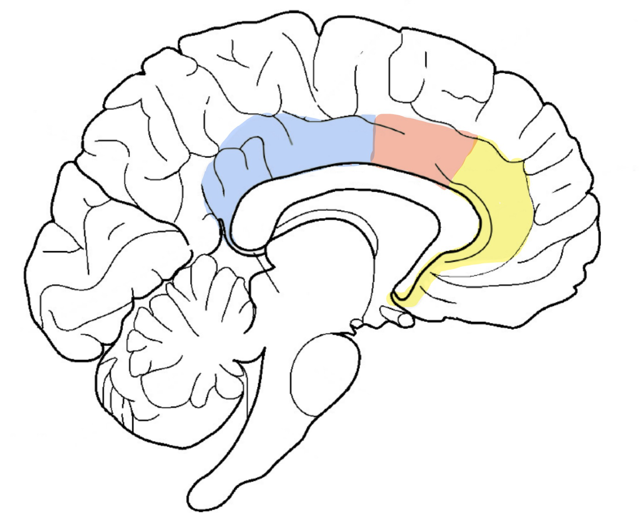
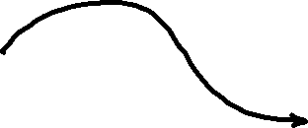

Function of Cingulate Lobe
Cingulate Lobe
PCC
ACC
Dorsal ACC
Rostral ACC
Clark et al. (annotated)
Notes:
The ACC is further divided into the dorsal ACC and the rostral ACC which is shown in orange and yellow respectively.
References:
https://www.cambridge.org/core/books/brain-and-behavior/limbic-system-cingulate-cortex/92BDF7C35A6789DE677813B2E4EEEA9D
https://neuro.psychiatryonline.org/doi/10.1176/jnp.23.2.jnp121#F1
More details for the ACC:
Anterior Cingulate Cortex
Location: Lies anterior and inferior to the anterior end of the corpus callosum
The ACC is known as the “primary limbic cortex” as well as the “affective or emotional” division of the cingulate cortex.

Slide 7
Function of Cingulate Lobe
Cingulate Lobe
PCC
ACC
Dorsal ACC
Function:
cognitive - sensorimotor processing,
performance monitoring and motivation
Clark et al. (annotated)
Notes:
The dorsal ACC plays a role in cognitive and sensorimotor processing, error detection and performance monitoring and motivation.
References:
https://www.cambridge.org/core/books/brain-and-behavior/limbic-system-cingulate-cortex/92BDF7C35A6789DE677813B2E4EEEA9D
https://neuro.psychiatryonline.org/doi/10.1176/jnp.23.2.jnp121#F1
More details for the dorsal ACC:
Dorsal ACC:
Extensive connections with cognitive (prefrontal) and motor-related (premotor and primary motor) areas of the cortex and with pain and motor related thalamic nuclei.
Contains the cingulate motor areas that project to the spinal cord
Correlated with areas involved in sensorimotor processing and cognition but not affective processing
Thought to play important role in cognitive processing, target detection, response selection and inhibition, error detection, performance monitoring and motivation.
Relevant to ADHD: modulates reward-based decision making

Slide 8
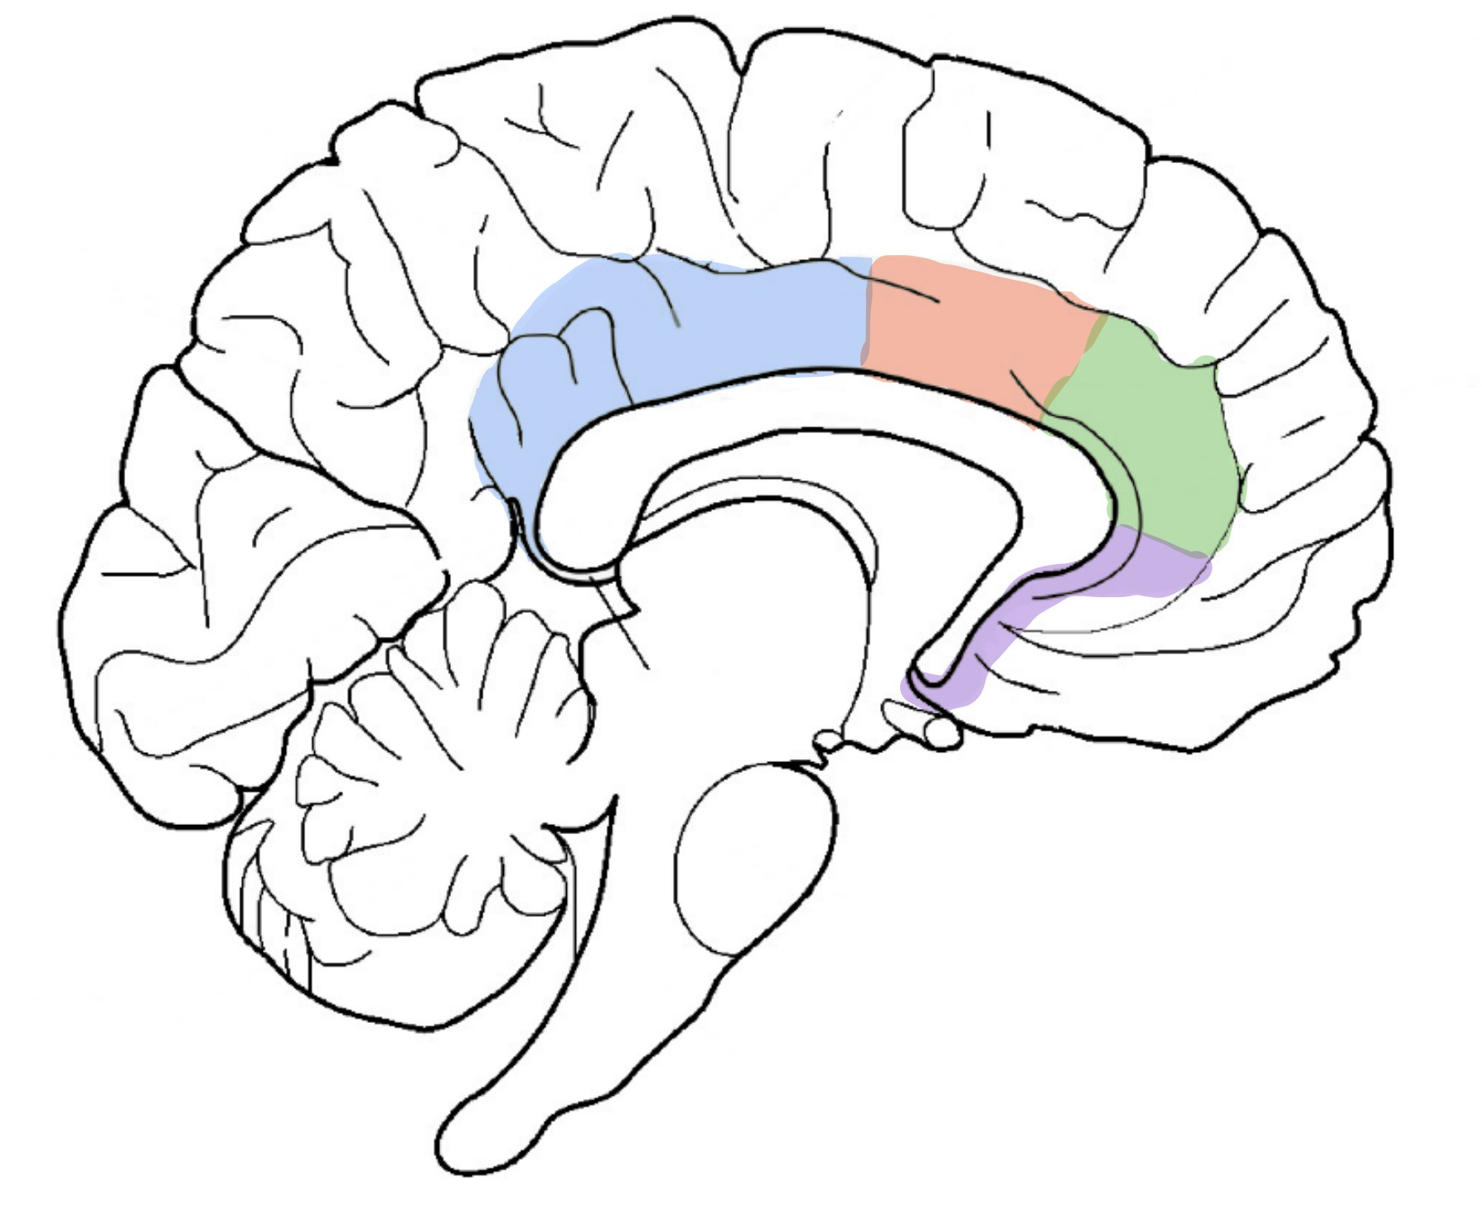

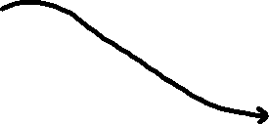
Function of Cingulate Lobe
Cingulate Lobe
PCC
ACC
Dorsal ACC
Rostral ACC
Pregenual ACC
Subgenual ACC
Function:
affective or emotional processing
Clark et al. (annotated)
Notes:
On the contrary, the rostral ACC is mostly involved in affective or emotional processing. It is further separated into the pregenual and subgenual ACC, shown in green and purple respectively.
References:
https://www.cambridge.org/core/books/brain-and-behavior/limbic-system-cingulate-cortex/92BDF7C35A6789DE677813B2E4EEEA9D
https://neuro.psychiatryonline.org/doi/10.1176/jnp.23.2.jnp121#F1
More details for the rostral ACC:
Rostral ACC:
Extensive connections with areas known to be related to emotion (amygdala), autonomic functions (lateral hypothalamus, brainstem cortex), memory (hippocampal region) and reward-related functions (orbitofrontal cortex, ventral striatum).
Both subdivisions not correlated with cognition or sensorimotor processing but correlated with areas involved in affective processing

Slide 9
Function of Cingulate Lobe
Cingulate Lobe
PCC
ACC
Dorsal ACC
Rostral ACC
Pregenual ACC
Subgenual ACC
Social decision making
Autonomic monitoring
Clark et al. (annotated)
Notes:
The main difference between the two is that the pACC has more connections with the lateral prefrontal cortex and is involved in conflict decision making especially in social settings whereas the sACC has reciprocal connections with the amygdala, ventral striatum, and autonomic centers (in the hypothalamus and brainstem) that indicate a strong role in autonomic monitoring.
References:
https://www.cambridge.org/core/books/brain-and-behavior/limbic-system-cingulate-cortex/92BDF7C35A6789DE677813B2E4EEEA9D
https://neuro.psychiatryonline.org/doi/10.1176/jnp.23.2.jnp121#F1
More details for the pregenual and subgenual ACC:
Pregenual ACC
More connections with the lateral prefrontal cortex and fewer with the amygdala and the ventral striatum
Receives projections from the pain related thalamic nuclei (less than the dorsal ACC though)
Function: “conflict” decision making especially in a social context (https://www.jneurosci.org/content/41/47/9742)
Subgenual ACC:
Reciprocal connections with the amygdala and projects to the ventral striatum and autonomic centers in the hypothalamus and the brainstem.
Strong connections with the limbic and autonomic related areas
Function: monitoring emotional arousal and autonomic states (https://www.jneurosci.org/content/41/47/9742)

Slide 10
Possible Involvement of Cingulate Lobe in ADHD
Symptoms of ADHD:
Hyperactivity
Difficulty to sustain attention
Cognitive control
Emotion control
High Impulsivity
Time management
Corresponding function of Cingulate Lobe:
PCC
Memory retrieval
Attention allocation
Self-awareness
Dorsal ACC
Emotion regulation
Decision making
Motivation and Reward
Literature:
Hypofunctional dorsal ACC
Underactivated PCC
Smaller volume of the cingulate lobe and ACC
❓
Notes:
References:
https://www.youtube.com/watch?v=C2SJdOzvDi4
https://www.sciencedirect.com/science/article/pii/S0006322305001113?via%3Dihub
https://pubmed.ncbi.nlm.nih.gov/23869106/
https://www.nature.com/articles/s41398-023-02541-z#:~:text=At%20the%20neurobiological%20level%2C%20structural,models%20%5B3%2C%206%5D.
In terms of the cingulate lobe‘s involvement in ADHD, we can look at the 6 main symptoms of ADHD which are hyperactivity, difficulty to sustain attention, cognitive control, emotion control, high impulsivity and time management. Considering the function of the cingulate lobe discussed in the previous slide, there are very clear connections with these symptoms. Previous studies have shown that the dorsal ACC is hypofunctional leading to decision making modulation, motivation and emotion regulation problems and the PCC is underactivated leading to lack of attention. Some scientists have also found that the volume of the cingulate lobe and specifically ACC is smaller in patients with ADHD. However, findings have been somewhat inconsistent, with some showing no significant difference.

Slide 11
Our Study
Motivation:
Most studies do not investigate the cingulate lobe specifically
The conclusions from previous studies are somewhat inconsistent
Demographic Characteristics | Controls N = 92 | ADHD N = 108
Age (Mean ± STD, years) | 6.1 ± 1.5 | 6.0 ± 1.3
Sex | 61 M / 31 F | 62 M / 46 F
Notes:
Despite the cingulate lobe's significance in ADHD, most studies do not focus specifically to this region of the brain. Moreover, many studies seem to have inconsistent conclusions. In this project, we worked with data from children with a mean age of 6 years old that would allow us to gain insights for the subregions of the cingulate lobe and their effect on ADHD pathology.
References:
https://www.youtube.com/watch?v=C2SJdOzvDi4
https://www.sciencedirect.com/science/article/pii/S0006322305001113?via%3Dihub
https://pubmed.ncbi.nlm.nih.gov/23869106/
https://www.nature.com/articles/s41398-023-02541-z#:~:text=At%20the%20neurobiological%20level%2C%20structural,models%20%5B3%2C%206%5D.
https://link.springer.com/article/10.1007/s10548-010-0168-4

Slide 12
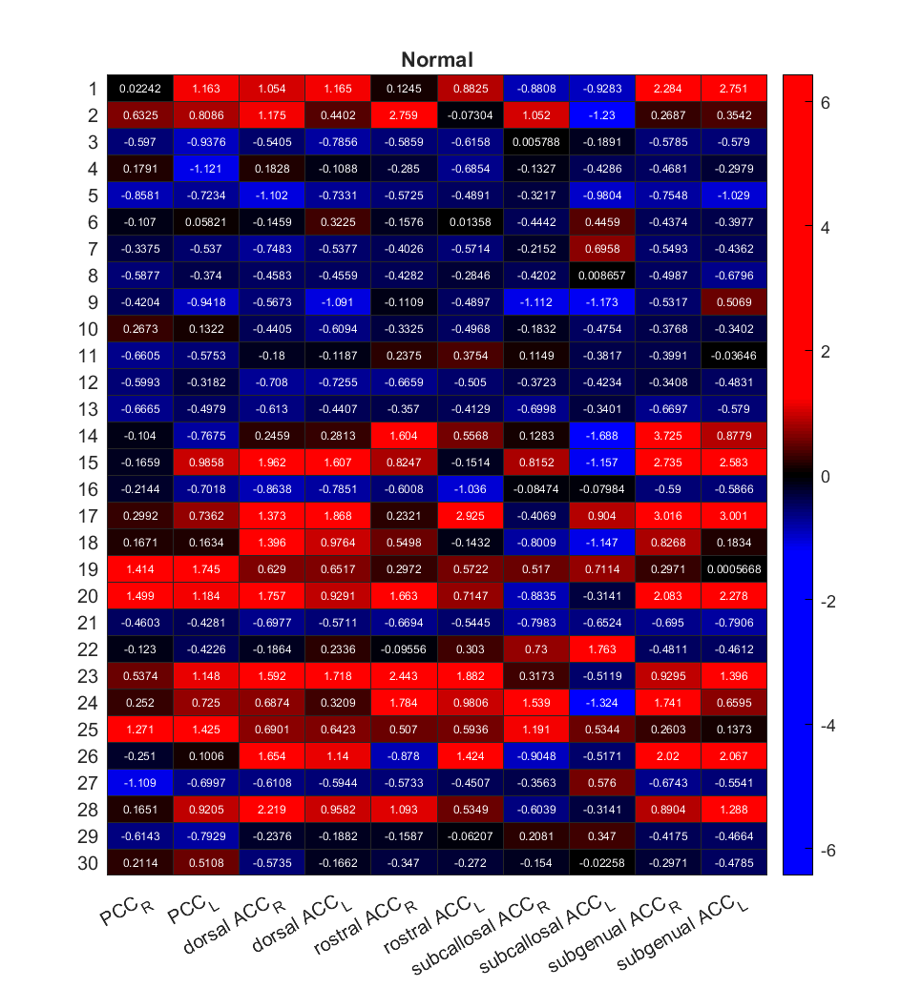
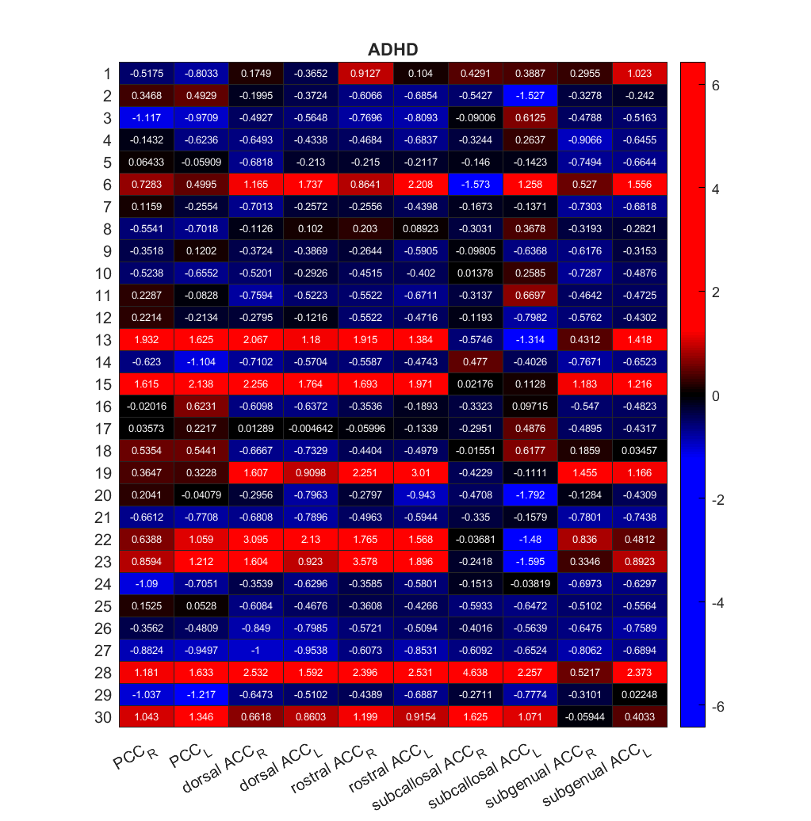
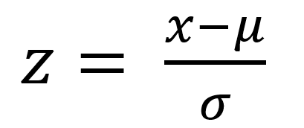
Results - Z-scores, barcode and heat maps
ADHD appears to have LARGER volumes of the subregions than control group
Methods: Z-score formula
μ & σ:
mean & STD volume of control group
Notes:
We created a barcode for each patient based on the volume distribution of the control group. The barcode contains the z score of the 10 structures of cingulate lobe. The formula is shown here, with μ the mean value of the control group, and σ the standard deviation. Therefore, the barcode gives us how deviated this structure of the patient is from the average volume among the normal population, and we are plotting 30 samples for each group. It is worth noticing that the distribution of both groups have outliers with very large z score, >2.5. To set aside the outliers, we set a threshold ratio to the color bar which is 0.2, the value above which proportion to be all red. The same for the negative components. Here, we can see that both groups there are more positive z scores that have magnitude larger than 1.5 than the negative z scores, and the positive values from the ADHD group seems bigger than the normal group, suggesting a higher volume of cingulate lobe in ADHD group. But we cannot assert that only based on the heatmap, we need to look at the statistics.

Slide 13
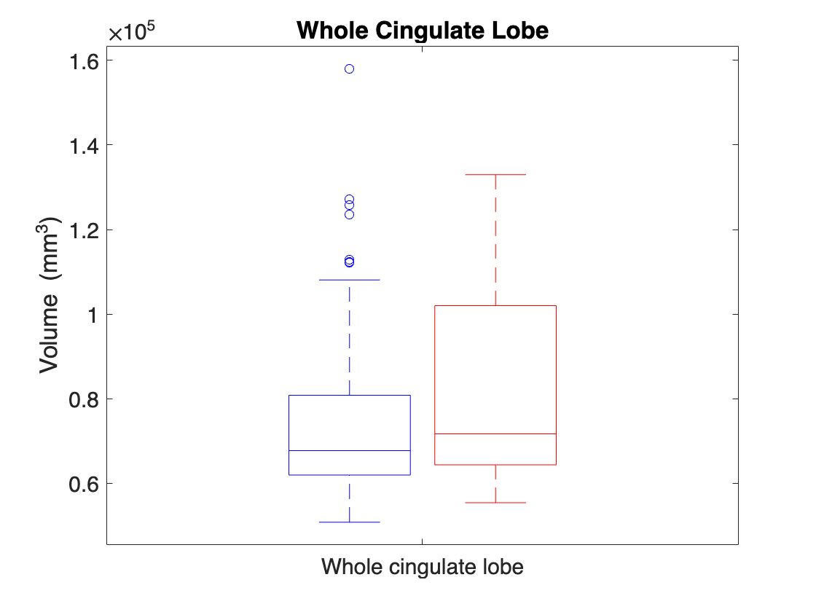
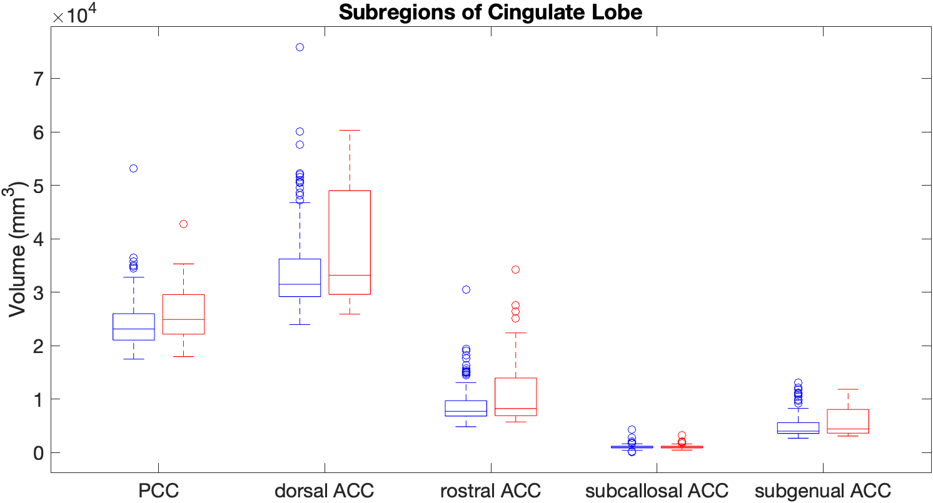
Results
Statistical analysis: Shapiro-Wilk normality → Wilcoxon rank-sum test, with Bonferroni correction
LARGER cingulate lobe volume for ADHD children, arising mainly from the posterior cingulate cortex
CONTROL
ADHD
p-values (<0.05)
0.021
0.019
Notes:
Showing only statistically significant findings!! Other p-values can be found in the code
Differences are also seen in the right cingulate lobe (not shown here, can be seen in the code) that arise from the right PCC

Slide 14
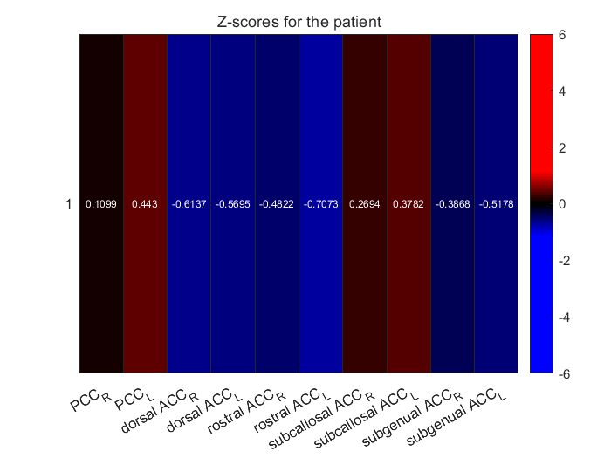
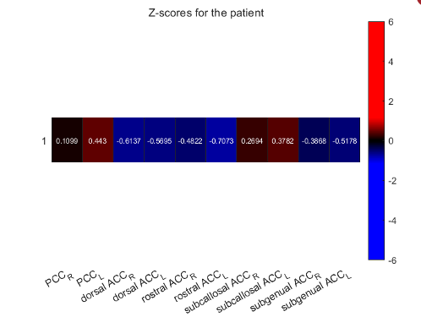
Our new patient
All z-scores ≈ 0
→ Normal

Slide 15
Discrepancy to existing literature
Our conclusion:
Slightly Larger volume of cingulate lobe, particularly the PCC
Comparison with literature:
Volume reduction of cingulate lobe and ACC
Volume increase of PCC (Nakao et al.)
Discussion:
Most studies done in adults and adolescents with ADHD vs ours is in very young children (approx. 5-19 years old vs ~6 years old)
Inconsistencies in imaging observations – different definition of ROIs and different testing among studies
Unclear function of each subregion of the ACC
Volume differences of cingulate lobe are insufficient for ADHD diagnosis
Notes:
Our conclusion of a larger volume in the cingulate lobe and especially the PCC is not entirely consistent with literature. We observed that most studies indicate volume reduction or no change in the cingulate lobe and ACC . However, as indicated in a study by Nakao et al., a volume increase in PCC was observed which was also verified in other studies and was consistent with our results. Possible reasons for this discrepancy could be that most studies were done in adults and adolescents that might have different structural deficits than small children. Moreover, each study used different definitions for the ROIs and different testing methods to identify possible changes in the cingulate lobe making it difficult to make confident comparisons. Finally, the function of each subregion of the ACC is still not entirely clear while volume differences are not sufficient indicators for ADHD diagnosis.
References:
https://www.sciencedirect.com/science/article/abs/pii/B9780444641960000169?via%3Dihub

Slide 16
THANK YOU

