Slide 1
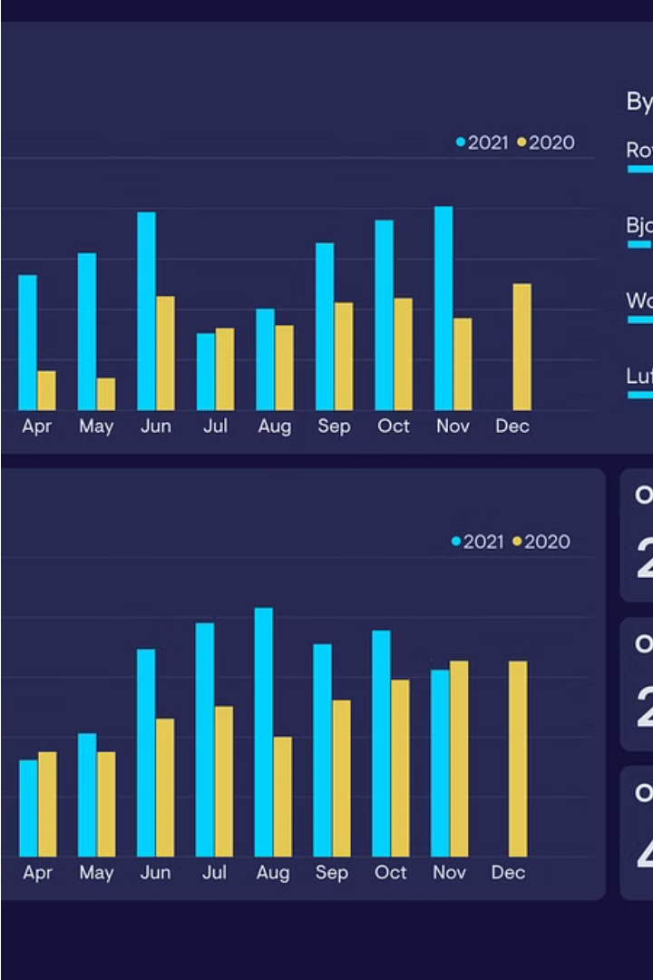
Interactive
Dashboard using Data Analytics and Tableau
This analytics project aims to create an interactive and visually appealing dashboard to present key metrics and insights to end-users. The dashboard will leverage tools like Power BI and integrate data from SQL databases to provide a comprehensive view of the organization's performance.
Chethan P P
Gagan Deep
K N Kanva Patel
Wesley Sam Thomas

Slide 2
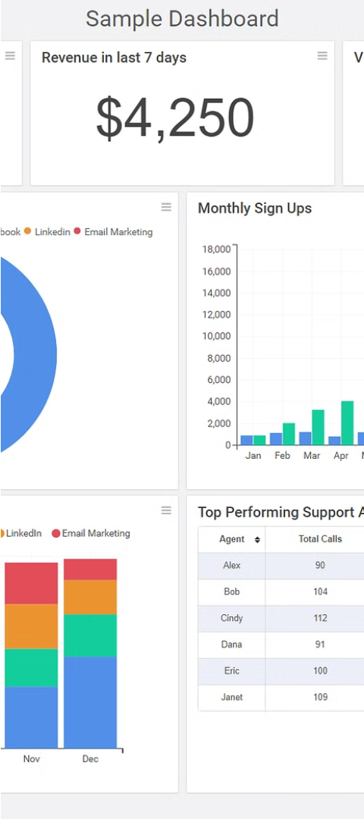
Importance of Effective Dashboard Design and Visualization
1
Clear Presentation
2
Actionable Insights
A well-designed dashboard organizes data in a clear, concise, and visually engaging manner, making it easy for users to understand and act on the information.
Effective visualizations can help uncover meaningful patterns and trends, empowering decision-makers to make more informed and impactful decisions.
3
Enhanced User Experience
An intuitive and aesthetically pleasing dashboard improves user engagement and adoption, fostering a positive experience for the end-users.

Slide 3
Principles of Effective Data Visualization
Clarity
Simplicity
Consistency
Visualizations should be easy to interpret, with clear labels, scales, and legends that help users quickly grasp the meaning of the data.
Avoid cluttering the dashboard with excessive information or complex charts. Focus on the most important metrics and present them in a clean, uncluttered manner.
Maintain a consistent visual style and layout throughout the dashboard, making it easier for users to navigate and understand the information.

Slide 4
Best Practices for Dashboard Design
Organize Data Hierarchically
Leverage Interactive Features
Group related metrics and insights into logical sections or modules, making it easier for users to find and understand the information they need.
Incorporate interactive elements like filters, drill-down capabilities, and dynamic visualizations to allow users to explore the data and uncover insights.
Prioritize Usability
Optimize for Mobile
Design the dashboard with the end-user in mind, ensuring it is intuitive, easy to navigate, and provides a seamless user experience.
Ensure the dashboard is responsive and optimized for viewing on various devices, including smartphones and tablets, to cater to the needs of a diverse user base.

Slide 5
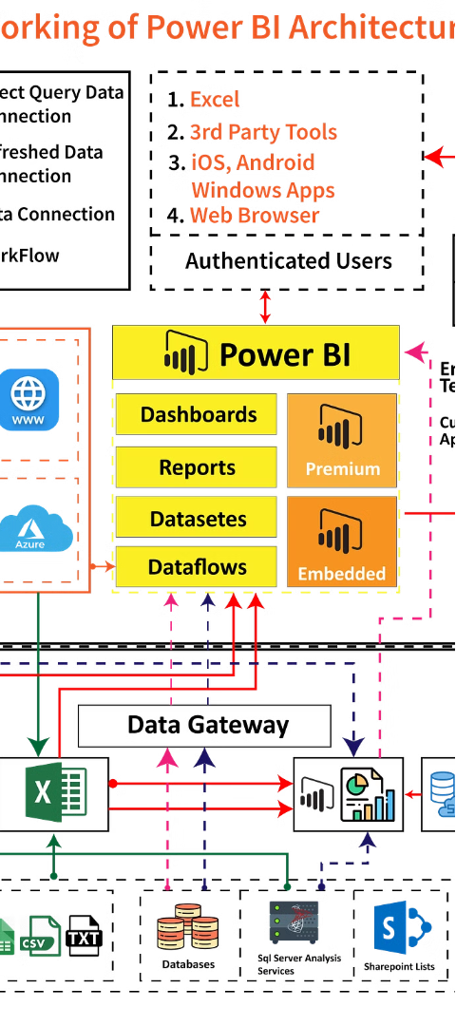
Integrating SQL Databases with Tableau
1
Data Extraction
Establish a secure connection between Power BI and the SQL database to extract the relevant data for the dashboard.
2
Data Transformation
Use Power BI's data transformation and modeling capabilities to clean, shape, and prepare the data for visualization.
3
Dashboard Creation
Leverage Power BI's intuitive interface to design the interactive dashboard, incorporating visually appealing charts, graphs, and other visualizations.

Slide 6




Techniques for Enhancing Dashboard Interactivity
Filtering
Drill-Down
Tooltips
Data Export
Implement dynamic filtering options that allow users to narrow down the data and focus on specific areas of interest.
Incorporate drill-down capabilities that enable users to explore data in more detail, uncovering deeper insights.
Use interactive tooltips to provide additional information and context when users hover over specific data points.
Allow users to export the dashboard data in various formats, such as Excel or CSV, for further analysis or reporting purposes.

Slide 7




Strategies for Presenting Key Business Metrics
Identify Key Metrics
Visualize Effectively
Provide Context
Include benchmarks, targets, and historical data to help users interpret the metrics and understand their significance.
Determine the most critical business metrics that align with the organization's goals and objectives.
Choose the appropriate chart types and visualizations to effectively communicate the selected metrics.

Slide 8
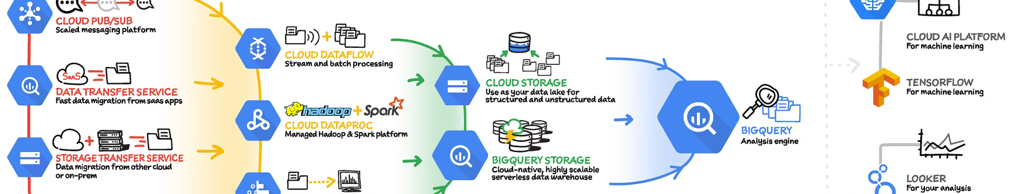
Conclusion and Next Steps
This project has laid the foundation for creating an engaging and impactful business analytics dashboard. By incorporating best practices in dashboard design and visualization, and leveraging the capabilities of Power BI and SQL databases, the team is well-positioned to deliver a comprehensive solution that meets the organization's needs.
The next step is to gather feedback from key stakeholders, refine the dashboard based on user insights, and continuously iterate and improve the solution to ensure it remains relevant and valuable over time.

