Slide 1

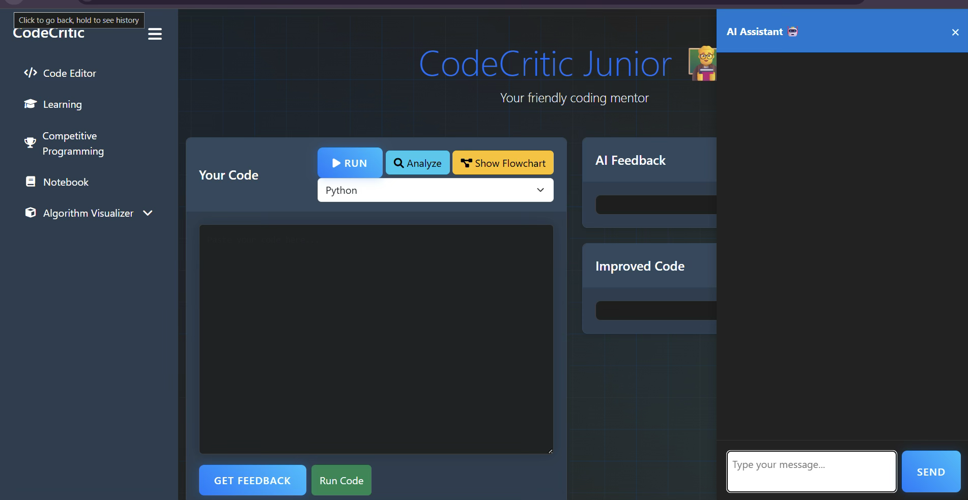
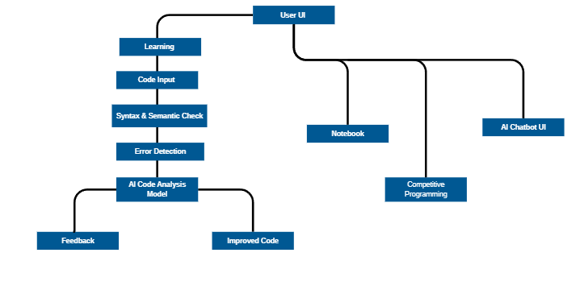

RV College of Engineering, Bengaluru – 560059.
Title: “CodeCritic Junior”: AI Coach for improving Beginner Coding Style
Mohammed Faid | M K Heera | Gagan Gowda V S | Ved M Revankar | Tejas Ganesh Hegde
1RV22IS403 | 1RV23IS404 | 1RV23AI400 | 1RV23CS419 | 1RV22CS219
Team name : Shadow Garden
Introduction
Tools used
Learning to program is crucial today, but beginners often write code that works yet lacks clarity, structure, or efficiency. This makes it hard to debug or scale in real-world scenarios. Our project, CodeCritic Junior, offers an AI-powered dashboard that gives real-time feedback, improved code suggestions, concept learning, note-taking, and chatbot support.
Research shows that 65% of CS beginners struggle with code quality, and poor coding habits can increase industry development time by up to 30%. By addressing these issues early, our system aims to build strong foundations and make coding education more effective and accessible.
AI Models (OpenAI, Custom Models): Used for analyzing user code and providing feedback on DSA concepts.
Flask (Python Framework): For backend development, managing API requests, and serving the application.
Front-end Technologies (HTML, CSS, JavaScript): For creating the user interface and interactive elements.
SQLite: For database management, storing user login data, and maintaining user progress.
AR/VR Technologies (WebXR, Three.js): For visualizing DSA concepts interactively.
ChatBot (AI-Powered): For assisting users with real-time guidance and answering their queries.
Problem Definition
Learning programming is crucial in today’s digital era, but beginner programmers frequently write code that, although functional, lacks efficiency and readability. This presents significant barriers in debugging, collaboration, and further development. The absence of structured guidance on coding standards leads to poor habits early in their learning journey.
CodeCritic Junior is an AI-enhanced platform designed to aid novice programmers in refining their coding style. With features such as real-time feedback, code correction suggestions, and interactive learning, this system helps foster strong programming.
Results
-
Objectives
To provide an AI-powered editor that gives real-time feedback on code quality and structure.
To automatically generate improved versions of student code for better readability and efficiency.
To offer an interactive learning module that teaches core programming concepts.
To provide real-time suggestions for logical, syntax, and semantic errors.
To enhance understanding through code explanations and comparisons.
Fig 2: Coding Interface
Methodology
Requirement Analysis: Identified the need for an interactive DSA learning platform.
Technology Selection: Choose Flask for backend, HTML/CSS/JS for frontend, SQLite for data storage, and AR/VR for DSA visualization.
AI Integration: Integrated AI models to analyse user code, provide feedback, and power the chatbot.
AR/VR Module Development: Developed immersive visualizations of DSA concepts using AR/VR.
Frontend and Backend Development: Built a responsive user interface and implemented server-side logic.
Database Setup: Configured SQLite for user data storage.
Testing and Optimization: Conducted extensive testing to ensure platform reliability and optimized AI analysis.
Deployment: Deployed the complete platform with secure user login and a smooth user experience.
-
Flow Diagram
Fig 3: Learning Center
Conclusions
Code Critic Junior demonstrates how AI can transform programming education by making it more accessible, responsive, and personalized. It creates a comprehensive ecosystem for beginners, combining conceptual learning, real-time practice, and improvement feedback in a single platform. The platform maintained strong performance, with an average response time of less than 2 seconds, ensuring smooth user interactions. The chatbot provided valuable real-time support, maintaining 90% accuracy in addressing user queries.
Future Scope:
Emotion-aware coding support using facial expression analysis.
Expansion to mobile platforms.
Integration with popular learning platforms like Coursera or edX.
Support for multiple languages and IDE plugins.
References
[1] S. R. Subramanya and B. K. Yi, "Artificial Intelligence in Education: Applications and Trends," Int. J. Adv. Comput. Sci. Appl., vol. 10, no. 5, pp. 599–602, 2019.
[2] A. Nguyen and S. Khosmood, "Teaching Code Style and Efficiency with AI Feedback Tools," J. Comput. Sci. Colleges, vol. 35, no. 2, pp. 119–125, 2020. [Online]. Available:
[3] S. J. Russell and P. Norvig, Artificial Intelligence: A Modern Approach, 3rd ed. Upper Saddle River, NJ, USA: Pearson Education, 2010.
[4] N. Wirth, Algorithms + Data Structures = Programs. Englewood Cliffs, NJ, USA: Prentice-Hall, 1976.
[5] R. Yin and C. Zhang, "An Intelligent Tutoring System for Code Writing and Debugging," IEEE Trans. Learn. Technol., vol. 10, no. 3, pp. 318–327, Jul.–Sep. 2017.
QR Code
Fig 1: Flow Diagram

