Slide 1
GPU Accelerated
THAPAR INSTITUTE OF
ENGINEERING & TECHNOLOGY
Image Super-Resolution
Using Deep Learning
Parallel & Distributed Computing | UCS645
TEAM NAME CUDA VISION
TEAM MEMBER 1: 102303349 | Gagandeep
TEAM MEMBER 2: 102313067 | Anmolpreet Kaur
Guide: Dr. Saif Nalband, Asst. Prof. DCSE
Date: 29 APRIL 2026
Department of Computer Science and Engineering

Slide 2
AGENDA
A structured story — from problem to GPU-powered solution to results
01
What is Super-Resolution?
04
Our Model — FinalSRCNN
The problem, theory, and why classical methods fail
Architecture, residual connections & perceptual loss
02
Real-World Use Cases
05
Implementation & Training Setup
Movies, satellites, storage, surveillance, gaming & medicine
Dataset, CUDA C++, hyperparameters — GPU-first approach
03
Why GPU for Deep Learning?
06
Results & Conclusion
GPU architecture & why it's the hero of our project
2.31× speedup, loss curve, visual quality & key takeaways

Slide 3
WHAT IS SUPER-RESOLUTION?
Recovering high-frequency detail that classical methods cannot
Super-Resolution (SR) = reconstructing a High-Resolution image from a Low-Resolution input. When you enlarge an image with classical methods like bicubic interpolation, you get a blurry result — because lost pixel detail cannot be mathematically recovered. Deep Learning solves this by learning the mapping from data.
Classical Methods
CNN-Based SR (Our Approach)
Key Math — What We Optimise
Bicubic / Bilinear Interpolation Estimate missing pixels using nearby values mathematically. Fast but produce blurry results — they have no knowledge of edges, textures, or real-world content.
FinalSRCNN — Learned Mapping Trained on thousands of LR↔HR pairs, the CNN learns to hallucinate sharp edges and textures that interpolation cannot. Maps LR → HR end-to-end.
Goal: X̂ = F(Y ; Θ) ≈ X Y = LR input X = True HR Θ = CNN weights Loss = MSE(X̂,X) + 0.05×MSE(φ(X̂),φ(X))

Slide 4
REAL-WORLD USE CASES
Super-Resolution is already used everywhere — from Netflix to NASA to your phone
🎬 Movies & OTT
🛰️ Satellite & Aerial
💾 Storage & Streaming
Netflix, Disney+, Amazon use SR to upscale old 480p/720p content to 4K. Old Bollywood & Hollywood films are being AI-restored — saving crores in re-production.
NASA, ISRO & Google Maps enhance raw satellite captures for terrain mapping, disaster response, border surveillance & crop monitoring before analysis.
Store/stream at LOW resolution → reconstruct HIGH quality on-device. Used by YouTube, Zoom (low-bandwidth calls) and NVIDIA DLSS (gaming) to save bandwidth.
🏥 Medical Imaging
📷 Surveillance & CCTV
🎮 Gaming — DLSS / FSR
MRI & CT scans are limited in resolution due to hardware/time. SR enhances these scans so doctors can detect tumors, fractures & tissue damage more accurately.
Police & forensics use SR to sharpen CCTV footage — making faces, number plates, and objects readable from blurry low-res recordings used in crime investigation.
NVIDIA DLSS & AMD FSR render at 1080p, SR upscales to 4K in real time — giving 2–4× FPS boost. Used in every major AAA game title today.

Slide 5
WHY GPU IS THE HERO OF THIS PROJECT
GPU is not just faster — it fundamentally enables deep learning at scale
⚡ A modern GPU has 3,000 – 10,000+ CUDA cores running in parallel. A CPU has 4–32 cores running sequentially.
✅ Why Convolution = Made for GPU
CPU vs GPU — Design Philosophy
▸ Each output pixel is independent In a conv layer, pixel (i,j) does NOT depend on pixel (i+1,j) → all can be computed simultaneously
CPU
GPU
Cores
4–32 powerful
2-3K cores small CUDA
▸ Thousands of threads, one task GPU launches 1 CUDA thread per output pixel → thousands run at once, not one after another
Optimised for
Latency (sequential)
Throughput (parallel)
▸ Our model: 128×128 feature maps = 16,384 pixels → GPU computes all in parallel, CPU does them serially
Memory
Large L1/L2 cache
High bandwidth GDDR6
DL Training
Slow — sequential ops
Fast — all ops parallel
▸ VGG16 perceptual loss adds load Extra VGG16 forward pass per step → CPU gets crushed, GPU handles it with spare capacity
This project
1447.9 seconds ❌
626.3 seconds ✅

Slide 6
OUR MODEL — FINALSRCNN ARCHITECTURE
4-layer CNN with residual connection + combined perceptual loss
Residual Skip Connection — output = Conv4(x) + bicubic_upsampled (prevents vanishing gradients, improves convergence)
LR Input
32×32
Bicubic
Upsample ×4
Conv1
9×9, 64ch
ReLU
Conv2
3×3, 64ch
ReLU
Conv3
3×3, 32ch
ReLU
Conv4
5×5, 1ch
HR Output
128×128
Why Residual Connection?
Loss Function — Why Combined?
Without residual: network must learn the full HR image from scratch , hard and slow. With residual: network only learns the high-frequency detail to ADD on top of the bicubic baseline. Much easier task → faster convergence & better results. Skip connections also prevent vanishing gradients in deeper layers.
L(Θ) = MSE(X̂, X) + 0.05 × MSE(φ(X̂), φ(X))
Pixel Loss (MSE): Penalises exact pixel errors → ensures numbers are correct. Perceptual Loss (VGG16 features): Matches deep feature maps from a pre-trained VGG16 → output looks sharp and realistic, not just numerically accurate.

Slide 7
IMPLEMENTATION & TRAINING SETUP
Two implementations — PyTorch (CPU baseline) vs hand-coded CUDA C++ (GPU)
CPU Baseline — PyTorch
⚡ GPU Implementation — CUDA C++
Framework: PyTorch (high-level, auto-grad) Loss: Perceptual + MSE Purpose: Baseline to measure speedup against GPU
Kernels written: Forward conv, backward pass (dW/db/dX), ReLU bwd, Adam update — all in CUDA Compiler: nvcc -O2 -arch=sm_75 | Parallelism: 1 CUDA thread per output pixel Data loading: libcurl + stb_image — dataset fetched directly inside CUDA program
Dataset & Hyperparameters — Identical for both CPU and GPU (for fair comparison)
Dataset:
300 images — Picsum Photos API (deterministic seeds)
Epochs:
60 epochs — same for both CPU & GPU
LR Input:
32×32 px — bicubic downscale from 256×256 source
Batch Size:
8 images per mini-batch
HR Target:
128×128 px — bicubic resize (4× upscale factor)
Optimiser:
Adam — lr=0.001, β₁=0.9, β₂=0.999, ε=1e-8
Normalisation:
Pixel values ÷ 255 → range [0.0, 1.0]
GPU Result:
626.3 s (vs CPU: 1447.9 s)
Diversity:
Landscapes, portraits, urban, textures — diverse scenes
GPU Speedup:
2.31× faster — 56.7% reduction in training time

Slide 8
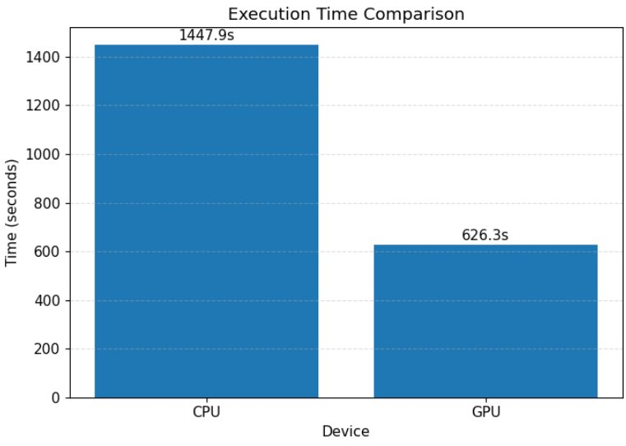
RESULTS — GPU SPEEDUP
GPU cut training time by 56.7% — empirical proof that parallelism works
1447.9s
626.3s
2.31×
Sequential CPU
CUDA Parallel GPU
56.7% Faster
PyTorch — CPU Training Time
CUDA C++ — GPU Training Time
Speedup Factor

Slide 9
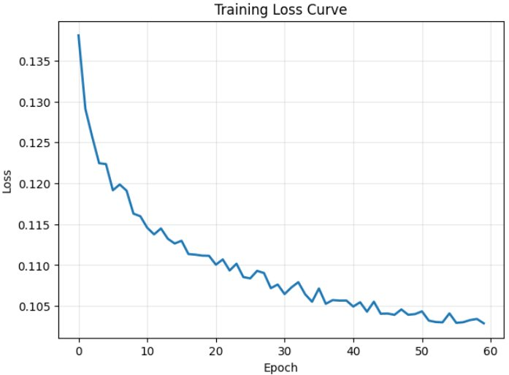
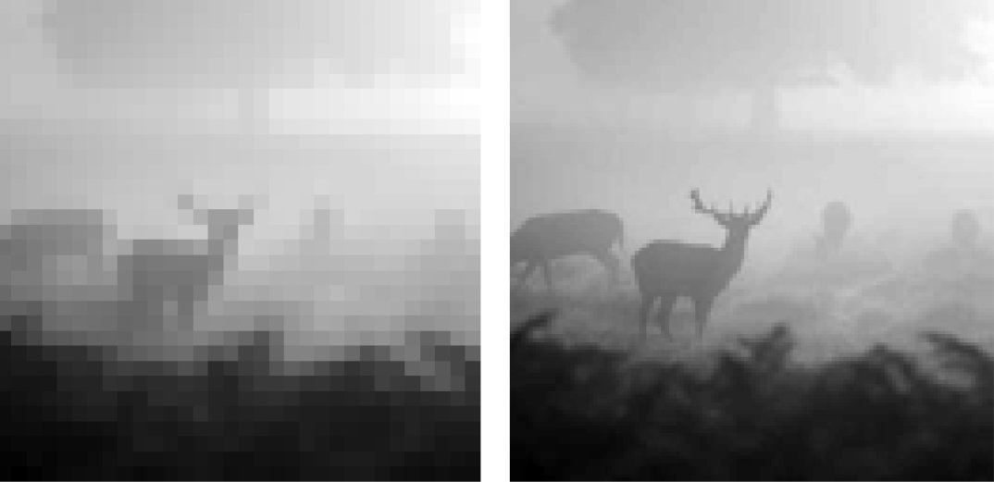
RESULTS — CONVERGENCE & VISUAL QUALITY
Loss dropped from 0.137 → 0.104 | SR outputs show clear visual improvement
Training Loss Curve — 60 Epochs
Super-Resolution Output — LR vs SR
Left: LR input 32×32 — pixelated, blurry edges Right: FinalSRCNN 128×128 — sharper edges, reduced blocking, natural textures
Epochs 1–5: Rapid drop: 0.137→0.122. Network quickly learns dominant low-freq mapping.
Epoch 40–60: Stabilises at 0.104–0.106. Convergence confirmed — no divergence.
Epochs 5–40: Slower with oscillations from stochastic mini-batch noise.

Slide 10
Key Takeaways
GPU is Essential
Deep learning is not practically feasible on CPU at scale. GPU is the foundation, not an optimisation.
2.31× Speedup
Training time dropped from 1447.9s → 626.3s — a 56.7% wall-clock reduction using CUDA parallelism.
Smooth Convergence
MSE loss 0.137 → 0.104 over 60 epochs. No divergence. Adam optimiser kept training stable throughout.
Residual + Perceptual
Skip connection + VGG perceptual loss produced outputs that are both numerically and visually sharp.
Real-World Impact
SR powers Netflix 4K, ISRO satellite mapping, CCTV forensics, NVIDIA DLSS, and medical MRI enhancement.

Slide 11
Thank You!
Questions & Discussion

