Slide 1


Department of Computer Science & Engineering (DATA SCIENCE)
MINI PROJECT PRESENTATION
HUMAN ACTION RECOGNITION
PRESENTED BY:-
Gagan Prajapati
Usama Patel
Kunal Dubey
Rajesh Pandit
Project Guide : Prof. Priya Deshpande
Notes:
1

Slide 2
PRESENTATION OUTLINE
Introduction
Motivation
Problem Statement
Literature Survey
Literature Survey
Proposed Methodology
Flowchart
Algorithm
Implementation
Software and Dataset Details
Result
Output Images
Conclusion and Future Scope
Conclusion
Future Scope
References

Slide 3
INTRODUCTION
Behavior action recognition using ConvLSTM (Convolutional Long Short-Term Memory) combines the strengths of CNNs for spatial feature extraction and LSTMs for capturing temporal dependencies in sequential data like videos. The CNN component extracts spatial features from each video frame, while the LSTM processes these frame sequences to learn temporal patterns. This approach is highly effective for recognizing complex human actions, where the temporal relationships between frames are crucial. ConvLSTM is commonly used in applications such as human behavior analysis and sports action recognition, providing efficient and accurate action understanding.

Slide 4
1.1 Motivation
1.2 Problem Statement
The motivation for building a human action recognition system is its ability to improve various areas: understanding human behavior for better interaction, enhancing security by detecting suspicious actions, and creating more immersive experiences in gaming and virtual reality. In healthcare, it helps monitor patients, especially the elderly. In sports, it analyzes player movements for better performance. It also supports human-robot interaction, road safety by detecting pedestrian behavior, and real-time analysis in areas like sports broadcasting. These systems drive innovation in AI and computer vision, improving technology across many fields.
Human action recognition (HAR) is challenging because it requires accurately identifying actions in videos, processing large datasets, and capturing the time-based relationships between frames. Many current systems struggle with real-time predictions and maintaining accuracy for different actions. This project aims to develop a reliable HAR model using a ConvLSTM approach to improve real-time action recognition in areas like surveillance and sports analytics, addressing these challenges effectively.

Slide 5
2. Literature Survey
Referred Paper 1: The ConvLSTM model is designed to handle both spatial and temporal data, making it a good fit for human action recognition. Its ability to capture fast and slow motions and integrate with convolutional networks can help recognize a variety of actions in video data. However, the paper doesn't directly explore ConvLSTM for action recognition, so further research is needed.
Referred Paper 2: LSTM is suited for time-sequence data, crucial for action recognition. Its architecture preserves long-term dependencies, allowing the system to focus on relevant information across video frames. Experiments show LSTM's success in handling noisy data, making it ideal for action recognition tasks.
Referred Paper 3: This paper highlights dropout regularization in LSTMs to prevent overfitting, crucial for action recognition on large datasets. The paper also discusses multilayer LSTMs, which help the system learn both low-level movements and high-level actions, improving robustness in recognizing complex actions.
Referred Paper 4: The UCF50 dataset, used for action recognition, includes 50 categories of real-world videos from YouTube, offering challenges like camera motion and background clutter. The dataset's diversity helps test models like ConvLSTM, which achieved 80.33% accuracy in capturing temporal dependencies and recognizing actions.

Slide 6
3. Proposed Methodology
To develop the Human Action Recognition model, we will utilize convolutional layers, followed by Long Short-Term Memory (LSTM) layers to capture temporal patterns and dependencies in the video sequences. Before building and training the model, we will first preprocess the video data, which involves extracting frames and preparing the dataset for optimal input to the neural network. The detailed steps of data processing and frame extraction are outlined on next slide.

Slide 7
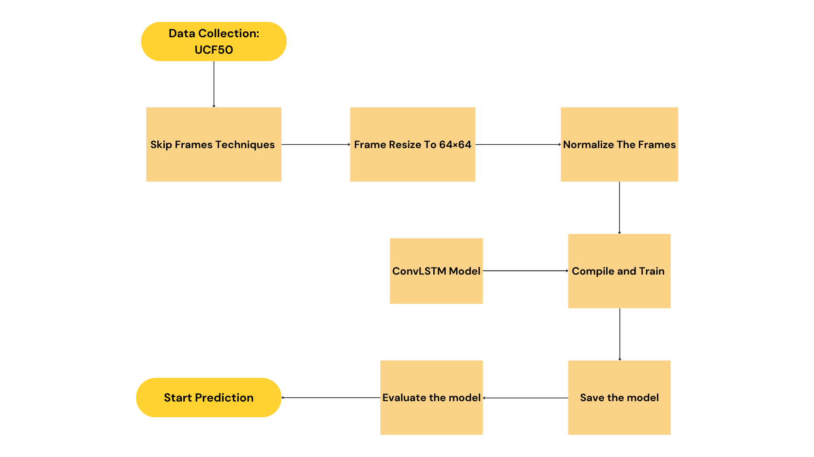
3.1 Flowchart

Slide 8
3.2 Algorithm
1. Initialize Parameters:
- Define constants: `SEQUENCE_LENGTH`, `IMAGE_HEIGHT`, `IMAGE_WIDTH`, `CLASSES_LIST`.
2. Data Preparation:
- Load and split UCF50 dataset into training and validation sets.
- For each video, extract and preprocess frames (resize, normalize, structure as `(SEQUENCE_LENGTH, IMAGE_HEIGHT, IMAGE_WIDTH, 3)`).
3. Model Construction:
- Create a Sequential model with:
- ConvLSTM2D layers (with increasing filters).
- MaxPooling3D layers.
- Dropout layers.
- Flatten and Dense layers for output.
4. Compile Model:
- Set loss function (categorical crossentropy), optimizer (Adam), and metrics (accuracy).

Slide 9
5. Train Model:
- Fit the model using training data with early stopping.
6. Predict Actions:
- Preprocess new video frames and use the model to predict actions.
7. Output Results:
- Display predicted actions for video sequences.

Slide 10
4. Implementation
4.1 Software and Dataset Details
1. Operating System:
- Windows (10 or later) or Linux
2. Python:
- Version: 3.10
- Anaconda Navigator-For creating isolated environments to manage dependencies.
3. Deep Learning Libraries:
- TensorFlow*(2.x): For building and training the ConvLSTM model.
- Keras: High-level API for building neural networks, included with TensorFlow.
5. IDE / Code Editor:
- Jupyter Notebook: For interactive coding and visualization.
- VS Code: For writing scripts and managing project files.

Slide 11
4. Additional Libraries:
- NumPy: For numerical operations and handling arrays.
-Pandas: For data manipulation and analysis.
- OpenCV: For video processing and frame extraction.
- Matplotlib: For data visualization (e.g., plotting training and validation loss/accuracy).
- scikit-learn: For any additional data preprocessing or evaluation metrics.
6. GPU:
- CUDA Toolkit (for NVIDIA GPUs) to enable GPU acceleration.
7. Dataset:
- UCF50 Dataset
8. Version Control:
- Git: For version control of your project and collaboration.

Slide 12
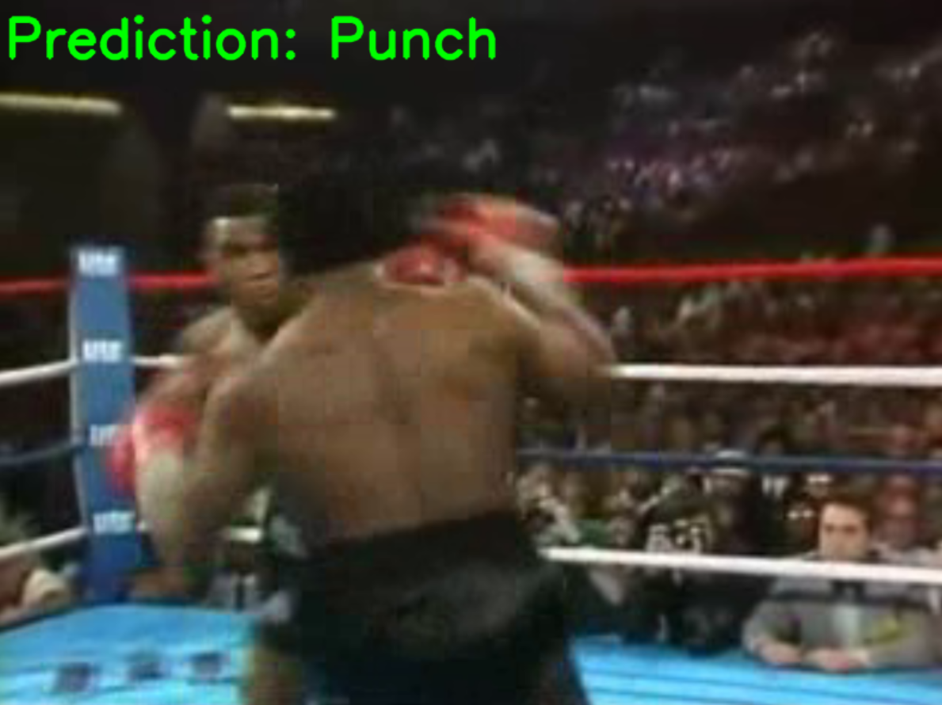
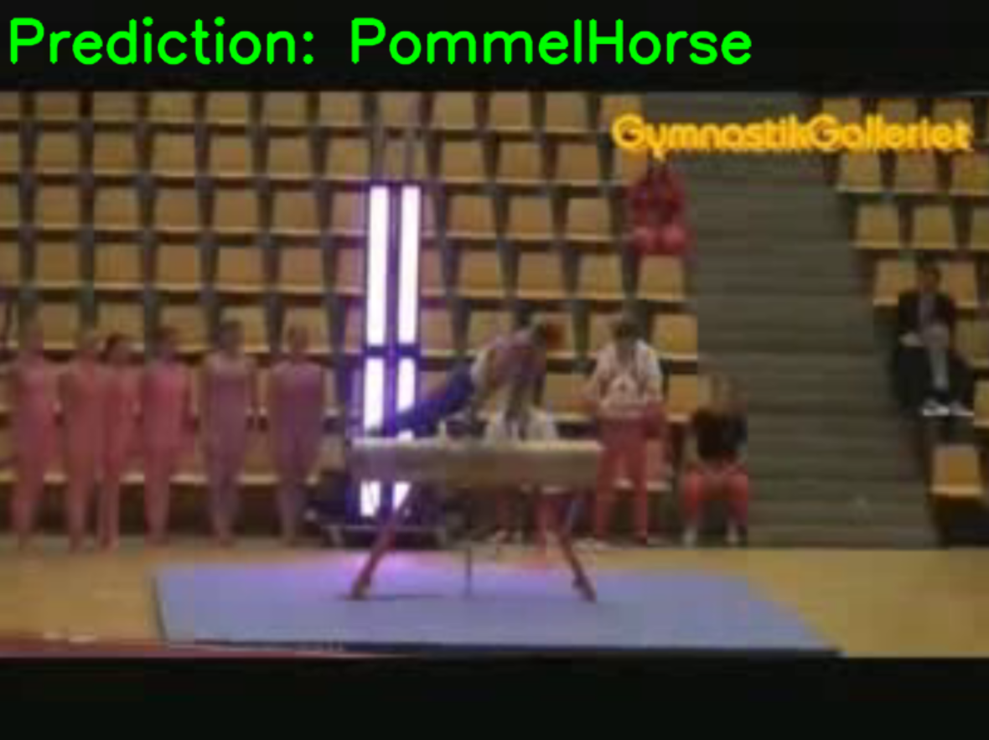
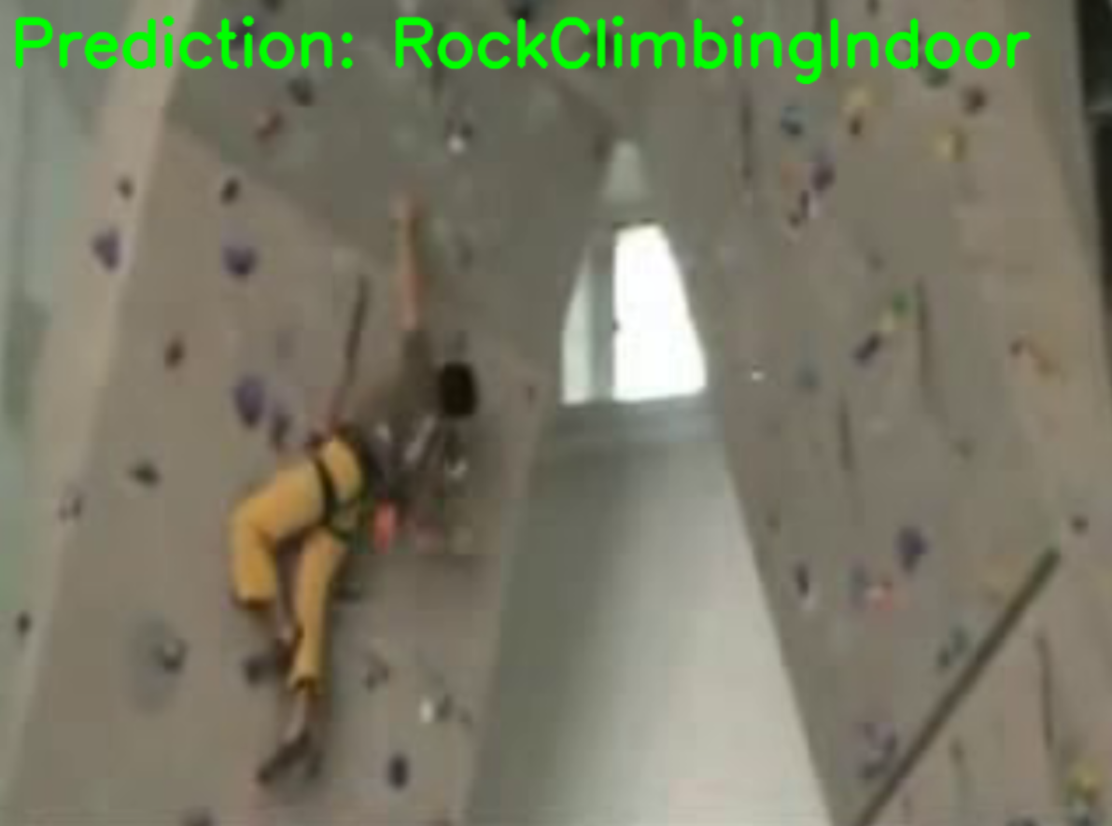
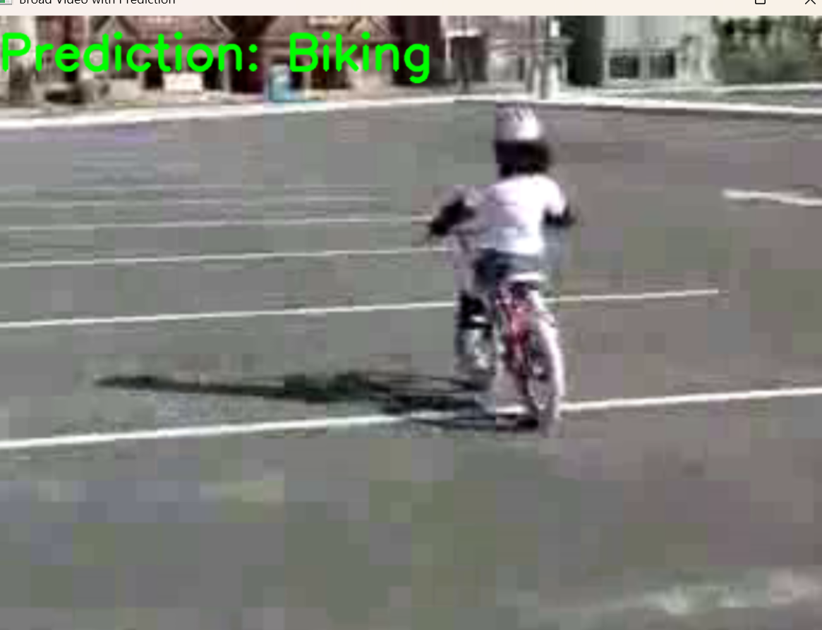
5. Results
5.1 Output Images

Slide 13
6. Conclusion
6.1 Conclusion
In conclusion, this human action recognition project successfully demonstrates how to identify and classify human activities in videos using a ConvLSTM model. By capturing the temporal dynamics of video sequences, the system achieved high accuracy in recognizing various actions. Key steps included data preprocessing, model training, and evaluation, with techniques like early stopping used to prevent overfitting. The integration of a label encoder ensured accurate predictions by mapping class labels to numerical values. Overall, this project showcases the effectiveness of deep learning in action recognition and lays the groundwork for future improvements, such as using advanced architectures or larger datasets. The potential applications in areas like surveillance and sports analysis highlight the real-world relevance of this work

Slide 14
6.2 Future Scope
In the future, we plan to develop an LRCN (Long Recurrent Convolutional Network) model trained on an abnormal activity dataset. This advanced model will enhance the recognition of unusual actions and behaviors from video sequences. Additionally, we aim to build a web application that leverages this model to predict actions captured by surveillance cameras in buildings and societies. This will improve camera surveillance systems by reducing the need for constant human attention and enabling automated detection of abnormal activities, leading to more efficient monitoring. Importantly, this system will also contribute to women’s safety by identifying suspicious activities in real-time, offering timely alerts for preventive action.

Slide 15
References
[1] X. Shi, Z. Chen, H. Wang, D.-Y. Yeung, W.-K. Wong, and W.-C. Woo,
“Convolutional LSTM network: A machine learning approach for precipitation
nowcasting,” Advances in Neural Information Processing Systems, vol. 28, 2015.
[2] S. Hochreiter and J. Schmidhuber, “Long Short-term Memory,” Neural
Computation, MIT Press, 1997.
[3] W. Zaremba, “Recurrent neural network regularization,” arXiv preprint
arXiv:1409.2329, 2014.
[4] K. K. Reddy and M. Shah, “Recognizing 50 human action categories of web
videos,” Machine Vision and Applications, vol. 24, no. 5, pp. 971-981, 2013

