Slide 1

LungAI
Interactive 3D Explainability for Chest X-Ray Diagnosis

Slide 2

PRESENTED BY
Our Team
T. Ganesh Reddy
V. Gagan Chandra Tej
Roll No: 2403A52233
Batch: 09
Roll No: 2403A52222
Batch: 09
Department of Computer Science and Engineering(AI & ML)
LungAI
2

Slide 3



The Problem
Chest X-ray is the most widely used thoracic imaging modality worldwide — low cost, fast, and low radiation. But interpretation is manual, time-consuming, and varies between radiologists. Even where AI already assists with classification, the explanation a clinician sees is a flat, static overlay with no spatial or anatomical context — nothing they can rotate, explore, or truly trust.
Globally accessible
Slow & inconsistent
Explanation gap
The most-used thoracic scan worldwide
Manual reads vary between radiologists
AI output isn't spatial or explorable
The result: patients everywhere get a fast scan, but not a trustworthy, explorable explanation of what it means.
LungAI
3

Slide 4



Existing Solutions
CNN Classifiers
Grad-CAM Heatmaps
3D Medical Visualization
CheXNet, ChestX-ray8
Standard explainability method
3D Slicer, SenseCare
Deep learning models classify multiple thoracic diseases directly from a chest X-ray with strong accuracy.
Highlights which image regions drove the model's prediction, overlaid on the original X-ray.
Interactive, rotatable 3D tools already exist and are used in medicine today.
Limitation: Gives a label and confidence score — not a reason.
Limitation: Flat 2D heatmap only — no spatial or anatomical context, nothing to rotate or explore.
Limitation: Require real volumetric CT / MRI data — not available for a simple 2D chest X-ray.
The Gap: No system bridges a 2D chest X-ray classifier's output with an interactive 3D spatial explanation — despite chest X-ray being the far more globally accessible modality.
LungAI
4

Slide 5



WHAT'S ACTUALLY NEW
Our Contribution
Not claiming a better classifier — claiming a better explainability interface.
3D-mapped explainability
A full clinical workstation
Honest scientific framing
LungAI takes a 2D CNN's prediction and Grad-CAM region, and maps it onto an interactive schematic 3D lung model the user can rotate, zoom, and explore.
Not just a model — a complete end-to-end product: upload, analysis, patient records, history, reporting, doctor login, and guest access.
The 3D model is a schematic anatomical reference, not a patient-specific reconstruction — that would require real volumetric CT data a single X-ray can't provide.
LungAI
5

Slide 6




System Architecture
Frontend
Backend
ML Pipeline
Next.js (App Router) + TypeScript
Tailwind CSS, Framer Motion
React Three Fiber / Three.js for 3D
FastAPI (Python) + SQLAlchemy
SQLite, REST API
bcrypt authentication
PyTorch, DenseNet-121 backbone
Transfer learning from ImageNet
Grad-CAM for explainability
Deployment
Docker Compose — containerized frontend + backend
Dataset
NIH ChestX-ray14 — 112,120 images, 14 disease classes, multi-label
LungAI
6

Slide 7


HOW IT WORKS
The 3D Explainability Pipeline
1
2
3
4
5
Upload
Classify
Localize
Map
Render
Chest X-ray uploaded
DenseNet-121 classifies across 14 disease classes (multi-label)
Grad-CAM generates a 2D activation heatmap for the top prediction
Activation centroid mapped to 1 of 6 anatomical zones (L/R × upper/mid/lower)
Zone rendered as an interactive 3D marker with an explorable annotation
Result: the clinician doesn't just see where the model looked — they see it placed in 3D anatomical space, and can explore it.
LungAI
8

Slide 8
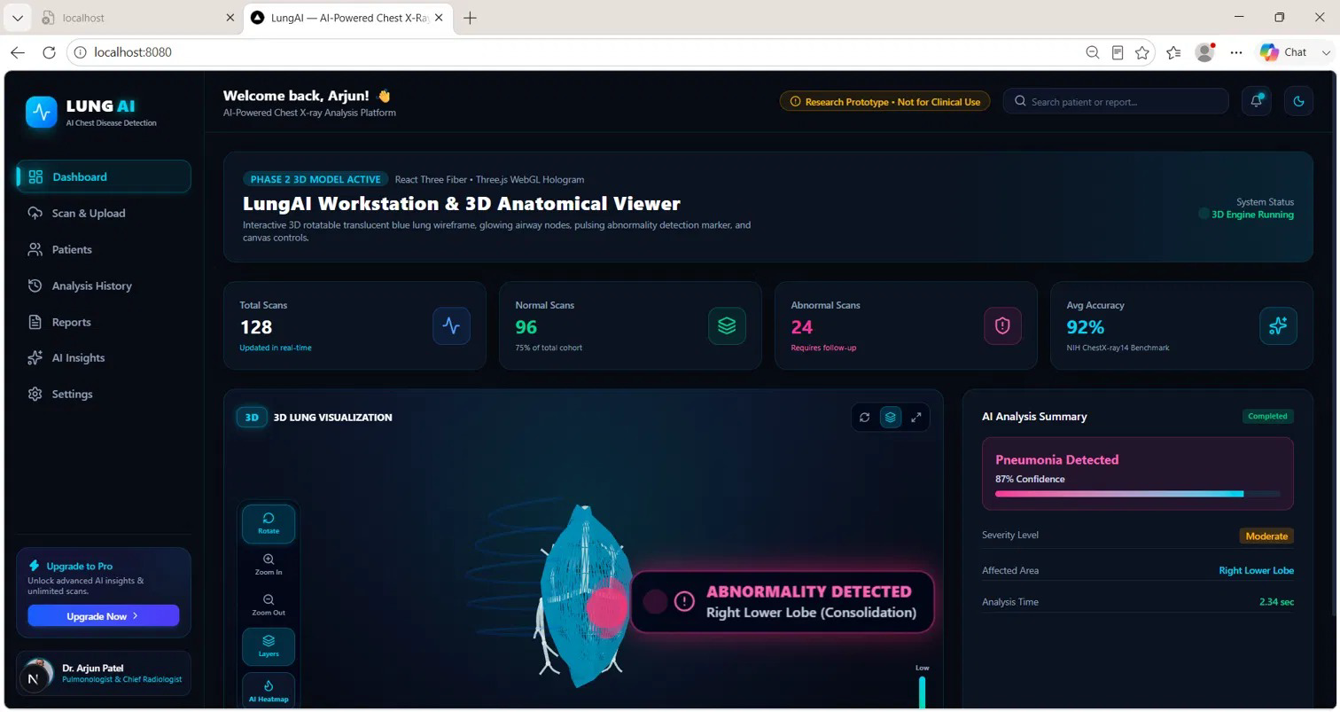
Interface
8

Slide 9
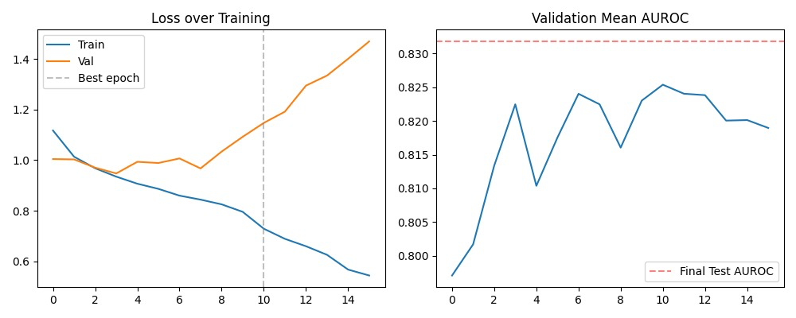
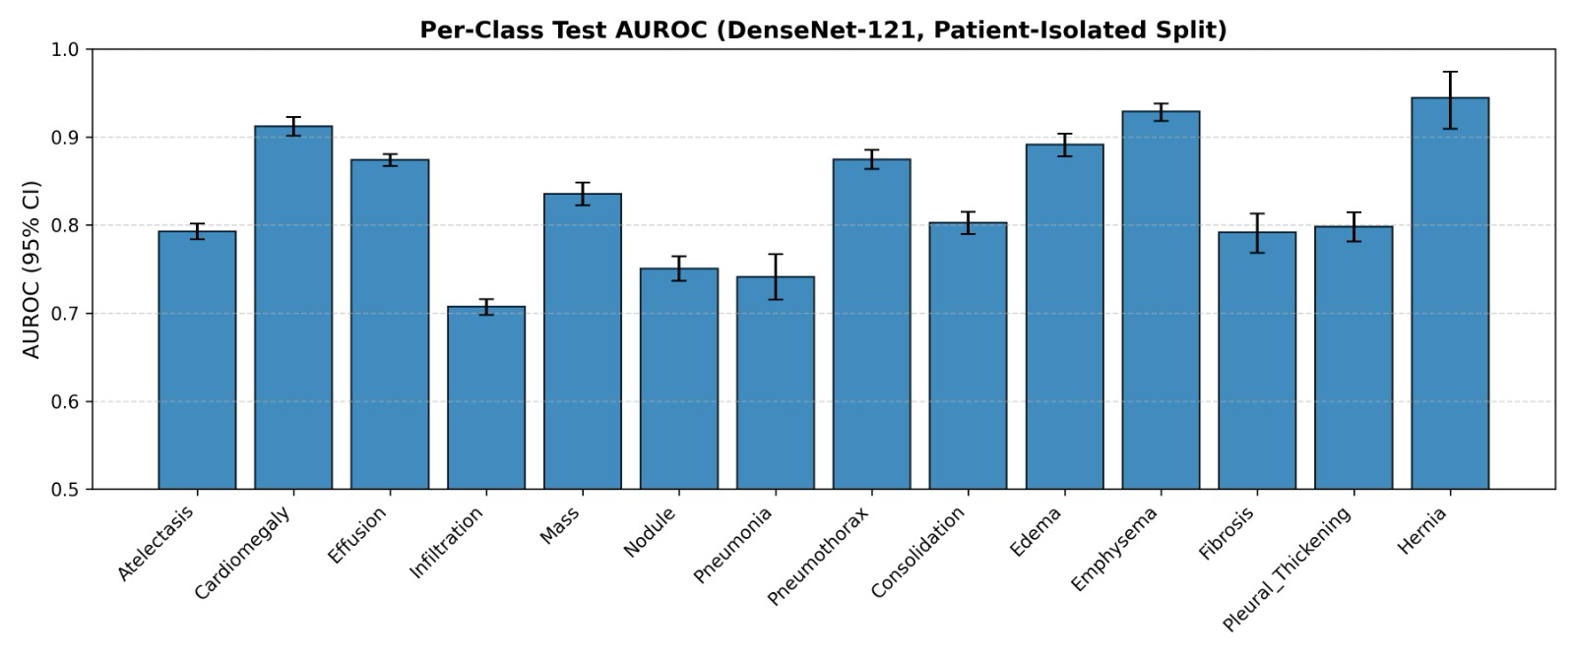
Results
LungAI
11

Slide 10



Limitations
Schematic, not patient-specific
Single train/val/test split
The 3D lung model is a schematic anatomical reference, not a patient-specific volumetric reconstruction.
Matches the baseline papers being compared against, but is not k-fold cross-validation or multi-seed averaging, due to compute constraints on free-tier hardware.
No clinician usability study yet
Research / portfolio prototype
No formal study yet comparing the 3D interface to flat 2D heatmaps.
Explicitly not intended for real clinical diagnostic use.
LungAI
12

Slide 11
Future Work
Multi-seed statistical validation of the reported result
1
Clinician usability study comparing 3D-referenced explanation vs. flat 2D heatmap
2
Independent reproduction of baseline methods for a strictly controlled comparison
3
Refine 2D-to-3D zone mapping precision (e.g. via lung-field segmentation)
4
Real anatomically-accurate 3D lung geometry (current version is a stylized placeholder)
5
LungAI
13

Slide 12
Conclusion
LungAI demonstrates that spatial, interactive 3D explainability for a standard 2D chest X-ray classifier is technically feasible — and can be integrated into a complete, real clinical workstation interface, addressing a genuine, currently unoccupied gap between saturated 2D Grad-CAM literature and CT-dependent 3D visualization tools.
The trained classifier achieves a macro-averaged test AUROC of 0.8318, comparable to established literature baselines.
LungAI
14

Slide 13
Thank You

