Slide 1



Sales Data Analysis
Final Project | Gagan Kumar | 29 Apr 2025

Slide 2
Project Overview
Objective:
Analyze transaction and response data to identify customer spending behavior.
Data Sources:
- Transactions dataset (customer, date, amount)
- Response dataset (marketing response: 0 or 1)

Slide 3
Data Cleaning
Key Steps:
- Removed missing/duplicate records
- Converted dates to datetime format
- Standardized numeric types
- Joined datasets on customer_id

Slide 4
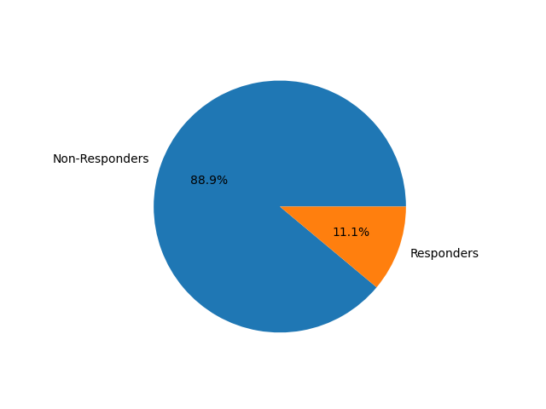
Customer Insights
Key Metrics:
- Total Transactions: 124,969
- Avg. Transaction: ₹64.99
- Responders: 13,842 (11.1%)
- Non-responders: 111,127

Slide 5
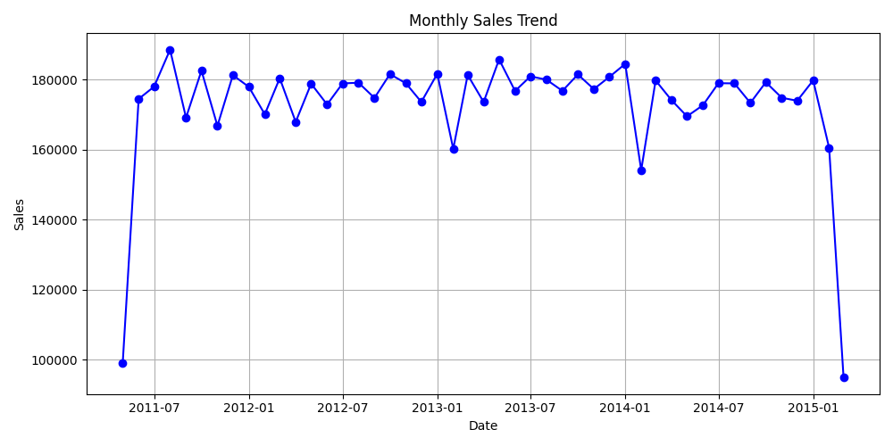
Monthly Sales Trend

Slide 6
Top 10 Customers
Customer ID | Total Spent (₹)
CS4424 | 2933
CS4320 | 2647
CS5752 | 2612
CS4660 | 2527
CS3799 | 2513
CS5109 | 2506
CS4074 | 2462
CS3805 | 2453
CS4608 | 2449
CS5555 | 2439

Slide 7
Recommendations
1. Target high-value customers (Top 10 spent ₹2,439–2,933)
2. Increase responder engagement (11% response rate)
3. Align promotions with sales trends
4. Monitor monthly fluctuations

