Slide 1


V.S.B. COLLEGE OF ENGINEERING TECHNICAL CAMPUS
CODE
TITANS
Approved by AICTE-New Delhi, Affiliated to Anna University -Chennai, Accredited with A+ Grade by NAAC, NBA Accredited Courses.
SMART HARVEST ADVISOR
Problem Statement ID – SIH25030
Problem Statement Title – AI Crop Recommendation
Category – Software
Theme – Agriculture
Team name – CODE TITANS
Team members :
  ASHA DAVID S J (TEAM LEADER)
  EVANGELIN VINISHA R
  DINESH A
  GAGAN B
  DHARSAN K
  AJAY R
MENTOR:
  Narmadha M.D
  Department: CSE

Slide 2

CODE
TITANS
AgriCrop
  IDEA/Solution:
  Implementation online platform offering expert agricultural guidance.
  Synthesizes data to provide personalized recommendations across the full crop lifecycle.
  Analyzes specific land conditions
  of individual farmers.
  Recommends the most suitable and profitable crops for cultivation.
  Empowers farmers to make strategic planting decisions.
  Aims to maximize harvest potential and boost overall productivity.
Problem Resolution :
Our Solution: Turning Data into Decisions
From Guesswork to Precision 🎯 Uses your farm's unique soil and weather data to recommend the perfect crop, eliminating uncertainty.
Boosts Profit & Reduces Risk 📈 Helps you plant smarter to maximize your harvest, increase income, and lower financial risks.
Expert Advice, Simplified 🧑‍💻 Puts a digital farming expert in your pocket, offering clear, actionable guidance through an easy-to-use platform.
Unique Value Propositions(UVP):
We analyze local market prices to suggest crops that will earn you the most profit, going beyond just what will grow well.
Access 24/7 expert agricultural advice in an easy-to-use platform (multilingual) right on your phone, making strategic farming simple for everyone.
Get recommendations based on the unique soil and water data of your specific field.

Slide 3
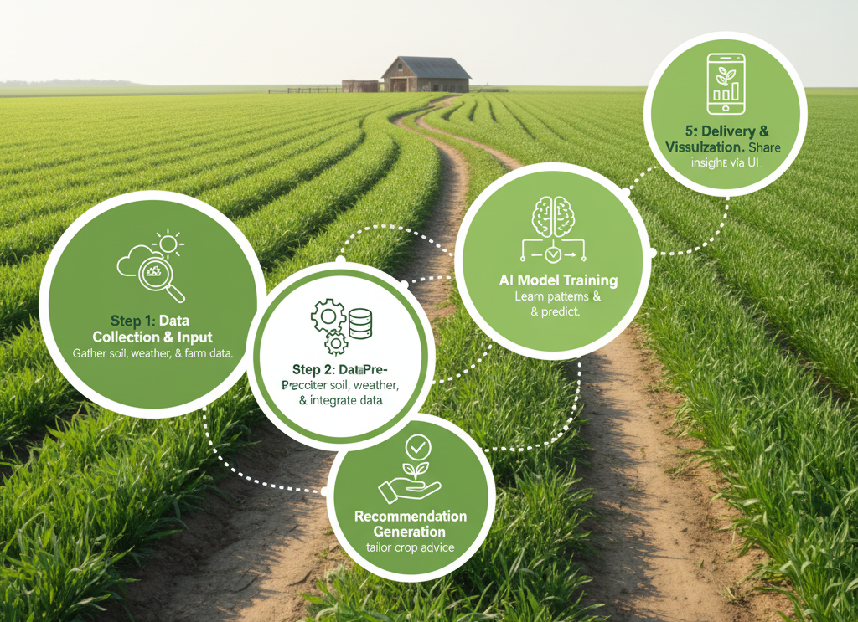
TECHNICAL APPROACH
CODE
TITANS
Harness hyper-local soil & weather insights
Power predictions with smart AI models
Deliver instant crop advice via fast APIs
Engage farmers with intuitive, multilingual UI
Visualize data for confident crop choices

Slide 4
FEASIBILITY AND VIABILITY
CODE
TITANS
FEASIBILITY
  Expected prediction accuracy is up to 97%.
  Real-time monitoring and personalized recommendations
VIABILITY
  Increases crop yields and optimizes resource use.
  Improves crop health and reduces losses.
  Enhances profitability.

Slide 5
IMPACT AND BENEFITS
CODE
TITANS
AI-based crop recommendation is essential to
  improve yield
  resource efficiency
  farmer income
Because it enables data-driven, precise decision-making that traditional methods lack.
Key Benefits :
  Enhanced Crop Yields and Profitability
  Risk Management
  Real-Time Adaptability and Decision Support
  Market and Price Forecasting
  Resource Optimization and Sustainability
  Accessibility and Ease of Use

Slide 6
RESEARCH AND REFERENCES
CODE
TITANS
Use of environmental data like soil type, rainfall, temperature, and humidity for accurate recommendations.
Adoption of Explainable AI (XAI) to make crop suggestions transparent and farmer-friendly.
Focus on sustainable agriculture and climate-resilient crop planning.
References :
  AI-based Smart Crop Recommendation System for Sustainable Agricultural Production(August 07, 2025) - Aarthi S , Manimegalai S , Sakthivel R.
  Artificial intelligence in agriculture: Advancing crop productivity and sustainability
  (28 February 2025) - Nazish Aijaz , Muhammad Salman Pathan.

