Slide 1
AI Cold Email Generator Pro
Enterprise RAG + Local LLM Email & Resume Automation
Project Overview & Architecture Explanation

Slide 2
Motive of the Project
Why build the AI Cold Email Generator?
- Personalization at Scale: Writing tailored cold emails and resumes manually is extremely time-consuming.
- Data Privacy: Using public cloud LLMs for proprietary company data or personal PII poses severe security risks.
- Cost Efficiency: API costs for massive email campaigns can skyrocket. Local LLMs (Ollama) eliminate these ongoing expenses.
- Contextual Accuracy (RAG): Generic LLMs hallucinate. By indexing your specific PDFs and DOCXs (RAG), the AI writes emails containing factual, tailored information about your exact product or job description.

Slide 3
Project Overview & Key Features
What is the system capable of?
- Project Management: Organize campaigns into isolated workspaces.
- Dynamic Knowledge Base: Upload PDF, DOCX, and TXT files per project.
- Retrieval-Augmented Generation (RAG): FAISS vector store combined with HuggingFace embeddings for precise context retrieval.
- Local AI Generation: Ollama (Gemma 2b model) processes context entirely on your machine to guarantee zero data leakage.
- Beautiful UI: Built with React 19, Tailwind CSS, Framer Motion, and Shadcn UI for a premium enterprise feel.
- Secure Authentication: JWT-based secure login and session management.

Slide 4
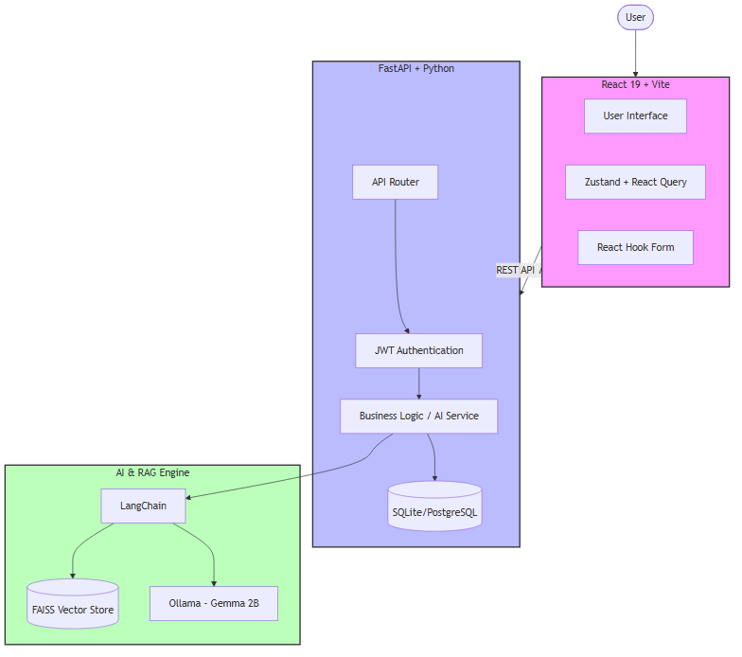
System Architecture
This diagram illustrates the complete end-to-end flow of the application:
- Frontend (React) communicates with Backend (FastAPI) via JWT authenticated REST APIs.
- Backend acts as the orchestrator, communicating with the SQLite/PostgreSQL Database.
- The AI Engine is powered by LangChain, utilizing FAISS for RAG and Ollama (Gemma) for text generation.

Slide 5
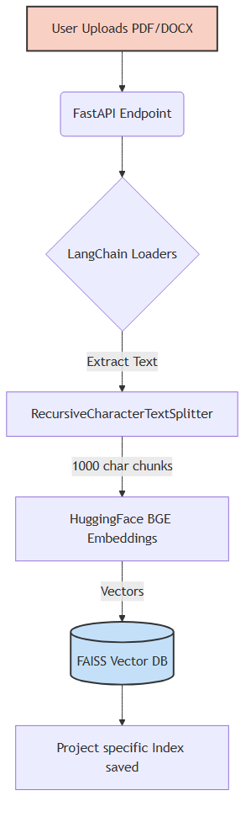
RAG Knowledge Ingestion Flow
How does the AI securely 'read' and memorize documents?
- Documents (PDF, DOCX) are parsed via LangChain loaders.
- Text is chunked (1000 characters) to ensure the embedding model can process it.
- HuggingFace BGE Embeddings convert text chunks into mathematical vectors.
- Vectors are saved locally to a FAISS index tagged by project for future retrieval.

Slide 6
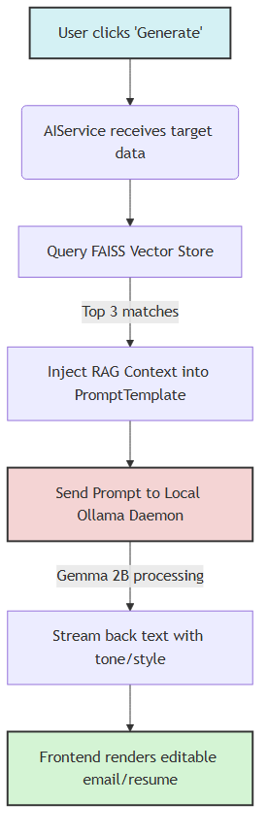
AI Content Generation Flow
How is a highly-tailored email generated?
- User requests an email by providing target company details and tone.
- The system retrieves the top 3 most relevant document chunks from the FAISS vector database.
- This contextual data is injected into a strict Prompt Template alongside the user's instructions.
- The local Ollama daemon (Gemma 2B) generates the email and streams the result back to the UI.

Slide 7
Backend Execution Flow (Deep Dive)
How does the backend process the generation request?
1. main.py intercepts the request (e.g. POST /api/emails/generate).
2. JWT Middleware validates the user's token.
3. Pydantic strictly validates the incoming JSON payload.
4. The AIService queries the local FAISS index for RAG context.
5. LangChain orchestrates the prompt assembly and local LLM execution.
6. The generated content is saved to the DB and returned to the client.

Slide 8
Frontend Experience Flow (Deep Dive)
How does the UI deliver a seamless user experience?
1. Zustand manages global application state (like User Auth).
2. React Hook Form + Zod provide instant, rigorous form validation.
3. TanStack React Query handles data fetching, caching, and background syncing.
4. Axios interceptors automatically attach JWT tokens to all requests.
5. Framer Motion provides smooth skeleton loaders during the AI generation process.

Slide 9
Conclusion
Thank You for your time!
Summary:
- A complete enterprise solution for automated cold outreach.
- 100% Data Privacy via Local AI.
- Highly tailored and factual emails via RAG.
Any Questions?

