Slide 1
epeigon
By- CODE CORPS
Team members:
Divij Kathuria
Gagan Chaudhary
Madhav Sharma
Harshit Guatam

Slide 2
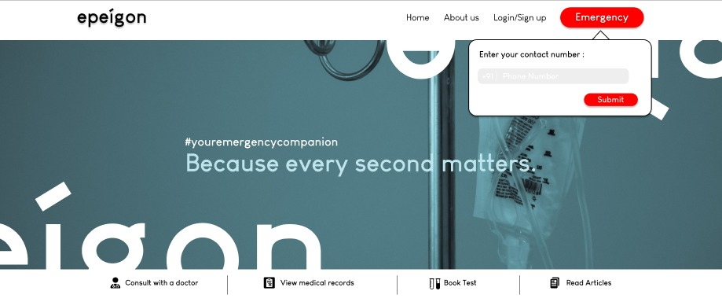
What is epeigon?
We are attempting to create a one stop solution for quick and decisive health services. Using modern technologies such as HTML,CSS,Figma and JS
We send users location to all nearby hospitals during an emergency and provide video call with certified professionals to assess the situation and provide users with adequate help.
We also help users to book appointments during nonemergency situations
Users can also collect donations from other users for their needs

Slide 3
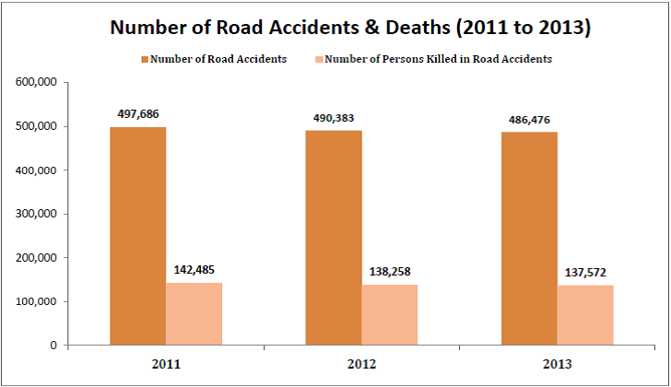
Solving India’s decades old healthcare infrastructure problem
There are 17 deaths on Indian roads every day. In most of these cases delayed first response was a decisive factor in their survival. Our help will help first response teams to reach victims significantly faster thanks to our 1 step emergency services.
Our app also helps rural Indians with lack of developed hospitals to receive remote consultancy from certified professionals and that too at minimal costs.
India also has a huge misinformation problem. Our sites provides free articles to help educate the masses.

Slide 4
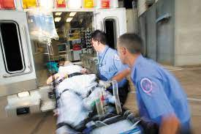
Primary Demographic
Our app helps all kinds of people who have any sort of medical emergency.
It especially helps rural Indians who lack information and resources about healthcare.

Slide 5

Application of our idea towards the problem statement
Our site helps increase the life expectancy of the patient by reducing the time that it takes an ambulance to reach the spot.
It helps in reducing the time taken by hospitals in formalities and thus help the doctors get ready quickly.
#EverySecondMatters

