Slide 1

Forecasting Students count visiting Feed-A-Bull Pantry at USF
Presented By:-
Chandni Kumari
Raghav Khurana
Venkata Sai Gagan Deep Alusuri
Lakshmi Preetam Gupta Dogiparthi

Slide 2
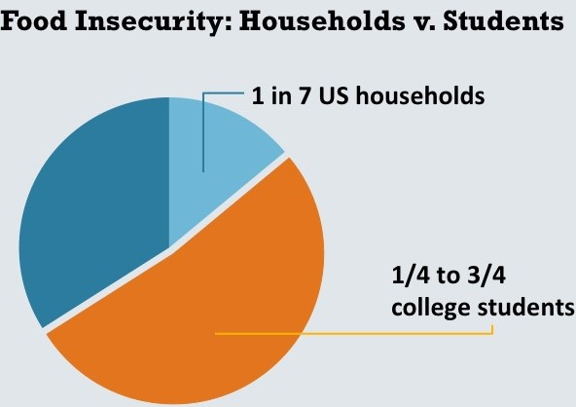
Business Objectives
Motivation
To predict the number of students who will be visiting weekly to Feed-A-Bull.
To provide data-driven insights by comparing the statistics pre-pandemic and post-pandemic data.
To help with staffing according to number of students forecasted.

Slide 3
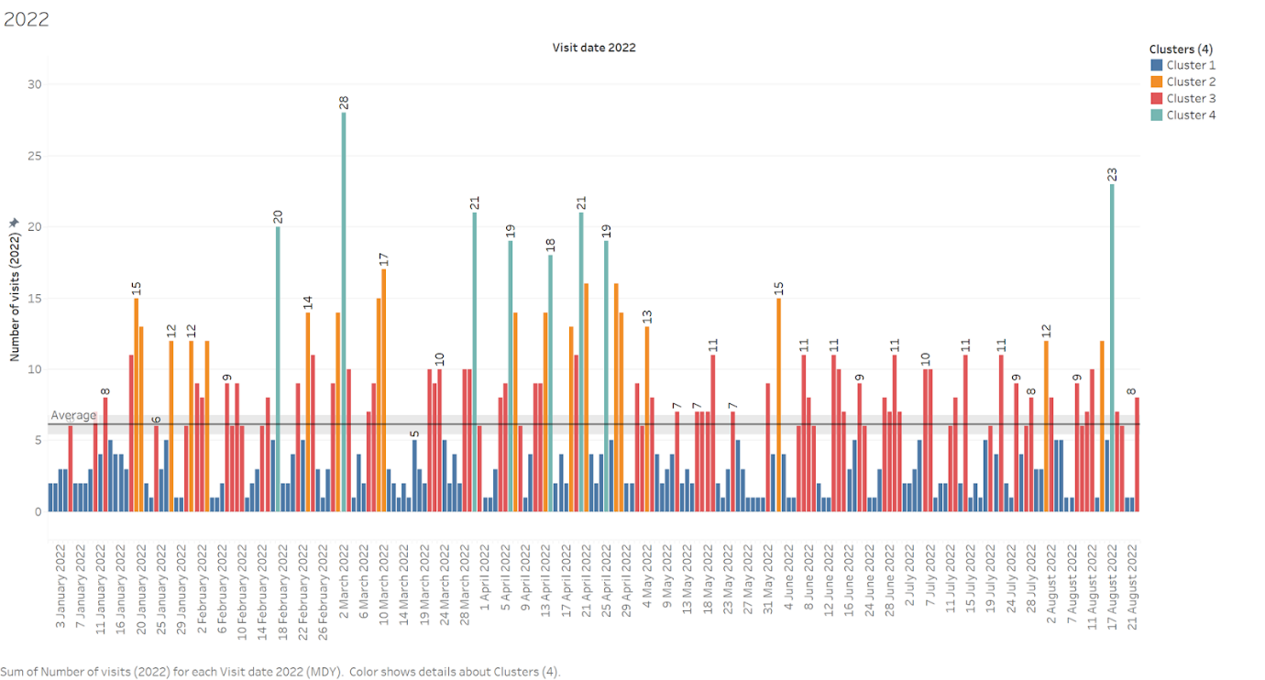
Data Features
Collected the survey data from the Fall to Summer semesters from the year 2018 to 2022(Till 22nd August) from Feed-A-Bull Food Pantry records.
A sample bar graph of the data collected in the year 2022 is shown in below Graph.
Survey data from 2018-22.

Slide 4
Data
Data Cleaning
Treating NAs., handling duplicates,labeling categorical data
Removing rows that were completely blank.
Data Cleaning
Data Transformation
Created a Time Series dataset of 5 years.
Final merged dataset has 10 variables.
Data Transformation
Prediction Model
Time Series Analysis using the Prophet package to forecast the number of visitors
Prediction Model
Results
Results from exploratory data analysis
Results from Time Series containing several seasons of historical data showed strong seasonal effects.
Results

Slide 5
Methodology
Exploratory Data Analysis
Cleaned the data and considered a few key variables that were common across all the files for this analysis.
Seasonality
There is no significant long-term trend throughout these years.
March and April experience a spike in the number of visitors, followed by a gradual decline.
August and September are the busiest months.
Weekly Trends
Observed definite peaks during Wednesdays, followed by a slight decline during Thursdays, which seem to be the busiest days of the pantry. After a slight fluctuation, these graphs level off after Fridays, with Saturdays observing the least number of visitors.

Slide 6
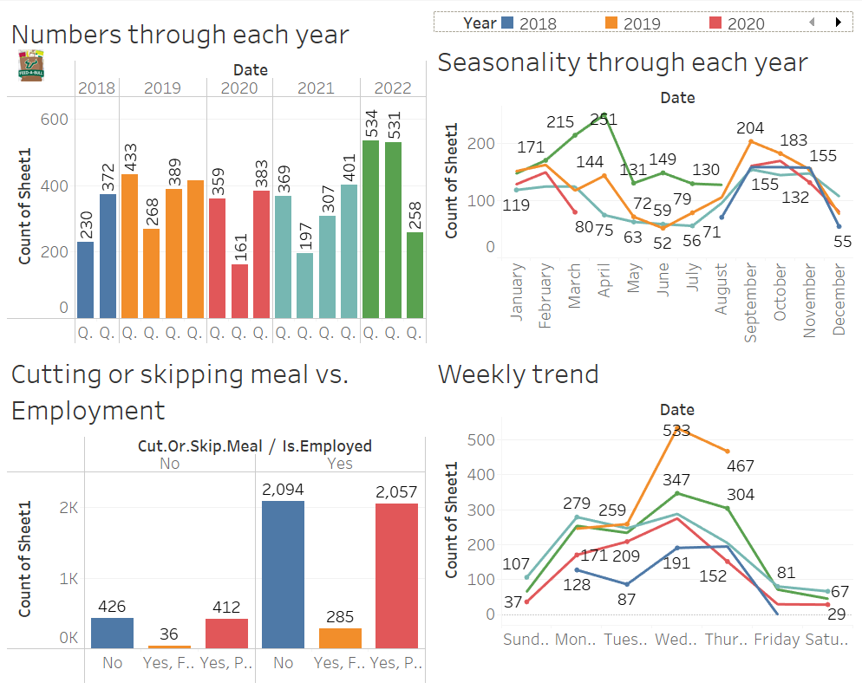

Slide 7
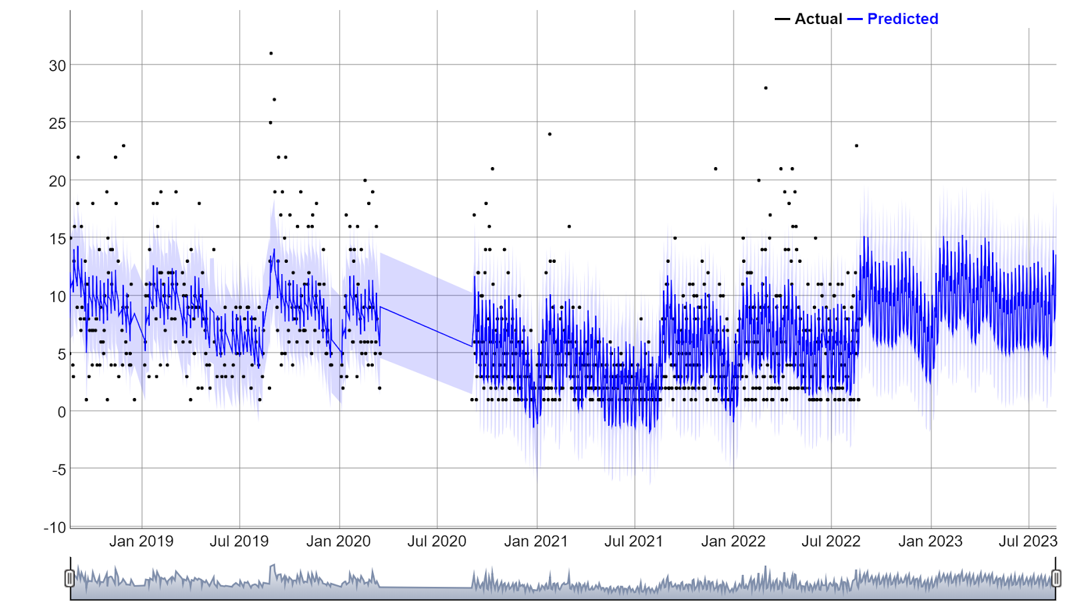
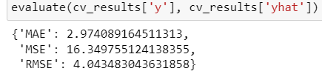
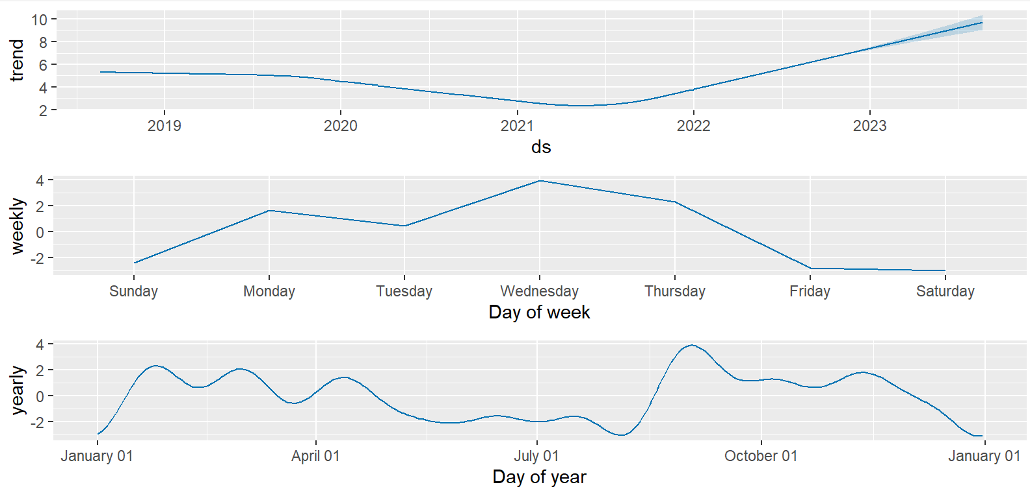
Results and Conclusion
Time Series Analysis using Prophet
The results from exploratory data analysis containing several seasons of historical data showed strong seasonal effects, prophet was the ideal tool for predicting changes in trends of this data.
Model Evaluation Results: using Prophet cross validation
Conclusions and Implications:
Further optimization of the model is required.
Identify change points and provide it to the model.
seasonality_mode = additive i.e. a linear trend of the form Yt = Tt +St+ Rt. Indicates linear trend but the seasonality in the data is multiplicative.Hence the model must accommodate additive trend and multiplicative seasonality.

Slide 8
FOUR MONTHS PLAN
Tune the parameters of the model.
In the survey forms, bring back the question of employment and ask whether food is provided during their part-time job.
Track items and amount of items for every week.

