Slide 1

Causes of disparities in life expectancy among counties in USA

Slide 2

Team Dark Forest
Members
•Chandan Patel
•Manoj Arasada
•Raghav Khurana
•Venkata Sai Gagan Deep Alusuri

Slide 3

Problem Statement
• Estimate the impact of each factors on life expectancy for States and see how they vary across the United States.
• Compare States which have a lower life expectancy with States that have a higher life expectancy and produce recommendations on how lower life expectancy states can improve.

Slide 4
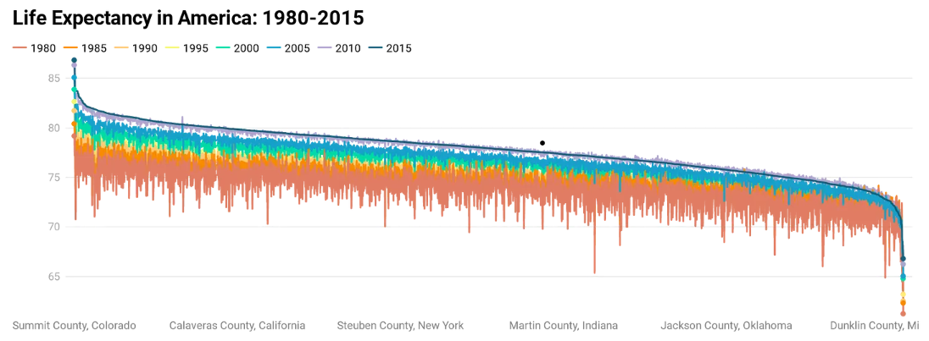
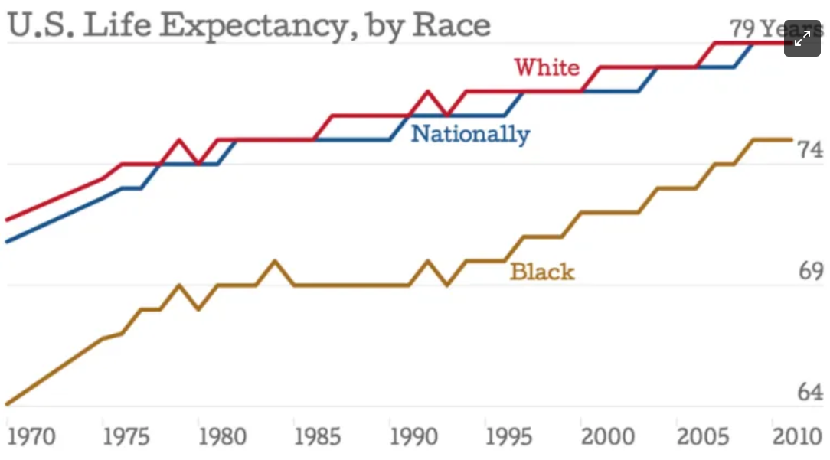
Problem Significance
The disparity in life expectancy between States in America is at its widest point in the past 40 years. Most Americans will live to be 78 years old, but if they were born in different areas, they may pass away more than ten years sooner.
The average lifespan has typically grown over the past 40 years as a result of advancements in medicine, society, and quality of life; however, many Americans have not benefited from this trend. As a result, some Americans are actually dying much sooner than they used to. Even though life may be unequal, death shouldn't be.
There is a wide disparity in Life expectancy among States is quite evident from the graphic below.
https://substackcdn.com/image/fetch/f_auto,q_auto:good,fl_progressive:steep/https%3A%2F%2Fbucketeer-e05bbc84-baa3-437e-9518-adb32be77984.s3.amazonaws.com%2Fpublic%2Fimages%2Feb553faf-565e-477b-948f-f746b7480c81_1240x1042.png

Slide 5

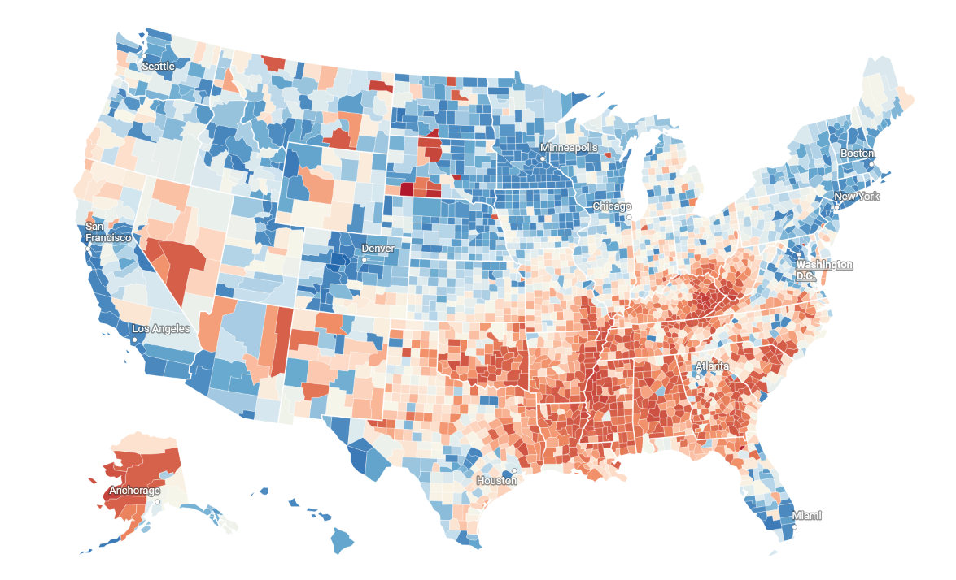
Disparity in life expectancies in the United States
Image Source: https://americaninequality.substack.com/p/life-expectancy-and-inequality

Slide 6
Prior Work
Papers published

Slide 7
Causes/Predictors for Life expectancy from research Papers
Geographic area (e.g., region, urban-rural status), socioeconomic status (e.g., income, education), household structure (e.g., family type, household size), and household composition (e.g., age and sex of household members)
Economic factors: Gross domestic product (GDP) per capita, income inequality, and poverty rates.
Health factors: Access to health care services, vaccination coverage, and HIV prevalence.
Demographic factors: Age structure, fertility rates, and literacy rates.
Environmental factors: Water and sanitation facilities, air pollution, and access to clean energy.
Political factors: Political stability, government effectiveness, and corruption levels.​
Income, Pollution, Obesity, Smoking, %Black, %Hispanic, Median age, %over 65 yrs and indicator variables for the nine census division areas.​
Age group, Total county population, median income quartile indicators, population density quartile indicators, proportion of individuals with a 4-year degree, PRCSDA status and census region indicators.

Slide 8
Title | Predictors | Models | Key Findings
Premature mortality in the United States: the roles of geographic area, socioeconomic status, household structure, and household composition | The predictors used in the study include geographic area (e.g., region, urban-rural status), socioeconomic status (e.g., income, education), household structure (e.g., family type, household size), and household composition (e.g., age and sex of household members) Y – Life expectancy (LE) | logistic regression models, Cox proportional hazards models, and random-effects Poisson regression models | Mortality rates vary geographically in the US, with certain regions having higher rates. Lower socioeconomic status is strongly associated with premature mortality. Household structure and composition also affect mortality rates, with non-traditional structures and living alone being linked to higher rates. The effects of household structure on mortality are largely mediated by socioeconomic status. Geographic area, socioeconomic status, and household structure together explain a large portion of the variation in premature mortality rates in the US.
Determinants of Life Expectancy in Developing Countries | Economic factors: Gross domestic product (GDP) per capita, income inequality, and poverty rates. Health factors: Access to health care services, vaccination coverage, and HIV prevalence. Demographic factors: Age structure, fertility rates, and literacy rates. Environmental factors: Water and sanitation facilities, air pollution, and access to clean energy. Political factors: Political stability, government effectiveness, and corruption levels. Y – Life expectancy (LE) | It primarily uses descriptive statistics and correlation analysis to identify the determinants of life expectancy in developing countries | The results suggest that factors such as access to safe water, education, per capita income, and health expenditure are positively associated with life expectancy. In contrast, infant mortality rates, prevalence of HIV/AIDS, and the proportion of the population living in urban areas are negatively associated with life expectancy. The study highlights the importance of investing in public health infrastructure, education, and poverty reduction programs to improve life expectancy in developing countries
How Important Are Health Care Expenditures for Life Expectancy? A Comparative, European Analysis by Wim J.A. van den Heuvel PhD | Does not focus on specific predictors, but instead examines the relationship between health care expenditures and life expectancy in European countries. The paper compares life expectancy and health care expenditures across 27 European countries, and also looks at other factors that may affect life expectancy, such as income and education Y – Life expectancy (LE) | The paper uses multiple linear regression models and structural equation modeling to analyze the data | The study compares the relationship between health care expenditures and life expectancy across 27 European countries. The results show a positive association between health care expenditures and life expectancy, but the relationship is weak and non-significant in some countries. Other factors such as socioeconomic conditions, lifestyle, and environmental factors have a stronger impact on life expectancy. The study suggests that investing in health care alone may not be enough to improve life expectancy, and a comprehensive approach that addresses social determinants of health is needed
Quantifying and explaining variation in life expectancy at census tract, county, and state levels in the United States | Geographic level: census tract, county, and state Socioeconomic factors: poverty rate, median household income, education level, race/ethnicity, and employment rate Health behaviors: smoking rate, physical inactivity, and obesity rate Healthcare access and quality: primary care physician rate and preventable hospitalization rate Y – Life expectancy (LE) | The study used a hierarchical linear regression model that included three levels: census tract, county, and state | The study examines life expectancy variation across US regions and finds socioeconomic factors, race/ethnicity, and health behaviors as significant predictors. Income, education, and unemployment are strong predictors at all levels. Racial and ethnic disparities exist, along with health behavior impact on life expectancy. The study underlines the need for policies and interventions to address social determinants of health and reduce disparities
Social determinants of health inequalities International Centre for Health and Society, University College London, 1–19 Torrington Place, London WC1E 6BT, UK Prof Michael Marmot | Social and economic factors, such as income, education, employment, and housing. Political and social factors, including government policies and social norms. Structural factors, such as discrimination, racism, and gender inequality. Y – Life expectancy (LE) | The paper is a literature review and discussion of the social determinants of health inequalities | There is a strong association between social determinants such as income, education, and occupation and health outcomes, including life expectancy and mortality rates. Health inequalities are not just a result of individual choices and behaviors but are shaped by broader social, economic, and political factors. Interventions and policies aimed at reducing health inequalities need to address the social determinants of health, such as poverty, social exclusion, and unequal access to education and employment opportunities. The paper advocates for a broader approach to health policy that includes not just health care interventions but also upstream interventions that address the social determinants of health
Impact of Socio-Health Factors on Life Expectancy in the Low and Lower Middle-Income Countries | Income, Education, Health Expenditure, Physicians Density, Sanitation, Clean Water Access, Malnutrition, HIV/AIDS, Tuberculosis, Malaria, Cardiovascular Diseases Y – Life expectancy (LE) | Multiple Regression Models | The study found that income, education, health expenditure, physician density, sanitation, and access to clean water were positively associated with life expectancy in low and lower-middle income countries. On the other hand, malnutrition, HIV/AIDS, tuberculosis, malaria, and cardiovascular diseases were negatively associated with life expectancy. The authors suggest that interventions aimed at improving education, healthcare access, and sanitation can have a positive impact on life expectancy in these countries. Additionally, addressing the burden of communicable diseases can also improve life expectancy.

Slide 9
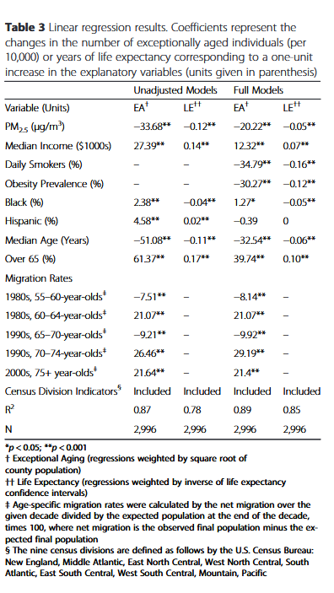
Title | Methods | Models |  | Key Findings
Countervailing effects of income, air pollution, smoking, and obesity on aging and life expectancy: population-based study of U.S. Counties Objective - This study aimed to identify how policymakers can implement the best policy to increase life expectancy but do it at the minimal tradeoff. For example, if increased life expectancy is linked to a better economic market and life expectancy is lowered due to more air pollution, policymakers need to know how much of a tradeoff there is between increasing and reducing life expectancy to make the right decision since increasing economic market can come at the expense of higher air pollution. | They used a cross-sectional study design applied to county level data to analyze how Index of Exceptional Aging and Life Expectancy are associated with Income, Obesity, Smoking and Air pollution using Linear regression, generalized additive models, and bivariate thin-plate spline smoothers. Models Used – Population Weighted Linear Regression Y – Life expectancy (LE) / Exceptional Aging (EA) X variables – Income, Pollution, Obesity, Smoking, %Black, %Hispanic, Median age, %over 65 yrs and indicator variables for the nine census division areas. Models for nonlinear relationships – Generalized Additive Model with Spline Smooth functions X variables – same as above except the census divisions. 2 types of models used under this –Adjusted (included smoking and obesity) + Unadjusted (without Smoking and Obesity) To examine tradeoffs between air pollution and income on exceptional aging, bivariate thin plate smoothing splines of both these variables were also estimated for both the adjusted and unadjusted model. The same 3 techniques were also applied to estimate the county level life expectancy. | EA – Index of Exceptional Aging LE – Life expectancy From the models, we can see the tradeoff the writers were referring to. In their analysis, it was found that "Given the estimated coefficients, a 1 % decrease in smoking corresponds to approximately the same in- crease in EA as a 1.7 μg/m 3 reduction in PM2.5 , a $2,800 increase in median income, or a 1.1 % decrease in obes- ity. For LE, a 1 % decrease in smoking corresponds to approximately the same increase in LE as a 3.2 μg/m3 reduction in PM 2.5 , a $2,300 increase in median income, or a 1.3 % decrease in obesity (results from fully adjusted models using all observations)." This way, they were able to paint a cohesive picture with impacts that each variable is having and how the complex interconnected nature of each variable's affect needs to be accounted for. The results from this model are informative but perhaps fall short in value compared to results from the flexible non linear results. |  | An interesting finding from the study was that policy on one factor alone like reducing air pollution isn't a strong enough tool to increase life expectancy. When comparing the tradeoffs with the other variables, This study found that a 10 μg/m 3 reduction in PM2.5 and a $5,000 increase (adjusted for inflation, base year 2000) in real, per-capita income corresponded to the same increase in Life expectancy. Additionally, they also found that while greater income does increase life expectancy, a bend in the relationship between income and longevity occurs at about 40,000$, indicating that beyond this level increases in income are associated with smaller increases in longevity. Since this study aggregates the county level data, they are not able to capture the individual level effects from each county. Therefore, if the results are influenced or skewed by a subset of the counties, this effect would not be captured in study's analysis. Given that this study is also trying to capture the correlated tradeoff's between the variables, this is an effective tool for policymakers to make sure that interventions in one aspect of improving life expectancy do not come at the cost of other aspects negative the progress made by the positive interventions.

Slide 10
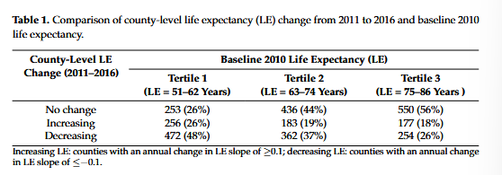
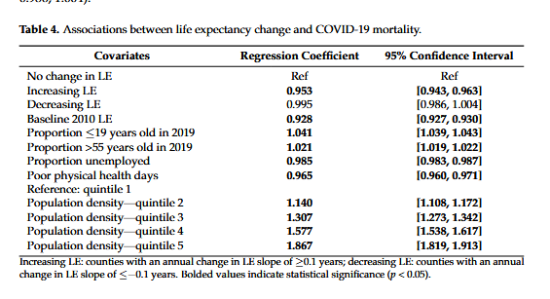
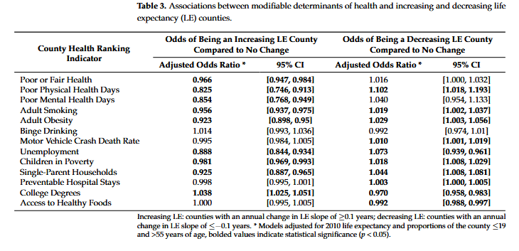
Title | Methods | Models |  | Key Findings
County-Level Life Expectancy Change: A Novel Metric for Monitoring Public Health Aruna Chandran 1,*,†, Ritika Purbey 1, Kathryn M. Leifheit 2, Kirsten McGhie Evans 1, Jocelyn Velasquez Baez 1 and Keri N. Althoff Objective - This study aimed to identify the change in LE at the county level between 2011-2016., to identify the community level predictors of Life expectancy change by measuring associations between the county health rankings report 2010 and life expectancy change in the following 5 years and estimate the associations between 2011-2016 LE change and county level COVID 19 mortality upto September 2021. | Annual death counts were grouped into 25-34, 35-44 and similar age groups. A Negative Binomial model was fitted with variables: Age group, Total county population, median income quartile indicators, population density quartile indicators, proportion of individuals with a 4-year degree, PRCSDA status and census region indicators to calculate the estimated death counts (for counties with <5 3 year averaged observed deaths) A Linear Regression model was used to estimate the average change in life expectancy per year for each county and counties were categorized as having increasing, decreasing or no change in LE. Y – Life expectancy (LE) | A Multinomial regression model – to identify the association between predictors socioeconomic factors, health behaviors, clinical care, and the physical environment AND county level LE change.. Covariates – 2010 life expectancy and proportions of under 19 and over 55 years of age. Poisson Model – Used to ascertain the relationship between change in LE and COVID-19 mortality from Jan 2020 – Sep 2021. Adjusted for - baseline 2010 LE, age proportions <=19 and >=55, unemployment, poor health physical days, population density. |  | Linking the County health rankings data was a good move by these researchers since it adds an additional layer to this analysis to help health officials in resource allocation. It was found that counties with increasing LE between 2011-2016 had significantly lower COVID mortality compared to no-change counties. However, counties with decreasing LE had similar mortality rates to counties with no change for reasons unanswered. Higher rates of smoking, obesity, unemployment, children in poverty and single parent households understandably led to a decrease in LE. However, binge drinking, motor vehicle crash mortality and preventable hospital stays did not impact LE.

Slide 11
Data Source & Preparation
The County Health Rankings, a program of the University of Wisconsin Population Health Institute, measures the health of nearly all counties in the nation and ranks them within states. The Rankings are compiled using county-level measures from a variety of national and state data sources. These measures are standardized and combined using scientifically-informed weights.
Counties in each of the 50 states are ranked according to summaries of a variety of health measures. Those ranking in the healthiest 75-100% of counties are considered to be the “healthiest.” Counties are ranked relative to the health of other counties in the same state.
County wise health ranking data https://www.countyhealthrankings.org/
United States Mortality Rates and Life Expectancy by County, Race, and Ethnicity 2000-2019
(https://ghdx.healthdata.org/record/ihme-data/united-states-life-expectancy-by-county-race-ethnicity-2000-2019)
Population data was acquired from https://data.census.gov/
Combined and merged the county wise data from 2019-2023.
Missing values in certain columns (e.g. -food environment index) were filled in using the county-wise data provided in https://datausa.io/

Slide 12

Variable Selection
Predictor | Expected Effect | Rationale
Year | + | With increasing years, causes of increasing LE should be identified and action is likely to be taken to reduce them
State | ? | Policy and laws by each state can have an effect on LE depending on how strict/lax their regulations are
County | +/- | Different counties can have different laws, population distributions and environmental factors which can affect LE
% of people under frequent physical distress | - | Greater physical distress/ more number of distressed individuals can affect LE negatively
% of people under frequent mental distress | - | More people under mental distress can lower the LE for an area
% of diabetic individuals | - | Although diabetes is not a fatal disease by itself, it can be hypothesized that those with diabetes might be relatively unhealthier than healthy individuals and can lower the LE of an area
# of food insecure individuals | - | Food insecurity can lead to malnutrition and lower LE
% of people getting insufficient sleep | - | Insufficient sleep can impair the body’s normal functions and can affect LE in the long term
No. of uninsured adults + No. of uninsured children | - | Uninsured people are likely to visit the doctor less frequently due to fear of hefty medical bills and might miss obvious signs of illness. However, it can also be said that they might take better care of themselves knowing that they can’t afford hefty fees. Regardless, the expected effect is likely a negative impact to LE.
Household income | + | Greater income leads to a better quality of life which can improve LE
No. of households with severe cost burden | - | Severe money issues can cause mental stresses, inadequate nutrition, and little to no preventative medical care, likely leading to reduced LE
Population | +/- | Greater population likely indicates a more urban city and can provide better access to food, more varied housing and better healthcare facilities leading to improved LE however can also contribute negatively due to increased pollution, greater mental stress and other factors.
% of population under 18 + % of population over 65 | +/- | The skew in population distribution can affect LE positively or negatively as a larger youth population can lead to increased LE due to better access to healthcare, environment and vaccinations compared to individuals over 65 who would not have had the same amenities growing up.

Slide 13
Variable Selection
# of mental health providers | +/- | Higher availability of mental healthcare providers likely in
Average Daily PM2.5 (Air Pollution) | - | Air pollution is a silent killer, constant exposure even in little than normal amounts can lead to long term health issues and is likely to negatively impact LE
Presence of Water Violation | - | If the water in a county does not meet safety norms, exposure to it even if not used for drinking purposes is likely to negatively impact LE
% with Severe Housing Problems | - | Shelter is one of the most basic human needs. Being exposed to the elements and without a safe shelter space is likely to reduce LE due to physical and mental burden including but not limited to exposure to heat/cold, lack of proper nutrition, exposure to viruses, lack of basic amenities, etc.
Excluded Variables
Years of Potential Life Lost Rate | Mammography Screening | HIV Prevalence
Deaths | High School Completion | Reading Scores
Low Birthweight | % Some College | Math Scores
% With Access to Exercise Opportunities | Children in Single-Parent Households | Gender Pay Gap
Alcohol-Impaired Driving Deaths | Social Associations | Homicides
Sexually Transmitted Infections | Injury Deaths | Suicides
Teen Births | Driving Alone to Work | Motor Vehicle Crash Deaths
# Dentists | Long Commute - Driving Alone | Juvenile Arrests
Preventable Hospitalization Rate | Child Mortality | Traffic Volume
Voter Turnout | Broadband Access | % Not Proficient in English

Slide 14
Variable Selection
# of African American % of African American | ? | Although ethnicity likely does not influence LE. It would be interesting to see how LE varies compared to other ethnic groups
# of American Indian/Alaskan Native % of American Indian/Alaskan Native | ? | Although ethnicity likely does not influence LE. It would be interesting to see how LE varies compared to other ethnic groups
# Asians % of Asians | ? | Although ethnicity likely does not influence LE. It would be interesting to see how LE varies compared to other ethnic groups
# of Hispanics % of Hispanic | ? | Although ethnicity likely does not influence LE. It would be interesting to see how LE varies compared to other ethnic groups
# of Non-Hispanic Whites % of Non-Hispanic Whites | ? | Although ethnicity likely does not influence LE. It would be interesting to see how LE varies compared to other ethnic groups
% Female population | + | Women generally live longer than men, this variable will help prove if % of female population in a county has any noticeable impact on LE
Average number of physically unhealthy days | - | Greater number of physically unhealthy days can negatively impact LE as it indicates lower levels of immunity and having less immunity/more susceptibility to diseases can impact health long term
% of Smokers | - | Smoking is very unhealthy and reduces LE.
% of Adults with Obesity | - | Obesity is a leading cause of death in America, more number of obese people can impact overall LE in a given area
Food environment index | +/- | This index is a measure based on both proximity to healthy foods and income. Access to supermarkets usually equates to higher nutritional benefit than areas which are considered food deserts which may only have access to convenience stores which typically don’t stock a very wide variety of nutritionally dense food. A lower food environment index likely leads to lower LE and vice versa.
% of Excessive drinkers in Population | - | Drinking is very unhealthy and reduces LE even especially when consumed in excessive amounts
# of primary care physicians | -/+ | Number of physicians available can impact how soon can a sick person receives care and can impact overall LE in a community. More physicians can also indicate better and more rounded access to specialized doctors who are experts in their domain and less can increase waiting time to get an appointment and may cause life threatening illnesses to stay undetected for longer.

Slide 15
About Data Set and variables that we will use
X variables are
Y Variable is
Life expectancy
Year
County
Percent of frequent physical distress
Mental distress percentage
Percent of diabetic
Number of food insecure
Percent of insufficient sleep
Household income
No of households with severe cost burden
Population
Percent of teen
Percent of 65 and over
No of African American
No of American Indian Alaskan native
No of Asian
No of Hispanic
No of non-Hispanic white
Percent of female
Average number of physically unhealthy days
Average number of mentally unhealthy days
Percent of smokers
Percent of adults with obesity
Food environment index
Percent of excessive drinking
No of primary care physicians
No of mental health providers
Percent vaccinated
No of employed
Percent of children in poverty
Average daily PM2.5
Presence of water violation
State

Slide 16
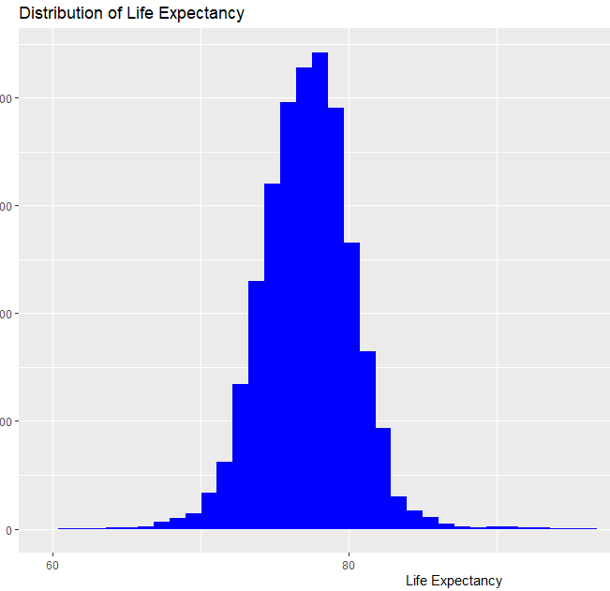
Data Visualizations
DEPENDENT VARIABLE- LIFE EXPECTANCY
The histogram shows us that the distribution of life expectancy is roughly normal, with a peak around 75-80 years.

Slide 17
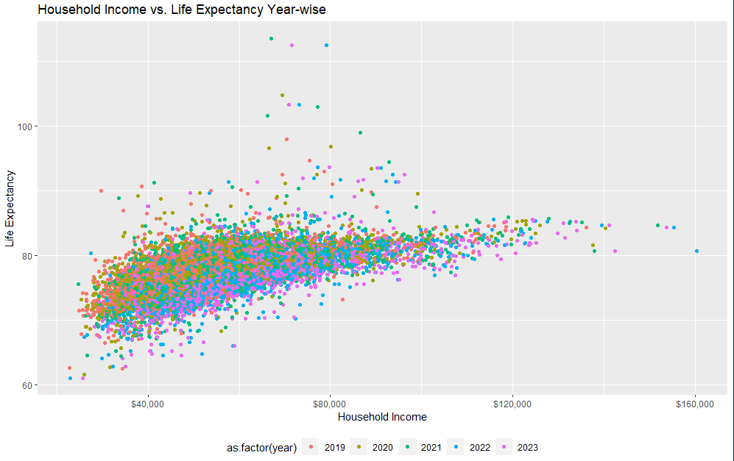
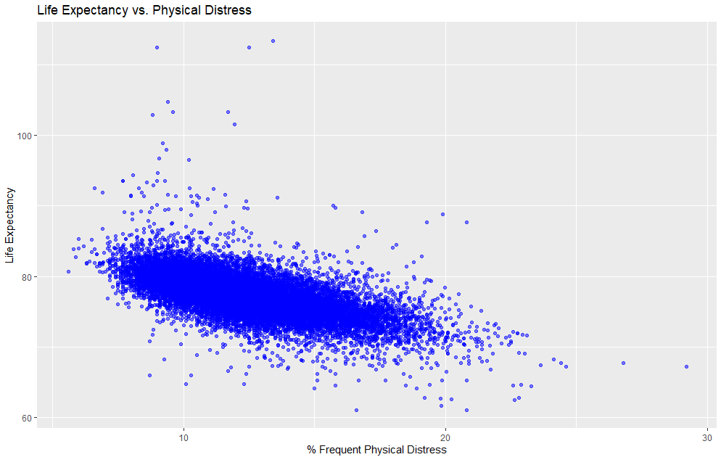
Data Visualizations
Household Income Vs Life Expectancy (Year-Wise)
The scatterplot shows us that there is a positive
correlation between household income and life
expectancy. Counties with higher household incomes
tend to have higher life expectancies.
Life Expectancy Vs Physical Distress
The scatterplot shows us that there is a negative
correlation between physical distress and life
expectancy. Counties with higher levels of physical
distress tend to have lower life expectancies.

Slide 18
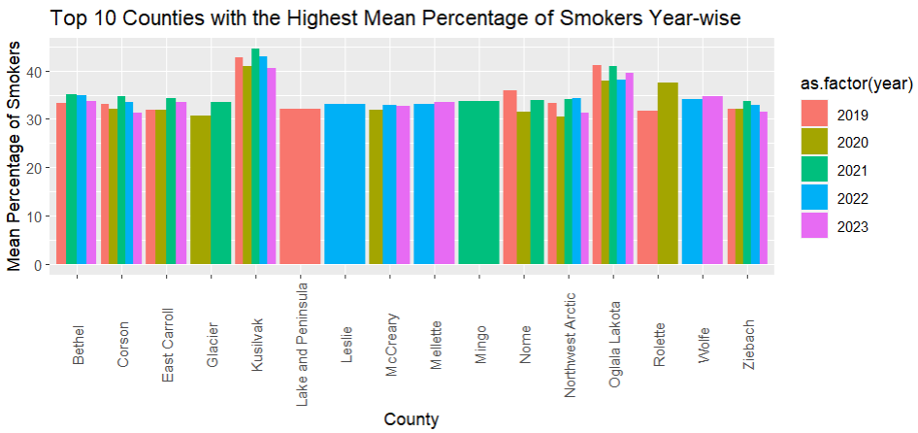
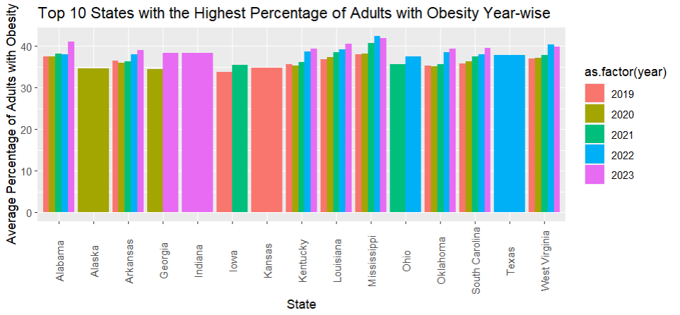
Data Visualization
First Plot: Top 10 Counties with Highest Mean Percentage of Smokers Year- Wise
Second Plot: Top 10 States with the Highest percentage of Adults with Obesity Year-Wise

Slide 19
Models and their rationale
Since Life expectancy is approximately normal, we can run linear models. But the data has different levels (County and State) along with a time dimension.
Hence, we ran 3 models starting with the Linear one, which is a fixed effect model, followed by LMER model to account for county-wide and state-wide variations in life expectancy.
The life expectancy varies by time and hence we ran PLM model to account for the time dimension.

Slide 20
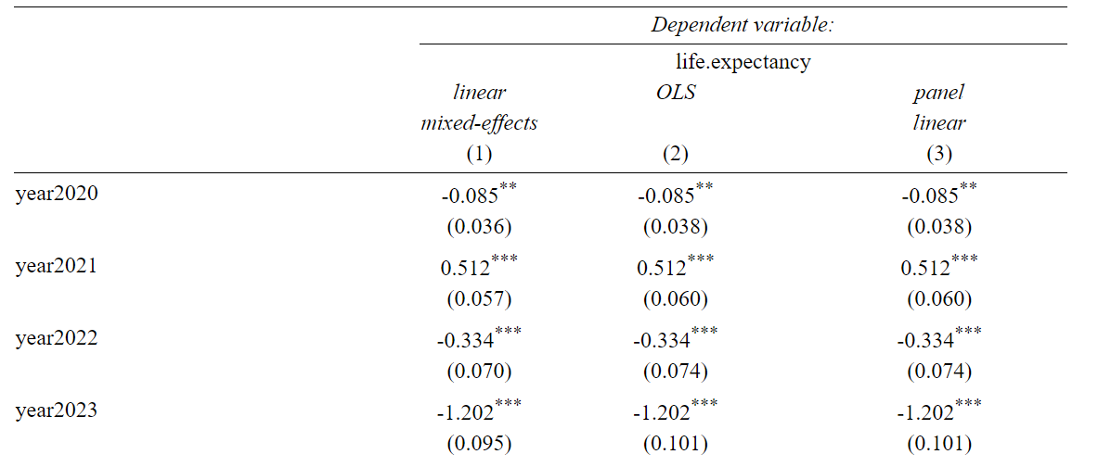
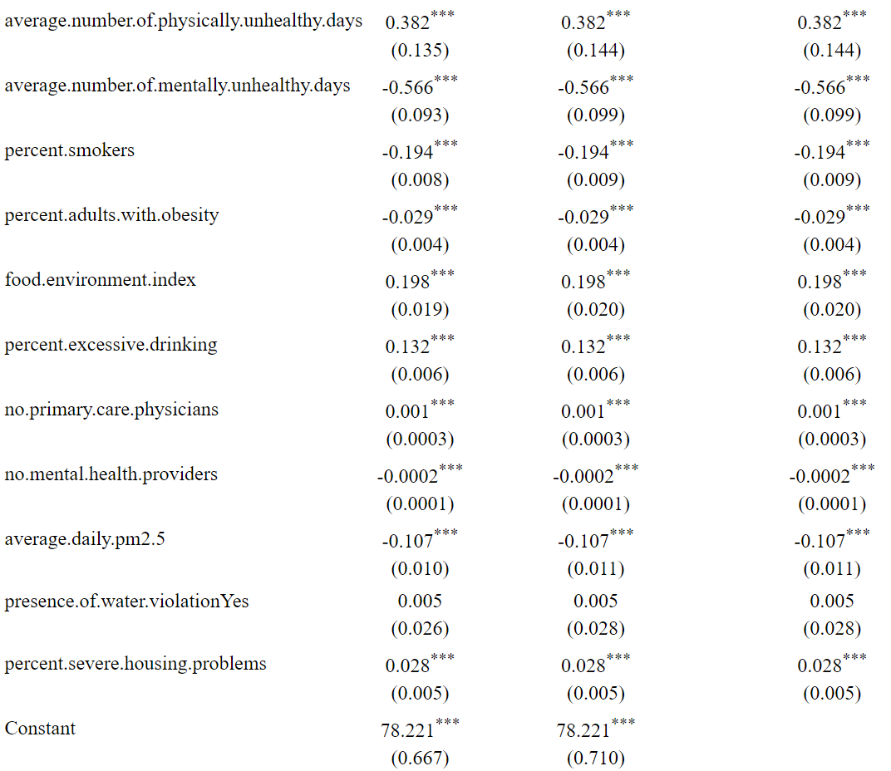
Output

Slide 21
Inferences
With an 10% increase in the physical distress among the counties, the life expectancy falls by almost 2 years.
With every one day increase in the average number of mentally unhealthily days for a county, we can expect the life expectancy to drop by over 6 months.
With every 10 % increase in smoker population in a county, Life expectancy reduces by almost 2 years.
With every unit increase in the Food environment index, we can expect Life expectancy to go up by approximately 2 months.
With every 10 points increase in the PM 2.5 levels in the air, we can expect the life expectancy to drop by more than 1 year.
In Year 2023 life expectancy reduced by 1.2 years compared to the year 2019.
Even at the height of the pandemic, Life expectancy increased by 6 months in the year 2021 compared to year 2019.

Slide 22
… in Continuation
Interestingly, the number of uninsured adults and unisured children does not impact the Life expectancy.
Interestingly, the household income does not seem to have a significant impact on Life expectancy.
Weirdly, a 10 % increase in excessive drinking, increases life expectancy in the counties by 1.3 years.
Presence of water violation apparently does not seem to have any significant impact on LE.

Slide 23

Recommendations
Governments can reduce physical distress by ensuring access to quality healthcare, implementing public health initiatives, promoting occupational health and safety, protecting the environment, providing social welfare programs, investing in infrastructure, supporting mental health services, and fostering research and innovation.
Governments can support mentally unhealthy people through accessible mental health services, awareness campaigns, social welfare programs, crisis intervention, policy and legislation, workforce development, collaborative partnerships, and research and innovation.
Government action for poor food index counties: food assistance, rural dev., nutrition ed., food safety, community gardens, public-private partnerships, policy advocacy, health/nutrition services, empowerment/capacity-building.
Government strategies to reduce smoking population: tobacco taxation, advertising regulations, tobacco control policies, cessation programs, health education campaigns, supportive social policies, enforcement of tobacco laws, stakeholder collaboration, and monitoring/evaluation.

Slide 24

Questions Please!
Team Dark Forest

