Slide 1

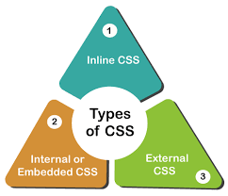
Web Technology CSS Presentation
Prepared By: Gagan Khadka

Slide 2
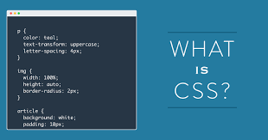

CSS stands for Cascading Style Sheets Styles define how to display HTML elements.

Slide 3

CSS has various levels and profiles. Each level of CSS builds upon the last, typically adding new features and typically denoted as CSS1, CSS2, and CSS3.
The first CSS: specification to become an official W3C Recommendation is CSS level 1, published in December 1996
CSS level 2: was developed by the W3C and published as a Recommendation in May 1998. A superset of CSS1, CSS2 includes a number of new capabilities like absolute, relative, and fixed positioning of elements and z-index, the concept of media types etc.
CSS 3:
CSS level 3 is currently under development. The W3C maintains a CSS3 progress report.

Slide 4
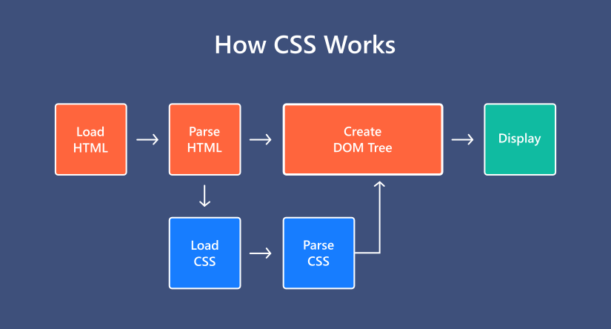
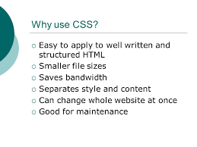
Uses:
CSS Saves a Lot of Work!
CSS defines HOW HTML elements are to be displayed.
Styles are normally saved in external .css files. External style sheets enable you to change the appearance and layout of all the pages in a Website, just by editing one single file!

Slide 5




Understanding Style Rules
A Style Rule is composed of two parts: a selector and a declaration.
Declaration
Selector
TH {color: red;}.
The Selector indicates the element to which the rule is applied.
The Declaration determines the property values of a selector.

Slide 6


Understanding Style Rules
The Property specifies a characteristic, such as color, font-family, position, and is followed by a colon (:).
The Value expresses specification of a property, such as red for color, arial for font family, 12 pt for font-size, and is followed by a semicolon (;).
Property
P {color: red;}
Value

Slide 7
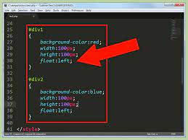
CSS declarations always ends with a semicolon, and declaration groups are surrounded by curly brackets:
p {color:red;text-align:center;}To make the CSS more readable, you can put one declaration on each line, like this:
Example,
p
{
color:red;
text-align:center;
}
CSS Comments
A CSS comment begins with "/*", and ends with "*/", like this:
/*This is a comment*/ p
{
text-align:center;
/*This is another comment*/
color:black;
font-family:arial;
}

Slide 8
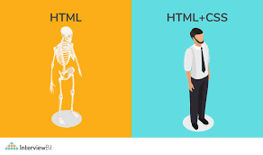
The id and class Selectors:
In addition to setting a style for a HTML element, CSS allows you to specify your own selectors called "id" and "class".
The id Selector
The id selector is used to specify a style for a single, unique element.
The id selector uses the id attribute of the HTML element, and is defined with a "#".
The style rule below will be applied to the element with id="para1":
Example
#para1
{
text-align:center; color:red;
}

Slide 9
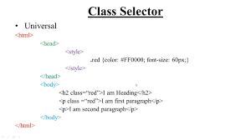
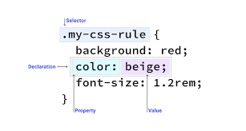
The class Selector
The class selector is used to specify a style for a group of elements. Unlike the id selector, the class selector is most often used on several elements.
This allows you to set a particular style for any HTML elements with the same
class.
The class selector uses the HTML class attribute, and is defined with a "."
In the example below, all HTML elements with class="center" will be center- aligned:
Example,
.center
{
text-align:center;
}
In the example below, all p elements with class="center" will be center- aligned:
Example
p.center {text-align:center;}

Slide 10
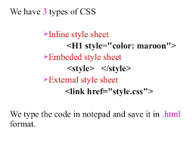
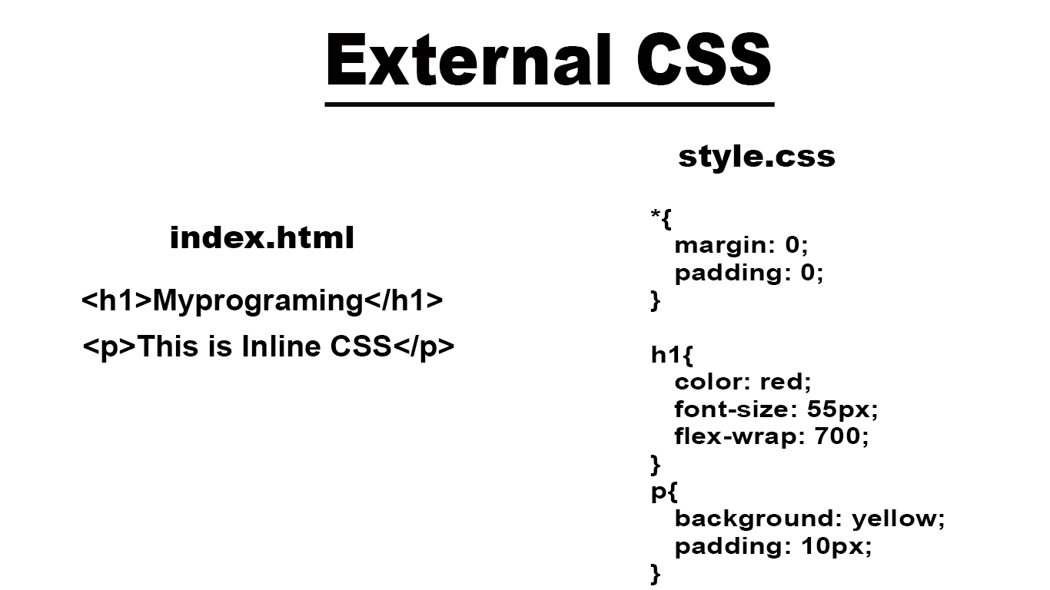
Three Ways to Insert CSS
External style sheet
Internal style sheet Inline style
External Style Sheet:
An external style sheet is ideal when the style is applied to many pages. With an external style sheet, you can change the look of an entire Web site by changing one file. Each page must link to the style sheet using the <link> tag. The <link> tag goes inside the head section:
<head>
<link rel="stylesheet" type="text/css" href="mystyle.css" />
</head>
An external style sheet can be written in any text editor. The file should not contain any html tags. Your style sheet should be saved with a .css extension. An example of a style sheet file is shown below:
hr {color:red;}
p {margin-left:20px;}
body {background-image:url("images/back40.gif");}

Slide 11
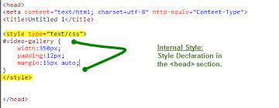
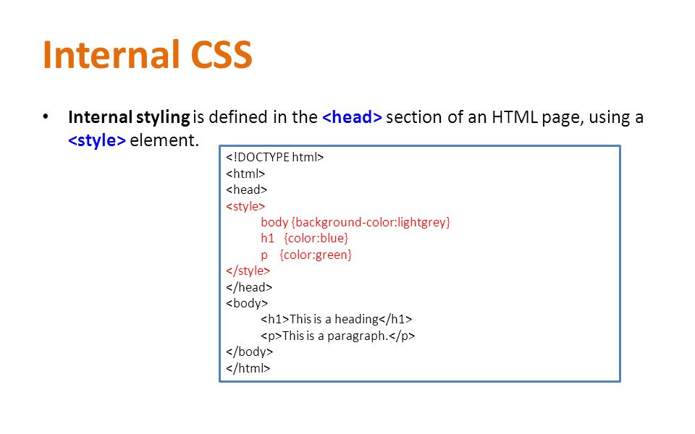
Internal Style Sheet
An internal style sheet should be used when a single document has a unique style.
<head>
<style type="text/css"> hr {color:red;}
p {margin-left:20px;}
body {background-image:url("images/back40.gif");}
</style>
</head>

Slide 12
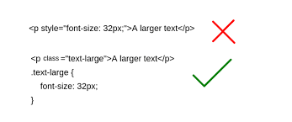
Inline Styles
<p style="color:red;margin-left:20px">This is a paragraph.</p>
Multiple Style Sheets
If some properties have been set for the same selector in different style sheets, the values will be
inherited from the more specific style sheet.
For example, an external style sheet has these properties for the h3 selector: h3
{
color:red;
text-align:left;
font-size:8pt;
}
And an internal style sheet has these properties for the h3 selector:
h3
{
text-align:right;
font-size:20pt;
}
If the page with the internal style sheet also links to the external style sheet the properties for h3 will be:
color:red;
text-align:right;
font-size:20pt;
The color is inherited from the external style sheet and the text-alignment and the font-size is replaced by the internal style sheet.

Slide 13
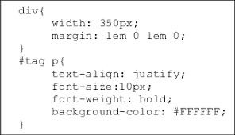
More examples,
body {background-color:#b0c4de;} h1 {background-color:#6495ed;}
p {background-color:#e0ffff;}
div {background-color:#b0c4de;}
body {background-image:url('paper.gif');}
body
{
background-image:url('gradient2.png'); background-repeat:repeat-x;
}
⚫
body
{
background-image:url('img_tree.png'); background-repeat:no-repeat;
}

Slide 14
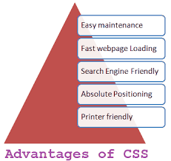
Advantages of CSS:
CSS saves time-
When most of us first learn HTML, we get taught to set the font face, size, colour, style etc every time it occurs on a page. This means we find ourselves typing (or copying & pasting) the same thing over and over again. With CSS, you only have to specify these details once for any element. CSS will automatically apply the specified styles whenever that element occurs.
Pages load faster-
Less code means faster download times.
Easy maintenance-
To change the style of an element, you only have to make an edit in one place.
Superior styles to HTML-
CSS has a much wider array of attributes than HTML.

Slide 15
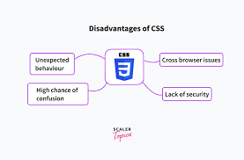
Disadvantage of CSS:
Browser compatibility-
Browsers have varying levels of compliance with Style Sheets. This means that some Style Sheet features are supported and some aren't. To confuse things more, some browser manufacturers decide to come up with their own proprietary tags.

Slide 16


Slide 17



