Slide 1

Introduction to
Web Development
Mentor
Gagan Sharma
Presentation 3
Education Outreach 2
Organised by: Girlscript

Slide 2
Bonus content
Internal linking
CSS animations
SVGs

Slide 3
Internal linking
Use anchor tag to add hyperlink to a location within the webpage.
<a href=‘#id’>go to id</a>

Slide 4

Let’s jump into VSCode
and
start developing.

Slide 5
SVGs
Scalable vector graphics.
Clear crisp no matter the scale, can be used like HTML elements.

Slide 6
Let’s jump into VSCode
and
start developing.

Slide 7
CSS animations
Various CSS states an element can go through.
Keyframes
@keyframes spin {
0% { transform: rotate(0deg) }
100% { transform: rotate(45deg) }
}

Slide 8
Applying animations
div{
animation-name: spin;
animation-duration: 3s;
animation-delay: 4s;
animation-iteration-count: infinite;
animation-direction: alternate;
}
animation-name
animation-duration
animation-delay
animation-iteration-count
animation-direction

Slide 9
Let’s jump into VSCode
and
start developing.

Slide 10
Responsive NavBar
3D flipping cards
3D flipping boxes

Slide 11
Introduction to Web Development
Doubt break
Please go through everything taught today and let me if any part is unclear we will continue tomorrow by then practice whatever you have learnt, contact me if any problem arises.
Organised by: Girlscript
Mentor: Gagan Sharma

Slide 12
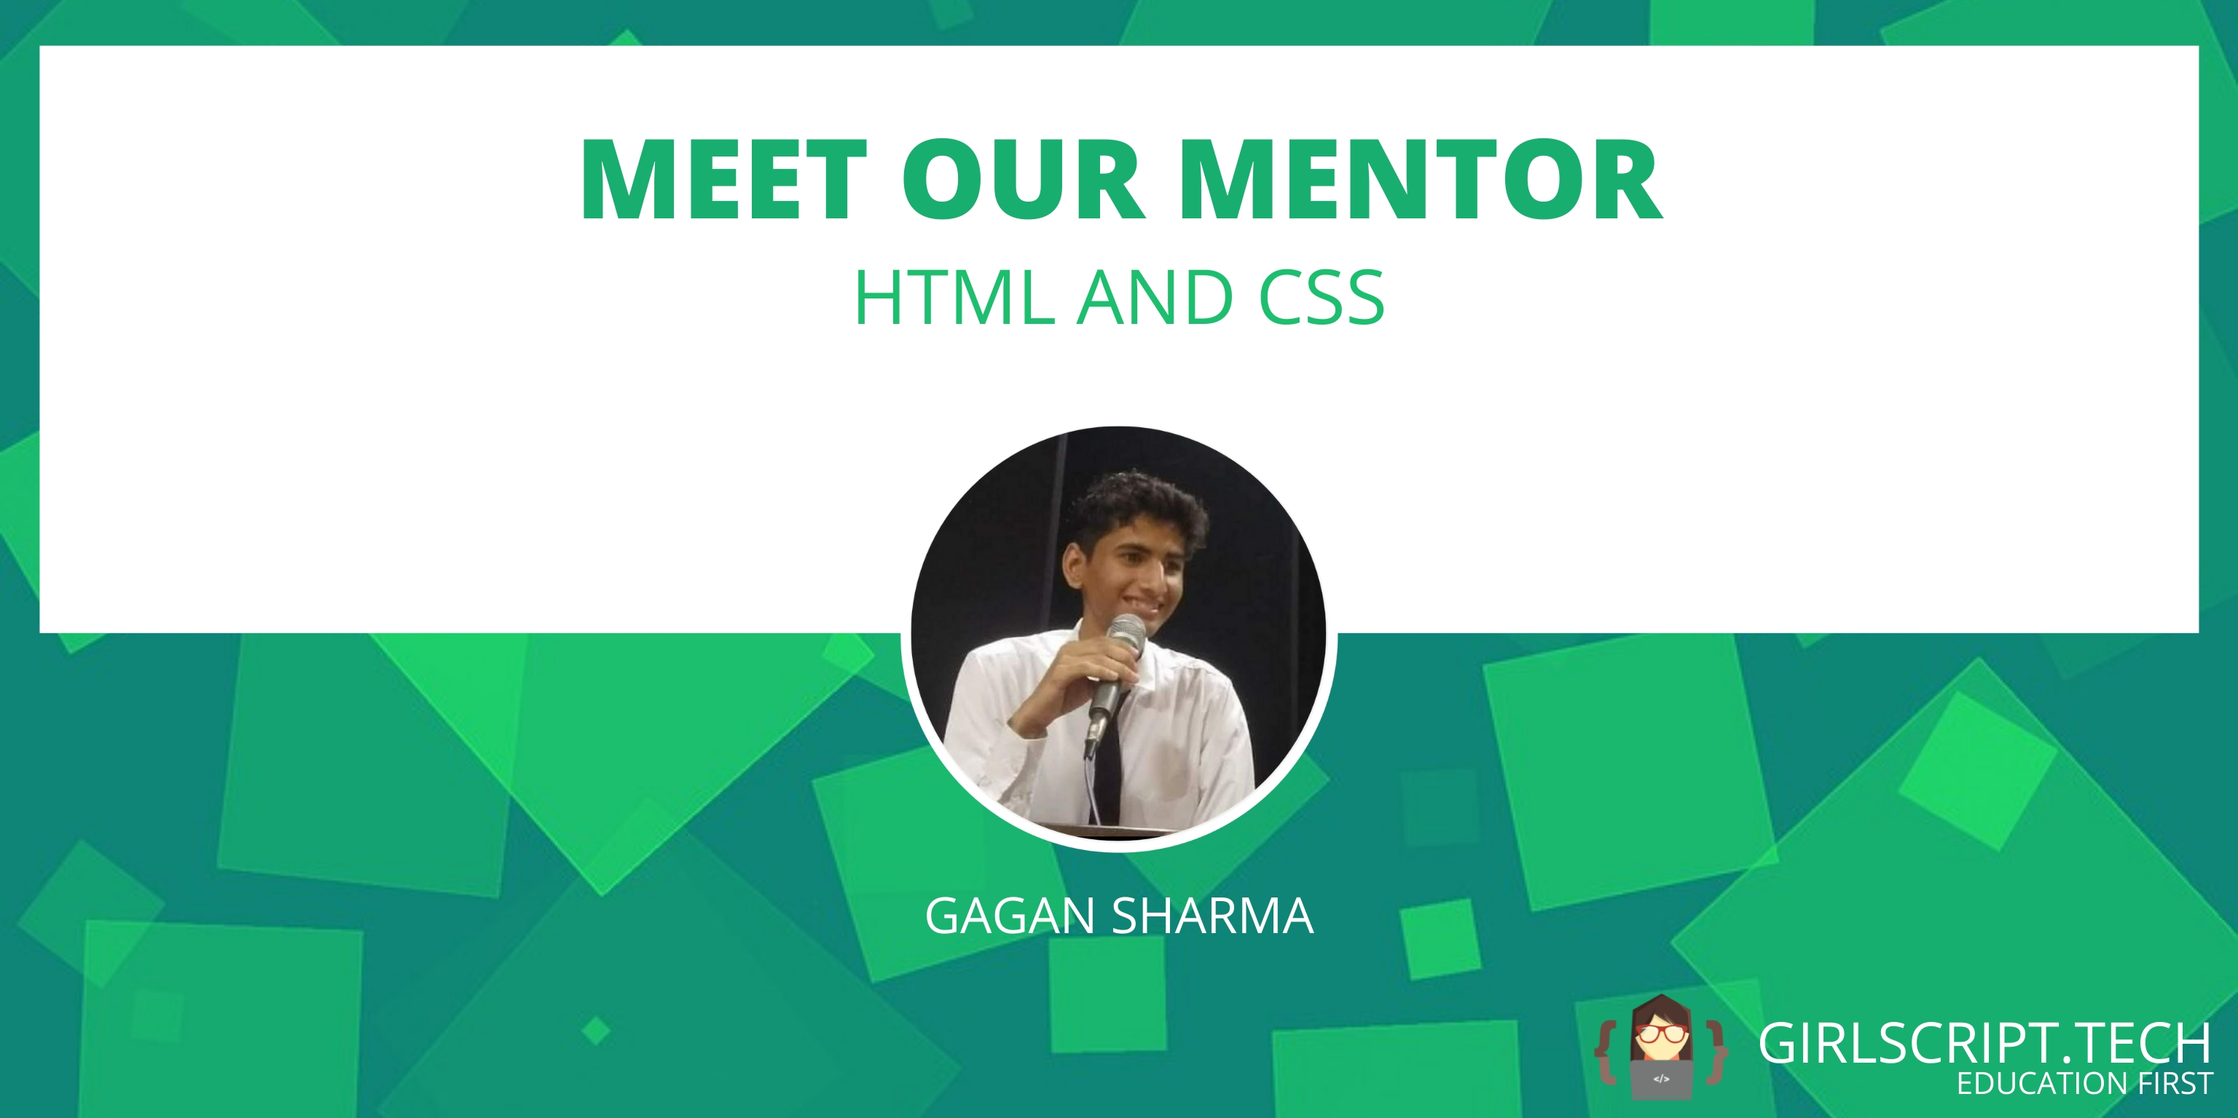
Class end
Practice everything you learned today, share your doubts and projects on the slack channel.

