Slide 1
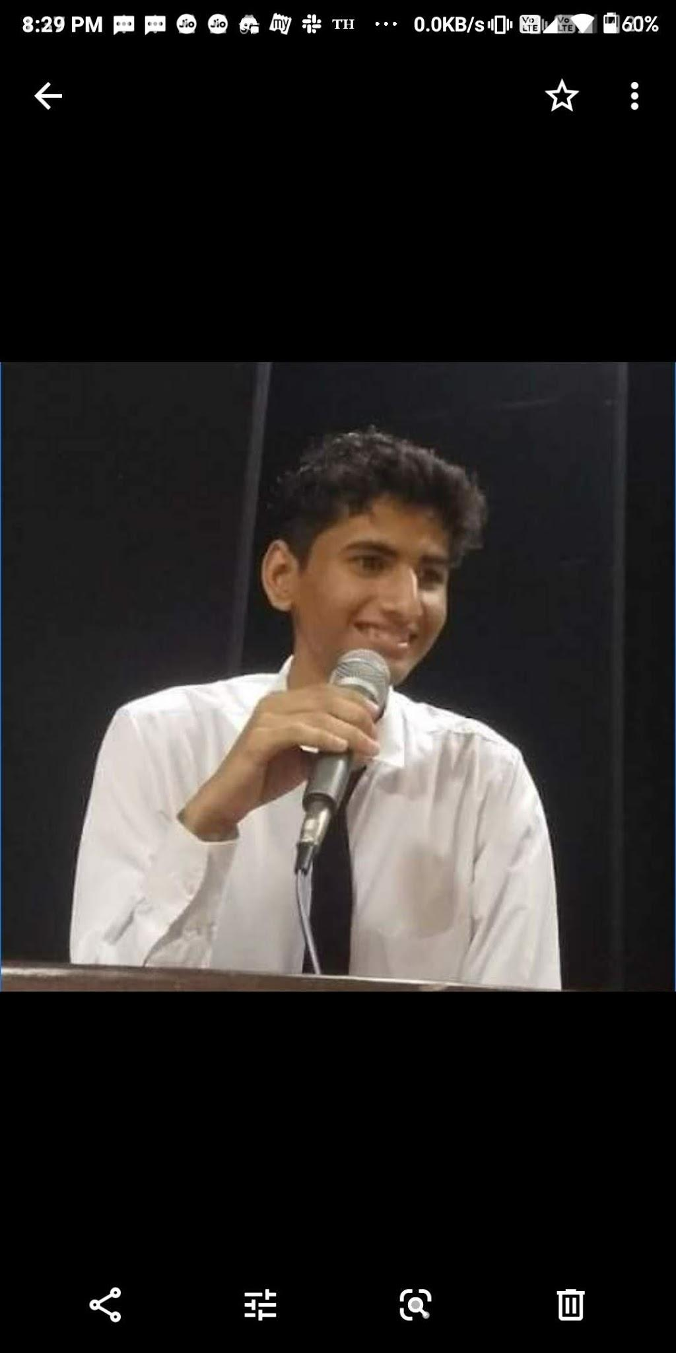
Introduction to
Web Development
Organised by: Girlscript
Mentor: Gagan Sharma

Slide 2
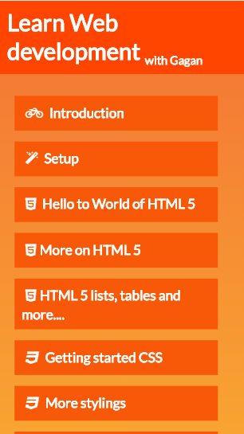
The Course outline
The complete course outline is available at:
webdevwithgagan.orgfree.com/

Slide 3

World of Web!
Web is present,
Web is future.

Slide 4
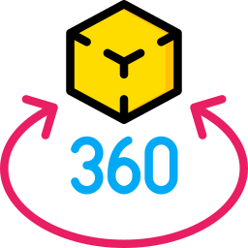



Don’t stop at websites,
because web doesn’t either.

Slide 5

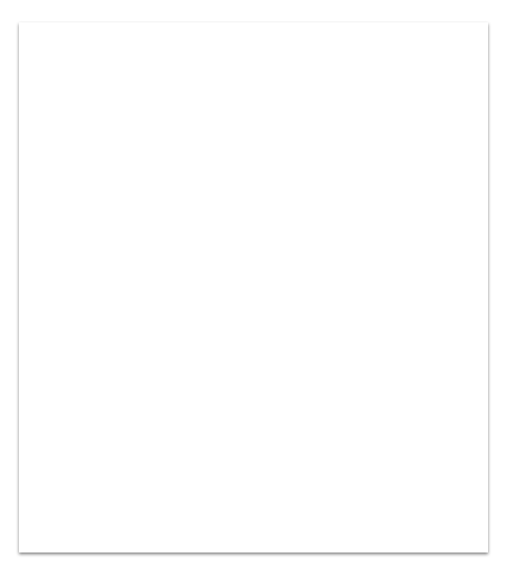
This Course
A basic website uses mainly 3 technologies.
HTML Create basic structure of your website
CSS Add stylings.
Javascript Add interactivity to your website.

Slide 6
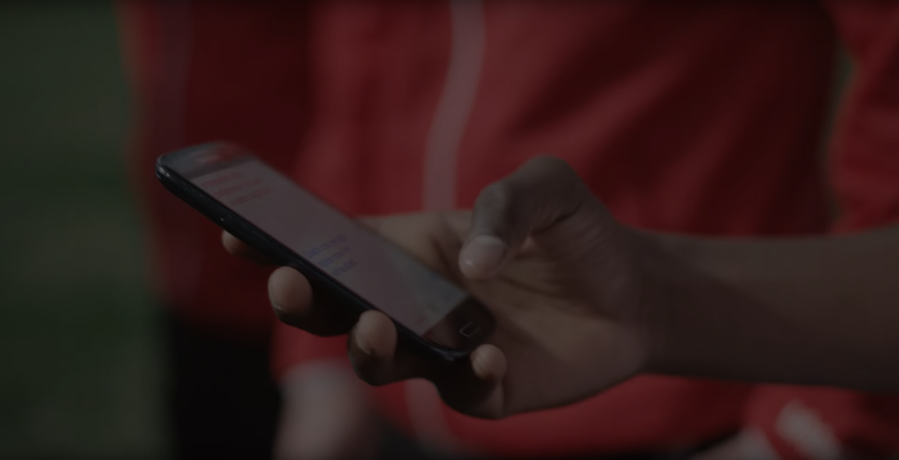



Contact me:
t.me/GaganSharma3103
gagan3103sharma2000@gmail.com
linkedin.com/in/gagan-sharma3103

Slide 7




Setup

Slide 8
Hello to World of HTML 5
HTML
Head
Tags:
It’s all about tags.
<HTML></HTML>
<IMG/>
<TABLE>
Body

Slide 9
Let’s jump into VSCode
and
start developing.

