Slide 1

Introduction to
Web Development
Mentor
Gagan Sharma
Education Outreach
Organised by: Girlscript

Slide 2
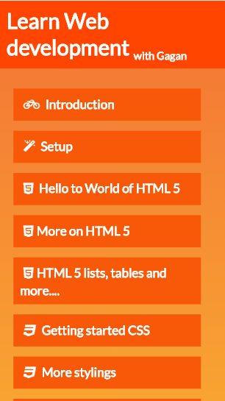
The Course outline
The complete course outline is available at:
webdevwithgagan.orgfree.com/

Slide 3

World of Web!
Web is present,
Web is future.

Slide 4




Don’t stop at websites,
because web doesn’t either.

Slide 5











We use web

Slide 6


This Course
A basic website uses mainly 3 technologies.
HTML Create basic structure of your website
CSS Add stylings.
Javascript Add interactivity to your website.

Slide 7




Contact me:
t.me/GaganSharma3103
gagan3103sharma2000@gmail.com
linkedin.com/in/gagan-sharma3103

Slide 8


Setup

Slide 9
Hello to World of HTML 5
HTML
Head
Tags:
It’s all about tags.
<HTML></HTML>
<IMG/>
<TABLE>
Body

Slide 10
Let’s jump into VSCode
and
start developing.

Slide 11
Basic HTML tags
<!DOCTYPE>
<HTML></HTML>
<HEAD></HEAD>
<TITLE></TITLE>
<BODY></BODY>
<H1>………<H6>
<P></P>
<BR>
<HR>

Slide 12
Let’s jump into VSCode
and
start developing.

Slide 13
Comments
Because developers work together :)

Slide 14
Let’s jump into VSCode
and
start developing.

Slide 15
Text formatting tags
Bold
Italic
Deleted
Marked
Subscript
Superscript
Code
Underline

Slide 16
Let’s jump into VSCode
and
start developing.

Slide 17
Text formatting tags
Bold
Italic
Deleted
Marked
Subscript
Superscript
Code
Underline

Slide 18
Let’s jump into VSCode
and
start developing.

Slide 19
Some other tags
Spans
Div
Buttons
Labels
Cite
Blockquote

Slide 20
Let’s jump into VSCode
and
start developing.

Slide 21
Attributes
Attributes are properties of an element each tag has it’s own special set of attributes, you can also define custom attributes for your tags
<html lang=“en-US”></html>
<p title=“this has a title”></p>

Slide 22
Let’s jump into VSCode
and
start developing.

Slide 23
IDs and Classes
The id attribute specifies a unique id for an HTML element
<p id=‘”turtle”></p>
The class attribute specifies a group an HTML element belongs to.
<p class=“reptile”></p>

Slide 24
Let’s jump into VSCode
and
start developing.

Slide 25
Links
Anchor tag:
<a>
Attributes:
Href= url, id, mailto:, tel:
target =_blank,_parent,_self,_top, framename
download

Slide 26
Let’s jump into VSCode
and
start developing.

Slide 27
Images
Image tag:
<img>
Attributes:
Src
Height, width
Alt

Slide 28
Let’s jump into VSCode
and
start developing.

Slide 29
Block tags
These tags are basically div tags specialized for one purpose.
Section
Header
Footer
Main
Article
Summary

Slide 30
Let’s jump into VSCode
and
start developing.

Slide 31
Lists
Creates a list of hypertext, there are 3 types of lists
Ordered list
Unordered list
Description list

Slide 32
Ordered list
This tag created a numbered/ordered list.
<ol>
<li>first</li>
<li>second</li>
<li>third</li>
<li>fourth</li>
</ol>
Attributes:
Start=number
reversed
Type= 1, a, A, I, i

Slide 33
Let’s jump into VSCode
and
start developing.

Slide 34
Unordered list
This tag created a numbered/ordered list.
<ul>
<li>first</li>
<li>second</li>
<li>third</li>
<li>fourth</li>
</ul>

Slide 35
Let’s jump into VSCode
and
start developing.

Slide 36
Tables
Tags:
caption
tbody
tr
td
thead
th
tfoot
This tag creates an HTML table.
<table> <thead> <th>Pet</th> <th>Score</th> </thead> <tr> <td>Bird</td> <td>100</td> </tr> </table>

Slide 37
Let’s jump into VSCode
and
start developing.

Slide 38
Form
This tag creates an HTML table.
<form> <label for=“pet">Pet:</label> <input type="text" id=“pet" name=“pet"><br><br> <label for=“name">Name:</label> <input type="text" id="name" name="name"><br><br> <input type="submit" value="Submit"> </form>
Attributes:
Name= text
Accept-charset= character_set
Name = ‘Text’

Slide 39
Form tags
Input:
TextArea:
Multi line text input
Select:
selection in options
options:
select options
Label:
label for elements
Buttons
Attributes:
Type=
Button
checkbox
Date
Email
file
Number
Password
Radio
Range
Reset
Search
Submit
Tel
text
Value= default
Name = ‘text’
Required

Slide 40
Let’s jump into VSCode
and
start developing.

Slide 41
Videos and audios
Adds video/audio to page.
<video > <source src=“duckTales.mp4"
type="video/mp4"> <source src=“duckTales.ogg“
type="video/ogg"> Your browser does not support the video tag. </video>
Attributes:
Controls
Muted
Poster=‘imageURL’
Loop
Autoplay

Slide 42
Let’s jump into VSCode
and
start developing.

Slide 43
iFrames
iFrame lets you insert a page within a page.
<iframe src=“http://webdevwithgagan.orgfree.com/”>
</iframe>
Attributes:
Allowfullscreen=true/false
Allowpaymentrequest
SRC

Slide 44
Let’s jump into VSCode
and
start developing.

Slide 45
Introduction to Web Development
Doubt break
Please go through everything taught today and let me if any part is unclear we will continue tomorrow by then practice whatever you have learnt, contact me if any problem arises.
Organised by: Girlscript
Mentor: Gagan Sharma

Slide 46
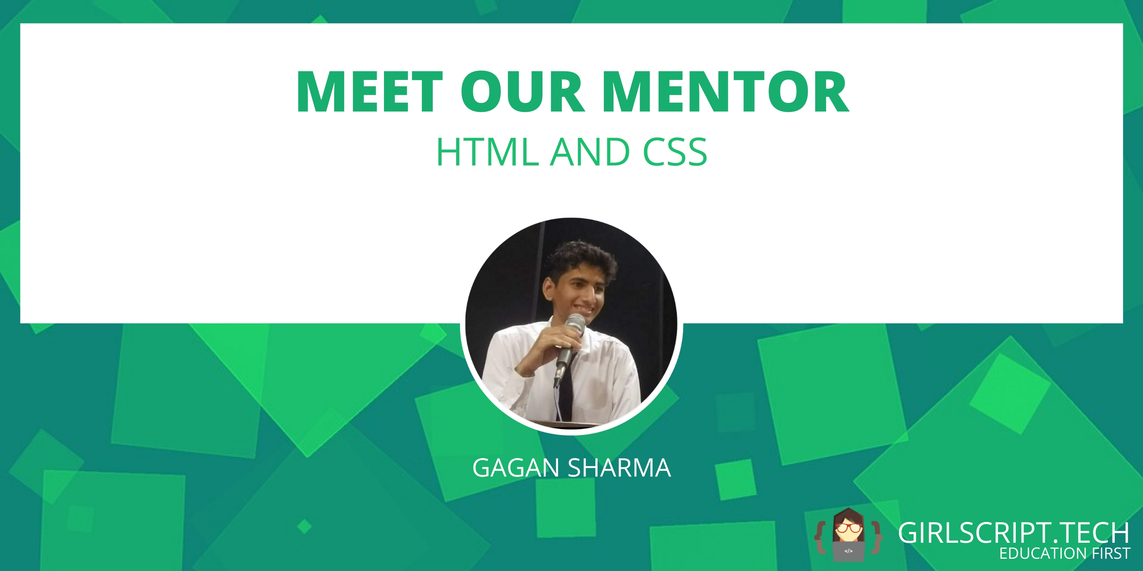
Class end
Practice everything you learned today, share your doubts and projects on the slack channel.

