Slide 1

Introduction to
Web Development
Mentor
Gagan Sharma
Presentation 2
Education Outreach 2
Organised by: Girlscript

Slide 2

What actually is CSS?
Cascading Style Sheet
CSS can be used for adding style to HTML documents. It is file that instructs browser about how to show hypertext

Slide 3


How it works?
CSS gives instruction to browser about how to show HTML files
Beautiful website

Slide 4
CSS syntax
selector{
property: value;
property: value;
}
selector{
property: value;
property: value;
}

Slide 5
CSS selectors
Tags
p{
color: red;
}
Nested Tags
body p{
color: red;
}
Classes
p.pink{
color: pink;
}
ID
p#styled{
color: pink;
}
All elements
*{
color: red;
}
Attributes
H1[title=ok]{
color: red;
}
Multiple tags
p,a,h1{
color: red;
}
Multiple classes
p.c.j.k{
color: red;
}

Slide 6
How to CSS?
Inline styling
Style tag
CSS file(s)

Slide 7

Let’s jump into VSCode
and
start developing.

Slide 8
CSS for boxes
Background-color
Background-image
Padding
Margin
Display

Slide 9
Let’s jump into VSCode
and
start developing.

Slide 10
CSS for texts
color
Text-align
Font-size
Text-decoration
Text-transform
font-family

Slide 11
Let’s jump into VSCode
and
start developing.

Slide 12
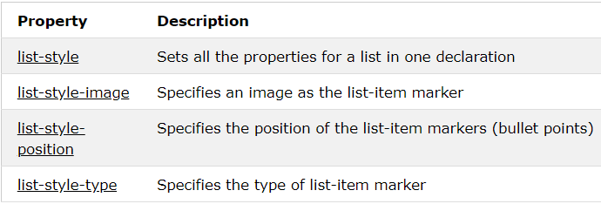
CSS for Lists

Slide 13
Let’s jump into VSCode
and
start developing.

Slide 14
CSS for forms
Focus
Checkbox label

Slide 15
Let’s jump into VSCode
and
start developing.

Slide 16
CSS gradients
Div{
background: #230A91;
background: -webkit-linear-gradient(top left, #230A91, #D98A7D);
background: -moz-linear-gradient(top left, #230A91, #D98A7D);
background: linear-gradient(to bottom right, #230A91, #D98A7D);}

Slide 17
Let’s jump into VSCode
and
start developing.

Slide 18
Introduction to Web Development
Doubt break
Please go through everything taught today and let me if any part is unclear we will continue tomorrow by then practice whatever you have learnt, contact me if any problem arises.
Organised by: Girlscript
Mentor: Gagan Sharma

Slide 19

Class end
Practice everything you learned today, share your doubts and projects on the slack channel.

