Slide 1

Introduction to
Web Development
Mentor
Gagan Sharma
Presentation 2
Education Outreach 2
Organised by: Girlscript

Slide 2

What actually is CSS?
Cascading Style Sheet
CSS can be used for adding style to HTML documents. It is file that instructs browser about how to show hypertext

Slide 3


How it works?
CSS gives instruction to browser about how to show HTML files
Beautiful website

Slide 4
CSS syntax
selector{
property: value;
property: value;
}
selector{
property: value;
property: value;
}

Slide 5
CSS selectors
Tags
p{
color: red;
}
Nested Tags
body p{
color: red;
}
Classes
p.pink{
color: pink;
}
ID
p#styled{
color: pink;
}
All elements
*{
color: red;
}
Attributes
H1[title=ok]{
color: red;
}
Multiple tags
p,a,h1{
color: red;
}
Multiple classes
p.c.j.k{
color: red;
}

Slide 6
How to CSS?
Inline styling
Style tag
CSS file(s)

Slide 7

Let’s jump into VSCode
and
start developing.

Slide 8
CSS for boxes
Background-color
Background-image
Padding
Margin
Height
Width

Slide 9
Let’s jump into VSCode
and
start developing.

Slide 10
CSS for texts
color
Text-align
Font-size
Text-decoration
Text-transform
font-family

Slide 11
Let’s jump into VSCode
and
start developing.

Slide 12
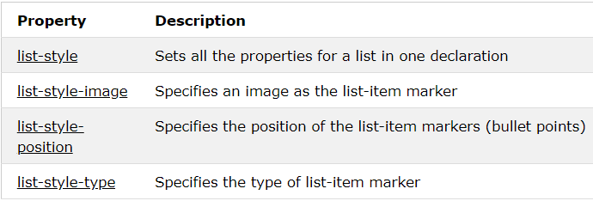
CSS for Lists

Slide 13
Let’s jump into VSCode
and
start developing.

Slide 14
CSS for forms
Focus
Checkbox label

Slide 15
Let’s jump into VSCode
and
start developing.

Slide 16
CSS gradients
Div{
background: #230A91;
background: -webkit-linear-gradient(top left, #230A91, #D98A7D);
background: -moz-linear-gradient(top left, #230A91, #D98A7D);
background: linear-gradient(to bottom right, #230A91, #D98A7D);}

Slide 17
Let’s jump into VSCode
and
start developing.

Slide 18
CSS position and layout
Display
Visibility
Position
Overflow
Float
Header
Sidebar
Content
Footer

Slide 19
Let’s jump into VSCode
and
start developing.

Slide 20
CSS pseudo class
Special selectors.
Hover
Active
Checked
Focus
Invalid
Visited

Slide 21
Let’s jump into VSCode
and
start developing.

Slide 22
CSS elements
Special elements added by CSS
::before
::after
Content property

Slide 23
Let’s jump into VSCode
and
start developing.

Slide 24
CSS borders and shadows
Border
Style
Width
Color
Shadow
Text-shadow: x y blur color, x y blur color;
Box-shadow: x y size blur color;

Slide 25
Let’s jump into VSCode
and
start developing.

Slide 26
CSS transitions
Transition: property time curve;
CSS transform
Transform
Rotate
Translate
Scale

Slide 27
Let’s jump into VSCode
and
start developing.

Slide 28
CSS icons
Font awesome icons.
<link rel="stylesheet" href="https://cdnjs.cloudflare.com/ajax/libs/font-awesome/4.7.0/css/font-awesome.min.css">
Icon catalog.
https://www.w3schools.com/icons/fontawesome_icons_intro.asp

Slide 29
Let’s jump into VSCode
and
start developing.

Slide 30
Responsive web design
Website that produce different layout for different devices
CSS media query
@media screen and (max-width:800px){ element { CSS } }

Slide 31
Let’s jump into VSCode
and
start developing.

Slide 32
Properties
Flexbox
element { display: flex; }
The flex container properties are:
flex-direction
flex-wrap
flex-flow
justify-content
align-items

Slide 33
Let’s jump into VSCode
and
start developing.

Slide 34
CSS variables
Declare once use anywhere.
:root { --main-bg-color: coral; } #div1 { background-color: var(--main-bg-color); }

Slide 35
Let’s jump into VSCode
and
start developing.

Slide 36
Projects
These projects will use the things you have learnt in this course this section will give you some practice and some reusable code you can use in future projects.

Slide 37
Amazing buttons
Spin on hover
Icon buttons
Let’s Go button
Dropdown
Water effect

Slide 38
Let’s jump into VSCode
and
start developing.

Slide 39
Responsive NavBar
3D flipping cards
3D flipping boxes

Slide 40
Introduction to Web Development
Doubt break
Please go through everything taught today and let me if any part is unclear we will continue tomorrow by then practice whatever you have learnt, contact me if any problem arises.
Organised by: Girlscript
Mentor: Gagan Sharma

Slide 41

Class end
Practice everything you learned today, share your doubts and projects on the slack channel.

