Slide 1



Slide 2
Introduction
Why Selenium?
Architecture of Selenium
Installation-Creation of Maven Project
Required Dependencies
Data Accessibility
Advantages and Disadvantages
Demo
Agenda

Slide 3
Introduction
Selenium is an open-source, automated testing tool used to test web applications across multiple browsers.
It's primarily built in Java and supports several browsers and programming languages.
It is exclusively for Web Based applications.
Selenium supports multiple browsers - Chrome, Firefox, Internet Explorer, Safari
Selenium works with Multiple Platforms Windows, Apple OS, Linux, Solaris
Selenium can be coded in multiple languages - Java, C#, Python, JavaScript, php, Ruby, Perl

Slide 4

Why Selenium?
Multi-Browser Support
Multi-Language Compatibility
Easy Identification and Use of Web Elements
Open Source
Reusability and Extras
Portability (Ability to work with different Operating Systems)

Slide 5
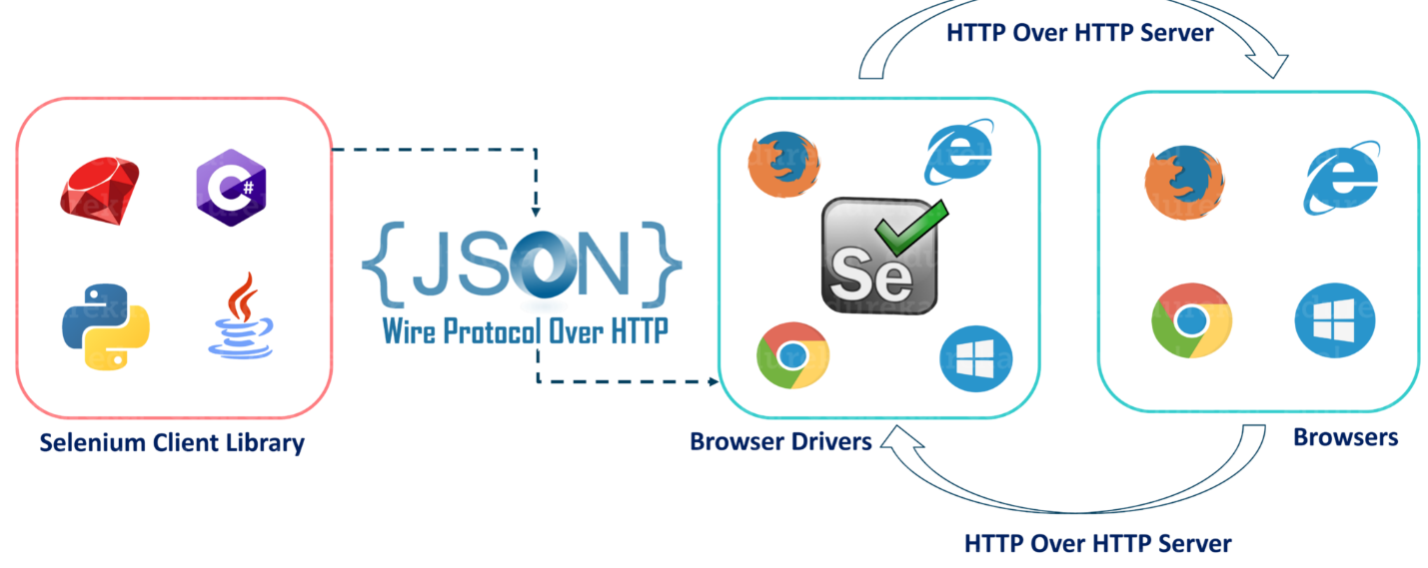
Architecture of Selenium

Slide 6
Creation of Project : Installation
JDK Download : Java
IDE – Eclipse IDE
- IntelliJ IDE
Creation Of Maven Project :
Folder Structure of Maven Project
Framework : TestNG
TestNG is a testing framework inspired by Junit and Nunit.
Install and configure TestNG in Eclipse
TestNG + cucumber framework -> Hybrid Framework

Slide 7
Dependencies :Maven Central Repository
Basic Dependencies
-Selenium Java
-TestNG
Excel Driven Testing
-poi-ooxml
-poi
Hybrid Cucumber Framework
-Cucumber java
-Cucumber TestNg
Json File Reader
Jackson DataBinder
Generating Report
-Extent Report
-Extentreports-cucumber7-adapter
-Allure Report

Slide 8
Data Accessibility
Configuration File
Json File
Excel
Data Provider annotation
-Single class have any test cases.
Parameterizing with multiple data sets by running tests with multiple combination

Slide 9
Advantages:
Data Provider Annotation.
Support parallel run even at class level, test level and method level.
One class contain many test cases.
One test case can depend on other class case by using depenendsOnMethod.
Disadvantages:
Incomplete solution – Selenium requires third-party frameworks in order to completely automate the testing of web applications.
Requires high skills – Though it supports multiple programming languages, it requires a high-level proficiency to deal with it effectively.

Slide 10
DEMO
Dot Foods Application
End to End Testing –Order Placement
Creating a new cart functionality
Order Form functionality
Footerlink functionality – To identify the Broken Link based on status code
My List Functionality
Search Mutiple Items Functionality
Hybrid Framework –cucumber
-Jenkins set up

Slide 11
Thank You

