Slide 1
PROJECT TITLE : Web-Based Time and productivity Analysis.
PIP104 University Project-II
Review-2
Batch Number: GCSE142
Under the Supervision of,
Dr. S Prakash
Assistant Professor
School of Computer Science & Engineering
Presidency University
Roll Number | Student Name
20201CSE0755 | VARSHA. G
20201CSE0754 | GAGANASHREE D

Slide 2
ABSTRACT
For the successful project management and its success, many studies have been done but still, many of the software projects cannot end up well. One of the main reason behind it is time management and also less efficiency. So, the time tracking software is being developed, this will collect and analyses the insights to improve overall efficiencies, like Identifying inefficiencies, Resource Allocation, enhancing team efficiency, task management, performance measurement and ensuring the successful project outcomes. By applying these insights, organizations can unlock their full potential and achieve their goals effectively.

Slide 3
Introduction
Time and productivity analysis can be defined as the process of systematically examining how time is utilized and how it affects the overall productivity of individuals, teams, or organizations.
Time and productivity analysis involves studying how time is allocated and how productivity is influenced in order to identify areas for improvement.
The main objectives of time and productivity analysis are to optimize resource allocation, improve efficiency, and enhance overall productivity.
Analyzing time and productivity is crucial for organizations as it allows them to identify bottlenecks, streamline processes, and make informed decisions to achieve better outcomes.

Slide 4
Literature Review
The Influence of Agile Methodology(scrum) on software Project Management, Aisal Hayat, (2020).
Advance Recommendation System for the Formation of More Prolific and Dynamic Software Project Team, Wasi Haider Butt (2019) .
Effect of Project management in requirement engineering and requirement change management processes for global software development, Muhammad Shafiq. (2018).
Time management method for software development projects-analytical summary, (2018).

Slide 5
Literature Review
The Problem at hand is the absence of a centralized and user-friendly system for monitoring and analyzing resource time allocation in organizations. Existing solutions are frequently disjointed and unable to give a comprehensive picture of how resources are used, which results in inefficiencies and decreased productivity.
Organizations struggle to maximize resource allocation and productivity because the lack of actionable insights into resource activities makes it difficult to make well-informed decisions. Without a centralized system, businesses find it difficult to identify time-wasting activities, understand where resources are most productive, and locate workflow bottlenecks. This lack of visibility causes lost productivity, improper resource allocation, and inadequate project planning.
Our project aims to create a web-based software tool that records and classifies the time spent on various activities and stores this information in a central database in order to address these issues. This system will give businesses the knowledge they need to boost resource productivity, simplify resource allocation, and make data-driven choices that will increase overall efficiency.

Slide 6
Proposed Method
The proposed system is a web-based application designed to capture and analyze the time spent by resources on various activities, such as coding, documentation, SQL, and internet usage.
It offers a user-friendly interface for resource input and centralizes this data in a secure database. The system allows for customization of activity categories, providing flexibility for different organizational needs.
Overall, the system aims to enhance resource productivity, optimize resource allocation, and facilitate data-driven decision-making. It offers transparency, accountability, and improved collaboration within the organization, making it an essential tool for time and productivity analysis.

Slide 7
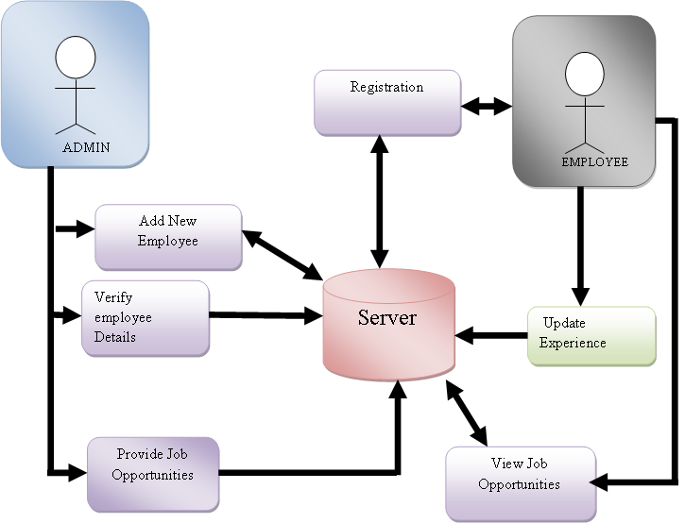
Architecture Diagram
Update projects
Assign projects
view projects

Slide 8
Software Requirements
1. Front-End
→ HTML → CSS → JavaScript → PHP
2. Back-End
PHP for server side
scripting
3. Software
Any web Browser and
Wamp Server
4. DataBase
MySQL for data storage

Slide 9
Objectives
Identify Inefficiencies:
Recognize and pinpoint areas where time is being wasted or utilized inefficiently within processes or workflows.
Resource Allocation:
Determine how time and resources are allocated across different tasks or projects to ensure optimal utilization.
Task Management:
Within each project, provide the ability to create, assign, and track individual tasks. Users should be able to set priorities and due dates for tasks.
User Authentication and Access Control:
Implement user accounts and roles, such as admin, manager, and team member, to ensure that only authorized individuals can access and modify project data.

Slide 10
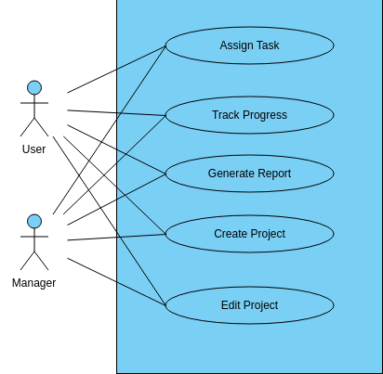
Use-case diagram

Slide 11
Timeline of Project
Review 0 – Title finalization with supervisor , Literature survey, Finalizing the objectives and Deciding the methodology.
Review 1 – Title, Abstract, Literature survey , Research paper , objectives, existing method- drawbacks , proposed method, Use case diagram, modules , hardware and software details, timeline by Gantt chart and submitting the hardcopy of report.
Review 2 – Algorithm details, source code and implementation details with live demo of project with 50% report softcopy to be submitted.
Review 3 – Algorithm details, source code and implementation details with live demo of project with 50% report softcopy to be submitted.
Review 4 – Final report and submission of project.

Slide 12
Expected Outcomes
1. Identification of Time Wasters.
2. Efficiency Improvements.
3. Time Allocation Insights.
4. Productivity Metrics.
5. Reallocating resources.
6. Benchmarking: Comparing productivity metrics to industry standards

Slide 13
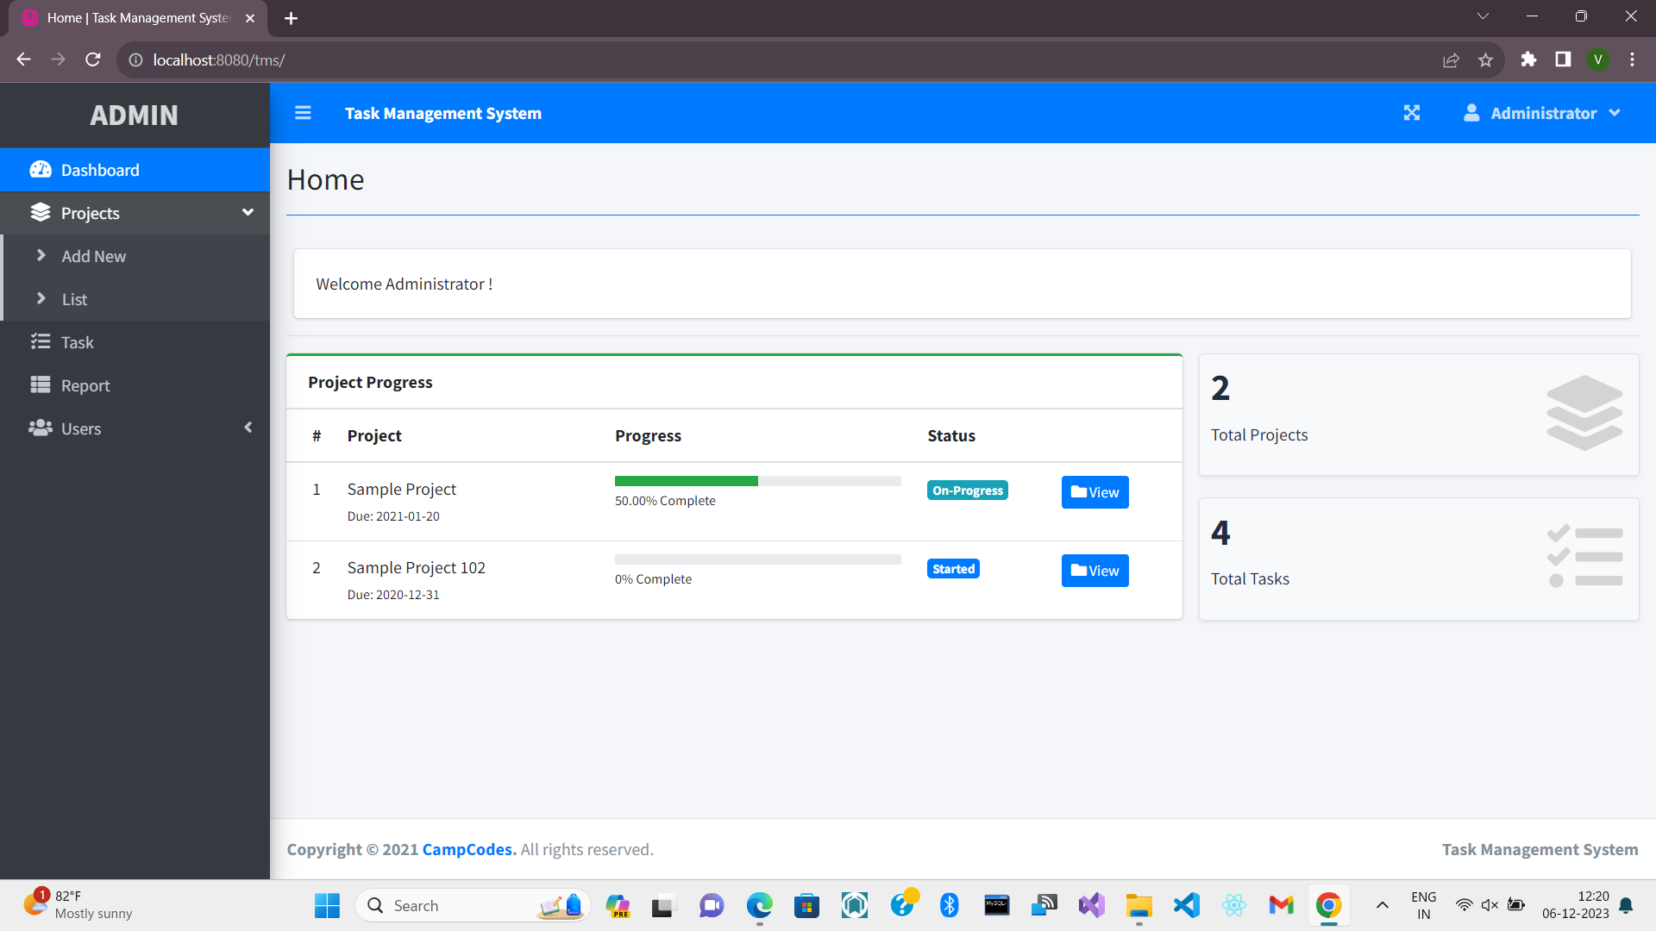
Snapshots

Slide 14
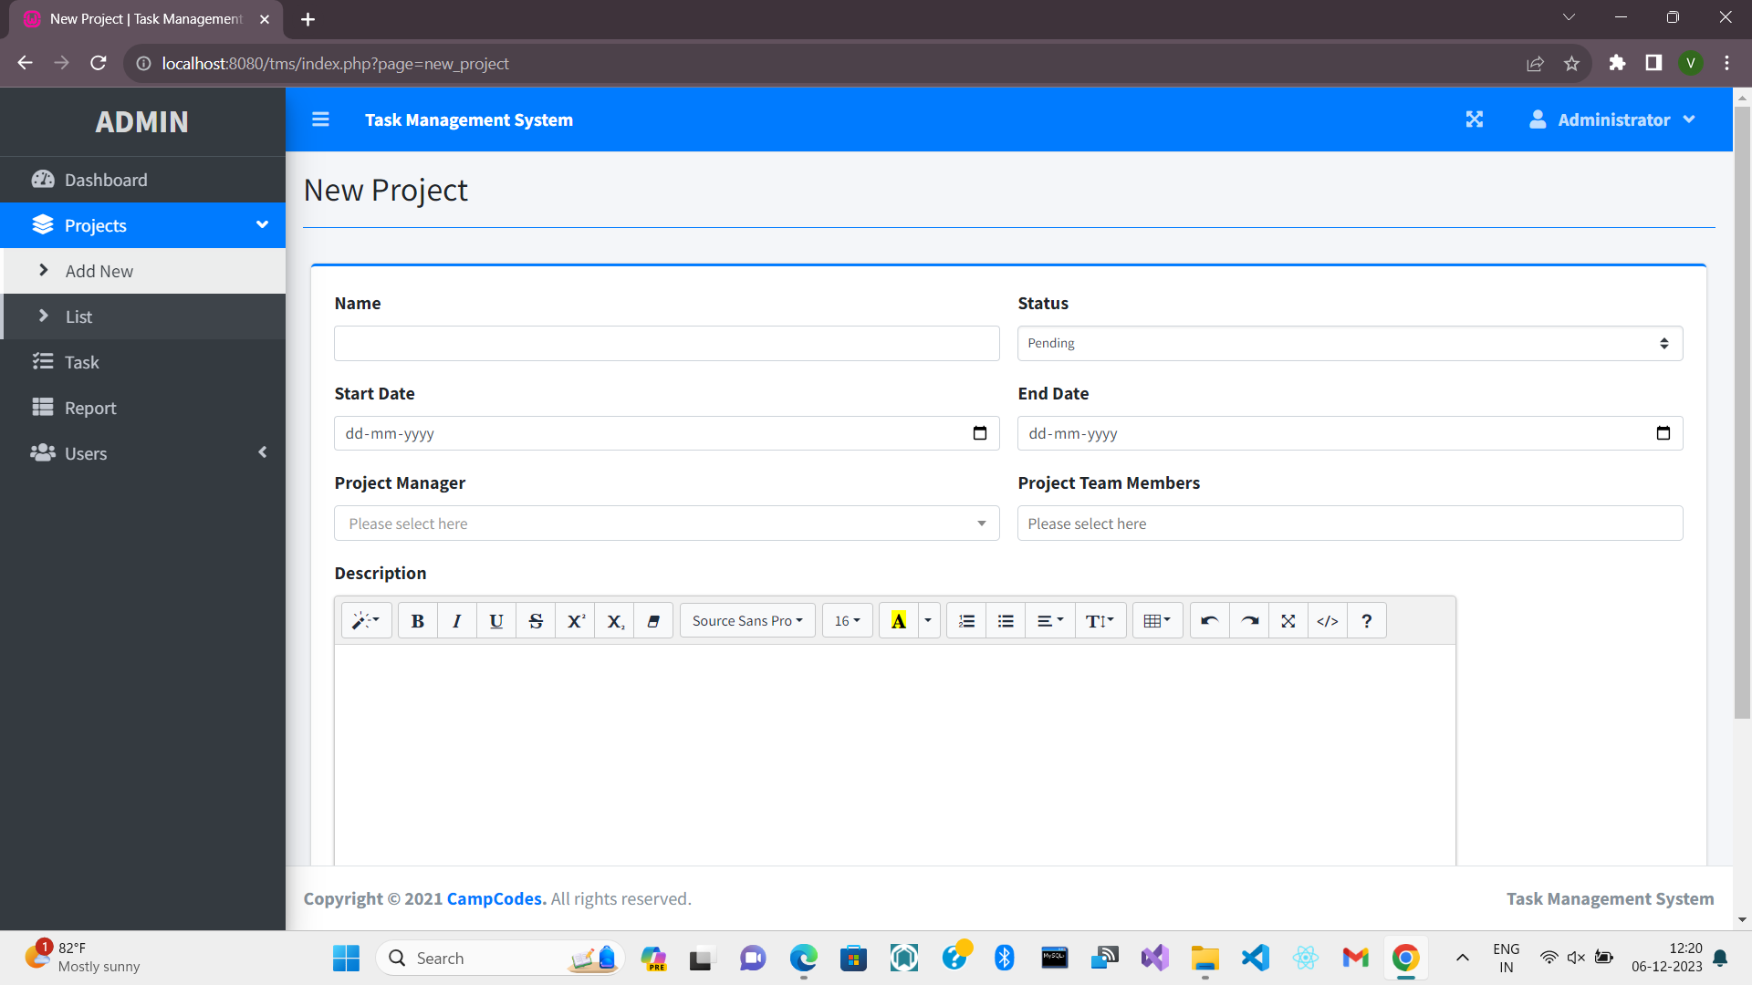

Slide 16
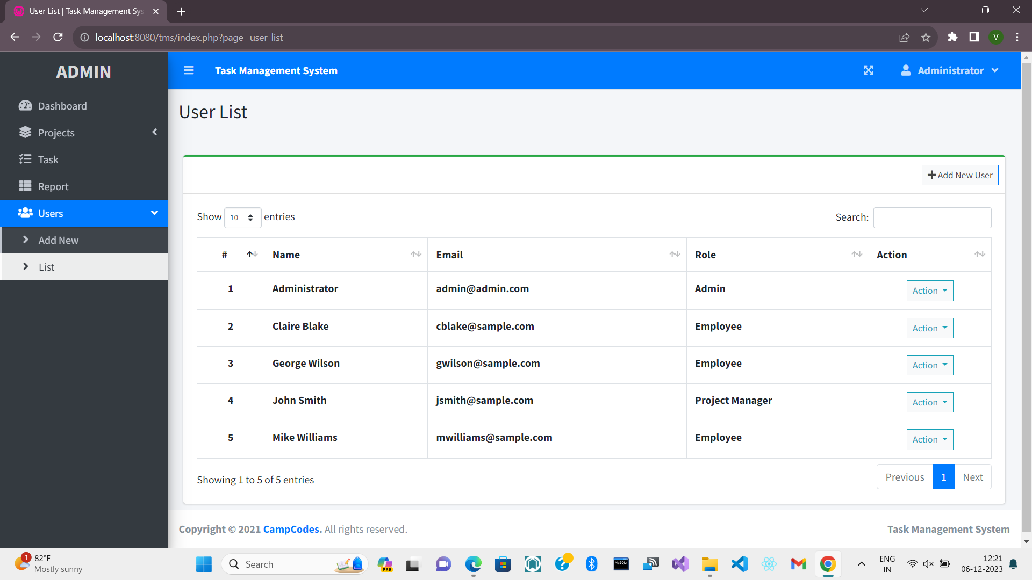

Slide 17
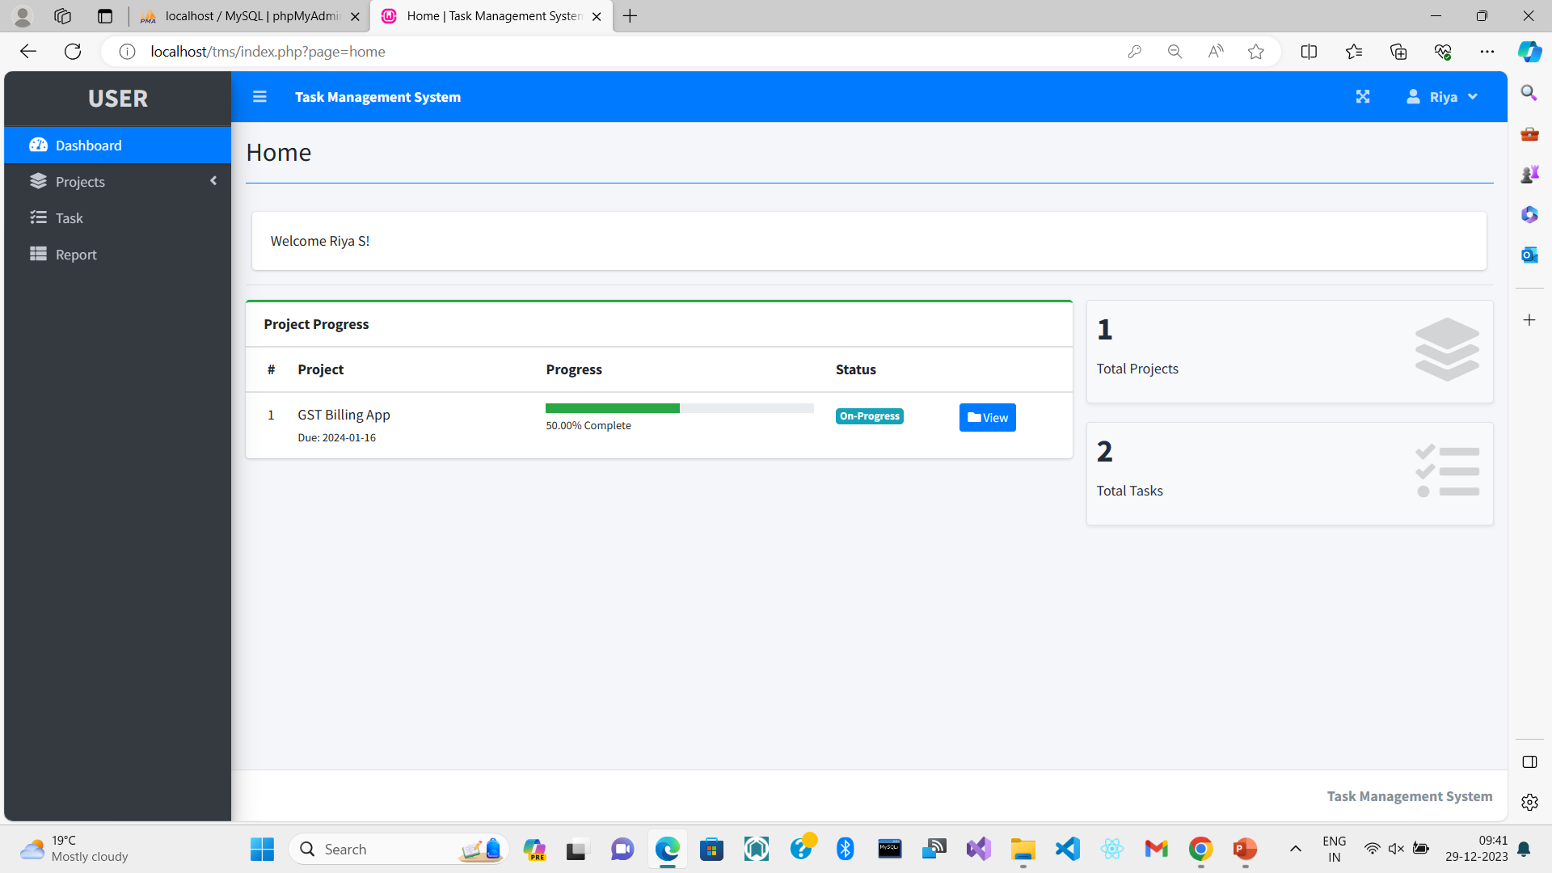
EMPLOYEE/USER

Slide 18
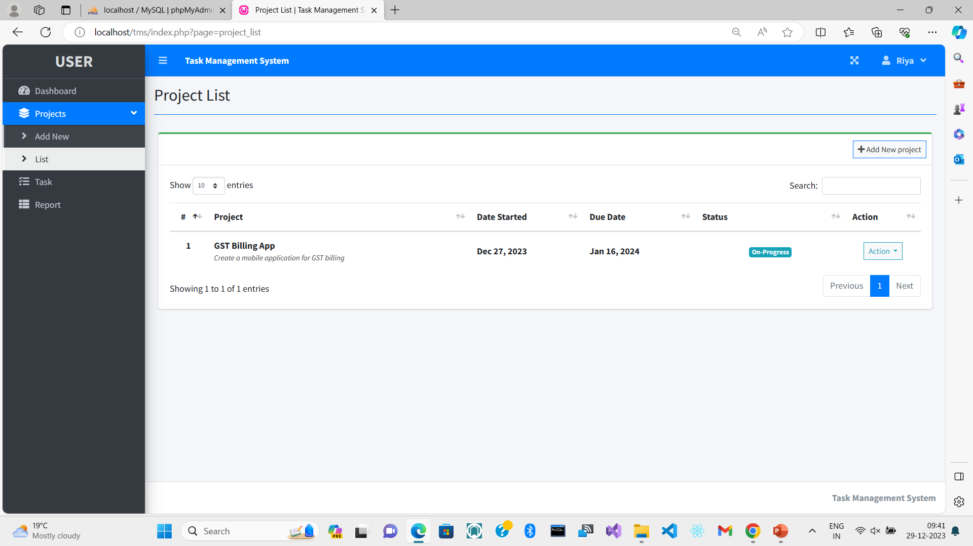

Slide 19
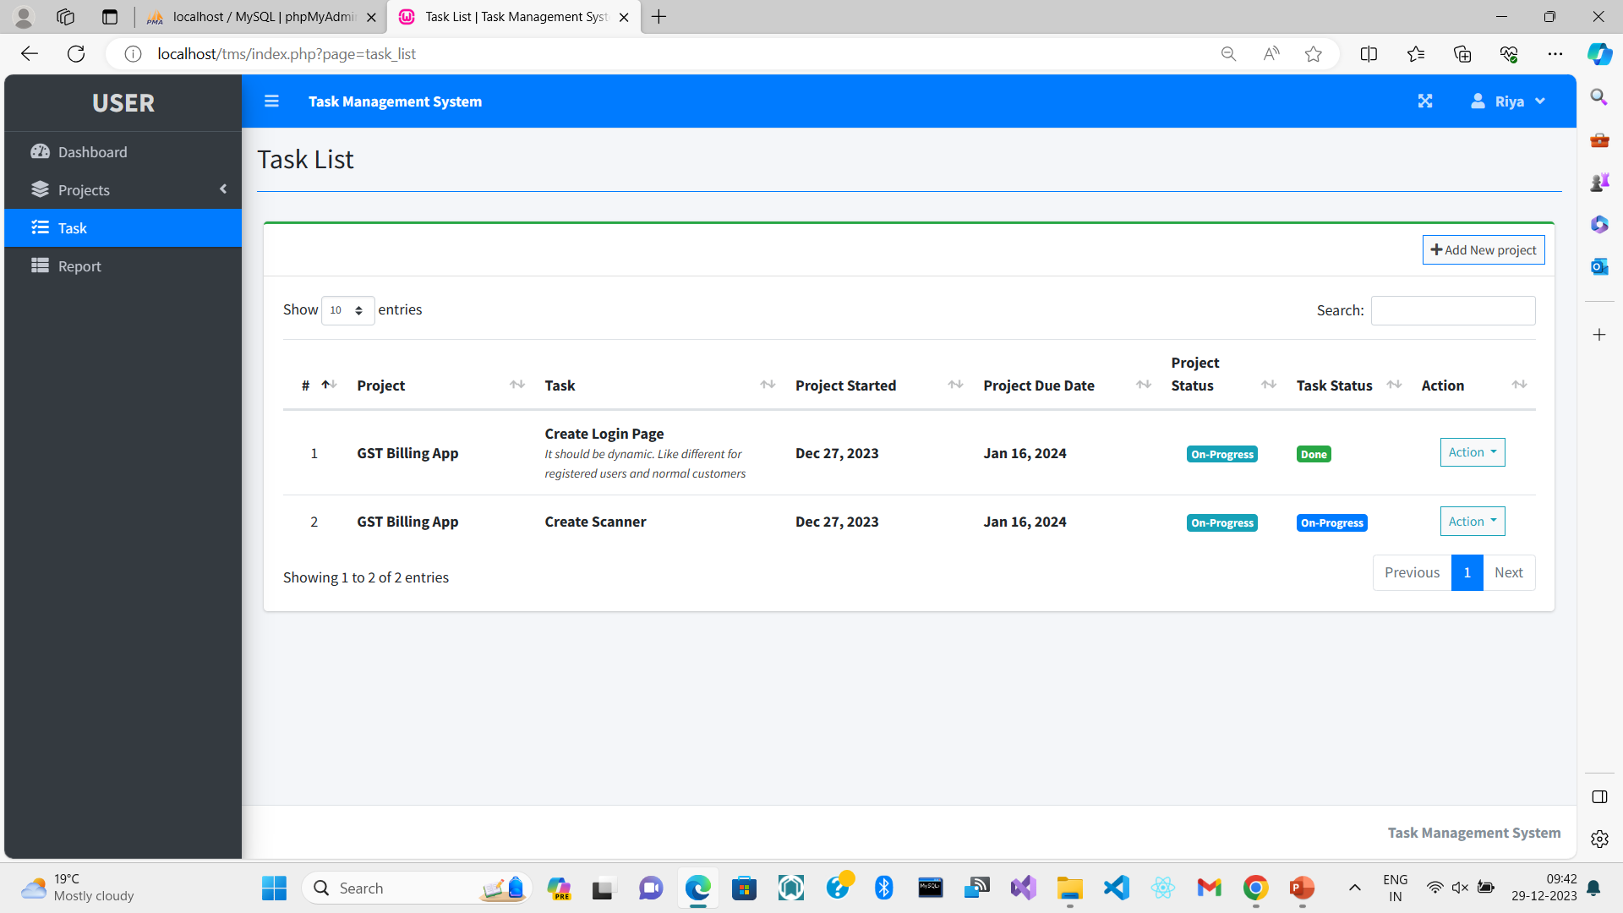

Slide 20
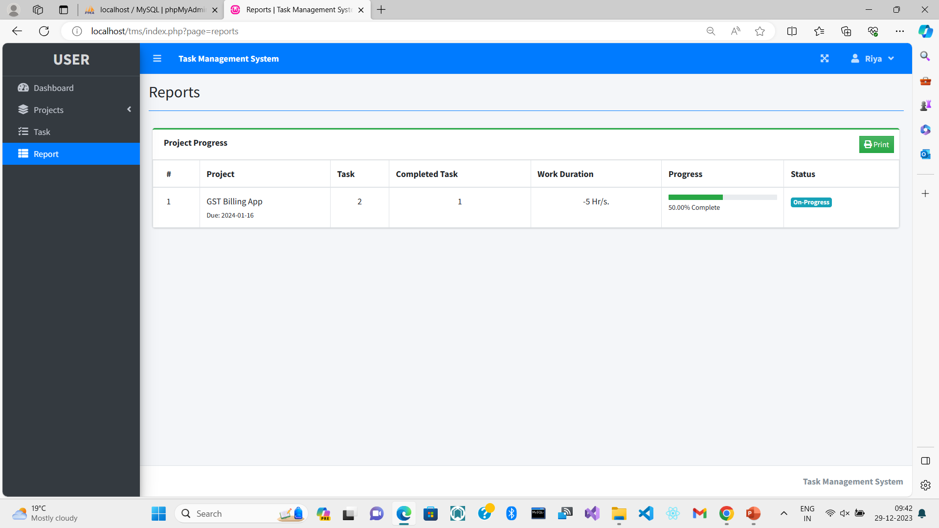

Slide 21
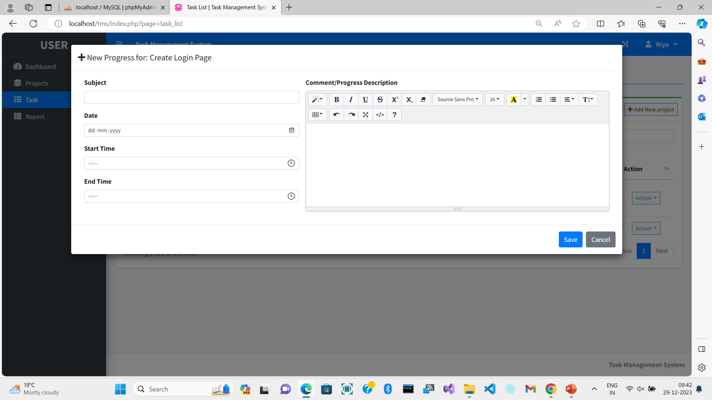

Slide 22
Conclusion
In conclusion, time and productivity analysis is a fundamental component of organizational success. By implementing effective analysis methods, organizations can improve efficiency, optimize resource allocation, and drive performance.
Key takeaways from this project include the importance of data-driven decision making, the role of technology in shaping the future of analysis, and the actionable recommendations for organizations to enhance their productivity. By applying these insights, organizations can unlock their full potential and achieve their goals effectively.

Slide 23
References
Advance Recommendation System for the Formation of More Prolific and Dynamic Software Project Teams, Mahreen Ahmad,2018.
R. Latone and J. Suarez, "Measuring social networks when forming information system project," The Journal of Systems and Software, pp. 304-323, 2017
"A framework for freelancer assessment in online marketplace," in ICSE-SEIP '17 Proceedings of the 39th International Conference on Software Engineering: Software Engineering in Practice Track, Buenos Aires, Argentina, 2017.
B. M. M. Q. R. U. Q. M. A. Fateh ur Rehman, "Scrum Software Maintenance Model: Efficient Software Maintenance in Agile Methodology," in 2018 21st Saudi Computer Society National Computer Conference (NCC), Riyadh, Saudi Arabia, 2018
S. B. S. S. Apoorva Srivastava, "SCRUM Model for Agile Methodology," in International Conference on Computing, 2017.
M. J. (MJ), "Scrum Reference Card," [Online]. [Accessed December 2018]

Slide 24
Thank You

