Slide 1
AED FINAL PROJECT DELIVER EASE
DEEPA SHENOY 2051133
GAGANA M 2310881
LIKHITH N G 2306312

Slide 2
PROPOSED SOLUTIONS
.
Implement a centralized
database with real-time updates
Deploy warehouse
management systems (WMS)
Establish a shared logistics hub
to consolidate shipments.
Buy Anything,
Sell anything

Slide 3
REAL PROBLEM
.
Lack of Real-Time
Information Sharing
Inefficient Warehouse
Operations
Limited Coordination Between
Different Enterprises
Lack of Platform for local shops
selling non-consumables

Slide 4

Approach
Customer - Choose store and place new orders or cancel eligible orders
Marketplace - Add/update/delete items from inventory - Receive orders and mark them ready - Purchase items to stock up inventory - Manage store finances
Logistics - Pick customer placed orders for delivery - Mark them completed once delivered
Distribution - Manage platform finances - Approve/reject store money requests

Slide 5
Design
Inventory
Marketplace
Store Manager
Purchase
Store-Finance
Customer
Network
Distribution
Platform Manager
Platform-Finance
Logistic
Delivery Manager
Delivery Company

Slide 6




Enterprises
Finance
Store
Distribution
Logistic

Slide 7
Organizations
Store Manager
Warehouse
Purchase
Store Finance
Platform/Distribution Manager
Platform/Distribution Finance
Delivery Company
Customer

Slide 8
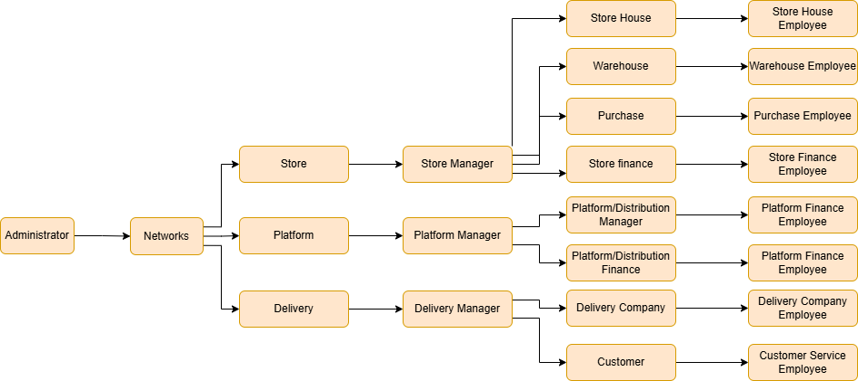
Workflow
1. Manage Employees

Slide 9
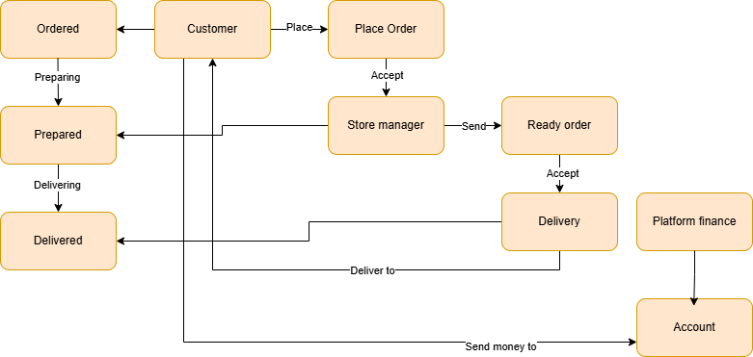
Workflow
2. Place Order

Slide 10
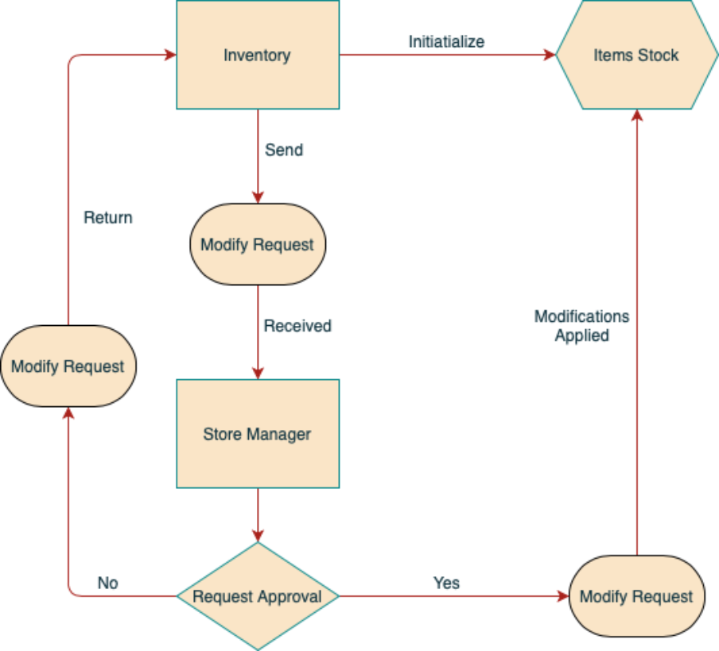
Workflow
3. Inventory Items Management

Slide 11
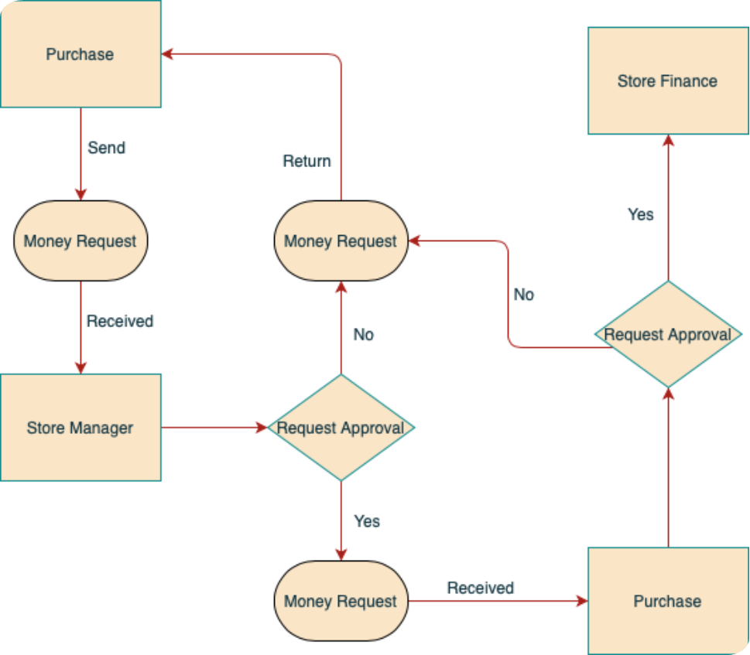
Workflow
4. Purchase for stocking up

Slide 12
Thank You!

