Slide 1
UE24CS352A MACHINE LEARNING · MINI-PROJECT 62
Machine learning for predicting sediment particle size distributions
Team B-16 · Bandugula Sai Rithesh Reddy (PES1UG24AM064) · Gagana C (PES1UG24AM099)
Reference: G. Egan, Stanford CS229, 2019 · Data: U.S. Geological Survey, doi:10.5066/P99Q4CHM

Slide 2
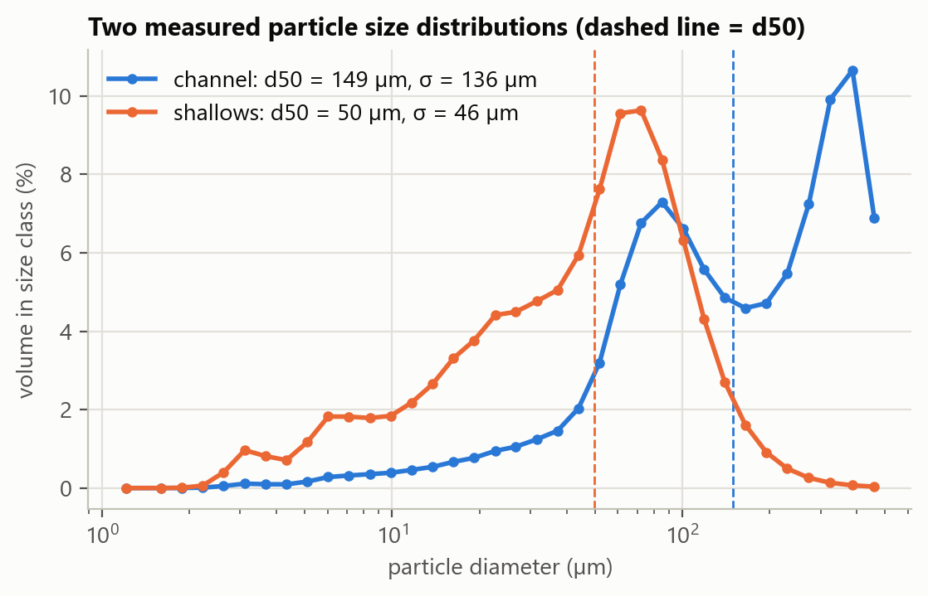
THE PROBLEM
Floc size controls how fast mud settles, and nobody can predict it well
• What happens Suspended mud particles stick together into flocs and break apart again within seconds to minutes.
• Why it matters Particle size sets settling speed, the most uncertain input to models of erosion, contaminant transport and carbon burial.
• The gap Physical flocculation models are tuned to each site; none predicts particle size in general.
• Our task Regression: predict two summaries of the particle size distribution from routinely measured water properties.
  • d50: the median particle diameter (µm)
  • σ: the spread of the distribution (µm), the square root of the paper's variance
• Success measure R² between predicted and measured values on held-out data.
2

Slide 3
REFERENCE PAPER
The reference paper reached R² of 0.75 to 0.81, and doubted its own generality
• Data 1,648 hourly samples from one instrument platform in South San Francisco Bay (2018–19). Not publicly available.
• Features Salinity, wave velocity, tidal velocity, temperature, chlorophyll, refractive index and two light-absorption ratios.
• Method Random Forest importance to pick the top four features, out-of-bag score to pick 32 trees, then SVR with a sweep over C and ε.
• Result Random Forest R² = 0.81 (d50) and 0.75 (σ²); SVR 0.76 and 0.76. Salinity dominated.
• Its open question “They could each be overfitting … rendering them less generalizable.” The models were only tested on a random split of one site's time series.
• Our plan Reproduce the method on public data, then test exactly that open question.
3

Slide 4
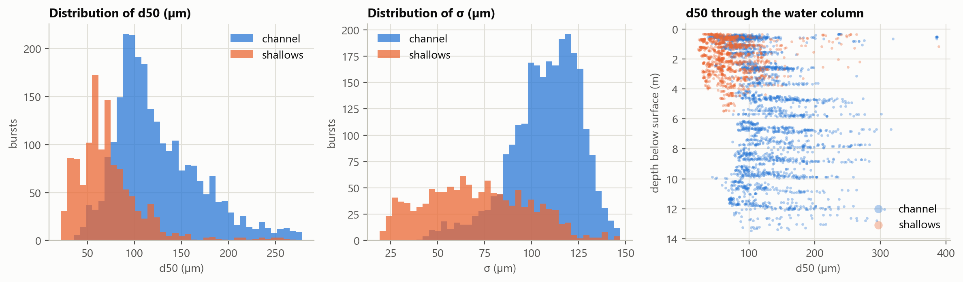
DATASET
We used USGS casts from the same bay: two sites, four days, 94 files
• Source USGS data release, South San Francisco Bay, summer 2020 (doi:10.5066/P99Q4CHM). Same bay and instrument family as the paper.
• Design Vertical casts at a channel site (11–14 m deep) and a shallows site (2–5 m), about one minute at each depth, on 21, 22, 24 and 28 July 2020.
• Contents 36-class particle size spectrum, depth, temperature and beam attenuation, once per second.
• Missing Salinity and turbidity (the CTD download links are dead); no chlorophyll or refractive index.
4

Slide 5
DATA PREPARATION
Cleaning turned 45,639 raw samples into 3,731 reliable bursts
Step | What it removes or does | Rows left
Read 94 NetCDF files | Decode the EPIC time format; drop one file that duplicates another | 45,639
Quality control | In-air samples, optical transmission outside 30–98 %, depths below the bed | 31,896
Burst averaging | Average 10 s at a steady depth so one row is one stable measurement | 3,731
Targets | Recompute d50 and σ from each averaged spectrum (r = 0.97 against the file's d50) | 3,731
• Final table 3,731 bursts from 89 casts (50 channel, 39 shallows).
• Features (7) Sensor depth, height above bed, water depth (tide stage), tide rate, temperature, beam attenuation, site.
• Left out on purpose Total volume concentration, because it is computed from the size spectrum itself and would leak the answer.
5

Slide 6
METHOD
Five models, four test protocols of increasing difficulty
• Models
  • Random Forest and SVR, as in the paper
  • Ridge regression as a linear baseline
  • Gradient boosting
  • Neural net with 10 hidden units (Sahin et al., 2017)
• Tuning, following the paper
  • Forest size from the out-of-bag curve: 50 trees
  • SVR sweep on validation casts: C = 0.25, ε = 0.03125
Test protocol | What the model has not seen
1. Random 70/30 (paper) | Individual bursts only; their neighbours are in training
2. Unseen casts (5-fold) | Whole casts
3. Unseen day | A whole day of sampling
4. Unseen site | The other site entirely
Bursts a few seconds apart are nearly identical, so a random split lets the model look up the answer from a neighbour. Protocols 2 to 4 remove that shortcut.
6

Slide 7
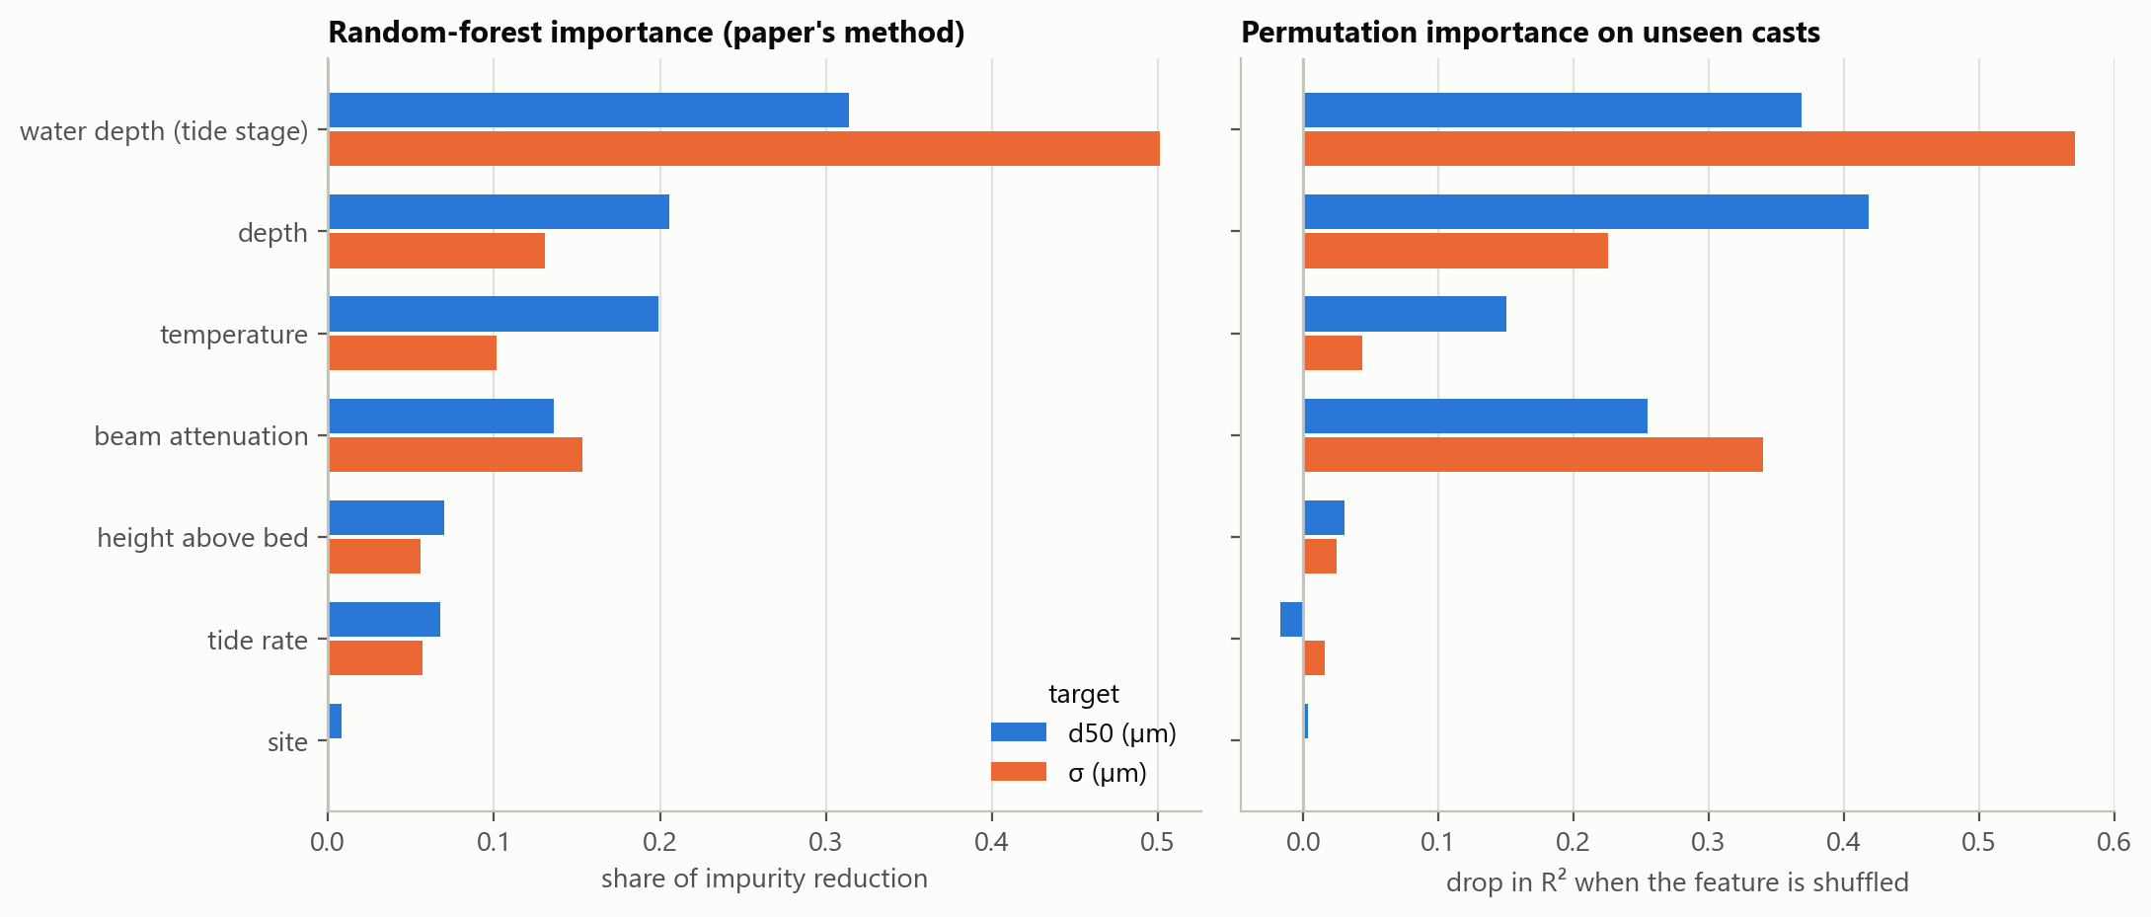
FEATURE IMPORTANCE
Tide stage, depth and attenuation carry the signal; site adds almost nothing
• Water depth (tide stage) leads for both targets (importance 31 % / 50 % for d50 / σ); salinity played this role in the paper.
• Both methods agree on the top four. Permutation importance on unseen casts rates beam attenuation higher and temperature lower than the paper's method does.
7

Slide 8
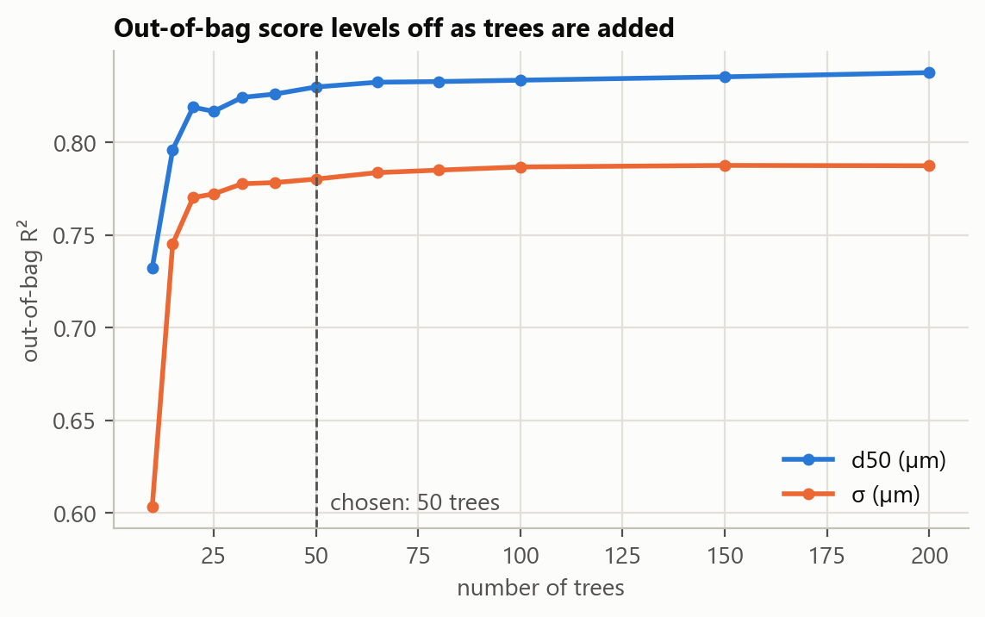
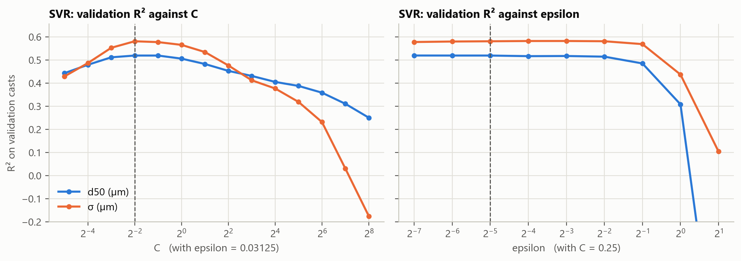
TUNING
Tuning: the out-of-bag score levels off by 50 trees; SVR prefers a small C
• We keep the smallest forest within 0.01 of the best out-of-bag R² (50 trees; the paper chose 32).
• SVR is tuned on casts it never saw, which favours a smooth fit (small C). The paper's very large C (2048) fits a random split better but memorises more.
8

Slide 9
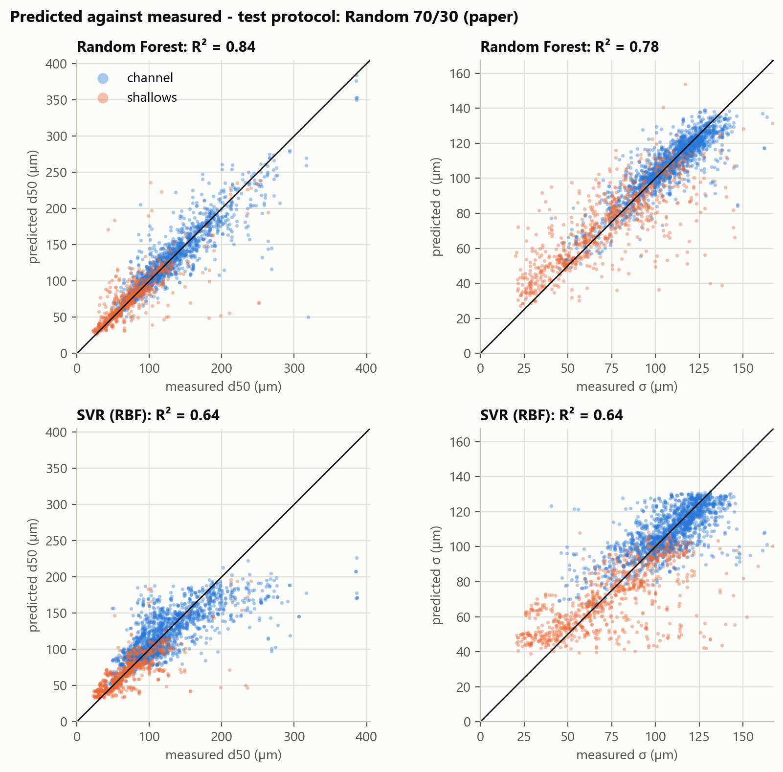
RESULT 1: REPLICATION
With the paper's random split we match its result: R² 0.84 and 0.78
Random 70/30 split | d50 | σ
Paper: Random Forest | 0.81 | 0.75
Ours: Random Forest | 0.84 | 0.78
Paper: SVR | 0.76 | 0.76
Ours: SVR | 0.64 | 0.64
• Different data and features, same headline accuracy for Random Forest.
• Our SVR is lower here because we tuned it for unseen casts, not for this split.
• Paper values for σ are for the variance σ².
9

Slide 10
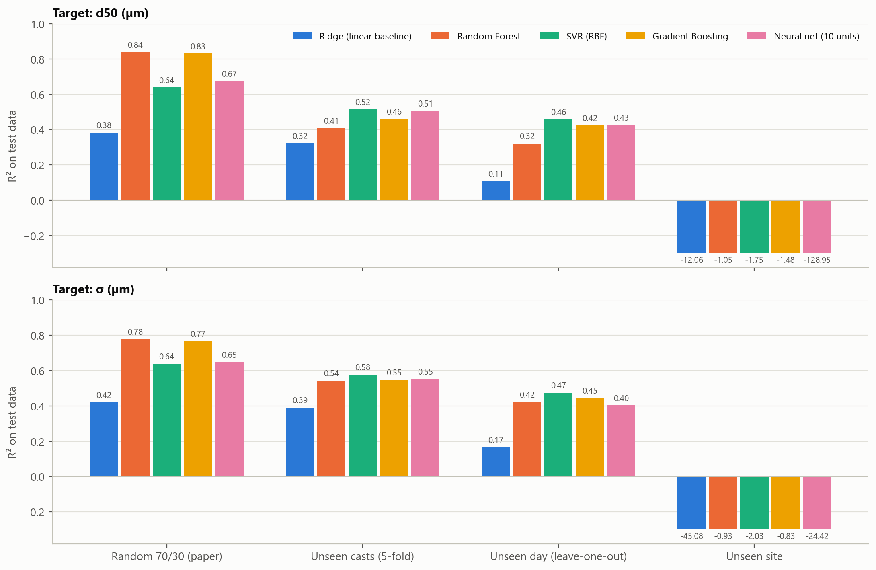
RESULT 2: GENERALISATION
On data the model has not seen, accuracy halves, then collapses across sites
• Unseen casts Random Forest drops from 0.84 to 0.41 for d50 and from 0.78 to 0.54 for σ.
• Best honest model SVR: 0.52 / 0.58 on unseen casts, 0.46 / 0.47 on an unseen day.
• Ranking flips The flexible tree models win the random split; the smoother SVR wins once neighbours are removed.
• Unseen site Every model is worse than predicting the mean. The two sites barely overlap in water depth or particle size.
10

Slide 11
CONCLUSIONS
Conclusions: about half the variation is predictable; the split decides the score
• What works Depth, tide stage, temperature and optical attenuation explain roughly half of the variation in d50 and σ on new casts.
• What the paper's score hid Its R² of 0.75 to 0.81 came from a random split of autocorrelated data. We reproduce it, then show it does not survive grouped testing. Its overfitting concern was justified.
• What does not work Transfer to a different site. A general model needs training data from many sites.
• Limitations Three to keep in mind.
  • Four days in one summer and two sites
  • No salinity or turbidity: the CTD files could not be downloaded
  • Beam attenuation comes from the same instrument as the targets
• Next steps Add the CTD and hydrodynamic data from the parent USGS release; train across more sites and seasons.
11

Slide 12
DEMO
Live demo and repository
• Rebuild everything from the raw files
  • python src/build_dataset.py
  • python src/train_evaluate.py
• Hold out one cast, retrain, compare predicted and measured
  • python demo.py
  • python demo.py --cast C21
• Predict for conditions we type in
  • python demo.py --predict --depth 6 --water-depth 12.5 --temp 21.5 --attn 20 --site channel
File | Role
src/build_dataset.py | NetCDF → clean table
src/psd.py | d50 and σ from a spectrum
src/train_evaluate.py | Models, tuning, protocols
src/plots.py | Figures
demo.py | Live demo
report/ | Write-up and slides
12

