Slide 1

Human-Centered Natural Language Processing · HCNLP 2026
LexiPath
A Stateful Retrieval-Augmented German Tutoring System
with Adaptive Learner Modeling
RAG
LangGraph
Learner Modeling
CEFR A1–B1
Shiny Naineni · Gagana Jayarama
Otto von Guericke University Magdeburg, Germany · April 2026
Group 14

Slide 2



Motivation & Problem Statement
Hallucination & Drift
No Personalization
Session Amnesia
Standalone LLMs lack grounding in verified instructional content, producing inconsistent or incorrect German grammar explanations.
Generic responses regardless of learner proficiency, prior errors, or history — every student gets the same output.
Zero cross-session memory disrupts progressive learning continuity and forces learners to repeat context each time.
German grammar demands case endings, gender agreement, verb inflection — learner error patterns are regular but unique to each individual.

Slide 3
Research Questions & Contributions
Research Questions
Key Contributions
RQ1
Does integrating a stateful learner model with RAG improve tutoring quality?
Stateful RAG-based tutoring with persistent learner model
Dynamic Diagnostic-driven CEFR level estimation (A1–B1)
RQ2
Does LexiPath maintain learner state across sessions?
Curated German grammar corpus (~1,240 documents)
RQ3
Does retrieval improve response stability?
Comparative evaluation: response quality, retrieval reliability, multi-session continuity
3

Slide 4
Methodology: Comparative System Design
BASELINE 1
BASELINE 2
FULL SYSTEM
State-Aware RAG - LexiPath
Zero-Shot LLM
Stateless RAG
Capabilities:
Capabilities:
Capabilities:
Parametric Memory: Limited to static weights pre-training.
Non-Parametric Memory: External Vector DB retrieval
Persistent Profile: JSON-serialized learner state machine.
Stateless Logic: Each request is independent; no historical context
Semantic Search: Cosine similarity matching on raw text chunks.
Metadata Filtering: Query restricted by CEFR level
Knowledge-Augmented: Grounded in verified external corpus.
Orchestrated Flow: Logic-driven transition between diagnostic and tutoring.
Stochastic Variance: High risk of hallucination in grammar rules.
Constraint: No tracking of learner proficiency or history.
Personalization: Weakness-weighted retrieval prioritization.
Context: Fixed token window.
5

Slide 5


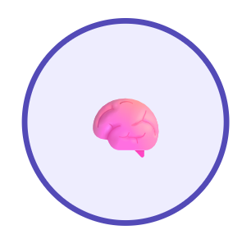

Knowledge Base:
Nicos Weg (DW)
Authentic Context
Avemio
Logical Reasoning
Nicos Curriculum
Teaching structure
DiscoResearch
Linguistic Core
Primary source for formal German grammar rules and structural linguistic patterns
Lexipath teaching structure Pedagogical Framework.
Transcripts providing situational dialogue for A1, A2, and B1 proficiency levels.
Complex reasoning tasks used to validate high-order comprehension and deduction.
Integration purpose
Grammar rules + Authentic dialogue create linguistic foundation.
Advanced reasoning validates complex language understanding.
Curriculum structure ensures systematic, pedagogically sound delivery.
Ingestion Pipeline
Uses the all-MiniLM-L6-v2 embedding model to convert language data into semantic vectors stored in PGVector for context-aware retrieval[1].

Slide 6
Dynamic Diagnostic Test:
Adaptive Assessment Framework
Adaptive and dynamic language assessment engine: The system evaluates learners through structured CEFR-based diagnostic tasks that specifically target key grammar skills.
Dynamic State Management
9-step diagnostic structure: The assessment consists of 3 grammar-focused questions per CEFR level. Each question carries 2 points, and the diagnostic stops when a learner scores below 50% at a level, ensuring precise proficiency evaluation.
Profile Integration and Learning Adaptation
Integrated learner results: After completion, the engine updates grammar mastery records and assigns a final proficiency level (A1–B1). This data enables personalized lesson support, curriculum selection, and the adaptation of future learning content[3].

Slide 7
Statefulness of the System
LexiPath persists a structured learner model (JSON) across sessions via LangGraph — enabling grounded, personalized, and continuous instruction.
Persistent Learner Profile
Cross-Session Continuity
Adaptive State Updates
Structured JSON state
Learner model stored in learners.json via LangGraph state controller
CEFR level + diagnostic results
Initial A1–B1 placement from adaptive diagnostic, updated over time
Grammar mastery tracking
Per-topic mastery scores for articles, cases, verb conjugation, and sentence structure
Error patterns + weak areas
Logged per interaction; used to weight retrieval and prioritize practice topics
New vs. returning detection
System checks learners.json at login; returning learners skip the diagnostic
Session restored immediately
Prior level, weak areas, and interaction history all reloaded from persisted state[2]
Memory keyword hits
LexiPath scores 3/3 prior-signal reuse vs. 2 (Stateless RAG) and 1 (Zero-Shot)
Multi-session recall: Strong
Qualitatively rated Strong[5] vs. Moderate (Stateless) and Weak (Zero-Shot)
Post-interaction update node
LangGraph Update node fires after every Tutor response; writes new state to disk
Level progression or reinforcement
System advances the learner or revisits weak topics based on updated mastery signals
Retrieval conditioned on state
RAG queries filtered by CEFR level and weakness profile — 0% fallback rate achieved
Interpretable and portable
JSON format allows direct inspection of proficiency, errors, and progress — no black-box memory
7

Slide 8
System Architecture
1. Learner
Identification
2. LangGraph
Controller
New vs. Returning
3. Diagnostic
Assessment
Orchestrates workflow
4. Personalized
RAG Retrieval
CEFR A1–B1 tasks
5. Adaptive
Tutoring
PGVector + MiniLM
6. State
Update & Save
Explain·Practice·Correct
Persistent learner.json
↺ Adaptive Feedback Loop — repeated every session
4

Slide 9
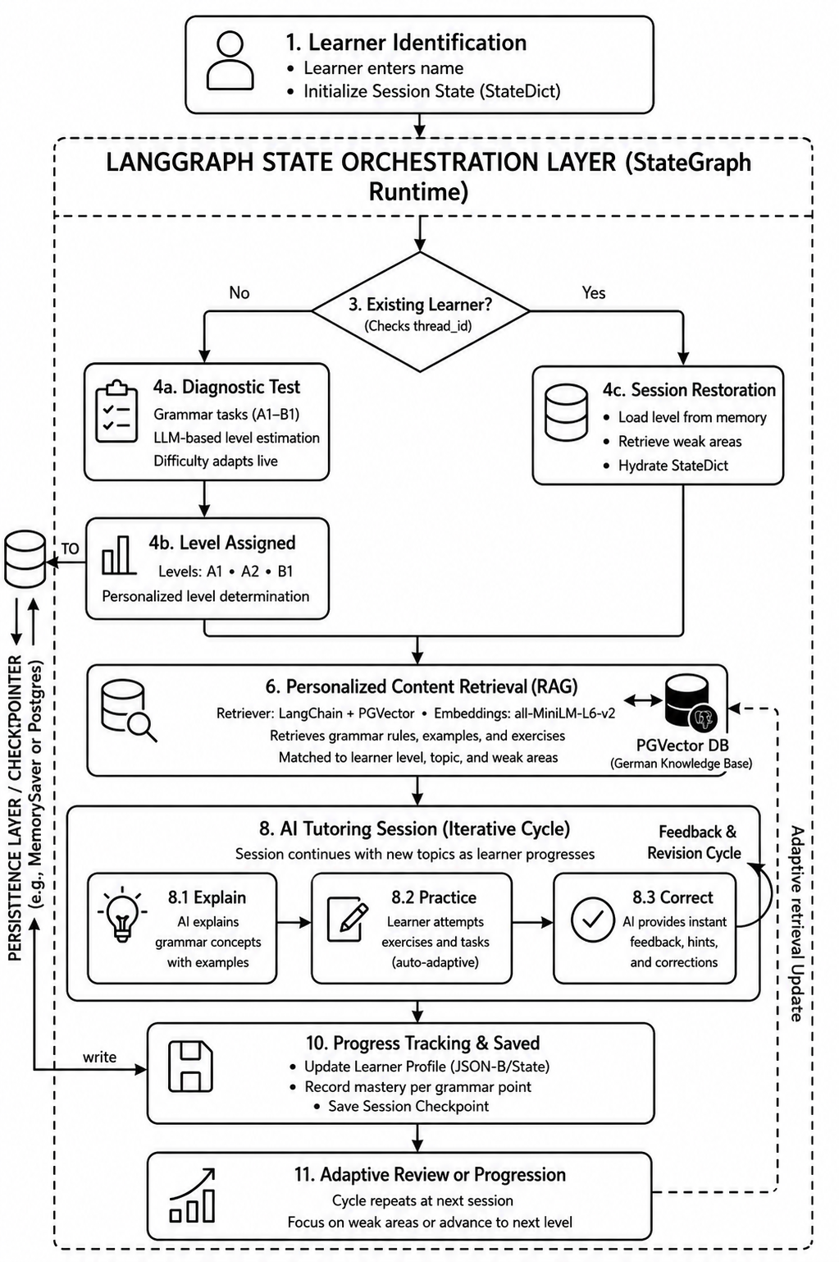
Lexipath Workflow:
Fig. 1 — LexiPath stateful tutoring workflow
5

Slide 10
Evaluation Results · 3 Systems × 3 Suites
Zero-Shot
Stateless RAG
LexiPath ✔
TUTORING
Avg Response Length (chars)
176.5
356.7
402.4 ↑
Follow-up Question Rate
0.50
0.67
0.83 ↑
Retrieval Turn Coverage
0.0
1.0
1.0 ✓
Retrieval Fallback Rate
N/A
33.3% ⚠
0.0% ✓
CONTINUITY
Memory Keyword Hits (avg)
1.0
2.0
3.0 ↑
Multi-Session Recall
Weak
Moderate
Strong ✓
Continuity Follow-up Rate
0.50
0.67
0.83 ↑
DIAGNOSIS
CEFR Level Accuracy
100%
100%
100% — shared module
Avg Diagnostic Turns
3.0
3.0
3.0
Key Takeaway: LexiPath leads on response richness (+13% over RAG, +128% over Zero-Shot), eliminates retrieval failures (0% vs 33%), and dominates multi-session memory (3 keyword hits vs 2 and 1).
10

Slide 11
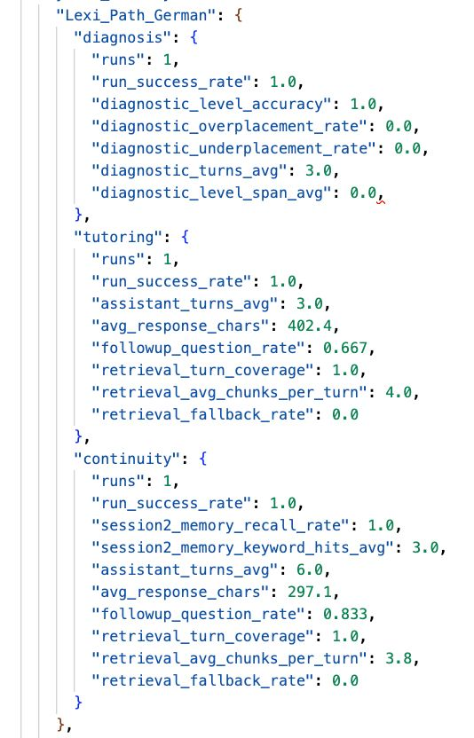
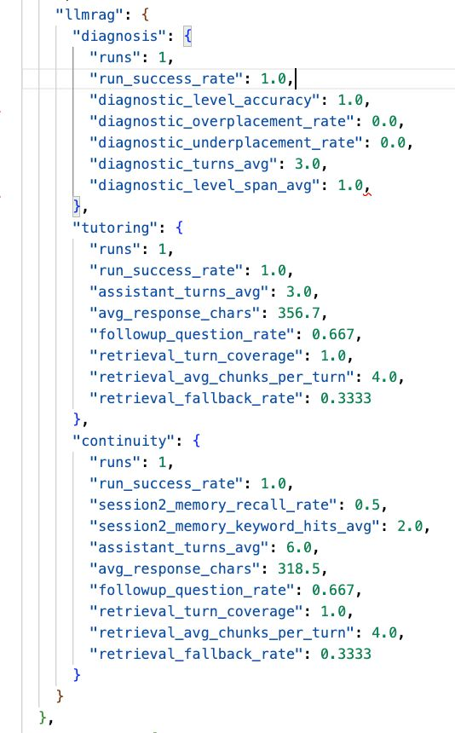
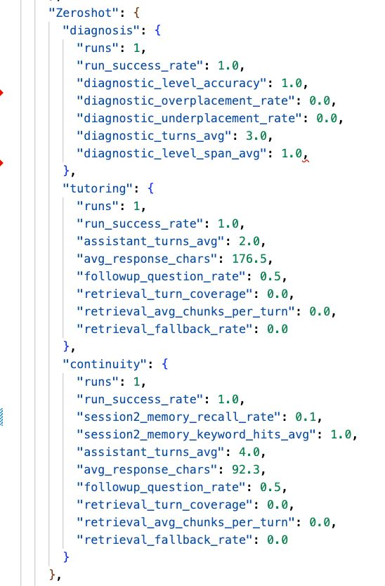
Benchmark Run Evidence · Automated evaluation output
Fig. 2 — Benchmark output: 3 systems × 3 suites (Diagnosis, Tutoring, Continuity). All runs: success=true.
Zero-Shot
176 chars · 1 mem hit · no retrieval
Stateless RAG
357 chars · 2 mem hits · 33% fallback
LexiPath ✔
402 chars · 3 mem hits · 0% fallback
11

Slide 12
User Study Findings
50
University Students
A1–B1 German Proficiency
4.3/5
"Responses felt more personalized and aligned with my actual learning needs."
"The system remembered my earlier mistakes and revisited them — unlike regular chatbots."
7

Slide 13
Limitations & Future Work
Current Limitations
Future Directions
Simulated Evaluation
Real Learner Evaluation
Primary assessment used synthetic learner scenarios, not real classroom sessions.
Longitudinal studies with actual students and learning outcome metrics.
Small User Study
Advanced Knowledge Tracing
n=50 with subjective Likert ratings — not statistically powered for significance.
Probabilistic BKT / hybrid symbolic-neural learner models.[4]
Single LLM Backend
Multi-Language Support
Tested only with kimi-k2.5 and ollama; generalizability to other models is unknown.
Generalize architecture beyond German to other target languages.
German-Only
Retrieval Optimization
Architecture not yet validated across other target languages.
Explore diverse retrieval strategies and prompting configurations.
Reproducibility Gap
Multimodal Input
Intermediate KB transformation steps not fully documented.
Speech-based interaction for pronunciation training and oral practice.
8

Slide 14
Conclusion · LexiPath
A Stateful Retrieval-Augmented German Tutoring System with Adaptive Learner Modeling
01
02
03
Grounding Works
State Enables Continuity
Combined Beats Either Alone
RAG integration eliminates hallucinations and significantly enriches response quality over zero-shot LLMs.
Persistent learner profiles drive consistent personalization and cross-session recall that stateless systems cannot match.
LexiPath’s integration of retrieval + learner state delivers the strongest performance across all four evaluation dimensions.
HCNLP 2026 · Otto von Guericke University Magdeburg · Group 14

Slide 15
References:
[1]Patrick Lewis, Ethan Perez, Aleksandra Piktus, Fabio Petroni, Vladimir Karpukhin, Naman Goyal, Heinrich Küttler, Mike Lewis, Wen-tau Yih, Tim Rocktäschel, Sebastian Riedel, and Douwe Kiela. 2020. Retrieval-Augmented Generation for Knowledge-Intensive NLP Tasks. In Advances in Neural Information Processing Systems, Vol. 33. 9459–9474
[2] Wanjun Zhong, Lianghong Guo, Qiqi Gao, He Ye, and Yanlin Wang. 2024. MemoryBank: Enhancing Large Language Models with Long-Term Memory. In Proceedings of the AAAI Conference on Artificial Intelligence, Vol. 38. 19724–19731. doi:10.1609/aaai.v38i17.29946
[3] Mieke Vandewaetere, Piet Desmet, and Geraldine Clarebout. 2011. The Contribution of Learner Characteristics in the Development of Computer-Based Adaptive Learning Environments. Computers in Human Behavior 27, 1 (2011), 118–130. doi:10.1016/j.chb.2010.07.038
[4] Chris Piech, Jonathan Spencer, Jonathan Huang, Surya Ganguli, Mehran Sahami, Leonidas J. Guibas, and Jascha Sohl-Dickstein. 2015. Deep Knowledge Tracing. arXiv:1506.05908 [cs.LG] https://arxiv.org/abs/1506.05908
[5] Luiz C. Borro, Luiz A. B. Macarini, Gordon Tindall, Michael Montero, and Adam B. Struck. 2026. Memori: A Persistent Memory Layer for Efficient, Context-Aware LLM Agents. arXiv:2603.19935 [cs.LG] https://arxiv.org/abs/2603.19935
5

Slide 16
Vielen Dank!
Fragen und Diskussion
LexiPath · Shiny Naineni · Gagana Jayarama
Otto-von-Guericke-Universität Magdeburg · HCNLP 2026 · Gruppe 14
Human-Centered Natural Language Processing · April 2026

