Slide 1
POC – LifePen API
Use Case
Pain Areas
Build a wrapper API (System Api) over the LifePen Mainframe system. To enable BSL-LifePen connectivity only through REST API’s
Build System APIs (as a bridge) over mainframe
System layer will help in defining connectivity with Mainframe
Integration solution provides loosely coupled and independent services to achieve centralized communication amongst internal systems
Architecture is scalable to accommodate future integrations in a simple and cohesive way without impacting the existing integrations
BSL layer will communicate with JSON format messages
Lack of flexibility and scalability due to a rigid architecture of policy life administration
Difficulty in integrating with underlying modular, and flexible IT architectures for payment system and customers data.
Piled up technology debt and lack of platform support of Mainframe
Slow development lifecycle and difficulty in code maintainability
Inability to refactor old code and code is not adaptable to changing new business requirements.
Challenges to support existing policies as lack of business function like policy enquiry and claim enquiry.
Complex request/response transformation for mainframe system

Slide 2
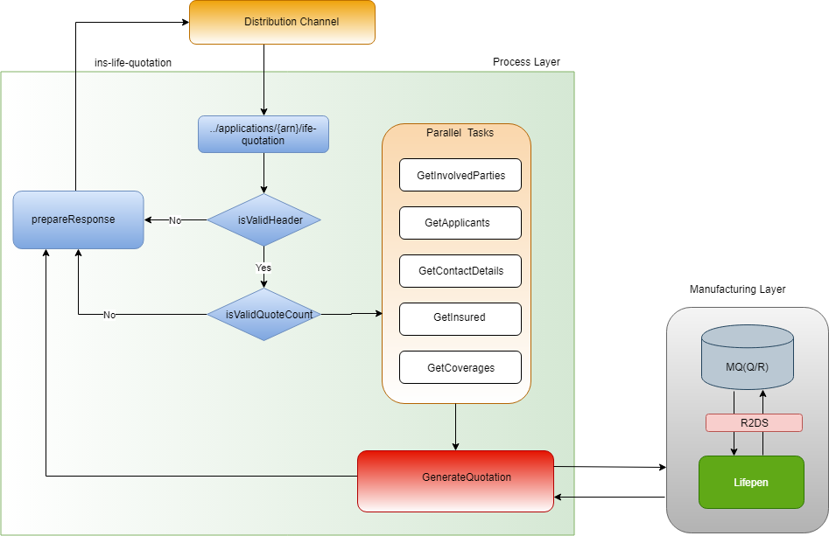
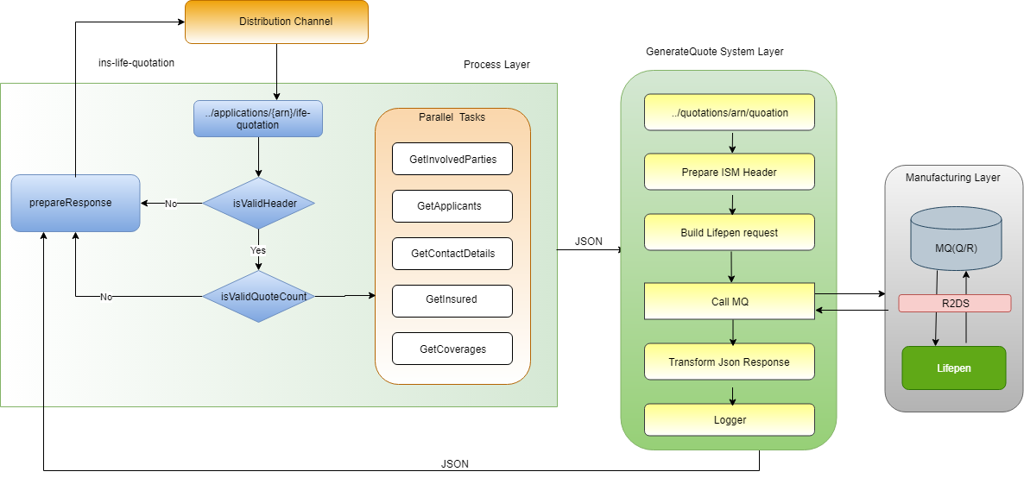
POC As-Is and Implemented Architecture
As Is Arch
To be Arch
No System API
System API Layer
Outcome
API over LifePen system enabling all other application to consume LifePen services with RESTFul services
LifePen complexities are abstracted behind the API’s
Mulesoft components and connecters reduces the development time to great extend
All LifePen business functions can be exposed using API’s for seamless integration

