Slide 1

Banking Risk Analytics
Role – Data Analyst

Slide 2
About Company
Meridian is Ontario’s largest credit union, and second largest in Canada, helping to grow the lives of more than 360,000 Members.
Origins: Formed in 2011 through a merger involving the former Desjardins Credit Union in Ontario.
87 branches and 15 Business Banking Centers across Ontario.
On-Balance Sheet Assets: $26.8 billion More than 75 years of banking history.
2,100+ employees at Meridian Credit Union.
Meridian Credit Union Corporate offices in St. Catharines and Toronto.
Subsidiaries: Meridian OneCap Credit Corp and the digital-only bank, motusbank.

Slide 3
Team Structure
Business Analyst
Azure Data Engineer(3)
Cloud/Infrastructure Engineer
Power BI Data Analyst (2)
Risk Analyst
Tester (QA)
Scrum Master
Product Owner

Slide 4
Project Overview
Built an end-to-end banking analytics solution using Azure Data Factory, Azure SQL, and Power BI
Design a interactive dashboard to deliver real-time credit risk insights and improve decision-making.
Project supports full load and incremental load.
Solution meets business values.

Slide 5
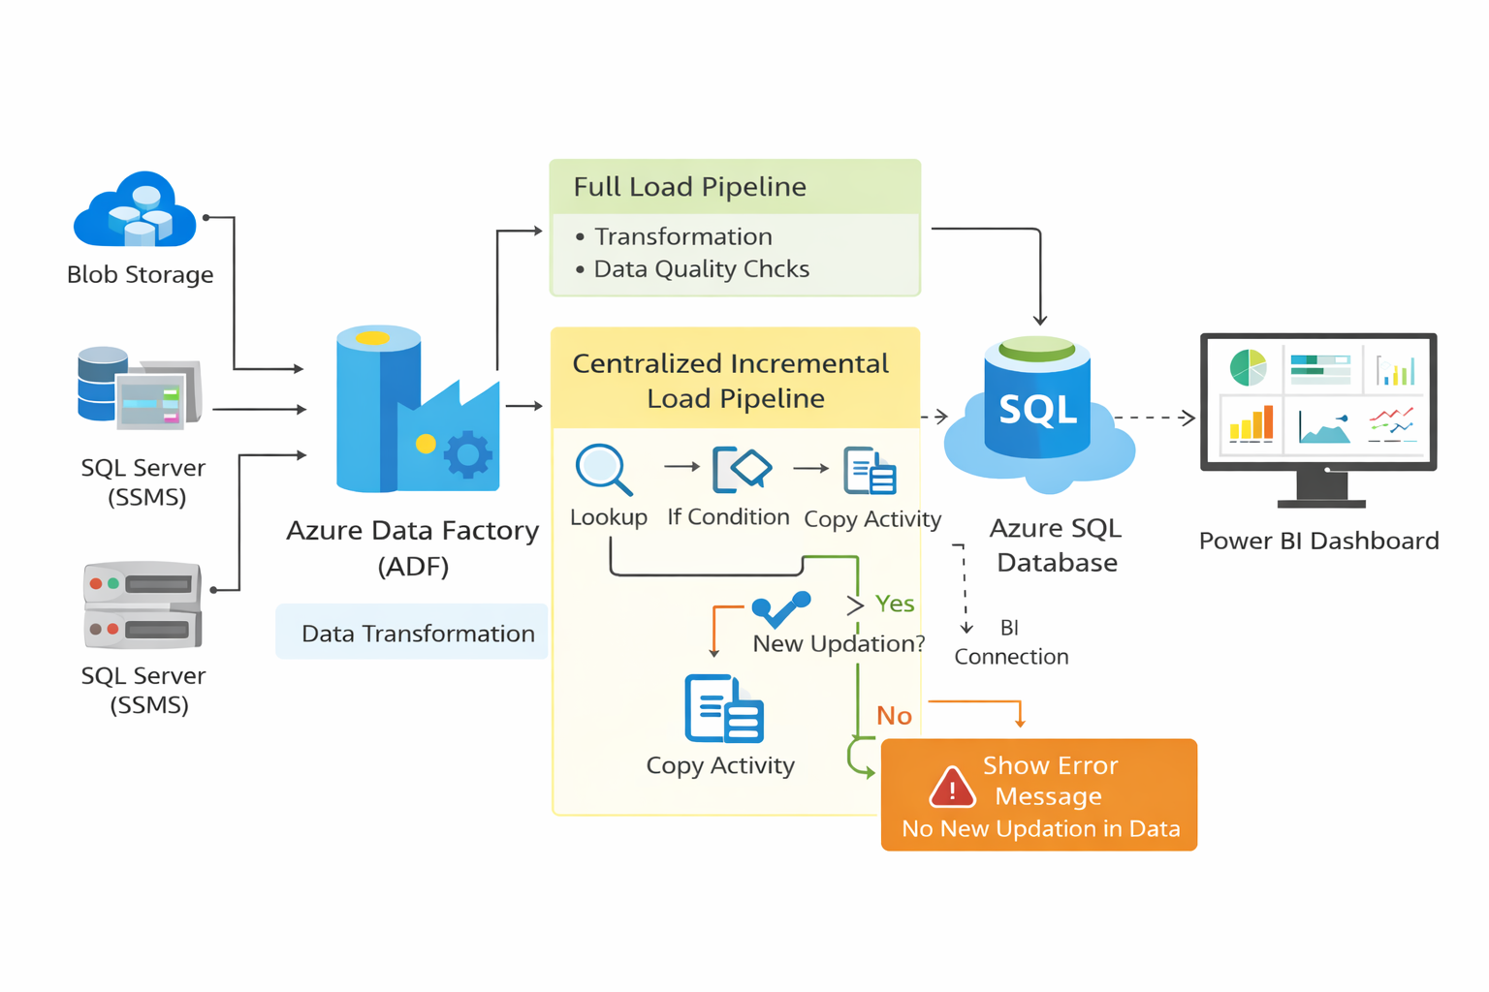
Project Architecture Overview
End-to-End Data Analytics Workflow (Azure + Power BI)

Slide 6
Situation (STAR)
Bank generate revenue by lending.
Every loan carries risk due to delay or failure of repayment.
Manual reporting was difficult and inaccurate.
Limited Visibility into high risk customers.
Delay and improper decision making process due to large number of data.
Overall impact on Risk Management and loan approval process.
High risk of financial loss and liquidity imbalance.

Slide 7
Task(STAR)
Collect the data from heterogenous sources.
Build centralized pipeline with incremental load.
Perform data quality and transformation.
Ensure data security based on RBAC.
Define meaningful and interactive KPI’s .
Support agile delivery with clear reporting requirements

Slide 8
Action(STAR)
Data Extraction and Ingestion
After the approval of feasibility study, data is extracted and load into and ADF pipelines
Azure blob storage( CSV) - Auto Resolve Integration Runtime
SQL Server Management Studio - Self-hosted runtime
Data Quality and Transformation
Remove missing and null values.
Handle Duplicate records.
Applied data Type casting and standardization.
Add derived columns with Business logics.
Used ADF mapping data flow to sort, aggregate and join the tables.

Slide 9
Action(STAR) cont..
Business Calculations and Enrichments
Add following conditional columns according to Business perspective by using derived column activity in ADF.
Income Category
Engagement Days
Engagement timeframe
Cleaned data load into Azure SQL database. (Full Load).
Design a Centralized automated pipeline with incremental load by using :-
Lookup activity
Copy activity
Display log message “ No new insertion”
Schedule pipeline execution every two days at 8 PM using ADF trigger.

Slide 10
Action(STAR) cont..
Implement RBAC for secure data access.
Power BI Reporting and Analytics.
Connect Azure SQL Database to Power BI.
Develop interactive and actionable dashboard for Loan, Deposit and Clients Analysis by using different KPIs.
In Data Modeling, Snowflake schema is used.
Dax measures are used.

Slide 11
Action(STAR)
Implement RBAC for secure data access.
Power BI Reporting and Analytics.
Connect Azure SQL Database to Power BI.
Develop interactive and actionable dashboard for Loan, Deposit and Clients Analysis by using different KPIs.
In Data Modeling, Snowflake schema is used.
Dax measures are used.

Slide 12
Result(STAR)
Reporting time reduced significantly
Early identification of high-risk loans
Proactive action is taken to manage the risk.
Fasten the process of loan approval.

Slide 13
Challenges
Data Quality & Consistency Issues
Handling Incremental Loads Accurately
Complex Business Logic Understanding
Security & Compliance Constraints

Slide 14
Tools and Technologies
Power BI (DAX, modeling)
Azure SQL Database
Azure Data Factory
SQL Server / SSMS
Excel
Azure Blob Storage
Azure Data Factory

Slide 15
Dashboard Walkthrough

Slide 16
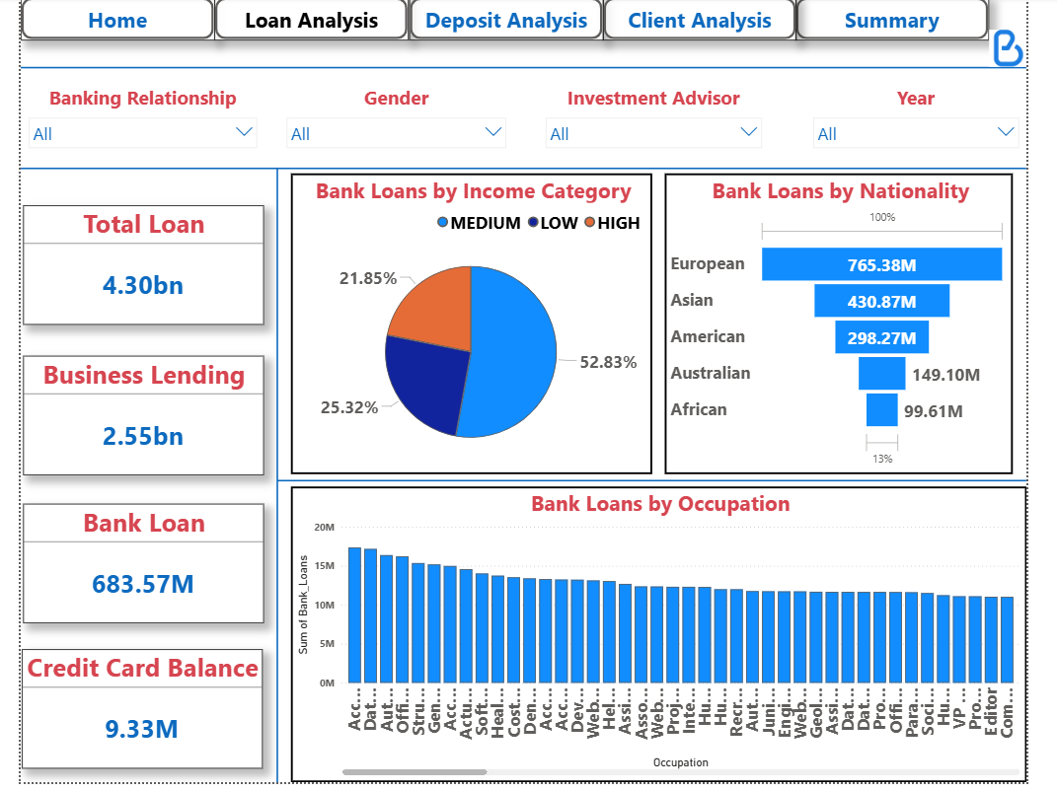

Slide 17
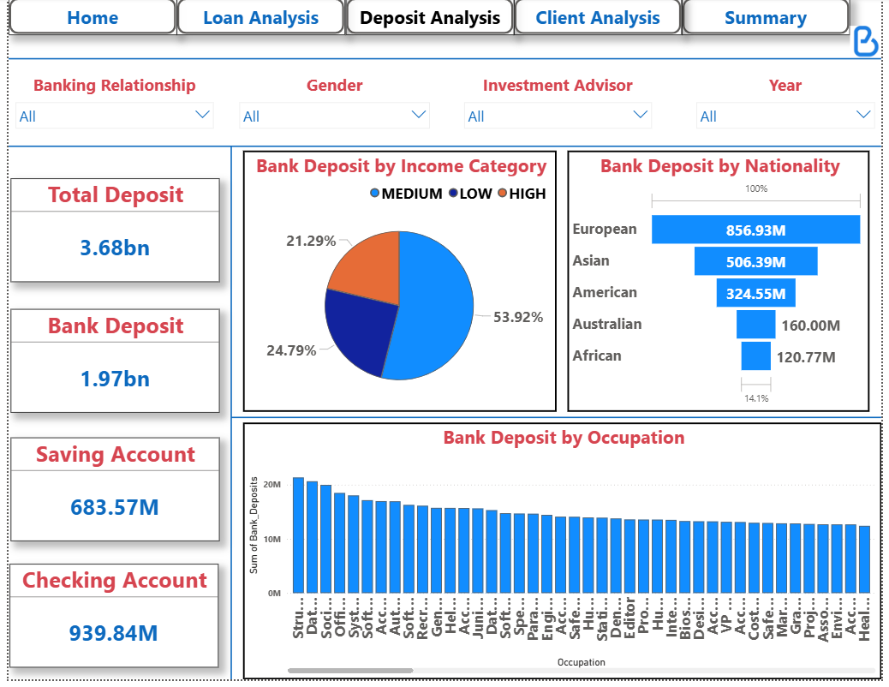

Slide 18
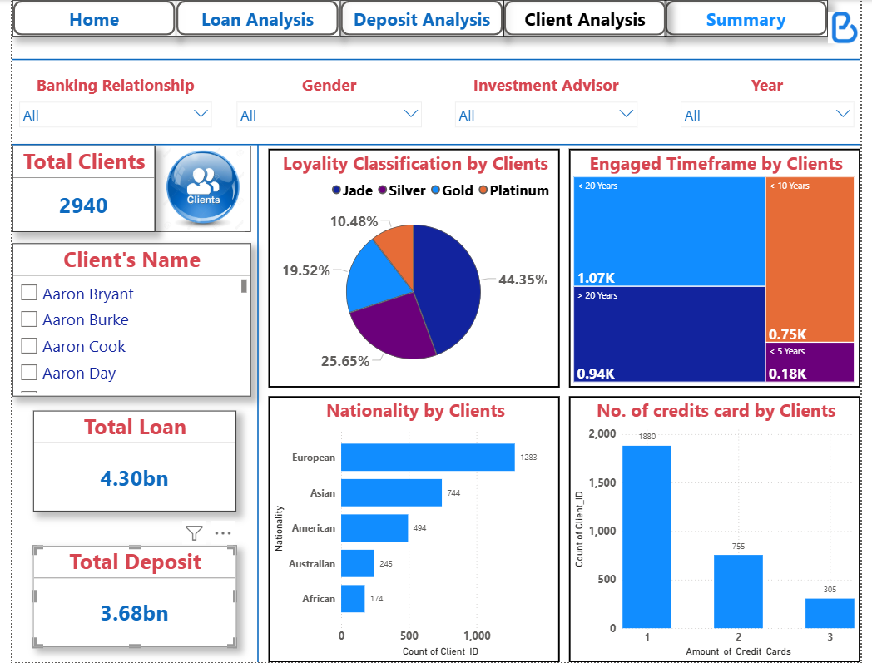

Slide 19
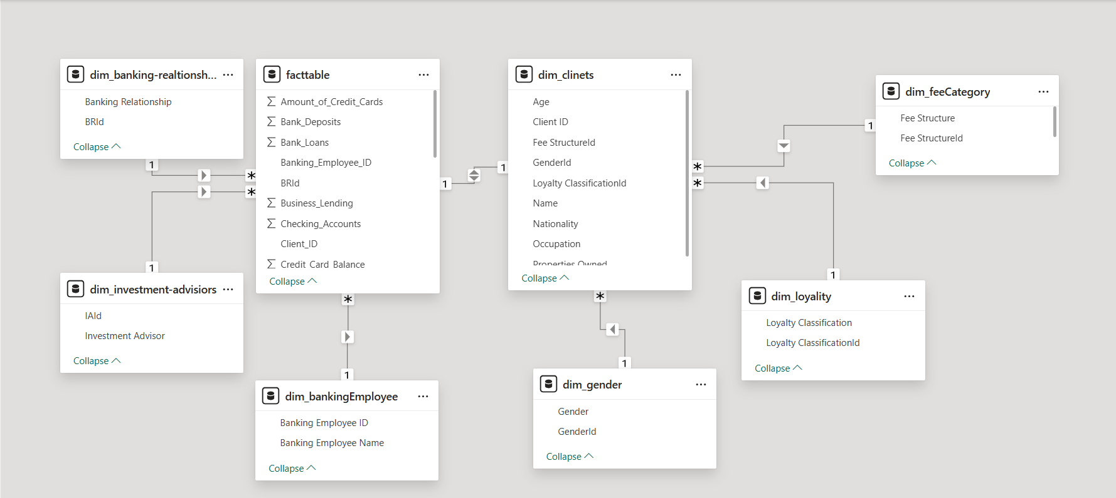

Slide 20

Azure Data Factory – ETL Workflow
End-to-end data extraction, transformation, loading, and reporting flow used in the banking risk analytics solution.
Extract
Load
Report
1. Data Sources
2. Azure Data Factory Pipeline
3. Azure SQL
4. Power BI
Azure Blob Storage
Extract & Ingest
Copy Activity
Centralized
clean data store
Interactive
risk dashboard
CSV files
Data Quality
Nulls • duplicates • data types
SQL Server / SSMS
Transform
Mapping Data Flow
Full load
+
Incremental load
Operational banking data
Loan • Deposit
Client KPIs
DAX + Snowflake model
Enrich
Derived columns + business logic
Integration Runtime:
Auto Resolve + Self-hosted
Load Control
Lookup • incremental load
RBAC-secured access
Trigger: every 2 days at 8:00 PM • “No new insertion” when no new rows
ETL outcome
Reliable centralized data • Better data quality • Faster reporting • Earlier identification of high-risk loans
Banking Risk Analytics | Azure Data Factory | Full + Incremental Load

