Slide 1
Self Driving Car Game
MMP
(Minimum Marketable Product)
Presentation

Slide 2

Group Members
Bhaviya Chopra (TL)
Gagandeep Singh
Favour Eseagwu
Ashwin Philip
Mohammedfaiq Shaikh

Slide 3
Work Done
We continued by doing some image processing.
We cropped the image to remove the unnecessary features, changes the images to YUV format, used gaussian blur, decreased the size for easier processing and normalized the values.

Slide 4
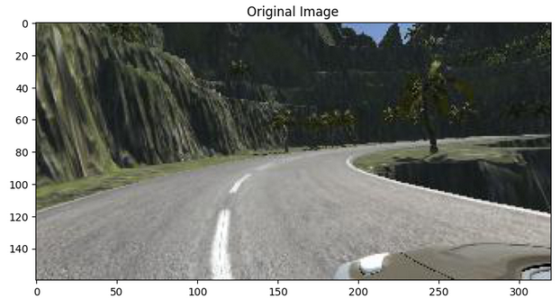
To compare and visualize we plotted the original and the pre-processed image.

Slide 5
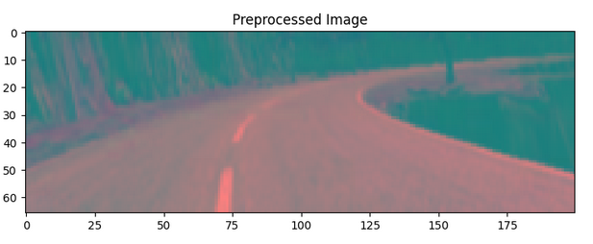

Slide 6
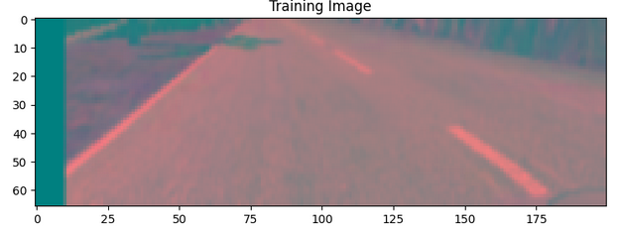
Next, we converted all the images into numpy array.

Slide 7
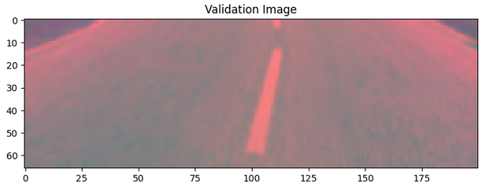

Slide 8
CNN model
We defined a function called NvidiaModel() that creates and compiles a Convolutional Neural Network (CNN) model using the Keras library with a TensorFlow backend.
We created a new Keras Sequential model.
We added the first 2D convolutional layer to the model. It has 24 filters with a size of 5x5, and it uses the ELU (Exponential Linear Unit) activation function.

Slide 9
Then added another 2D convolutional layer with 36 filters, using the same settings as the previous layer.
Added a third 2D convolutional layer with 48 filters and the ELU activation function. It also uses a stride of 2.
Added another 2D convolutional layer with 64 filters and the ELU activation function.
The model is compiled with the Adam optimizer, which is an adaptive learning rate optimization algorithm.

Slide 10
We printed the summary of the model, which gives an overview of the entire neural network structure, including the input shape, output shape, and the number of parameters in each layer.

Slide 11
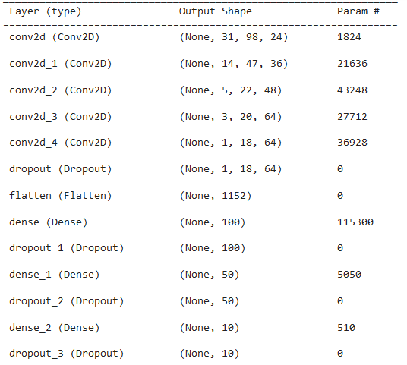
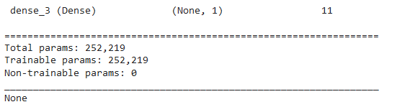

Slide 12
We used the fit_generator() method in Keras to train a neural network model using a custom data generator for batch training.
After running the model.fit_generator() function with the arguments, it will train the model using the provided custom data generator and perform training for 10 epochs. During each epoch, it will process 300 batches of training data and 200 batches of validation data, showing progress bars in the console.

Slide 13
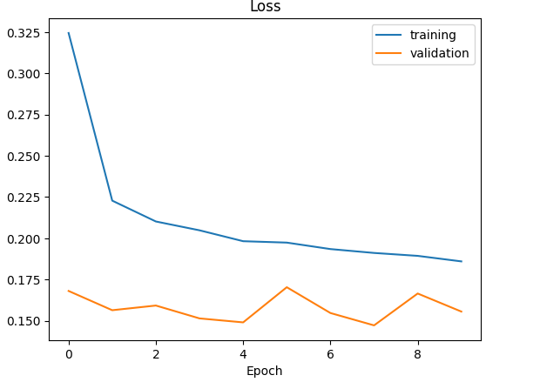
Then we plotted a line plot showing the training and validation loss values over the training epochs.

Slide 14


