Slide 1

AI Product Design for Language Model-Powered Q&A Bot
Group 14
Gagandeep Singh
Ashwin Philip
Preeja Vimala Antony

Slide 2
Introduction
In this AI product design, we present the development of a Language Model (LLM)-powered Question and Answer (Q&A) Bot. Our project leverages advanced language models to create an interactive and user-friendly AI application that provides answers to user queries based on input text documents. The Q&A Bot integrates Gradio.io for the front-end interface and Hugging Face's transformers for language model implementation.

Slide 3

Problem Identification
Our AI product addresses the challenge of efficient and accurate information retrieval from large text documents. Users often struggle to extract relevant information from lengthy textual sources such as research papers and articles. The AI-powered Q&A Bot streamlines this process by allowing users to input a text document and interactively ask questions to retrieve specific information.

Slide 4
Language Model Selection
model "google/flan-t5-large" powerful text-to-text generation capabilities.
This model excels in generating coherent responses and handling diverse textual input formats.
goal - developing an effective Q&A Bot.

Slide 5
AI Product Design - Backend
-Custom LLM Class (customLLM): Responsible for text generation tasks.
The GPTVectorStoreIndex is used to query for a response based on the user input.

Slide 6
AI Product Design - Front-end Application
Gradio.io Integration: Provides an interactive and intuitive interface.
Input Text Document Tab: Users input text documents to build the Q&A index.
Knowledge Bot Tab: Users engage in real-time conversations with the Q&A Bot.

Slide 7
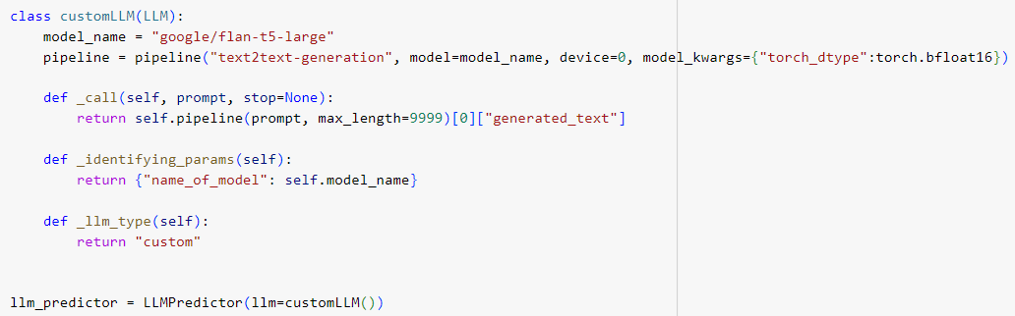
Technical Implementation - Custom LLM Class

Slide 8

Technical Implementation - Custom LLM Class (customLLM)
Our custom LLM class, customLLM, is built upon the "google/flan-t5-large" model:
- _call method generates textual responses based on user prompts.
- _identifying_params method provides model information.
- _llm_type method defines the type of Language Model.

Slide 9
Technical Implementation - Building the Index
The GPTVectorStoreIndex is used to create an index that maps user inputs to chatbot-generated responses.
It's then used to query this index and retrieve relevant responses based on the user's inputs.
The index provides a mechanism for efficient retrieval of responses associated with user inputs, making the interaction with the chatbot more responsive and contextually relevant.

Slide 10

Technical Implementation - Front-end Interaction
Gradio.io facilitates an interactive front-end interface:
01
- Input Text Document: Users submit text to build the Q&A index.
02
- Chat Interface: Users engage in dynamic conversations with the Q&A Bot.
03

Slide 11
Chat Interaction and Response Generation
User queries processed by the Q&A Bot:
- Relevant sections identified through index.
- Custom LLM generates responses for accurate answers.

Slide 12
Screenshots

Slide 13


Slide 14
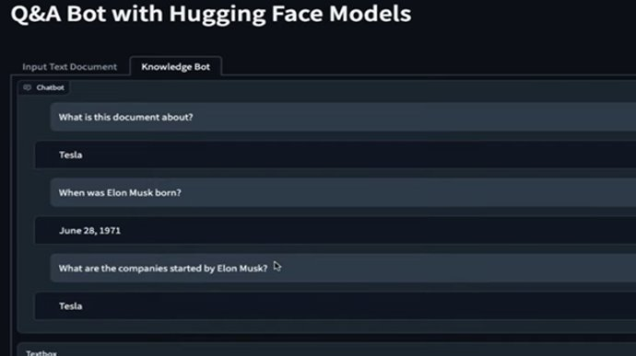

Slide 15
Limitations and Ethical Considerations
Limitations:
- Limited Context: Responses tied to input document's context.
- Complex Queries: Challenges with ambiguous or complex questions.
Ethical Considerations:
- Bias and Fairness: Potential bias in responses due to training data.
- User Responsibility: Encourage critical thinking and verification.
- Privacy and Data Usage: Secure handling of user data.

Slide 16

Conclusion
Our AI product bridges the gap between users and information, providing efficient and user-friendly access to textual content. While offering valuable benefits, it's crucial to acknowledge limitations and ethical considerations. By promoting responsible usage and addressing potential challenges, we aim to enhance the Q&A Bot's performance and user experience.

Slide 17


