Slide 1
Responsive Design with Twitter Bootstrap
-Gagan Patel

Slide 2
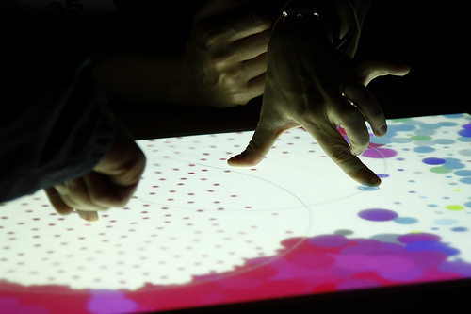
Concepts
Overview
Get started
Responsive web design
Grid System

Slide 3
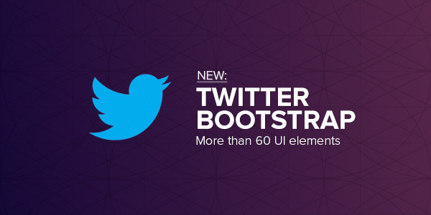
Overview
Bootstrap is a framework for front end web development and uses HTML5, CSS3 and Javascript.
One can employ responsive web designs with relative ease (the page will shrink and images will resize as the amount of screen real estate is reduced).
This framework uses a 12 column grid for initial layout of items.
It was developed at Twitter and relies on LESS CSS and jQuery.

Slide 4
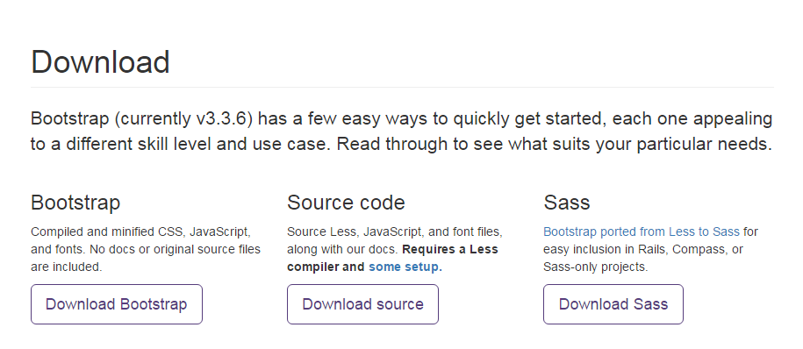
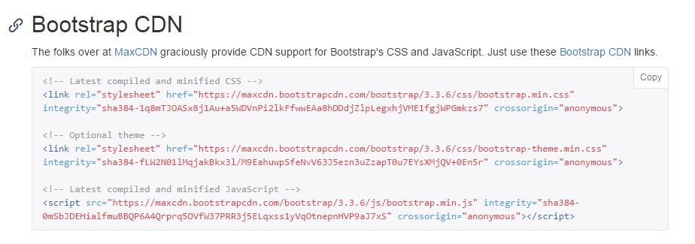
Get started

Slide 5
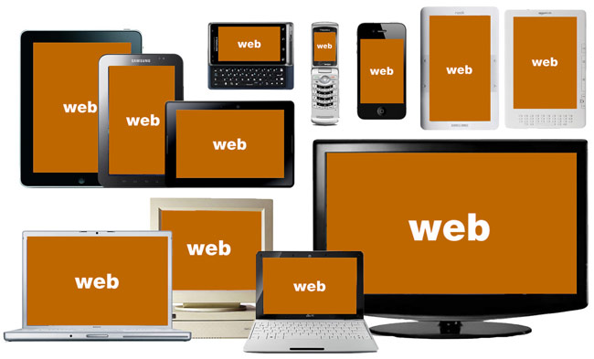
State of Today’s Web

Slide 6
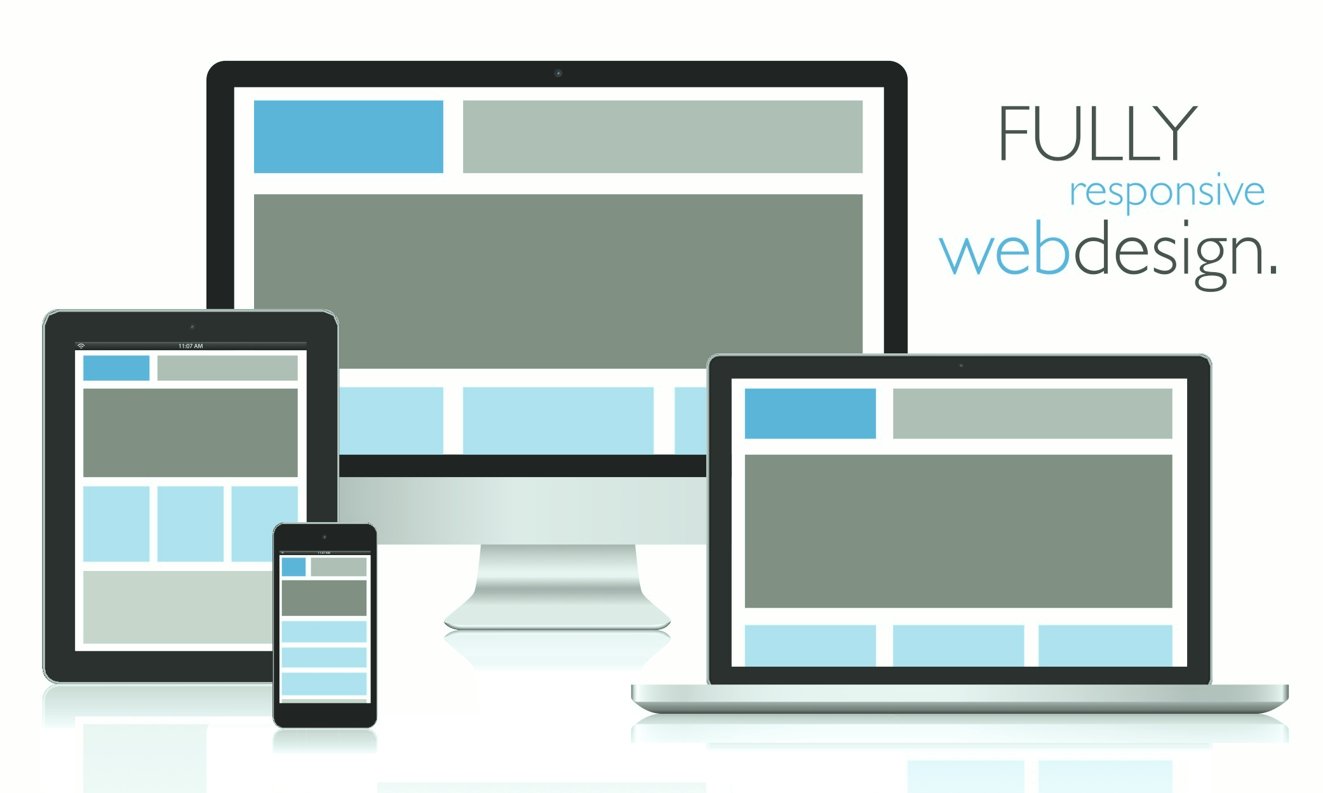
What is Responsive Web Design?
An approach to web design that provides
an optimal viewing experience across a wide range of devices.

Slide 7
Elements of RWD
Fluid Grid
Resizable Images
Media Queries

Slide 8
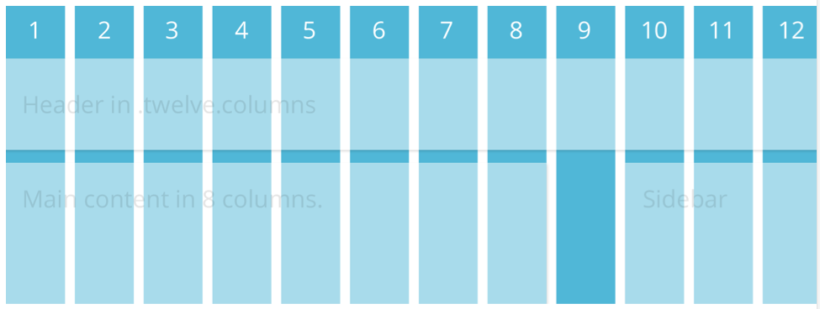
Grid System (Page 1/3)

Slide 9
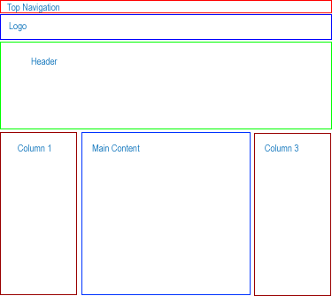
Grid System (Page 2/3)

Slide 10
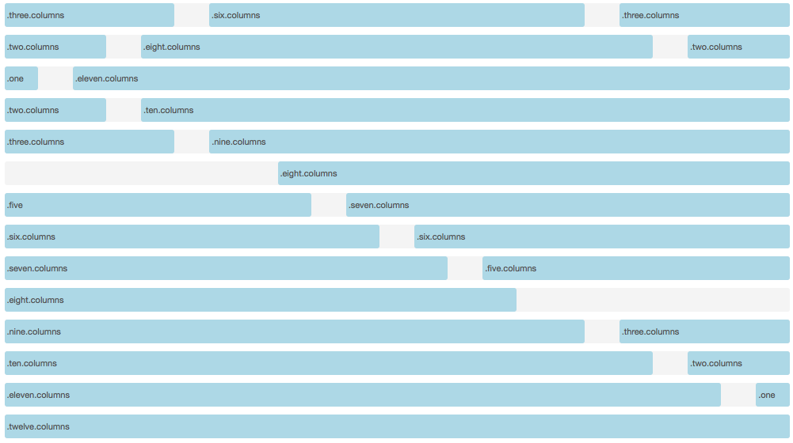
Grid System (Page 3/3)
How do grid system work

Slide 11
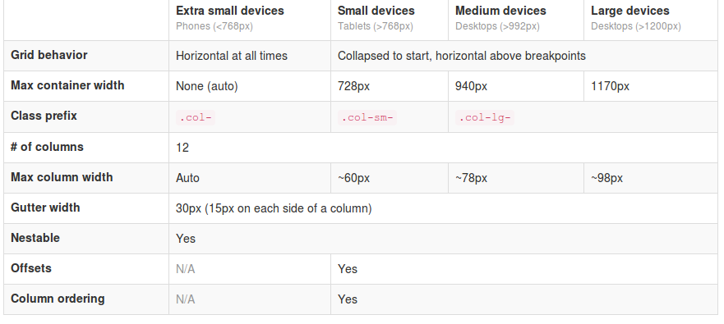
Common Breakpoints

Slide 12
Predefined classes 1/2
1. Tables
  table-stripped
  table-condensed
  table-bordered
  table-hover
2. Navbar
  navbar-fixed-top
  navbar-default
  navbar-inverse
  Navbar-collapse

Slide 13
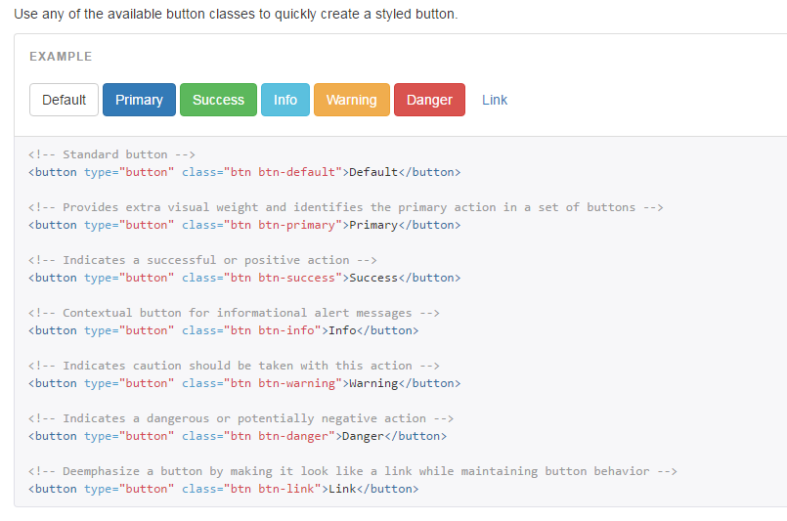
Predefined classes 2/2
3. Button

Slide 14
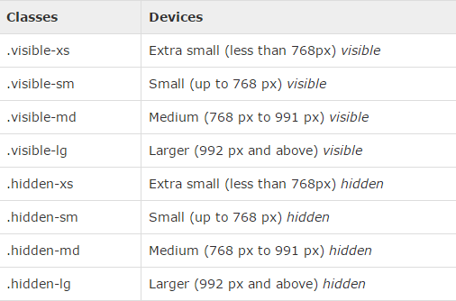
Helper classes in Bootstrap 1/4
Bootstrap provides some handful helper classes, for faster mobile-friendly development. These can be used for showing and hiding content

Slide 15
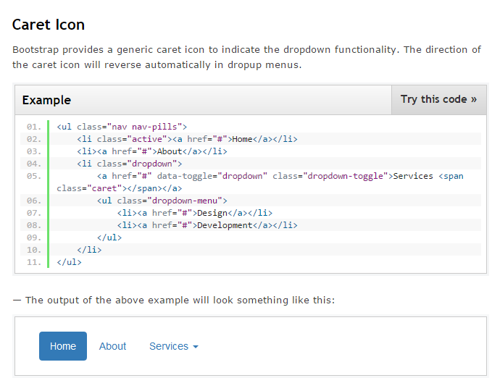
Helper classes in Bootstrap 2/4

Slide 16
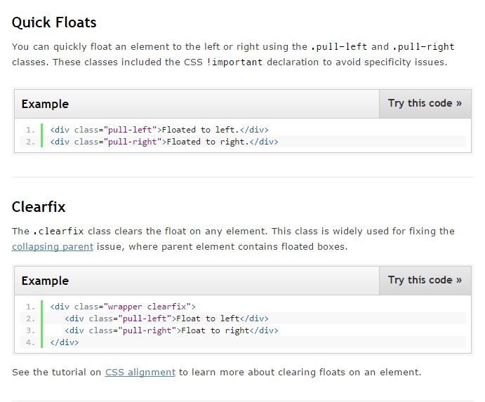
Helper classes in Bootstrap 3/4

Slide 17
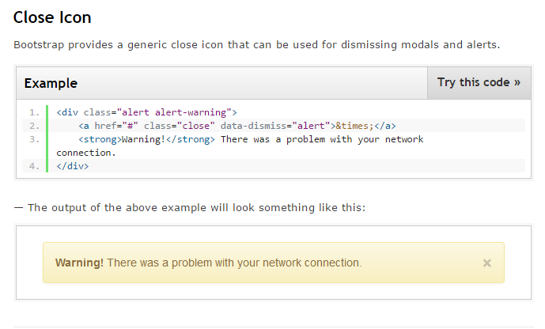
Helper classes in Bootstrap 4/4

Slide 18
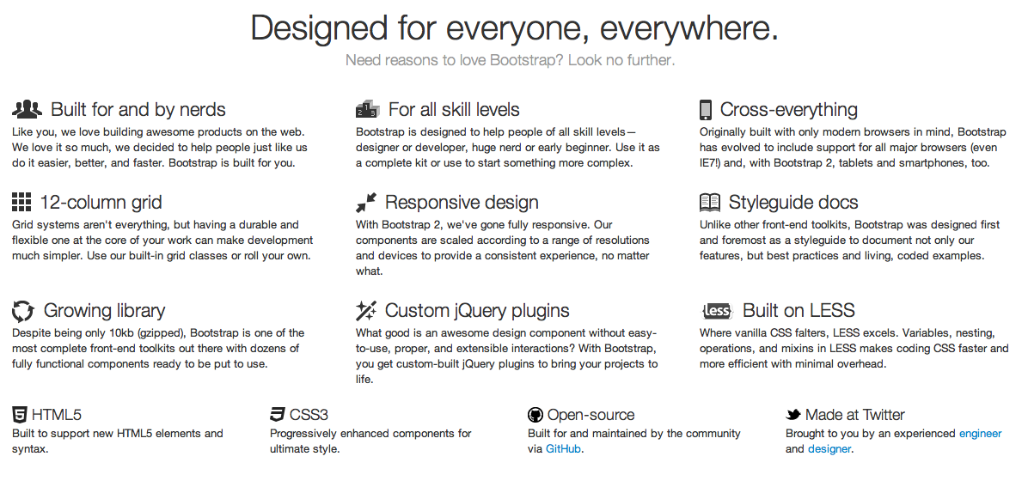
Why Bootstrap ?
Reason #1: Rich Features

Slide 19
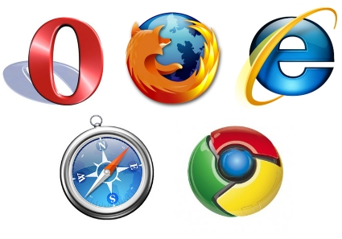
Why Bootstrap ?
Reason #2: Browser Support

Slide 20
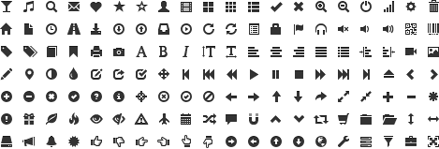
Why Bootstrap ?
Reason #3: Rich Features

Slide 21
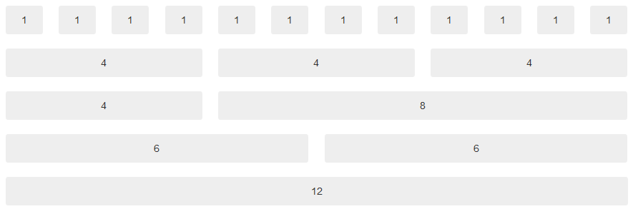
Why Bootstrap ?
Reason #4: Grid System

Slide 22

Why Bootstrap ?
Reason #5: Components
Buttons:
Tabs:
Breadcrumb:
Pagination:
Alerts:
Progress bar:

Slide 23
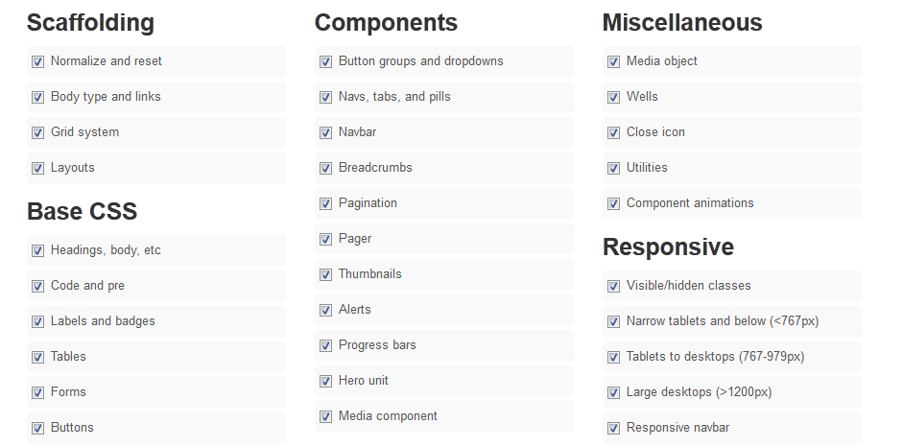
Why Bootstrap ?
Reason #6: Customization

Slide 24
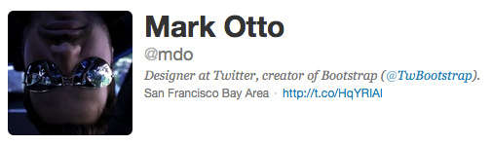
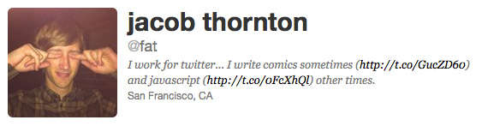
Created By

Slide 25

Questions ?

