Slide 1
DREAMS CAFE

Slide 2
Pgdca Semester - 2 Title – Dreams Cafe Name: Solanki Gagan R. Roll No :312308005 Paper No- 204 (Open Source Framework -Case Study) Guide: Dr. Ajaybhai Parikh , Dr. Bhavin Patel
Gujarat Vidyapith Department of Computer Science

Slide 3
About Site:
Cup of Dreams Cafe was established in 2015.Cup of Dreams Cafe is Ahmedabad's favorite hangout for coffee and conversation. We strive to provide the best experience to our guests. Our coffee is sourced from thousands of small coffee planters, who made us what we are today and we are happy to be a part of their lives. We opened our cafe in 2015, the young and the young immediately went to the cafe, and it is one of the most fun places in the city. Our cafe is a "hangout" spot for the youth. Where they meet people, chat and enjoy a cup of steaming coffee. It has been an exciting journey to become the best cafe ever since.

Slide 4
Objective:
Cafe business is spread all over the world. In Dreams Cafe user can get many facilities. The pleasant atmosphere and delicious coffee make people’s mood cheerful. This is our goal.
Features:
Responsive design
Social sharing feature
Multiple page styles
Auto upgrade and support
Extend with plugins
SEO- Search optimization friendly

Slide 5
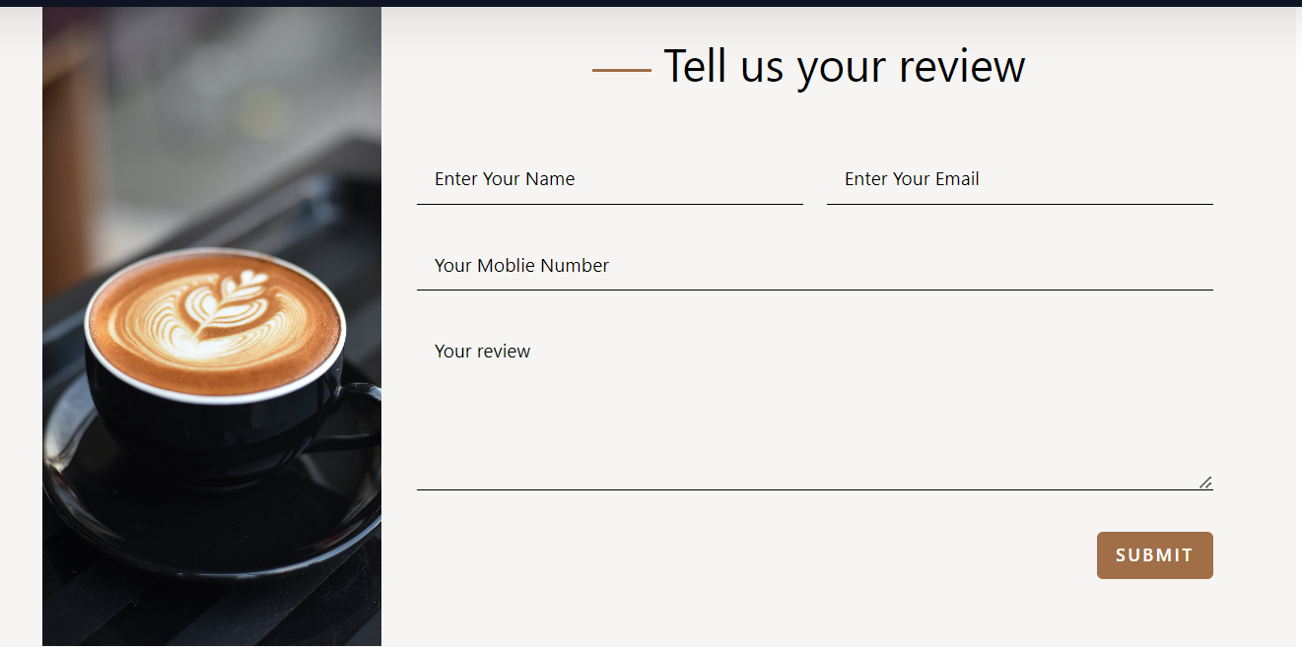
Limitations & Difference:
The website does not work when there is an internet problem. The language cannot be change in the website.
Other websites do not have a review option. It is in my website.
It gives the information about coffee and their types.

Slide 6
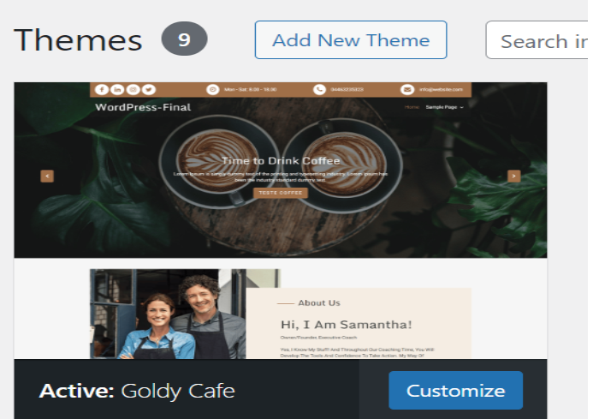
Theme:

Slide 7
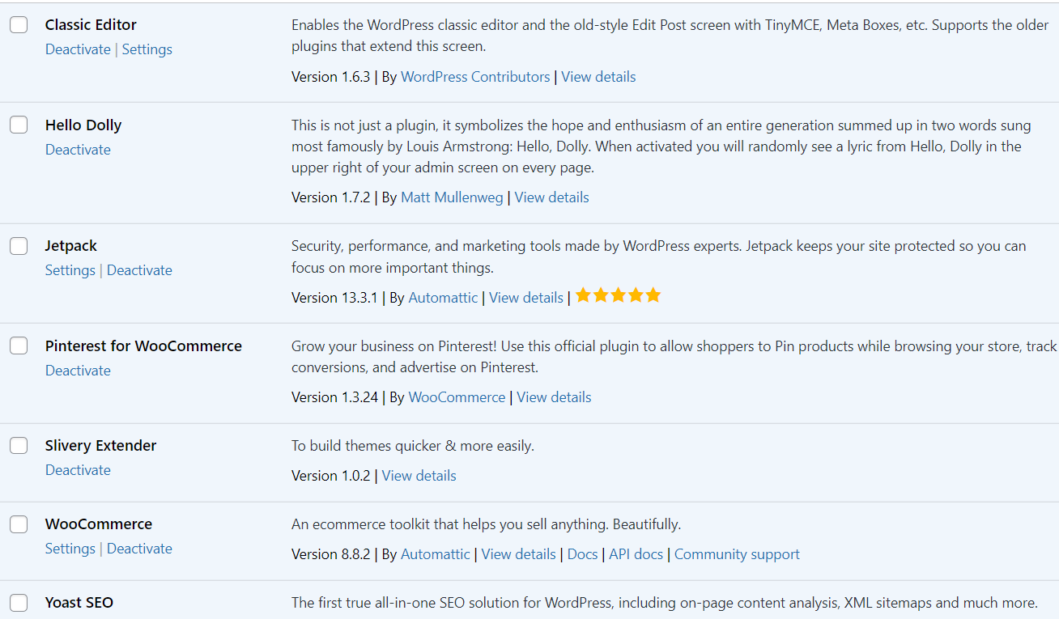
Plugins:

Slide 8
Plugins Information:
Classic Editor, Hello Dolly , Jetpack, Slivery Extender, Yoast SEO
WooCommerce:
WooCommerce is an open-source flexible software solution built for WordPress-based websites. It is commonly used to create online e-commerce stores. With this software solution, anyone can turn their regular website into a fully functional online store with all the necessary e-commerce features.

Slide 9
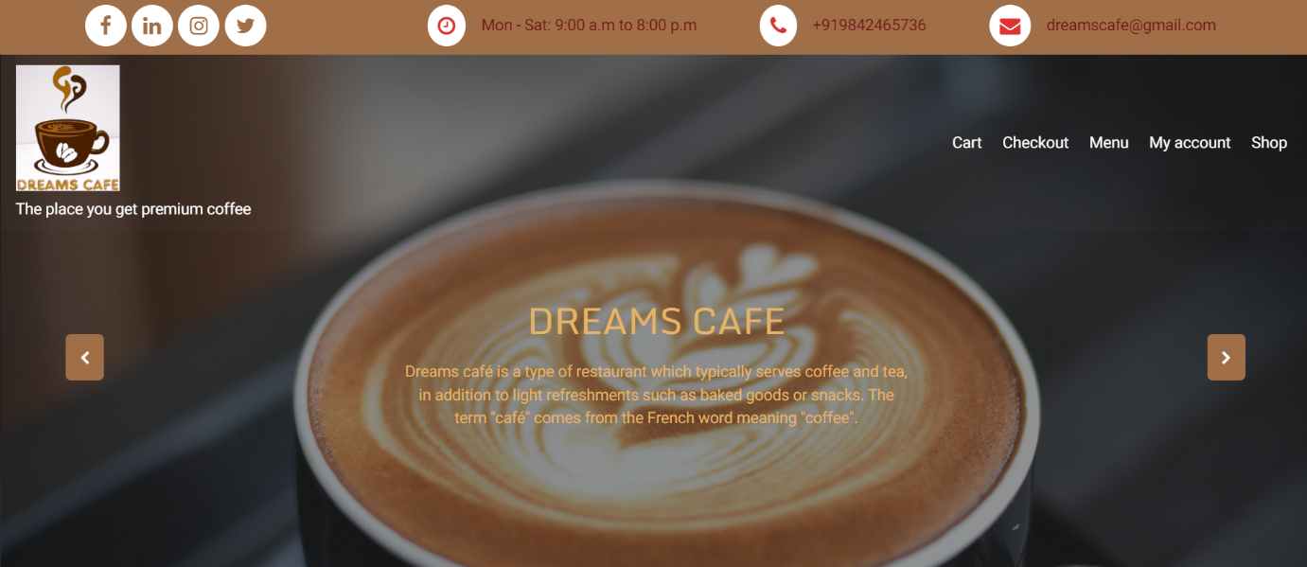
HomePage:

Slide 10
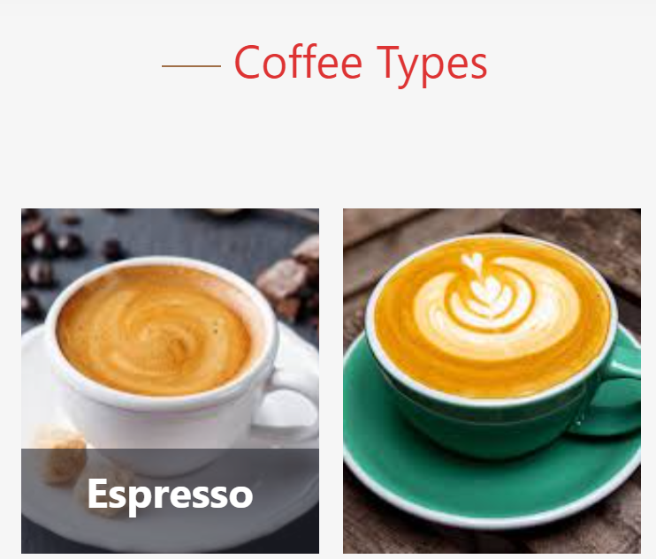
Uniqueness:
The site gives information about the coffee types.

Slide 11

Theme Loader:
Theme loader gives site a visual delight.
Apart from normal loading this unique loader runs when site is loading.

Slide 12

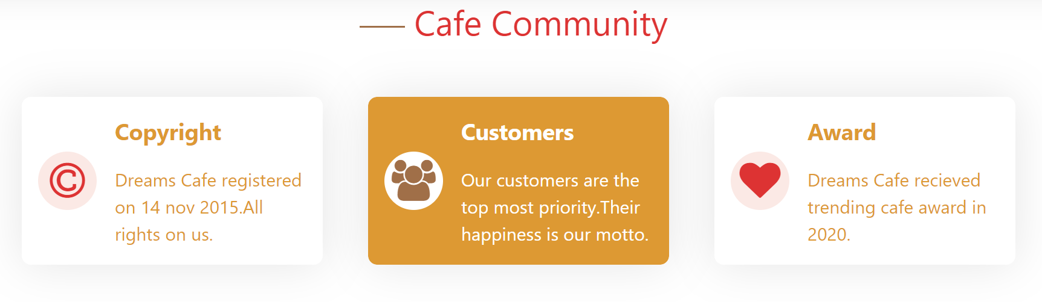
Slider & Hover Option:

Slide 13
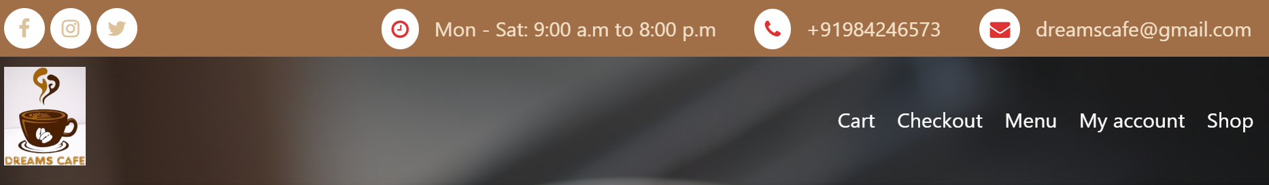
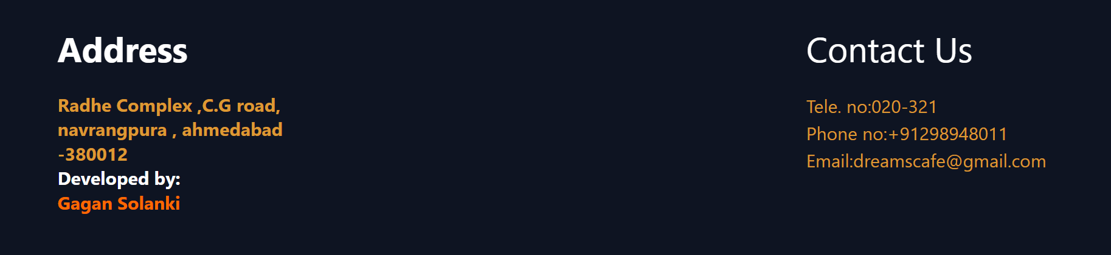
Header&Footer:

Slide 14
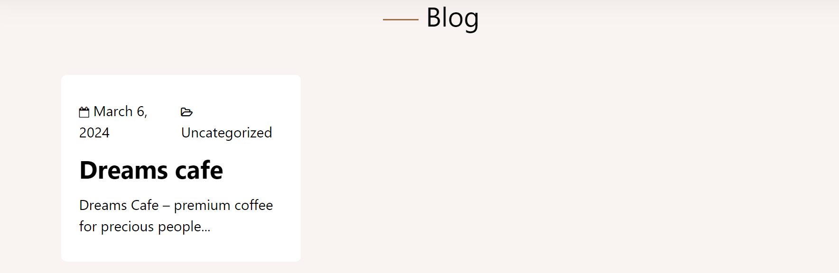
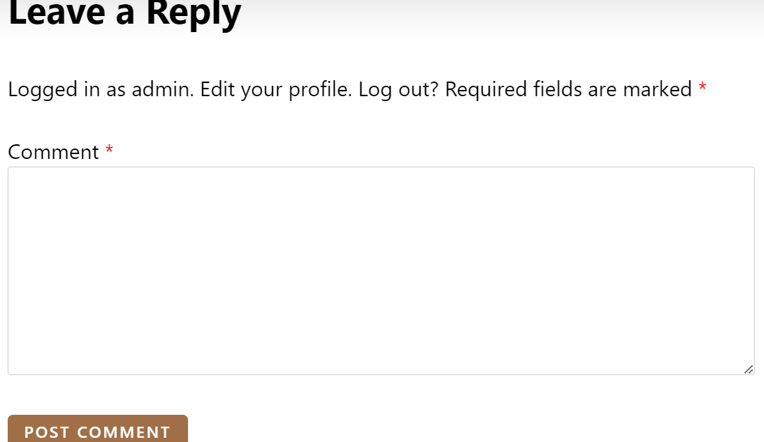
Blog: The blog has written about Dreams Cafe. User comments are written there. Customer comment option is there.

Slide 15
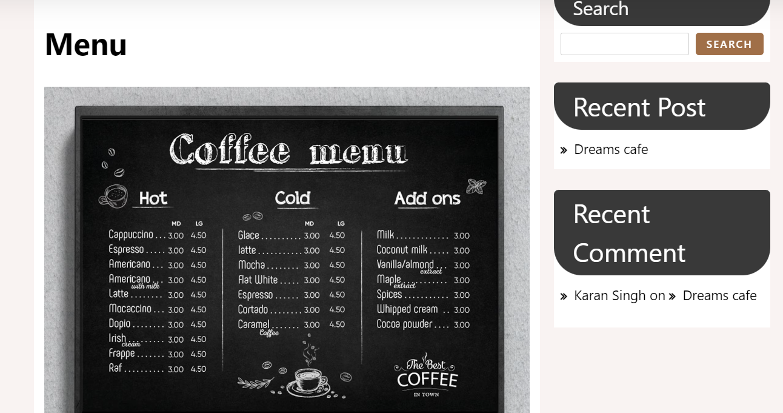
Menu page:

Slide 16
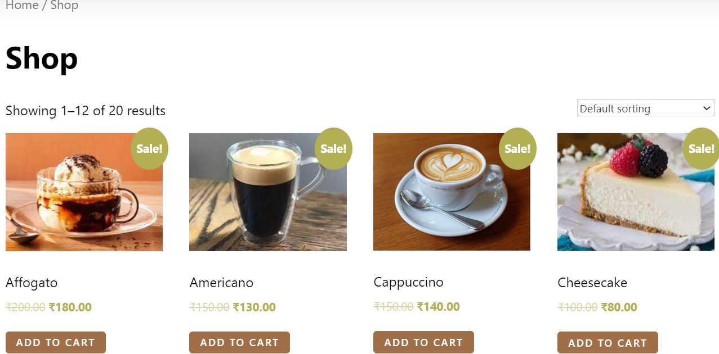
Shop Page:

Slide 17
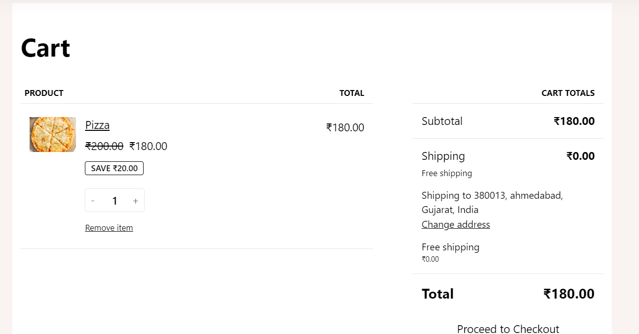
Cart Page:
From cart option we can add items and people can make payment through checkout.

Slide 18
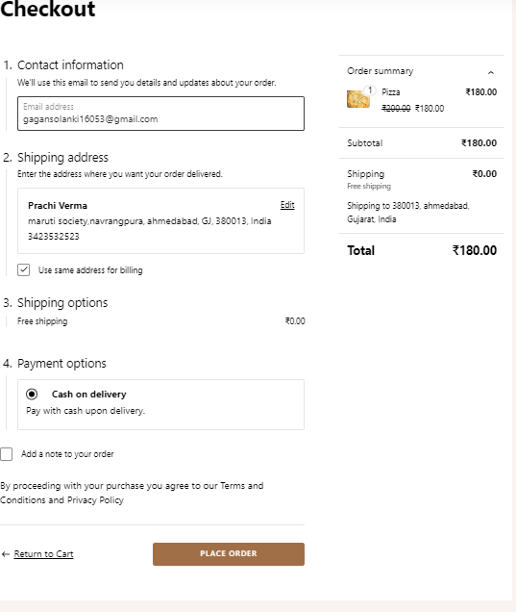

Slide 19
THANK YOU

