Slide 1
PLANT IQ SMART PLANT WATERING SYSTEM
PROJECT by
Harjot Singh - 9047603 Mehak Kakkar - 9052586 Gagandeep Singh - 8990191
Submitted TO
MEYER TANUAN

Slide 2
OVERVIEW
🌿 IoT-based system for remote plant watering via smart hub & drip devices
📱 Configure plant type, soil, and water needs through mobile/web apps
🧠 Supports default and custom settings from a built-in plant database
🛠️ Backend for managing users, hubs, and devices
👩‍💻 Admin panel for system oversight and data updates

Slide 3
RESEARCH
Smart gardening is becoming more popular around the world. We are moving it to homes.
IoT in agriculture is expected to grow over $15 billion by 2025.
Our system is based on real plant care data (like soil, temperature, and water needs).
We checked existing smart home apps to design a simple and easy user experience.
The system is designed to save water and help plants grow better.

Slide 4
BUSINESS MODEL
The application supports the enterprise through multiple revenue streams, ensuring long-term financial viability:
Hardware Sales: The primary revenue comes from selling the smart hub and water dripping pumps, generating initial income.
Subscription Plans: The app offers a free basic version and a paid premium plan with advanced features like smart scheduling, weather-based adjustments, and plant health tracking.
In-App Purchases: Users can buy additional features like expert-curated watering plans, plant packs, or real-time sensor integration.
Partnership Deals: Collaborations with nurseries and gardening brands can bring affiliate income and exposure.

Slide 5
System Components
HARDWARE:
Hub device (connected to internet)
Dripping pumps (controlled by hub)
Sensors (optional: soil moisture, temperature)
SOFTWARE:
Web & mobile applications
Backend server with API
Database of plant types and settings
Admin dashboard

Slide 6
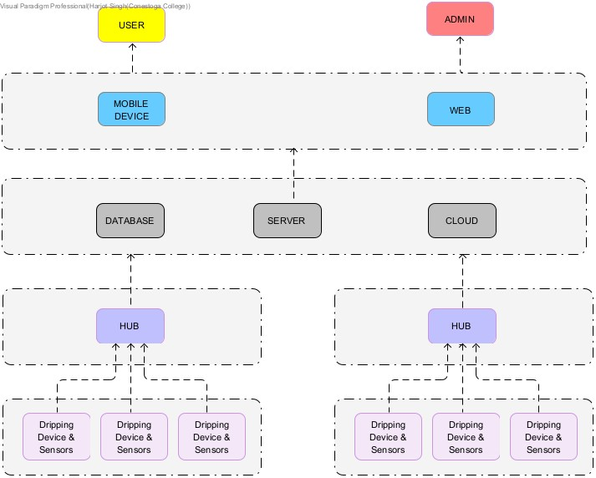
System DIAGRAM
USERS
FRONTEND LAYER
CLOUD + BACKEND
EDGE LAYER

Slide 7
USER FEATURES
User Authentication:
Signup
Login
Add/manage hubs and devices
Select plant type or define
custom settings:
Plant species
Room temperature
Soil type
Water frequency & amount
4. Use default or custom configurations
5. Monitor device status and logs
6. Reminder Notifications

Slide 8
ADMIN FEATURES
Manage user accounts
Add/update plant database
Add/edit device types
View all hubs and activity logs
Override/update any configurations

Slide 9
ER Diagram Summary
ENTITIES
User
Hub
Device
Plant
PlantConfig
UserPlant
Admin
DeviceLog
REALTIONSHIPS
One user can own multiple hubs
One hub can control many devices
Configs link users, plants, and hubs
Admin is a user with elevated permissions

Slide 10
Class Diagram Summary
CLASSES:
User
Hub
Device
Plant
PlantConfig
UserPlant
Admin
DeviceLog
RESPONSIBILITIES
User: Auth, ownership
Hub/Device: Control & operation
Plant/Config: Data and personalization
Admin: System management

Slide 11
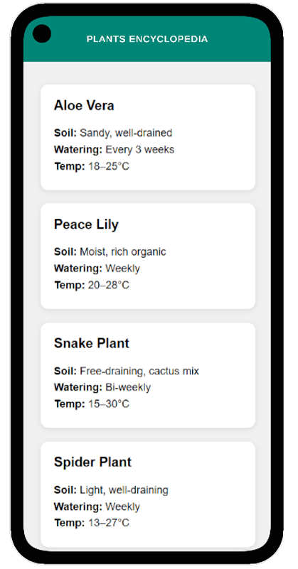
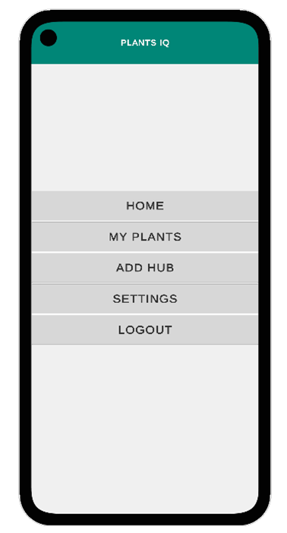
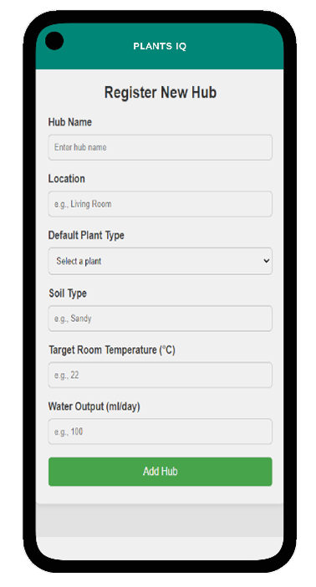
PROTYPES

Slide 12
THANK YOU

