Slide 1
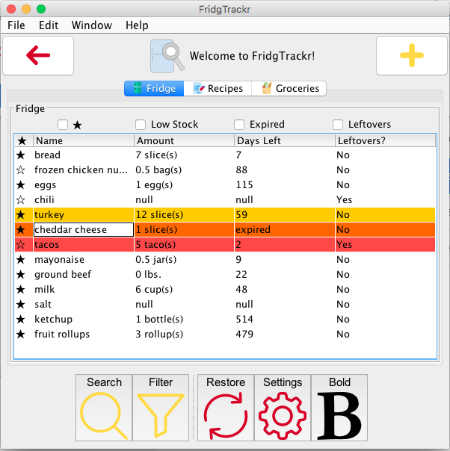
FridgTrackr
Team 06
Members: Hunter Black, William Cobb, Conner Flansburg, Sarah Myers, Melissa Wilson
Welcome to FridgTrackr!
An application to help you waste less food and always know what’s in your fridge.
Notes:
Who did what:
Hunter Black - Menu design and about page, Github/git integration
Melissa Wilson - Functional filtering boxes, custom tables with highlighting, file editing and saving
Sarah Myers - Tabbed pages, base panels and buttons, toolbar
William Cobb - Came up with the data schema for CSV formatting
Conner Flansburg - Add button, add window

Slide 2
FridgTrackr
What it does:
Track food stock
Store recipes
Keep grocery list
Motivation:
We were tired of never having anything to eat in our kitchens and wasting money on food going bad
Items:
Food
Name, quantity, expiration, favorites, leftovers
Recipe
Name, ingredient list
Grocery
Names, quantity

Slide 3
FridgTrackr
Evaluation results:
Quantitative and qualitative measurements
Time taken and extraneous clicks were low
Survey results were positive with some helpful feedback
From feedback:
Definitely adding “import” button
Considering removing some features to help improve Ockham’s Razor (principle of parsimony) of our design
Where to go from here:
Complete functionality
Provide nutritional info
Suggest new recipes

