Slide 1

Collaborative Filtering

Slide 2
Agenda
Collaborative Filtering (CF)
Pure CF approaches
User-based nearest-neighbor
The Pearson Correlation similarity measure
Memory-based and model-based approaches
Item-based nearest-neighbor
The cosine similarity measure
Data sparsity problems
Recent methods (SVD, Association Rule Mining, Slope One, RF-Rec, …)
The Google News personalization engine
Discussion and summary
Literature

Slide 3
Collaborative Filtering (CF)
The most prominent approach to generate recommendations
used by large, commercial e-commerce sites
well-understood, various algorithms and variations exist
applicable in many domains (book, movies, DVDs, ..)
Approach
use the "wisdom of the crowd" to recommend items
Basic assumption and idea
Users give ratings to catalog items (implicitly or explicitly)
Customers who had similar tastes in the past, will have similar tastes in the future

Slide 4
Pure CF Approaches
Input
Only a matrix of given user–item ratings
Output types
A (numerical) prediction indicating to what degree the current user will like or dislike a certain item
A top-N list of recommended items

Slide 5
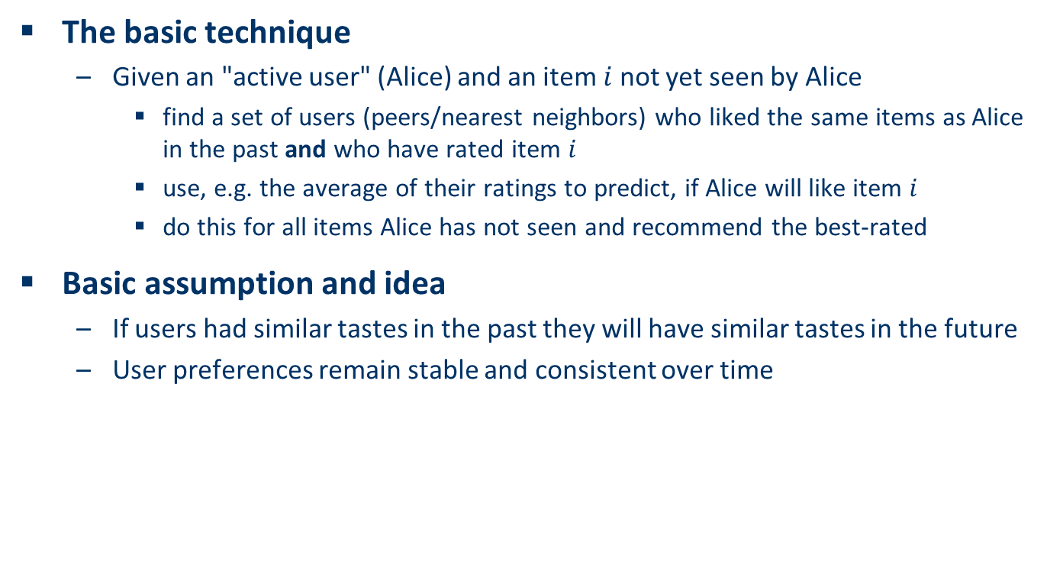
User-based nearest-neighbor collaborative filtering (1)
The basic technique
Given an "active user" (Alice) and an item $i$ not yet seen by Alice
find a set of users (peers/nearest neighbors) who liked the same items as Alice in the past and who have rated item $i$
use, e.g. the average of their ratings to predict, if Alice will like item $i$
do this for all items Alice has not seen and recommend the best-rated
Basic assumption and idea
If users had similar tastes in the past they will have similar tastes in the future
User preferences remain stable and consistent over time

Slide 6
User-based nearest-neighbor collaborative filtering (2)
Example
A database of ratings of the current user, Alice, and some other users is given:
Determine whether Alice will like or dislike Item5, which Alice has not yet rated or seen
 | Item1 | Item2 | Item3 | Item4 | Item5
Alice | 5 | 3 | 4 | 4 | ?
User1 | 3 | 1 | 2 | 3 | 3
User2 | 4 | 3 | 4 | 3 | 5
User3 | 3 | 3 | 1 | 5 | 4
User4 | 1 | 5 | 5 | 2 | 1

Slide 7
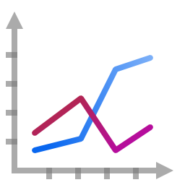
User-based nearest-neighbor collaborative filtering (3)
Some first questions
How do we measure similarity?
How many neighbors should we consider?
How do we generate a prediction from the neighbors' ratings?
 | Item1 | Item2 | Item3 | Item4 | Item5
Alice | 5 | 3 | 4 | 4 | ?
User1 | 3 | 1 | 2 | 3 | 3
User2 | 4 | 3 | 4 | 3 | 5
User3 | 3 | 3 | 1 | 5 | 4
User4 | 1 | 5 | 5 | 2 | 1

Slide 8

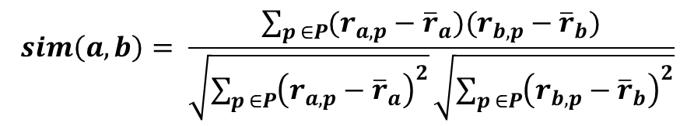
Measuring user similarity (1)
A popular similarity measure in user-based CF: Pearson correlation
$a$, $b$ : users
$r_{a,p}$ : rating of user $a$ for item $p$
$P$ : set of items, rated both by $a$ and $b$
Possible similarity values between $−1$ and $1$
$$sim\left(a,b\right)= \frac{\sum_{p ∈P}{(r_{a,p}−{\overline{r}}_{a})(r_{b,p}−{\overline{r}}_{b})}}{\sqrt{\sum_{p ∈P}{{\left(r_{a,p}−{\overline{r}}_{a}\right)}^{2}}}\sqrt{\sum_{p ∈P}{{\left(r_{b,p}−{\overline{r}}_{b}\right)}^{2}}}}$$

Slide 9
Measuring user similarity (2)
A popular similarity measure in user-based CF: Pearson correlation
$a$, $b$ : users
$r_{a,p}$ : rating of user $a$ for item $p$
$P$ : set of items, rated both by $a$ and $b$
Possible similarity values between $−1$ and $1$
 | Item1 | Item2 | Item3 | Item4 | Item5
Alice | 5 | 3 | 4 | 4 | ?
User1 | 3 | 1 | 2 | 3 | 3
User2 | 4 | 3 | 4 | 3 | 5
User3 | 3 | 3 | 1 | 5 | 4
User4 | 1 | 5 | 5 | 2 | 1
sim = 0,85
sim = 0,00
sim = 0,70
sim = -0,79

Slide 10
Pearson correlation
Takes differences in rating behavior into account
Works well in usual domains, compared with alternative measures
such as cosine similarity

Slide 11
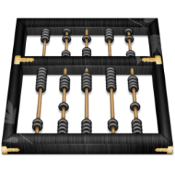
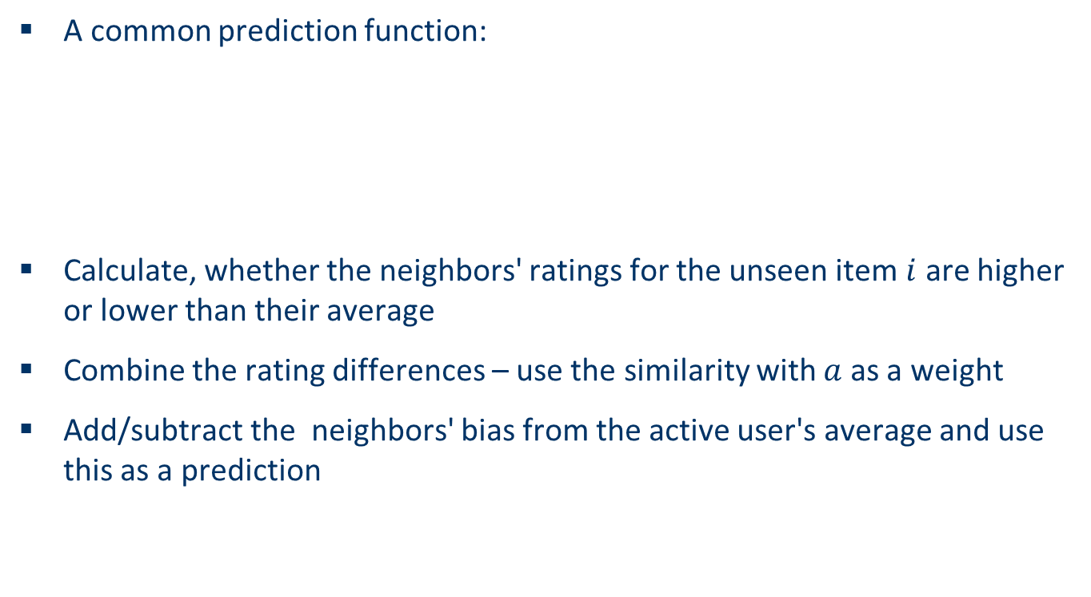
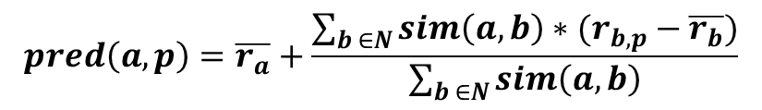
Making predictions
A common prediction function:
Calculate, whether the neighbors' ratings for the unseen item $i$ are higher or lower than their average
Combine the rating differences – use the similarity with $a$ as a weight
Add/subtract the neighbors' bias from the active user's average and use this as a prediction
$$pred\left(a,p\right)=\overline{r_{a}}+\frac{\sum_{b ∈N}{sim\left(a,b\right)∗(r_{b,p}−\overline{r_{b}})}}{\sum_{b ∈N}{sim\left(a,b\right)}}$$

Slide 12
Improving the metrics / prediction function
Not all neighbor ratings might be equally "valuable"
Agreement on commonly liked items is not so informative as agreement on controversial items
Possible solution: Give more weight to items that have a higher variance
Value of number of co-rated items
Use "significance weighting", by e.g., linearly reducing the weight when the number of co-rated items is low
Case amplification
Intuition: Give more weight to "very similar" neighbors, i.e., where the similarity value is close to 1.
Neighborhood selection
Use similarity threshold or fixed number of neighbors

Slide 13
Memory-based and model-based approaches
User-based CF is said to be "memory-based"
the rating matrix is directly used to find neighbors / make predictions
does not scale for most real-world scenarios
large e-commerce sites have tens of millions of customers and millions of items
Model-based approaches
based on an offline pre-processing or "model-learning" phase
at run-time, only the learned model is used to make predictions
models are updated / re-trained periodically
large variety of techniques used
model-building and updating can be computationally expensive
item-based CF is an example for model-based approaches

Slide 14
Item-based collaborative filtering
Basic idea:
Use the similarity between items (and not users) to make predictions
Example:
Look for items that are similar to Item5
Take Alice's ratings for these items to predict the rating for Item5
 | Item1 | Item2 | Item3 | Item4 | Item5
Alice | 5 | 3 | 4 | 4 | ?
User1 | 3 | 1 | 2 | 3 | 3
User2 | 4 | 3 | 4 | 3 | 5
User3 | 3 | 3 | 1 | 5 | 4
User4 | 1 | 5 | 5 | 2 | 1

Slide 15
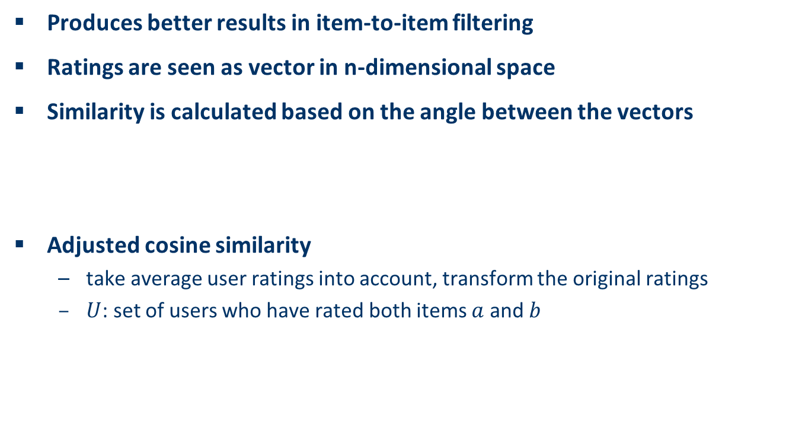
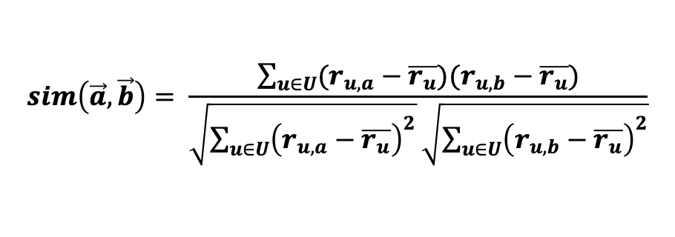

The cosine similarity measure
Produces better results in item-to-item filtering
Ratings are seen as vector in n-dimensional space
Similarity is calculated based on the angle between the vectors
Adjusted cosine similarity
take average user ratings into account, transform the original ratings
$U$: set of users who have rated both items $a$ and $b$
$$sim\left(\vec{a},\vec{b}\right)=\frac{\vec{a}∙\vec{b}}{\left|\vec{a}\right|∗|\vec{b}|}$$
$$sim\left(\vec{a},\vec{b}\right)= \frac{\sum_{u∈U}{(r_{u,a}−\overline{r_{u}})(r_{u,b}−\overline{r_{u}})}}{\sqrt{\sum_{u∈U}{{\left(r_{u,a}−\overline{r_{u}}\right)}^{2}}}\sqrt{\sum_{u∈U}{{\left(r_{u,b}−\overline{r_{u}}\right)}^{2}}}}$$

Slide 16
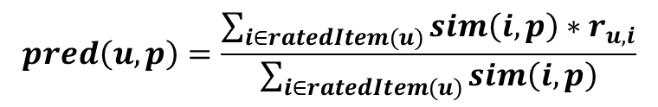
Making predictions
A common prediction function:
Neighborhood size is typically also limited to a specific size
Not all neighbors are taken into account for the prediction
An analysis of the MovieLens dataset indicates that "in most real-world situations, a neighborhood of 20 to 50 neighbors seems reasonable" (Herlocker et al. 2002)
$$pred\left(u,p\right)=\frac{\sum_{i∈ratedItem(u)}{sim\left(i,p\right)∗r_{u,i}}}{\sum_{i∈ratedItem(u)}{sim\left(i,p\right)}}$$

Slide 17
Pre-processing for item-based filtering
Item-based filtering does not solve the scalability problem itself
Pre-processing approach by Amazon.com (in 2003)
Calculate all pair-wise item similarities in advance
The neighborhood to be used at run-time is typically rather small, because only items are taken into account which the user has rated
Item similarities are supposed to be more stable than user similarities
Memory requirements
Up to N² pair-wise similarities to be memorized (N = number of items) in theory
In practice, this is significantly lower (items with no co-ratings)
Further reductions possible
Minimum threshold for co-ratings
Limit the neighborhood size (might affect recommendation accuracy)

Slide 18
More on ratings – Explicit ratings
Probably the most precise ratings
Most commonly used (1 to 5, 1 to 7 Likert response scales)
Research topics
Optimal granularity of scale; indication that 10-point scale is better accepted in movie dom.
An even more fine-grained scale was chosen in the joke recommender discussed by Goldberg et al. (2001), where a continuous scale (from −10 to +10) and a graphical input bar were used
No precision loss from the discretization
User preferences can be captured at a finer granularity
Users actually "like" the graphical interaction method
Multidimensional ratings (multiple ratings per movie such as ratings for actors and sound)
Main problems
Users not always willing to rate many items
number of available ratings could be too small → sparse rating matrices → poor recommendation quality
How to stimulate users to rate more items?

Slide 19
More on ratings – Implicit ratings
Typically collected by the web shop or application in which the recommender system is embedded
When a customer buys an item, for instance, many recommender systems interpret this behavior as a positive rating
Clicks, page views, time spent on some page, demo downloads …
Implicit ratings can be collected constantly and do not require additional efforts from the side of the user
Main problem
One cannot be sure whether the user behavior is correctly interpreted
For example, a user might not like all the books he or she has bought; the user also might have bought a book for someone else
Implicit ratings can be used in addition to explicit ones; question of correctness of interpretation

Slide 20
Data sparsity problems
Cold start problem
How to recommend new items? What to recommend to new users?
Straightforward approaches
Ask/force users to rate a set of items
Use another method (e.g., content-based, demographic or simply non-personalized) in the initial phase
Default voting: assign default values to items that only one of the two users to be compared has rated (Breese et al. 1998)
Alternatives
Use better algorithms (beyond nearest-neighbor approaches)
Example:
In nearest-neighbor approaches, the set of sufficiently similar neighbors might be too small to make good predictions
Assume "transitivity" of neighborhoods

Slide 21

Example algorithms for sparse datasets
Recursive CF (Zhang and Pu 2007)
Assume there is a very close neighbor $n$ of $u$ who however has not rated the target item $i$ yet.
Idea:
Apply CF-method recursively and predict a rating for item $i$ for the neighbor
Use this predicted rating instead of the rating of a more distant direct neighbor
 | Item1 | Item2 | Item3 | Item4 | Item5
Alice | 5 | 3 | 4 | 4 | ?
User1 | 3 | 1 | 2 | 3 | ?
User2 | 4 | 3 | 4 | 3 | 5
User3 | 3 | 3 | 1 | 5 | 4
User4 | 1 | 5 | 5 | 2 | 1
sim = 0.85
Predict rating for
User1

Slide 22
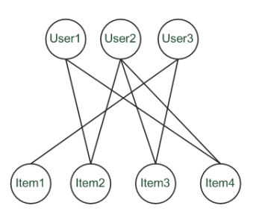
Graph-based methods (1)
"Spreading activation" (Huang et al. 2004)
Exploit the supposed "transitivity" of customer tastes and thereby augment the matrix with additional information
Assume that we are looking for a recommendation for User1
When using a standard CF approach, User2 will be considered a peer for User1 because they both bought Item2 and Item4
Thus Item3 will be recommended to User1 because the nearest neighbor, User2, also bought or liked it

Slide 23
Graph-based methods (2)
"Spreading activation" (Huang et al. 2004)
In a standard user-based or item-based CF approach, paths of length 3 will be considered – that is, Item3 is relevant for User1 because there exists a three-step path (User1–Item2–User2–Item3) between them
Because the number of such paths of length 3 is small in sparse rating databases, the idea is to also consider longer paths (indirect associations) to compute recommendations
Using path length 5, for instance

Slide 24
Graph-based methods (3)
"Spreading activation" (Huang et al. 2004)
Idea: Use paths of lengths > 3 to recommend items
Length 3: Recommend Item3 to User1
Length 5: Item1 also recommendable

Slide 25
More model-based approaches
Plethora of different techniques proposed in the last years, e.g.,
Matrix factorization techniques, statistics
singular value decomposition, principal component analysis
Association rule mining
compare: shopping basket analysis
Probabilistic models
clustering models, Bayesian networks, probabilistic Latent Semantic Analysis
Various other machine learning approaches
Costs of pre-processing
Usually not discussed
Incremental updates possible?

Slide 26
2000: Application of Dimensionality Reduction in Recommender System, B. Sarwar et al., WebKDD Workshop
Basic idea: Trade more complex offline model building for faster online prediction generation
Singular Value Decomposition for dimensionality reduction of rating matrices
Captures important factors/aspects and their weights in the data
factors can be genre, actors but also non-understandable ones
Assumption that k dimensions capture the signals and filter out noise (K = 20 to 100)
Constant time to make recommendations
Approach also popular in IR (Latent Semantic Indexing), data compression,…

Slide 27
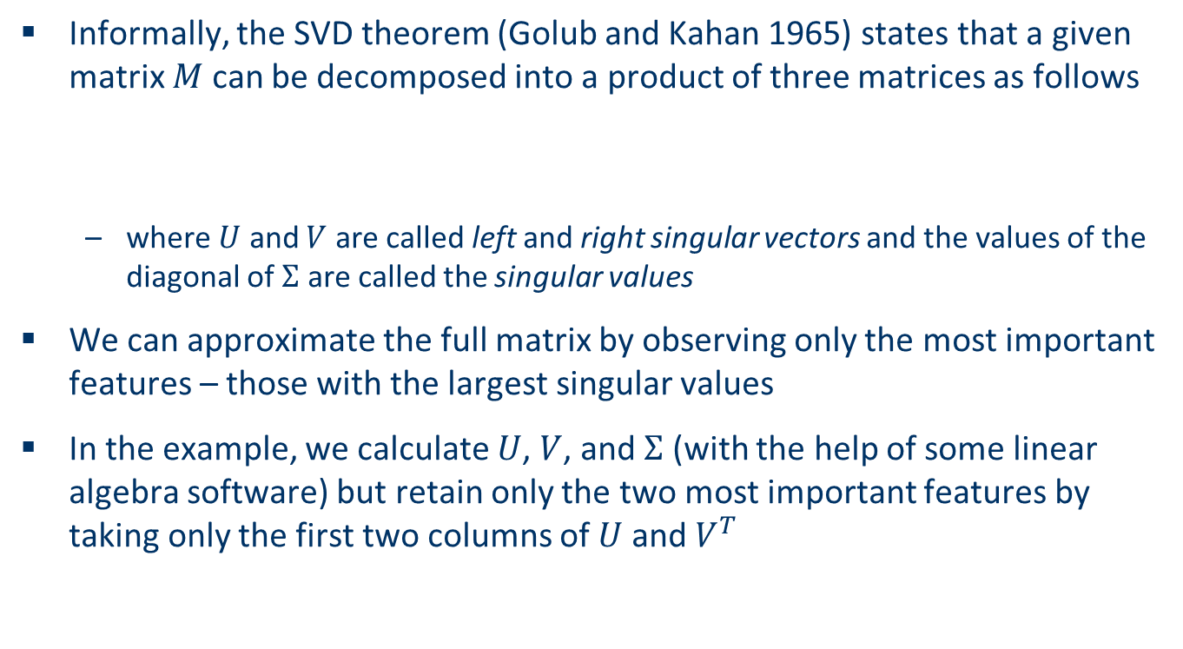
Matrix factorization
Informally, the SVD theorem (Golub and Kahan 1965) states that a given matrix $M$ can be decomposed into a product of three matrices as follows
where $U$ and $V$ are called left and right singular vectors and the values of the diagonal of $Σ$ are called the singular values
We can approximate the full matrix by observing only the most important features – those with the largest singular values
In the example, we calculate $U$, $V$, and $Σ$ (with the help of some linear algebra software) but retain only the two most important features by taking only the first two columns of $U$ and $V^{T}$

Slide 28
Example for SVD-based recommendation
SVD:
Terminator
Die Hard
Twins
Eat Pray Love
Pretty Woman
U_{k} | Dim1 | Dim2
Alice | 0.47 | -0.30
Bob | -0.44 | 0.23
Mary | 0.70 | -0.06
Sue | 0.31 | 0.93
V_{k}^{T}
Dim1 | -0.44 | -0.57 | 0.06 | 0.38 | 0.57
Dim2 | 0.58 | -0.66 | 0.26 | 0.18 | -0.36
 | Dim1 | Dim2
Dim1 | 5.63 | 0
Dim2 | 0 | 3.23
Prediction:
= 3 + 0.84 = 3.84

Slide 29
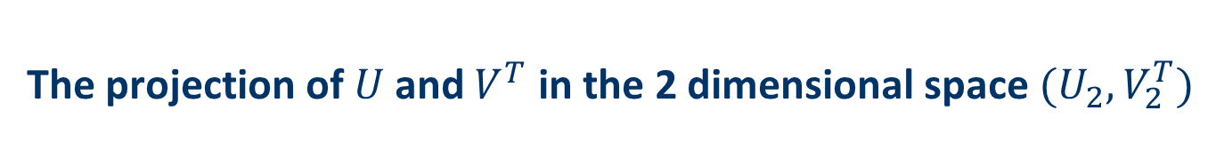
The projection of $U$ and $V^{T}$ in the 2 dimensional space $(U_{2},V_{2}^{T})$
Sue
Terminator
Twins
Bob
Eat Pray Love
Mary
Alice
Pretty Woman
Die Hard

Slide 30
Discussion about dimensionality reduction (Sarwar et al. 2000a)
Matrix factorization
Generate low-rank approximation of matrix
Detection of latent factors
Projecting items and users in the same n-dimensional space
Prediction quality can decrease because…
the original ratings are not taken into account
Prediction quality can increase as a consequence of…
filtering out some "noise" in the data and
detecting nontrivial correlations in the data
Depends on the right choice of the amount of data reduction
number of singular values in the SVD approach
Parameters can be determined and fine-tuned only based on experiments in a certain domain
Koren et al. 2009 talk about 20 to 100 factors that are derived from the rating patterns

Slide 31
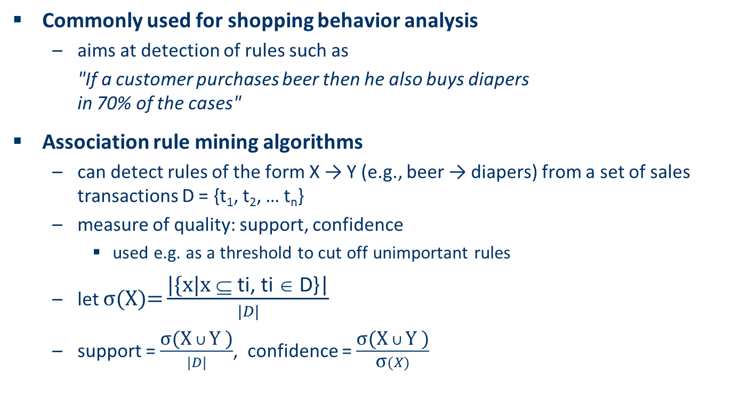
Association rule mining
Commonly used for shopping behavior analysis
aims at detection of rules such as
"If a customer purchases beer then he also buys diapers in 70% of the cases"
Association rule mining algorithms
can detect rules of the form X → Y (e.g., beer → diapers) from a set of sales transactions D = {t₁, t₂, … t_{n}}
measure of quality: support, confidence
used e.g. as a threshold to cut off unimportant rules
let $\text{σ}\text{(}\text{X}\text{)=}\frac{\text{|\{}\text{x}\text{|}\text{x} \text{⊆ }\text{ti}\text{, }\text{ti}\text{ ∈ }\text{D}\text{\}|}}{|D|}$
support = $\frac{\text{σ}\text{(}\text{X} ∪ \text{Y}\text{ )}}{|D|}$, confidence = $\frac{\text{σ}\text{(}\text{X} ∪ \text{Y}\text{ )}}{\text{σ}(X)}$

Slide 32
Recommendation based on Association Rule Mining
 | Item1 | Item2 | Item3 | Item4 | Item5
Alice | 1 | 0 | 0 | 0 | ?
User1 | 1 | 0 | 1 | 0 | 1
User2 | 1 | 0 | 1 | 0 | 1
User3 | 0 | 0 | 0 | 1 | 1
User4 | 0 | 1 | 1 | 0 | 0
Simplest approach
transform 5-point ratings into binary ratings (1 = above user average)
Mine rules such as
Item1 → Item5
support (2/4), confidence (2/2) (without Alice)
Make recommendations for Alice (basic method)
Determine "relevant" rules based on Alice's transactions (the above rule will be relevant as Alice bought Item1)
Determine items not already bought by Alice
Sort the items based on the rules' confidence values
Different variations possible
dislike statements, user associations ..

Slide 33
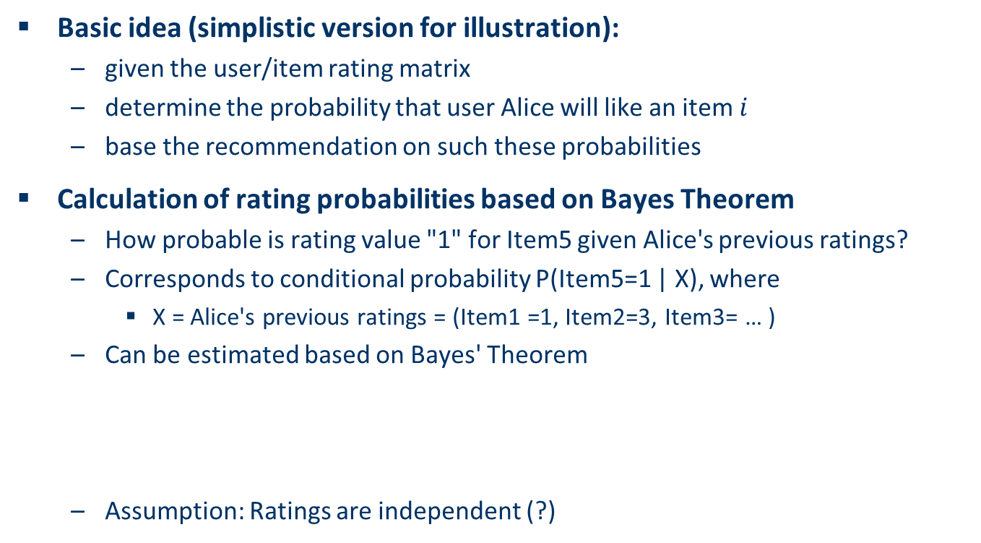
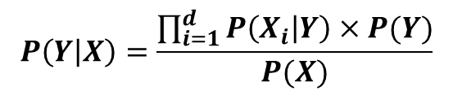
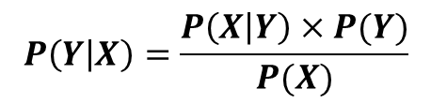
Probabilistic methods
Basic idea (simplistic version for illustration):
given the user/item rating matrix
determine the probability that user Alice will like an item $i$
base the recommendation on such these probabilities
Calculation of rating probabilities based on Bayes Theorem
How probable is rating value "1" for Item5 given Alice's previous ratings?
Corresponds to conditional probability P(Item5=1 | X), where
X = Alice's previous ratings = (Item1 =1, Item2=3, Item3= … )
Can be estimated based on Bayes' Theorem
Assumption: Ratings are independent (?)
$$P\left(Y | X\right)=\frac{P\left(X | Y\right)×P(Y)}{P(X)}$$
$$P\left(Y | X\right)=\frac{\prod_{i=1}^{d}{P\left(X_{i} | Y\right)×P(Y)}}{P(X)}$$

Slide 34

Calculation of probabilities in simplistic approach
 | Item1 | Item2 | Item3 | Item4 | Item5
Alice | 1 | 3 | 3 | 2 | ?
User1 | 2 | 4 | 2 | 2 | 4
User2 | 1 | 3 | 3 | 5 | 1
User3 | 4 | 5 | 2 | 3 | 3
User4 | 1 | 1 | 5 | 2 | 1
X = (Item1 =1, Item2=3, Item3= … )
$$P\left(X | Item5=1\right)=P\left(Item1=1 | Item5=1\right)×P\left(Item2=3 | Item5=1\right)×P\left(Item3=3 | Item5=1\right)×P\left(Item4=2 | Item5=1\right)=\frac{2}{2}×\frac{1}{2}×\frac{1}{2}×\frac{1}{2}≈0.125$$
$$P\left(X | Item5=2\right)=P\left(Item1=1 | Item5=2\right)×P\left(Item2=3 | Item5=2\right)×P\left(Item3=3 | Item5=2\right)×P\left(Item4=2 | Item5=2\right)=\frac{0}{0}×⋯×⋯×⋯=0$$
More to consider
Zeros (smoothing required)
like/dislike simplification possible

Slide 35
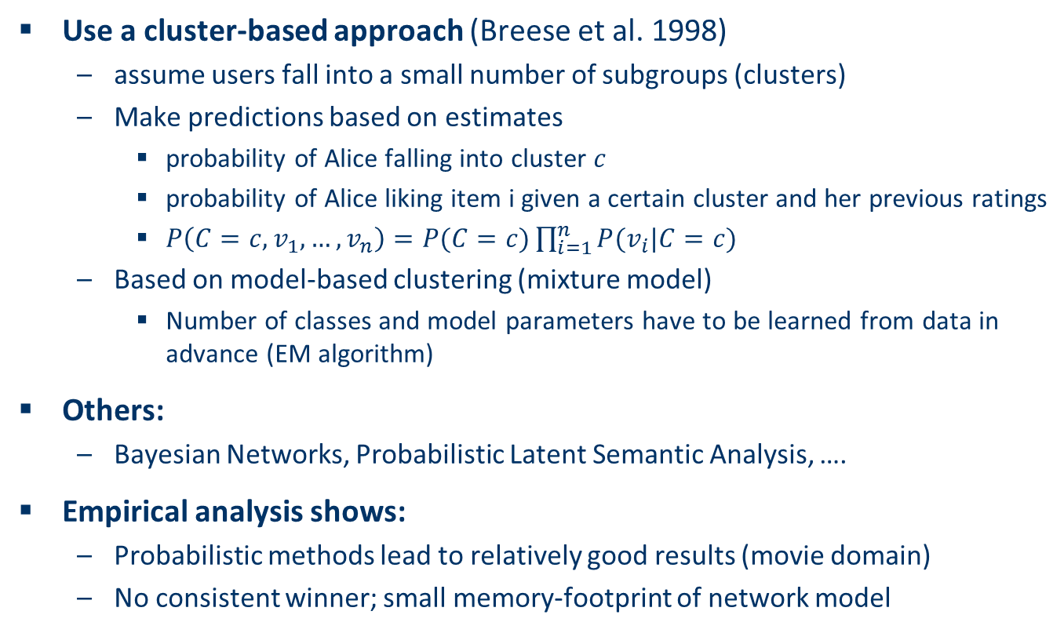
Practical probabilistic approaches
Use a cluster-based approach (Breese et al. 1998)
assume users fall into a small number of subgroups (clusters)
Make predictions based on estimates
probability of Alice falling into cluster $c$
probability of Alice liking item i given a certain cluster and her previous ratings
$P\left(C=c,v_{1},…, v_{n}\right)=P(C=c)\prod_{i=1}^{n}{P(v_{i}|C=c)}$
Based on model-based clustering (mixture model)
Number of classes and model parameters have to be learned from data in advance (EM algorithm)
Others:
Bayesian Networks, Probabilistic Latent Semantic Analysis, ….
Empirical analysis shows:
Probabilistic methods lead to relatively good results (movie domain)
No consistent winner; small memory-footprint of network model

Slide 36
Slope One predictors (Lemire and Maclachlan 2005)
Idea of Slope One predictors is simple and is based on a popularity differential between items for users
Example:
p(Alice, Item5) =
Basic scheme: Take the average of these differences of the co-ratings to make the prediction
In general: Find a function of the form f(x) = x + b
That is why the name is "Slope One"
 | Item1 | Item5
Alice | 2 | ?
User1 | 1 | 2
-
2 +
( 2 - 1 )
= 3

Slide 37
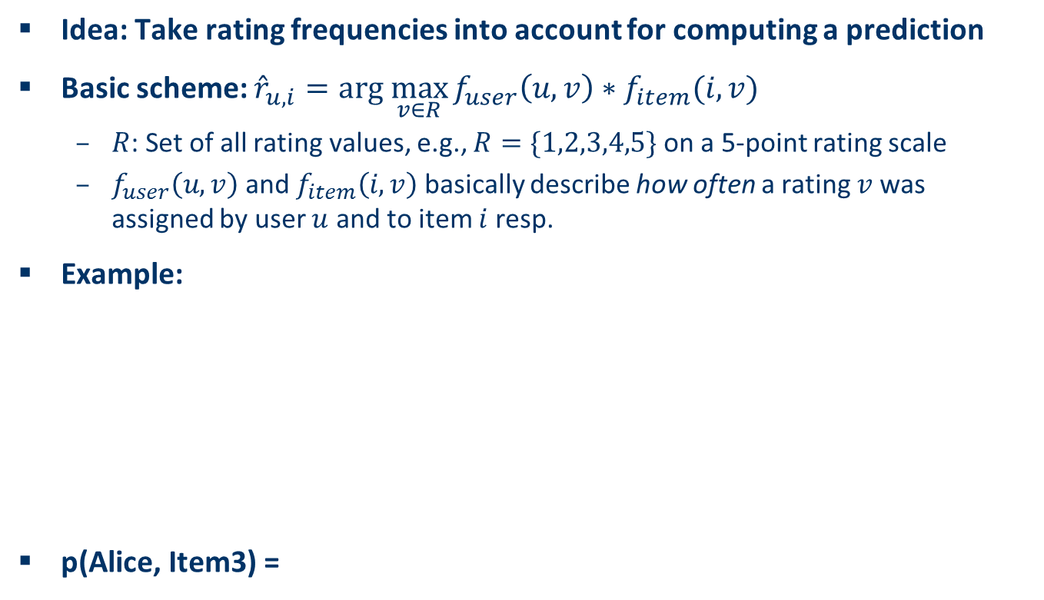
RF-Rec predictors (Gedikli et al. 2011)
Idea: Take rating frequencies into account for computing a prediction
Basic scheme: ${\hat{r}}_{u,i}=arg \max_{v∈R}{f_{user}\left(u,v\right)∗f_{item}(i,v)}$
$R$: Set of all rating values, e.g., $R=\{1,2,3,4,5\}$ on a 5-point rating scale
$f_{user}\left(u,v\right)$ and $f_{item}\left(i,v\right)$ basically describe how often a rating $v$ was assigned by user $u$ and to item $i$ resp.
Example:
p(Alice, Item3) =
 | Item1 | Item2 | Item3 | Item4 | Item5
Alice | 1 | 1 | ? | 5 | 4
User1 | 2 |  | 5 | 5 | 5
User2 |  |  | 1 | 1
User3 |  | 5 | 2 |  | 2
User4 | 3 |  | 1 | 1
User5 | 1 | 2 | 2 |  | 4
1

Slide 38
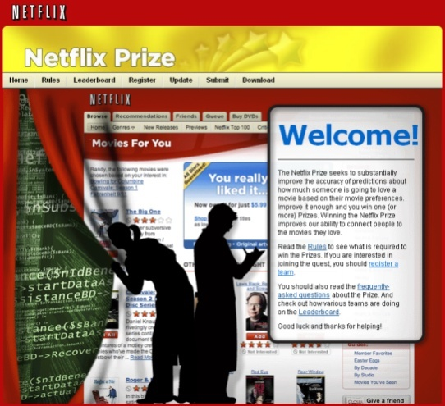

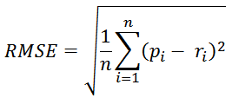
2008: Factorization meets the neighborhood: a multifaceted collaborative filtering model, Y. Koren, ACM SIGKDD
Stimulated by work on Netflix competition
Prize of $1,000,000 for accuracy improvement of 10% RMSE compared to own Cinematch system
Very large dataset (~100M ratings, ~480K users , ~18K movies)
Last ratings/user withheld (set K)
Root mean squared error metric optimized to 0.8567
Metrics measure error rate
Mean Absolute Error (MAE) computes the deviation between predicted ratings and actual ratings
Root Mean Square Error (RMSE) is similar to MAE, but places more emphasis on larger deviation

Slide 39
2008: Factorization meets the neighborhood: a multifaceted collaborative filtering model, Y. Koren, ACM SIGKDD
Merges neighborhood models with latent factor models
Latent factor models
good to capture weak signals in the overall data
Neighborhood models
good at detecting strong relationships between close items
Combination in one prediction single function
Local search method such as stochastic gradient descent to determine parameters
Add penalty for high values to avoid over-fitting

Slide 40
Summarizing recent methods
Recommendation is concerned with learning from noisy observations (x,y), where has to be determined such that is minimal.
A huge variety of different learning strategies have been applied trying to estimate f(x)
Non parametric neighborhood models
MF models, SVMs, Neural Networks, Bayesian Networks,…

Slide 41


Collaborative Filtering Issues
Pros:
well-understood, works well in some domains, no knowledge engineering required
Cons:
requires user community, sparsity problems, no integration of other knowledge sources, no explanation of results
What is the best CF method?
In which situation and which domain? Inconsistent findings; always the same domains and data sets; differences between methods are often very small (1/100)
How to evaluate the prediction quality?
MAE / RMSE: What does an MAE of 0.7 actually mean?
Serendipity (novelty and surprising effect of recommendations)
Not yet fully understood
What about multi-dimensional ratings?

Slide 42
The Google News personalization engine

Slide 43
Google News portal (1)
Aggregates news articles from several thousand sources
Displays them to signed-in users in a personalized way
Collaborative recommendation approach based on
the click history of the active user and
the history of the larger community
Main challenges
Vast number of articles and users
Generate recommendation list in real time (at most one second)
Constant stream of new items
Immediately react to user interaction
Significant efforts with respect to algorithms, engineering, and parallelization are required

Slide 44
Google News portal (2)
Pure memory-based approaches are not directly applicable and for model-based approaches, the problem of continuous model updates must be solved
A combination of model- and memory-based techniques is used
Model-based part: Two clustering techniques are used
Probabilistic Latent Semantic Indexing (PLSI) as proposed by (Hofmann 2004)
MinHash as a hashing method
Memory-based part: Analyze story co-visits for dealing with new users
Google's MapReduce technique is used for parallelization in order to make computation scalable

Slide 45
Literature (1)
[Adomavicius and Tuzhilin 2005] Toward the next generation of recommender systems: A survey of the state-of-the-art and possible extensions, IEEE Transactions on Knowledge and Data Engineering 17 (2005), no. 6, 734–749
[Breese et al. 1998] Empirical analysis of predictive algorithms for collaborative filtering, Proceedings of the 14th Conference on Uncertainty in Artificial Intelligence (Madison, WI) (Gregory F. Cooper and Seraf´in Moral, eds.), Morgan Kaufmann, 1998, pp. 43–52
[Gedikli et al. 2011] RF-Rec: Fast and accurate computation of recommendations based on rating frequencies, Proceedings of the 13th IEEE Conference on Commerce and Enterprise Computing - CEC 2011, Luxembourg, 2011, forthcoming
[Goldberg et al. 2001] Eigentaste: A constant time collaborative filtering algorithm, Information Retrieval 4 (2001), no. 2, 133–151
[Golub and Kahan 1965] Calculating the singular values and pseudo-inverse of a matrix, Journal of the Society for Industrial and Applied Mathematics, Series B: Numerical Analysis 2 (1965), no. 2, 205–224
[Herlocker et al. 2002] An empirical analysis of design choices in neighborhood-based collaborative filtering algorithms, Information Retrieval 5 (2002), no. 4, 287–310
[Herlocker et al. 2004] Evaluating collaborative filtering recommender systems, ACM Transactions on Information Systems (TOIS) 22 (2004), no. 1, 5–53

Slide 46
Literature (2)
[Hofmann 2004] Latent semantic models for collaborative filtering, ACM Transactions on Information Systems 22 (2004), no. 1, 89–115
[Huang et al. 2004] Applying associative retrieval techniques to alleviate the sparsity problem in collaborative filtering, ACM Transactions on Information Systems 22 (2004), no. 1, 116–142
[Koren et al. 2009] Matrix factorization techniques for recommender systems, Computer 42 (2009), no. 8, 30–37
[Lemire and Maclachlan 2005] Slope one predictors for online rating-based collaborative filtering, Proceedings of the 5th SIAM International Conference on Data Mining (SDM ’05) (Newport Beach, CA), 2005, pp. 471–480
[Sarwar et al. 2000a] Application of dimensionality reduction in recommender systems – a case study, Proceedings of the ACM WebKDD Workshop (Boston), 2000
[Zhang and Pu 2007] A recursive prediction algorithm for collaborative filtering recommender systems, Proceedings of the 2007 ACM Conference on Recommender Systems (RecSys ’07) (Minneapolis, MN), ACM, 2007, pp. 57–64

