Slide 1
Performance metrics, cross validation etc

Slide 2
Memorization and generalization
Memorization:
Are we specifically only learning an algorithm on our data?
Generalization
Refers to the capability of applying learned knowledge to previously unseen data
Without generalization there is no learning, just memorizing!
Notes:
Give the example of the math test with 200 exercises

Slide 3
Features and labels
Features (a.k.a covariates) are the variables that describe the data.
Label (target variable/target covariate): The feature we want to predict in supervised learning.
So, a label is kind of like a feature

Slide 4
Supervised vs unsupervised examples
Supervised - Predict housing prices using:
Features: number of bathrooms, floor, number of windows, kitchen size
Label: House prices
*** We can switch around the label and the features
Unsupervised - Find patterns in books using:
# of pages, # of printed copies, language, mean words per page
Label: there is none
Maybe we will ‘cluster’ the books into genres? Maybe into authors? Etc.

Slide 5
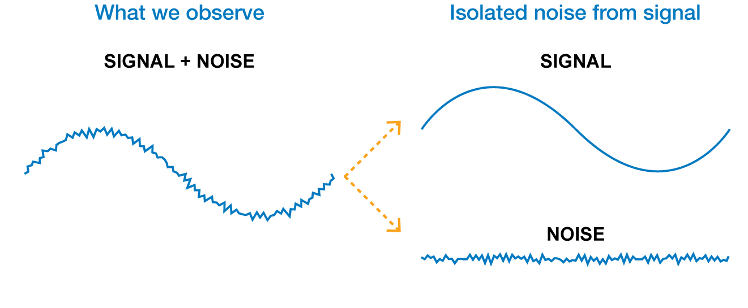
What’s in the data we learn from
The data usually has two components:
Signal: information that is relevant to pattern detection or prediction
Noise: information that is irrelevant to the future
Finding which is which is the challenge
Intel – Advanced Analytics
Notes:
Today we’re going to Talk about some of the chanllages that are intrinsic with the data . One of the :overfitting

Slide 6
The basic rule in model validation
Don’t test your model on data it’s been trained with!
Intel – Advanced Analytics

Slide 7
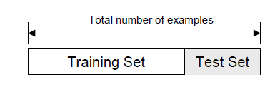
Holdout test set: The naïve approach
Randomly split the entire dataset into:
Training set: A dataset used for training the model
Test set (a.k.a validation set): Data only used for testing the model
Train model here
Estimate model performance here
Intel – Advanced Analytics

Slide 8
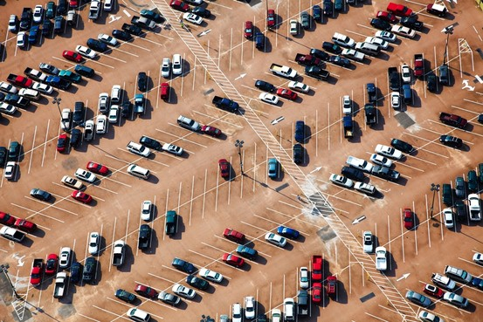
Holdout test set – considerations
Can the data be split randomly without bias?
Test set and training set should be interchangeable, except for data size. Otherwise test results are not a true reflection of performance.
In other words, test and train data should be from the same distribution
Do we have enough data?
Example: Predict if a car is American or Japanese based on 50 examples?
Will the test set be big enough to accurately report our model performance?
Intel – Advanced Analytics

Slide 9
What is biased/unbiased data?
Unbiased data sampling:
Data that represents the diversity in our target distribution of data on which we want to make predictions.
I.e., a random, representative sample of the entire distribution.
Biased data:
Data that does not accurately reflect the target distribution.
Examples:
Elections: we only asked people with glasses who they will vote for, instead of asking a random sample of the population.
Simulated data: We cannot get real data, so we create simulated/synthetic data
May be addressed using transfer learning/domain adaptation
Intel – Advanced Analytics

Slide 10
The three-way split
Training set
A set of examples used for learning
Validation (a.k.a development) set
A set of examples used to tune the parameters of a classifier
Test set
A set of examples used only to assess the performance of fully-trained classifier. After assessing the model with the test set, YOU MUST NOT further tune your model (that’s the theory anyway… - in order to prevent ‘learning the test set’ and ‘overfitting’)
Intel – Advanced Analytics

Slide 11
The three-way split
The entire available dataset
Training data
Validation data
Test data
Model tuning
Performance evaluation
Intel – Advanced Analytics

Slide 12
How to perform the split?
How many examples in each data set?
Training: Typically 60-80% of data
Test set: Typically 20-30% of your trained set
Validation set: Often 20% of data
Examples
3 way: Training: 60%, CV: 20%, Test: 20%
2 ways: Training 70%, Test: 30%
The entire available dataset
Train set
Test set
Intel – Advanced Analytics

Slide 13
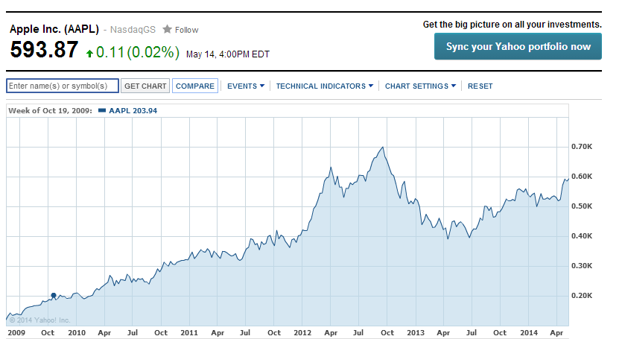
How to perform the split?
Time based – If time is important
Can you use Jul 2011 stock price to try and predict Apr 2011 stock price?
Intel – Advanced Analytics

Slide 14
How to perform the split?
Some datasets are effected by seasonality
Is it a good test set?
Intel – Advanced Analytics
Notes:
Either you neutralize the seasonality or you take a proper train set

Slide 15


Holdout summary
Good news:
Intuitive
Usually easy to perform
Considered the ideal method for evaluation
Drawbacks:
In small datasets you don’t have the luxury of setting aside a portion of your data
The performance will be misleading if we had unfortunate split
Often requires planning ahead of time to prevent training on test set or getting insights from it)
External evaluation is ideal
Intel – Advanced Analytics

Slide 16
Cross validation
Used when:
a hold-out plan is difficult to design or was not designed at the beginning
the dataset is small, and you want to use all the data for good model training
Intel – Advanced Analytics

Slide 17
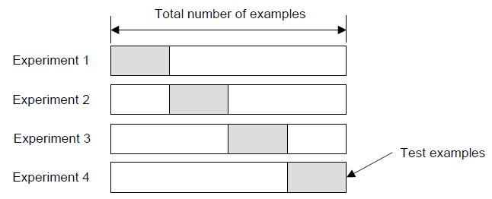
Cross - Validation
Create a K-fold partition of the dataset
For each of the K experiments, use K-1 folds for training and the remaining one for testing
4-fold cross validation example
Test set
Train
Test set
Test set
Test set
Intel – Advanced Analytics

Slide 18

Cross - Validation
How do you summarize the performance?
Average: Usually average of performance between experiments
How many folds are needed?
Common choice: 5-fold or 10-fold cross validation (probably since these numbers sound nice)
Large datasets → even a 3-Fold cross validation will be quite accurate
Smaller datasets → we will prefer bigger K
Leave-One-Out approach (K=n). In this case the number of folds K is equal to the number of examples n. Used for smaller datasets
Intel – Advanced Analytics

Slide 19
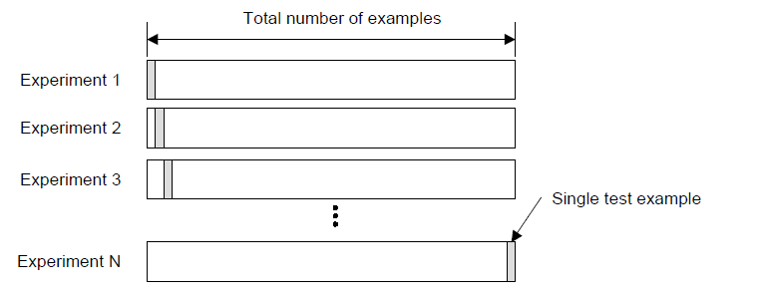
Leave-One-Out Cross Validation (LOOCV)
Leave-One-Out is the degenerate case of K-Fold cross validation, where K is chosen as the total number of examples
Intel – Advanced Analytics

Slide 20
LOOCV in action
For k=1 to R, do:
1. Let (xk,yk) be the k’th record
2. Remove (xk,yk) from the dataset
3. Train on the remaining R-1 datapoints
4. Measure your error (xk,yk)
When you’ve done all points, report the mean error.
Error
y
x
I was left out ☹.
Intel – Advanced Analytics

Slide 21
LOOCV in action
Small error
y
y
y
x
x
x
Big error
y
y
y
x
x
x
y
y
y
x
x
x
MSE_{LOOCV} = 2.12
Intel – Advanced Analytics

Slide 22
Cross-Validation summary
Good news:
Good for small datasets - training on all the data
No need to plan hold-out dataset(s), which can be challenging sometimes
Drawbacks:
Partitioning is not always easy to do
Can be less believable than hold-out data (especially 3rd party holdout).
Intel – Advanced Analytics

Slide 23
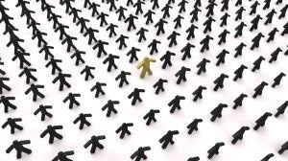
Dealing with imbalanced classes
Class 1: Short people
Class 2: Tall people
Can we build a classifier that can find the needles in the haystack?
Intel – Advanced Analytics

Slide 24
Imbalanced Class Sizes
Classes frequently have very unequal frequency
Creates training and evaluation challenges
Examples:
Security: >99.9999% of people are not terror related
Cancer diagnosis: 99% healthy, 1% disease
If we ‘straight-up’ predict that nobody has cancer, then 99% of our predictions are correct, but we will never detect cancer.
If we misclassify 1% of healthy patients → 50% of people we tell have cancer are actually cancer-free!
Intel – Advanced Analytics

Slide 25
Learning with imbalanced datasets is often done by balancing the classes
Create a balanced data set by:
Down-sampling the majority class
Up-sampling the minority class
Assign larger weights to the minority class samples
Important: Estimate the final results using an imbalanced held-out (test) set
Intel – Advanced Analytics
Notes:
Repeat that the cost function is imbalanced hence the problem
Ensemble method on all the small and part of the big
Again repeat that there’s no silver bullet you risk missing important cases
1000 patients only 10 have cancer down sampling gives 10/10

Slide 26
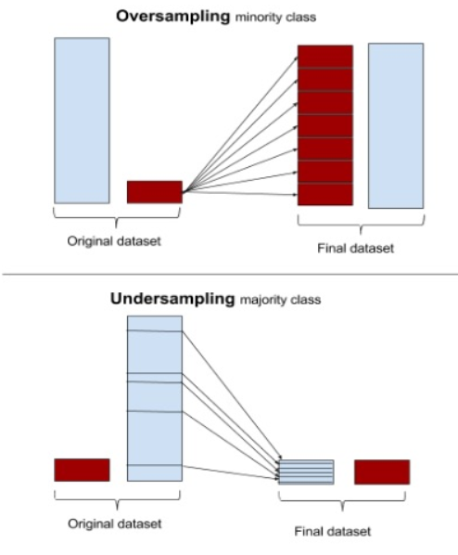
Up-sampling and Down-sampling
Up-sample:
Repeat minority points
Synthetic Minority Oversampling Technique (SMOTE)
Down-sample:
Sample (randomly choose) a random subset of points in the majority class
Bootstrapping (next slide)
Intel – Advanced Analytics
Notes:
Downsample already covered:
SMOTE: interpolate points with their nearest neighbors

Slide 27
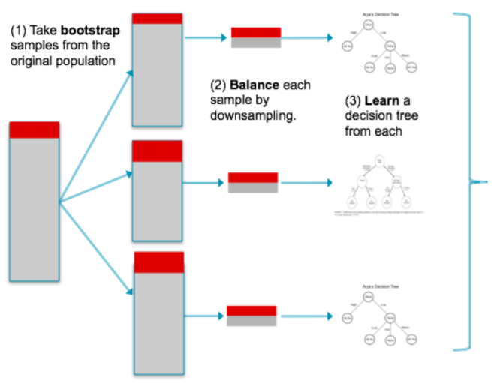
Bootstrapping
Take average prediction
or
majority vote

Slide 28
Bootstrapping
Sample m sets from the majority so that each sets size is equal to the minority set.
The downsampling is done with replacement (repeats allowed).
Train a model of minority vs. bootstrapped sample for each bootstrap iteration
This gives us m different models this is the basis of ensemble models like Random forest
Intel – Advanced Analytics

Slide 29


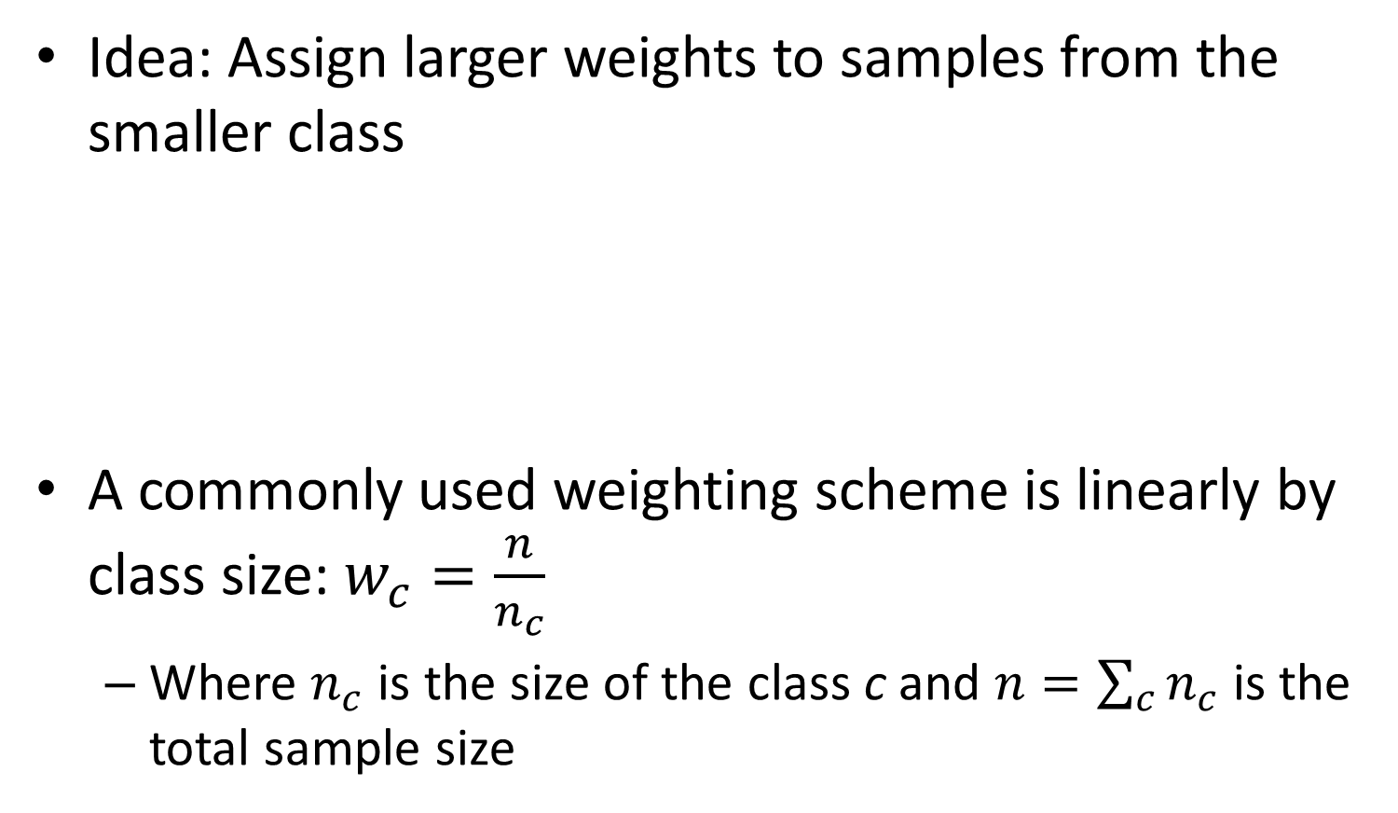
Reweighting
Idea: Assign larger weights to samples from the smaller class
A commonly used weighting scheme is linearly by class size: $w_{c}=\frac{n}{n_{c}}$
Where $n_{c}$ is the size of the class c and $n=\sum_{c}{n_{c}}$ is the total sample size
Intel – Advanced Analytics

Slide 30
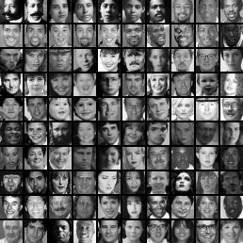
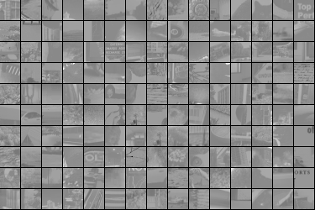
Imbalanced data can be harnessed
The Viola/Jones Face Detector
Faces
Non-Faces
Training data
5000 faces 10⁸ non faces
P. Viola and M. Jones, “Rapid object detection using a boosted cascade of simple features”, CVPR, 2001
P. Viola and M. Jones, “Robust real-time face detection”, IJCV 57(2), 2004
Intel – Advanced Analytics
Notes:
Imbalanced can still lead to amazing results:
Viola jones trained on very imbalanced data and yet it’s in every iphone
Multiple cascade classifiers
After 32 cascade classifiers we reach 10^-6 false positive with 65% false positive per classifier
BUT to achieve 90% detection total you need 99.7% detection per classifier

Slide 31
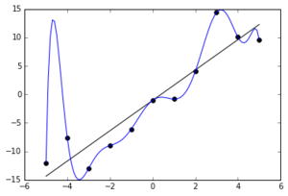
Over-fitting and under-fitting
The blue model has zero error!
The black model has error!
So which model is better : blue or black?
Intel – Advanced Analytics

Slide 32
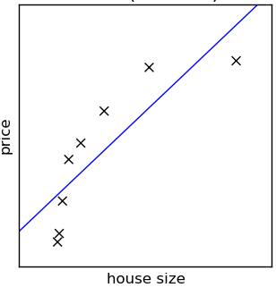
Under-fitting (high bias)
In under-fitting, the training error and test error are high
Caused by too ‘simple’ models
Too few features
Use of features is not ‘complex’
Examples
Can you accurately detect spam emails using only the word ‘free’?
Can you accurately predict housing prices using only the year it was built?
The blue line is not a great model
Probably not. More features (words) are needed)
Probably not - More features are needed: size, location, #windows, etc.

Slide 33
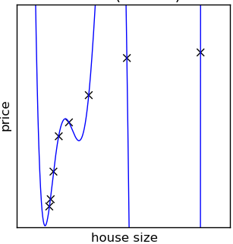
Overfitting (high variance) is when the model learns the noise and signal
If the model overfits
It cannot generalize well to new data
It memorizes the training data
It has a low training error, and high test error
The model has no error, but it does not seem to represent the data well

Slide 34

Overfitting is caused by:
Too much model complexity
Typically too many features
Little or not diverse data
Big data: The more data we have, the more complex a model we can use
Diversity: Redundant data does not add information and thus does not improve the model

Slide 35
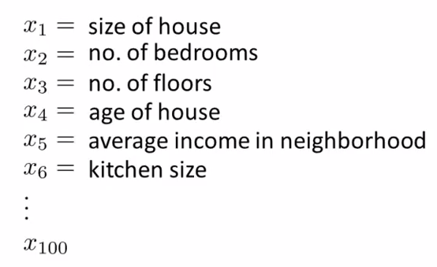
Overfitting due to the choice of too many features
We can use many features to try and predict the price of a house
Notes:
When we add feature we add noise, so it’s harder to find a model that doesn’t take it into account

Slide 36
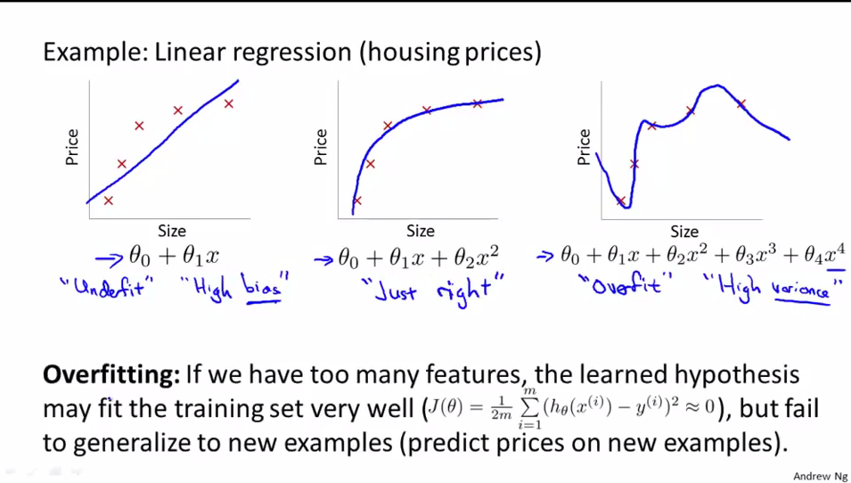
Overfitting due to poor model choice
Not many features
(only x1)
Too many features
(x1 to x4)
Notes:
Note that even the just right model is just an approximation

Slide 37
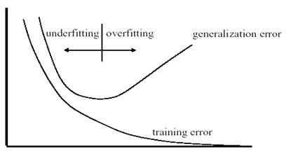
We can plot learning curves to spot overfitting
Training/test error
Overfitting
Underfitting
test
Optimum
Model complexity
Notes:
Come back to this slide later at the end

Slide 38
Addressing Overfitting
More data and more diverse data if possible
Reduce # of features/dimensionality
Regularization
Keep all the features but penalize some features/ values of parameters
This is particularly useful when we have a lot of features, each contributing a bit to the prediction
Notes:
Evaluation = Train \ Test \ Validation

