Slide 2
Gini Index
The Gini index or Gini coefficient is a statistical measure of distribution which was developed by the Italian statistician Corrado Gini in 1912.
It is used as a gauge of economic inequality, measuring income distribution among a population.

Slide 3
Gini coefficient
The Gini coefficient can then be thought of as the ratio of the area that lies between the line of equality and the Lorenz curve (marked A in the diagram over the total area under the line of equality (marked A and B in the diagram ); i.e., G = A / (A + B)
It is also equal to 2A and to 1–2B due to the fact that A + B = 0.5 (since the axes scale from 0 to 1)

Slide 4
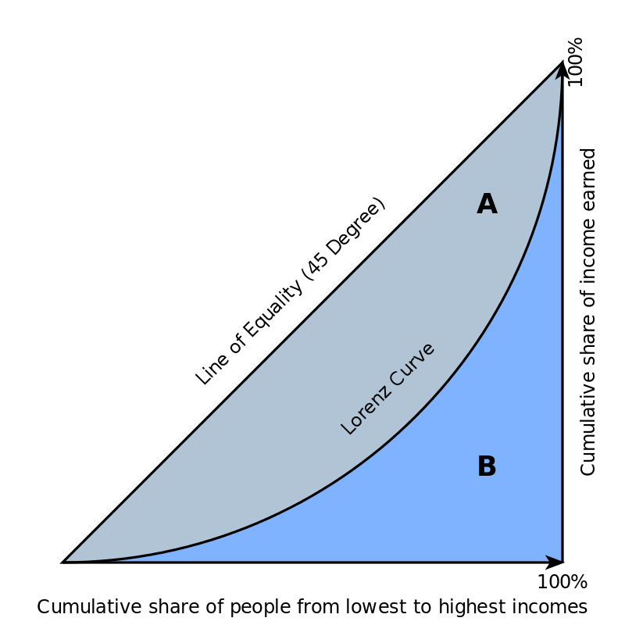

Slide 5
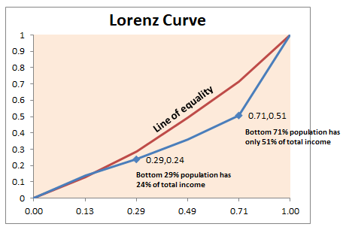

Slide 6
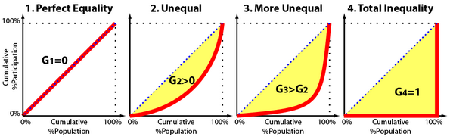

Slide 7
Gini coefficient
The Gini coefficient is equal to the area below the line of perfect equality (0.5 by definition) minus the area below the Lorenz curve, divided by the area below the line of perfect equality.
In other words, it is double the area between the Lorenz curve and the line of perfect equality.

Slide 8
Gini coefficient
Another way of thinking about the Gini coefficient is as a measure of deviation from perfect equality.
The further a Lorenz curve deviates from the perfectly equal straight line (which represents a Gini coefficient of 0), the higher the Gini coefficient and the less equal the society.

Slide 9
Use of Gini index in data modelling
The Gini Coefficient or Gini Index measures the inequality among the values of a variable.
Higher the value of an index, more dispersed is the data
Alternatively, the Gini coefficient can also be calculated as the half of the relative mean absolute difference.

