Slide 1
What are Decision Trees

Slide 2
Decision trees
Decision trees are tool to come to a decision
Decision trees are multi-way tree data structures
It is probably the most common algorithm used by data scientists
If you want to understand how the decision trees are used you do not need to know machine learning
But for understanding how the split takes place or how the decision trees are created, you need some appreciation of mathematics

Slide 3
Decision Trees -http://amsdecisiontreeanalysis.weebly.com/history.html
One model for performing decision tree analysis was created by J.Ross Quinlan at the University of Sydney and presented in his book Machine Learning, vol.1, no. 1, in 1975
His first algorithm for decision tree creation was called the Iterative Dichotomiser. This algorithm was created based on the principles of Occam's razor, with the idea of creating the smallest, most efficient decision tree possible
Quinlan went on to further develop this model with his creation of the C4.5 algorithm and finally, the C5.0 algorithm

Slide 4
Decision Trees
Classification and Regression Trees or CART for short is a term introduced by Leo Breiman to refer to Decision Tree algorithms that can be used for classification or regression predictive modelling problems
This algorithm is referred to as decision trees, but on some platforms like R they are referred to by the more modern term CART.
CART algorithm provides a foundation for important algorithms like bagged decision trees, random forest and boosted decision trees.

Slide 5
Decision Trees
You can have decision trees for both numerical and categorical values of the predictor variable
At the same time the output variable or the response variable can be real valued number in which case it is called Decision Tree Regression and a categorical value in which case it is called Classification Decision Trees

Slide 6
4 types of decision trees
Input categorical, output categorical
Input categorical, output continuous
Input continuous, output categorical
Input continuous, output continuous

Slide 7
Decision Trees
Some decision tree examples ahead ……

Slide 10
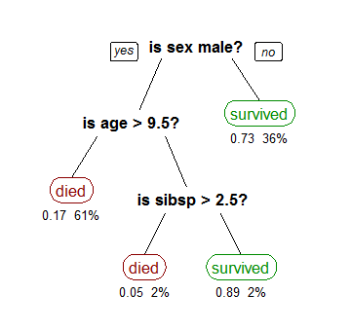

Slide 11
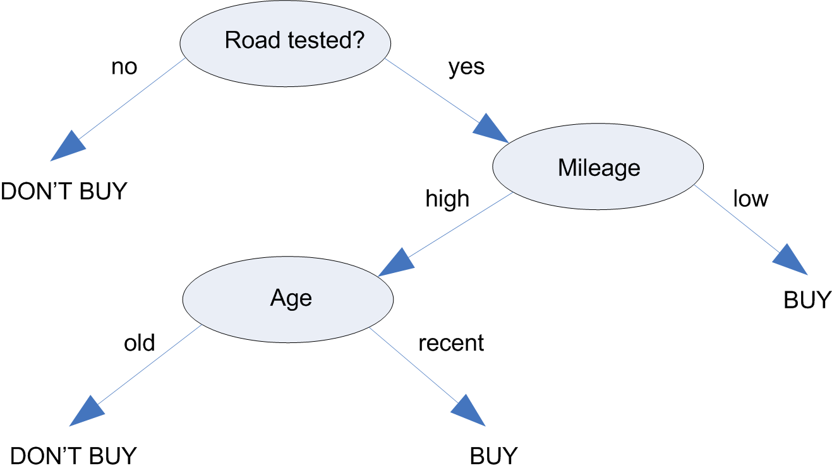

Slide 12
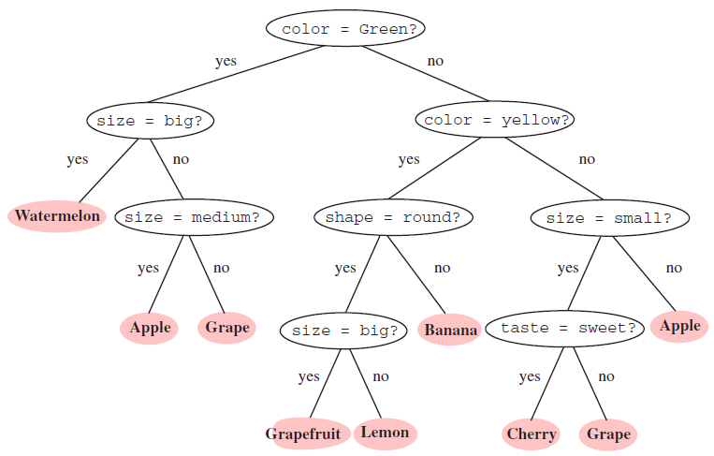

Slide 13
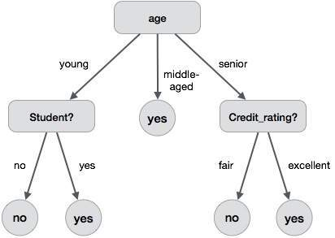

Slide 14
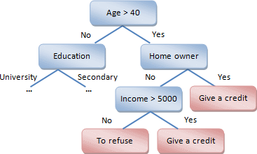

Slide 15
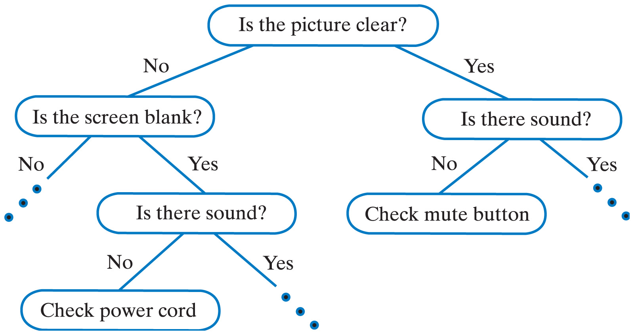

Slide 16
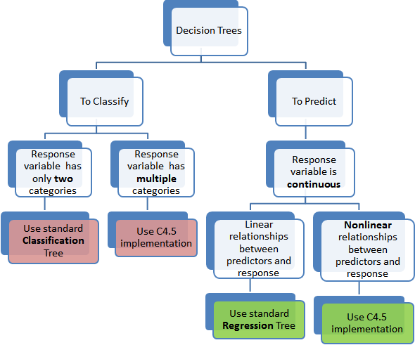

Slide 17
How to store a decision tree
The tree can be stored as a
File – you store as a dictionary of dictionaries
graph or
a set of rules
For example, this is a decision tree as a set of rules
If Height > 180 cm Then Male
If Height <= 180 cm AND Weight > 80 kg Then Male
If Height <= 180 cm AND Weight <= 80 kg Then Female

Slide 18
How to create a decision tree
Creating a binary decision tree is actually a process of dividing up the input space. A greedy approach is used called recursive binary splitting.
This is a numerical procedure where all the values are lined up and different split points are tried and tested using a cost function.
The split with the best cost (lowest cost because we minimize cost) is selected.
All input variables and all possible split points are evaluated and chosen in a greedy manner based on the cost function.

Slide 19
Regression or Classification?
Regression: The cost function that is minimized to choose split points is the sum squared error across all training samples that fall within the rectangle.
Classification: The Gini cost function is used which provides an indication of how pure the nodes are, where node purity refers to how mixed the training data assigned to each node is.
Splitting continues until nodes contain a minimum number of training examples or a maximum tree depth is reached.

