Slide 1
Methods for Dummies 2009
Bayes for Beginners
Georgina Torbet & Raphael Kaplan

Slide 2
Bayesian Probability
“Probability”: often used to refer to frequency
… but
Bayesian Probability: a measure of a state of knowledge.
It quantifies uncertainty. Allows us to reason using uncertain statements.
A Bayesian model is continually updated as more data is acquired.

Slide 3
How did this come about?
Billiard Table:
A white billiard ball is rolled along a line and we look at where it
stops.
We suppose that it has a uniform probability of falling anywhere
on the line. It stops at a point p.
A red billiard ball is then rolled n times under the same uniform
assumption.
How many times does the red ball roll further than the white ball?

Slide 4
Bayes' Theorem
Bayes' Theorem shows the relationship between a conditional probability and its inverse.
i.e. it allows us to make an inference from
the probability of a hypothesis given the evidence to
the probability of that evidence given the hypothesis
and vice versa

Slide 5
Bayes' Theorem
P(A|B) = P(B|A) P(A)
P(B)
P(A) – the PRIOR PROBABILITY – represents your knowledge about A before you have gathered data.
e.g. if 0.01 of a population has schizophrenia then the probability that a person drawn at random would have schizophrenia is 0.01

Slide 6
Bayes' Theorem
P(A|B) = P(B|A) P(A)
P(B)
P(B|A) – the CONDITIONAL PROBABILITY – the probability of B, given A.
e.g. you are trying to roll a total of 8 on two dice. What is the probability that you achieve this, given that the first die rolled a 6?

Slide 7
Bayes' Theorem
P(A|B) = P(B|A) P(A)
P(B)
So the theorem says:
The probability of A given B is equal to the probability of B given A, times the prior probability of A, divided by the prior probability of B.

Slide 8
A Simple Example
Mode of transport: Probability he is late:
Car 50%
Bus 20%
Train 1%
Suppose that Bob is late one day.
His boss wishes to estimate the probability that he traveled to work that day by car.
He does not know which mode of transportation Bob usually uses, so he gives a prior probability of 1 in 3 to each of the three possibilities.

Slide 9
A Simple Example
P(A|B) = P(B|A) P(A) / P(B)
P(car|late) = P(late|car) x P(car) / P(late)
P(late|car) = 0.5 (he will be late half the time he drives)
P(car) = 0.33 (this is the boss' assumption)
P(late) = 0.5 x 0.33 + 0.2 x 0.33 + 0.01 x 0.33
(all the probabilities that he will be late added together)
P(car|late) = 0.5 x 0.33 / 0.5 x 0.33 + 0.2 x 0.33 + 0.01 x 0.33
= 0.165 / 0.71 x 0.33
= 0.7042

Slide 10
More complex example
Disease present in 0.5% population (i.e. 0.005)
Blood test is 99% accurate (i.e. 0.99)
False positive 5% (i.e. 0.05)
- If someone tests positive, what is the probability that they have the disease?
P(A|B) = P(B|A) P(A) / P(B)
P(disease|pos) = P(pos|disease) x P(disease) / P(pos)
= 0.99 x 0.005 / (0.99x0.005)+(0.05x0.995)
= 0.00495 / 0.00495 + 0.04975
= 0.00495 / 0.0547
= 0.0905

Slide 11
What does this mean?
If someone tests positive for the disease, they have a 0.0905 chance of having the disease.
i.e. there is just a 9% chance that they have it.
Even though the test is very accurate, because the condition is so rare the test may not be useful.

Slide 12
So why is Bayesian probability useful?
It allows us to put probability values on unknowns. We can make logical inferences even regarding uncertain statements.
This can show counterintuitive results – e.g. that the disease test may not be useful.

Slide 13
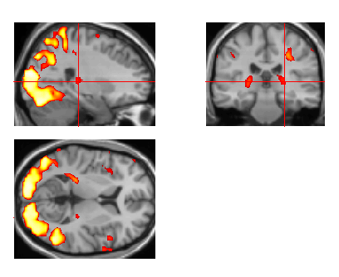
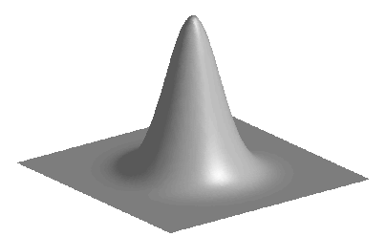
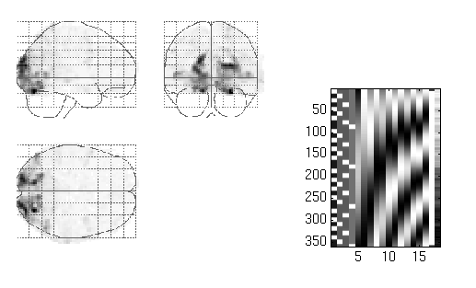
Bayes in Brain Imaging
realignment
smoothing
general linear model
statistical
inference
Gaussian
field theory
normalisation
p <0.05
template
Notes:
Traditional Statistics and where Bayes fits in

Slide 14
Bayes in SPM
Realignment & Spatial normalization
Spatial Priors (for the extent of an activation)
Posterior Probability Maps (PPMs)
Connectivity (DCM)

Slide 15
The GLM (again)
β
y
=
X
+
ε
Observed Signal/Data = Experimental Matrix x Parameter Estimates(prior) + Error (Artifact, Random Noise)

Slide 16
Bayes and β
Use priors to predict the variance of the regressors (the β’s) in our GLM.
Allows for comparison of the strength of different β’s and how they could contribute to the linear model.
Furthermore, it allows us to ask how plausible a particular β value/parameter estimate is given our data?

Slide 17
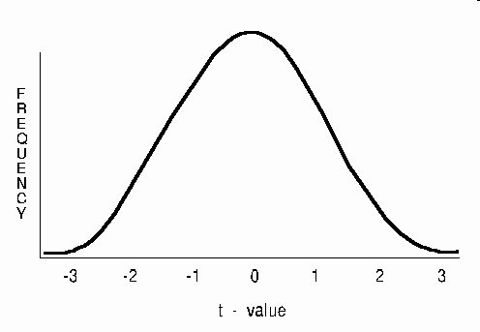
Why can’t we always use a T-Test to find out what we need?

Slide 18
Shortcomings of Classical Inference in fMRI
1.One can never reject the alternative hypothesis. The chance of getting a zero effect is zero! (e.g. Looking at whether a brain region responds to viewing faces, but does not respond at all to viewing trees.)
2. Along the same lines, if you have enough people or scans, almost any effect can become significant at every voxel. (Multiple comparisons)
3.Correcting for multiple comparisons. P value of an activation changes with a search volume. Does not truly work that way.
How do we rephrase this question to find the answers we want?
Notes:
All three points carry over to each other

Slide 19
What is the solution then?
“All these problems would be eschewed by using the probability that a voxel had
activated, or indeed its activation was greater than some threshold. This sort of
inference is precluded by classical approaches, which simply give the likelihood of
getting the data, given no activation. What one would really like is the probability
distribution of the activation given the data. This is the posterior probability used in
Bayesian inference.
-Chapter 17, page 4 of Human Brain Function (chapter authors Karl Friston and Will Penny. Eds. Ashburner, Friston, & Penny)
Notes:
Bayes is not a data analysis, it is a way to make an inference.

Slide 20
Comparing Bayes
Classical Inference- What is the likelihood that our data is not the result of random chance? (e.g. Following a nested design; What is the likelihood of getting this data given there is no activation?)
Bayesian Inference- Does our hypothesis fit our data? Does it work better than other models? (e.g. Assess how well a model fits our data; What is the likelihood of getting this activation given the data?)

Slide 21
Why Use It?
After all, it is a subjective model isn’t it? Our inference is only as good as our prior, right?
We can rule out or accept the null hypothesis. By looking at the null given the data, instead of the data given the null.
This also means we can compare any model (including the null hypothesis), even the validity of our priors!
We can estimate the plausibility of whether one Beta might have a stronger effect than another Beta in our GLM.

Slide 22
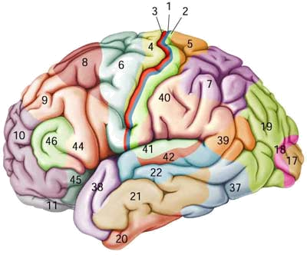

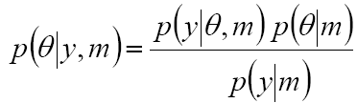
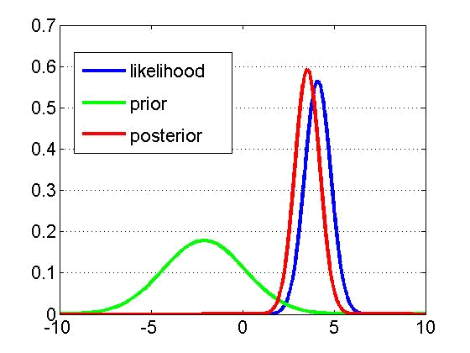
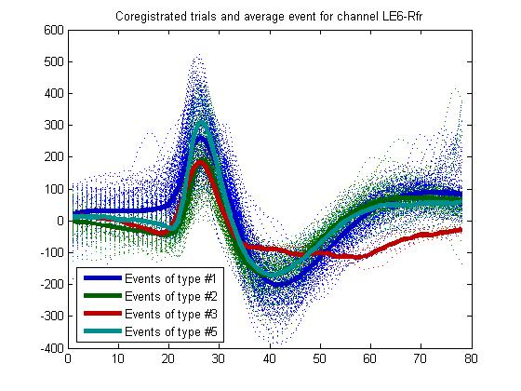
Bayesian paradigm Likelihood and priors
Likelihood:
Prior:
Bayes rule:
generative model m
Notes:
See how close the posterior is to either the likelihood or the prior, depending on where the data in relation to both. What is the chance of getting these betas given the data.

Slide 23
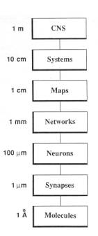
Hierarchical Models
Levels of Analysis
Even though we cannot measure at every level, but we can place priors on what we think might be going on at each level.
Use Empirical Bayes assumptions
We can then compare models at each level to determine what best fits our data at each level from a single neurotransmitter, all the way up to a cognitive network.
(Churchland and Sejnowski, 1988; Science)
Notes:
Empirical Bayes assumptions of the workings of the brain

Slide 24

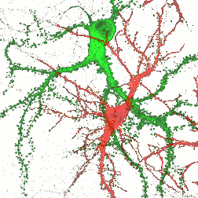
Hierarchical models
hierarchy
causality
Notes:
Courtesy of J. Daunizeau. Empirical Bayes

Slide 25
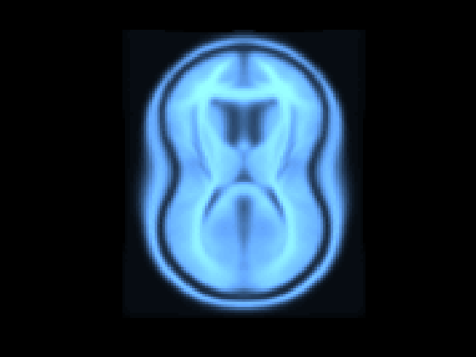
Applying Bayesian Model Comparison to Neuroimaging
What are some ways we can use Bayesian Inference in SPM8?

Slide 26

Example#1
Pharmacological Neuroimaging experiment
Clinical application (Parkinson’s, Alzheimer’s, etc.)
Use priors to compare an activation in a particular brain region (basal ganglia, hippocampus, etc.) that a drug targets to the rest of the brain.
Using model comparison, we can assess the relative strengths of a particular region to decide whether a targeted brain region was influenced by pharmacological intervention more than the rest of the brain or other specific regions.

Slide 27
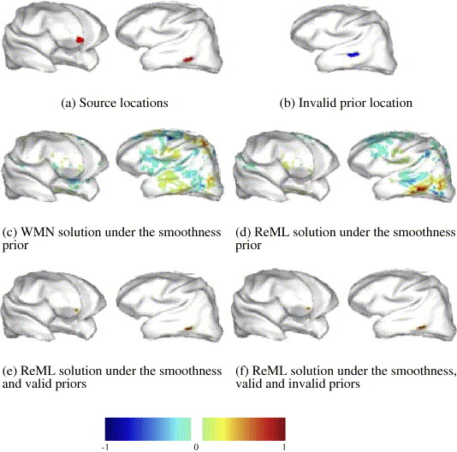
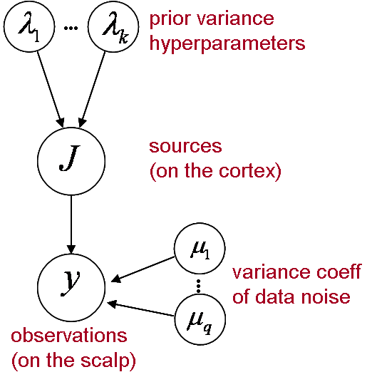
Example#2
EEG/MEG Source Reconstruction
(Mattout et al, 2006, Neuroimage)
Notes:
ReML= Restricted Maximum Likelihood (uses Bayes)
WMN= Weighted Minimum Norm

Slide 28
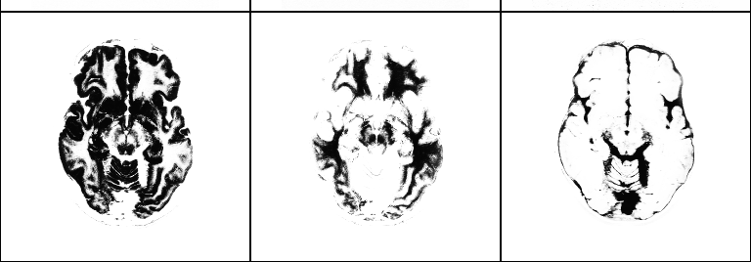
Other Example/Uses
Anatomical Segmentation
Dynamic Causal Modeling (DCM)
grey matter
white matter
CSF
[Ashburner et al., Human Brain Function, 2003]

Slide 29
Take Home Messages
Bayesian Inference allows you to ask different questions than you normally would with more classical approaches. (e.g. It allows you to accept instead of fail to reject the null hypothesis as the most likely hypothesis/model)
It is an extremely useful tool in model comparison. You can compare models that are not nested (instead of comparing to random chance)
It allows for incorporation of prior evidence and helps constrain inferences to see how plausible they are against the given data.
Notes:
Useful when comparing uneven models (different sample sizes)

Slide 30

Conclusion
Bayesian inference is applicable to something other than a billiards game

Slide 31
Acknowledgements and Recommended Resources
Jean Daunizeau and his SPM course slides
Past MFD slides
Human Brain Function (eds. Ashburner, Friston, and Penny) www.fil.ion.ucl.ac.uk/spm/doc/books/hbf2/pdfs/Ch17.pdf
http://faculty.vassar.edu/lowry/bayes.html

