Slide 1
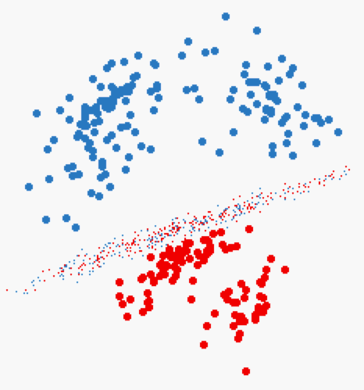
Naïve Bayes Classifier
Given a dataset (training data), we learn (build) a statistical model
This model is called “Classifier”
Each point in the training data is in the form of:
<label, feature 1, feature 2, ….feature N>
Label ➔ is the class label
Features 1..N ➔ the features (dimensions of the point)
Then, given a point without a label <??, feature 1, ….feature N>
Use the model to decide on its label

Slide 2
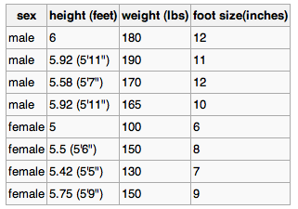
Naïve Bayes Classifier: Example
Best described through an example
Three features
Class label (male or female)
Training dataset

Slide 3

Naïve Bayes Classifier (Cont’d)
For each feature in each label
Compute the mean and variance
That is the model (classifier)

Slide 4

Naïve Bayes: Classify New Object
Male or female?
For each label ➔ Compute posterior value
The label with the largest posterior is the suggested label

Slide 5

Naïve Bayes: Classify New Object (Cont’d)
Male or female?
>> evidence: Can be ignored since it is the same constant for all labels
>> P(label): % of training points with this label
>> p(feature|label) = , f is feature value in sample
f

Slide 6


Naïve Bayes: Classify New Object (Cont’d)
Male or female?

Slide 7
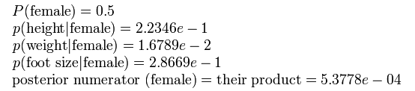
Naïve Bayes: Classify New Object (Cont’d)
Male or female?
The sample is predicted to be female

