Slide 1
CS 124/LINGUIST 180 From Languages to Information
Naïve Bayes and Sentiment Analysis
Kevin Nguyen
Notes:
1

Slide 2
2
Agenda Today
Bayes Rule Naïve Bayes Review
Conceptual Understanding Questions
PA3 Overview
Demos on Sentiment Analysis
Fun with NLTK!!!

Slide 3
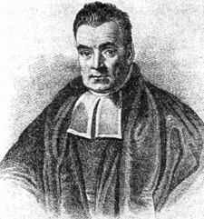
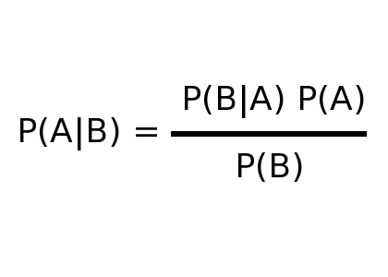
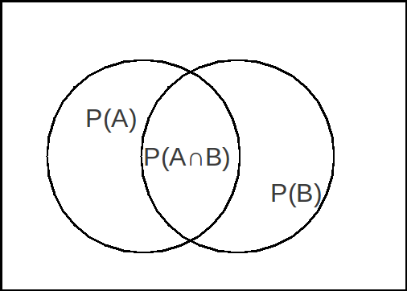
3
Bayes Rule
Deriving Bayes Rule

Slide 4
4
Review Questions
For Multinomial Naïve Bayes for Text Classification, what training set “state” do we need to keep track of?
What are the assumptions of Naïve Bayes?
What are some practical things we can do to help Naïve Bayes for text classification, specifically for Sentiment Analysis (preparing the data, etc.)?
What is the difference between Multinomial Naïve Bayes, Bernoulli Naïve Bayes, and Binarized Multinomial Naïve Bayes?
What is Cross Validation and why do we do it?

Slide 5
5
PA3
Implement Multinomial Naïve Bayes to classify the sentiment of movie reviews (positive or negative)
Use Add One Smoothing
Modify two methods (addExample and classify) as well as initialize data variables
Don’t forget the Short Answer section!

Slide 6
6
Sentiment Analysis Demos
http://sentiment.christopherpotts.net/
(Link found on cs124 Schedule Page)
We will look at:
Tokenization
Stemming

Slide 7
7
NLTK
Natural Language Toolkit for Python
Libraries for classification, tokenization, stemming, tagging, parsing, and semantic reasoning
Really Powerful + Easy to Use = FUN!!
http://nltk.org/

Slide 8
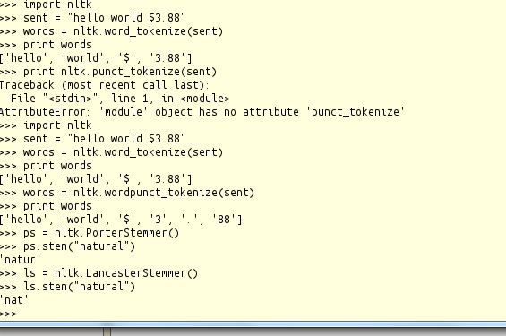
8
Let’s Try It Out!
SSH into Corn (Myth does not have nltk installed)
Run “python”
“Import nltk”

Slide 9
9
Sentiment.py (Available on Class Schedule page)
Very Similar to Assignment
analyzing the IMDB data using nltk naïve bayes
No real implementation you have to complete, just fun features to try!
Look at comments to see what you can do
Look at README and correspond sections in the comments with sections of the README
Look up cool things to try online

