Slide 1
Cross Validation, testing, training

Slide 2
Memorization and generalization
what is accuracy ? how measure it ?
we will only about accuracy here
after you have built a model or an algorithm, how do you justify
that it is a good model ? how do you validate the model you have built ?
how to choose a model ? how to choose an algorithm ?
how to choose what type of learning is needed ?
when to do selection of parameters or tuning of the parameters ?
What is generalization error or bias variance error ?
what is grid search or random search ? when is it done ?
Notes:
Give the example of the math test with 200 exercises

Slide 3
Memorization and generalization
Quick ML review
Model evaluation
Performance metrics
Hold-out evaluation
Cross validation
Training with imbalanced classes
Overfitting/underfitting
Dimensionality and feature selection
Curse of dimensionality
Filter feature selection
Wrapper feature selection
Principal Component Analysis (dimensionality reduction)
Notes:
Give the example of the math test with 200 exercises

Slide 4
Memorization and generalization
Memorization:
Are we specifically only learning an algorithm on our data?
Generalization
Refers to the capability of applying learned knowledge to previously unseen data
Without generalization there is no learning, just memorizing!
Notes:
Give the example of the math test with 200 exercises

Slide 5
Features and labels
Features (a.k.a covariates) are the variables that describe the data.
Label (target variable/target covariate): The feature we want to predict in supervised learning.
So, a label is kind of like a feature

Slide 6
Supervised vs unsupervised examples
Supervised - Predict housing prices using:
Features: number of bathrooms, floor, number of windows, kitchen size
Label: House prices
*** We can switch around the label and the features
Unsupervised - Find patterns in books using:
# of pages, # of printed copies, language, mean words per page
Label: there is none
Maybe we will ‘cluster’ the books into genres? Maybe into authors? Etc.

Slide 7
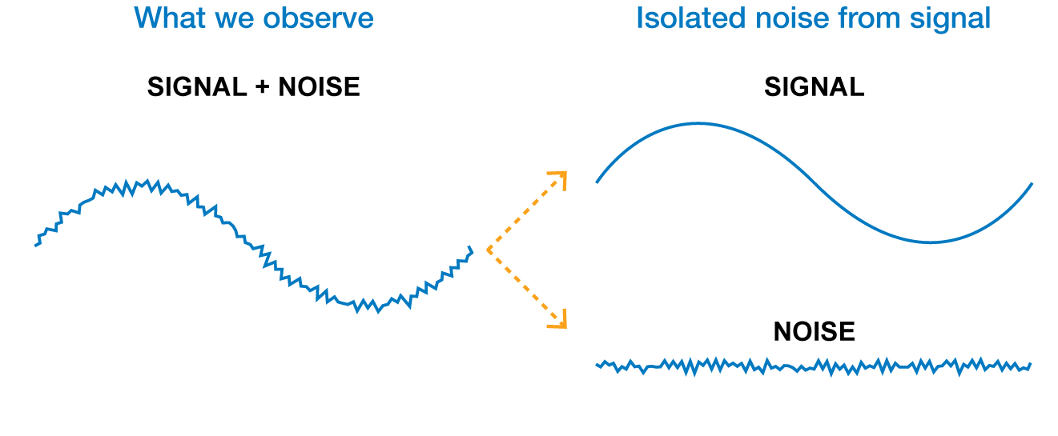
What’s in the data we learn from
The data usually has two components:
Signal: information that is relevant to pattern detection or prediction
Noise: information that is irrelevant to the future
Finding which is which is the challenge
Notes:
Today we’re going to Talk about some of the chanllages that are intrinsic with the data . One of the :overfitting

Slide 8
The basic rule in model validation
Don’t test your model on data it’s been trained with!

Slide 9
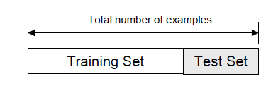
Holdout test set: The naïve approach
Randomly split the entire dataset into:
Training set: A dataset used for training the model
Test set (a.k.a validation set): Data only used for testing the model
Train model here
Estimate model performance here

Slide 10
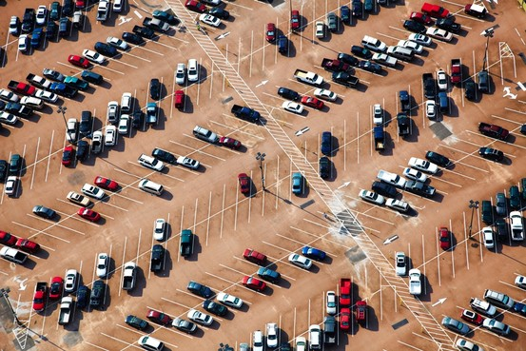
Holdout test set – considerations
Can the data be split randomly without bias?
Test set and training set should be interchangeable, except for data size. Otherwise test results are not a true reflection of performance.
In other words, test and train data should be from the same distribution
Do we have enough data?
Example: Predict if a car is American or Japanese based on 50 examples?
Will the test set be big enough to accurately report our model performance?

Slide 11
What is biased/unbiased data?
Unbiased data sampling:
Data that represents the diversity in our target distribution of data on which we want to make predictions.
I.e., a random, representative sample of the entire distribution.
Biased data:
Data that does not accurately reflect the target distribution.
Examples:
Elections: we only asked people with glasses who they will vote for, instead of asking a random sample of the population.
Simulated data: We cannot get real data, so we create simulated/synthetic data
May be addressed using transfer learning/domain adaptation

Slide 12
The three-way split
Training set
A set of examples used for learning
Validation (a.k.a development) set
A set of examples used to tune the parameters of a classifier
Test set
A set of examples used only to assess the performance of fully-trained classifier. After assessing the model with the test set, YOU MUST NOT further tune your model (that’s the theory anyway… - in order to prevent ‘learning the test set’ and ‘overfitting’)

Slide 13
The three-way split
The entire available dataset
Training data
Validation data
Test data
Model tuning
Performance evaluation

Slide 14
How to perform the split?
How many examples in each data set?
Training: Typically 60-80% of data
Test set: Typically 20-30% of your trained set
Validation set: Often 20% of data
Examples
3 way: Training: 60%, CV: 20%, Test: 20%
2 ways: Training 70%, Test: 30%
The entire available dataset
Train set
Test set

Slide 15
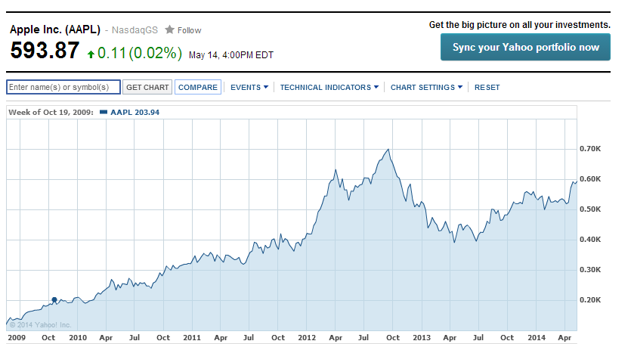
How to perform the split?
Time based – If time is important
Can you use Jul 2011 stock price to try and predict Apr 2011 stock price?

Slide 16
How to perform the split?
Some datasets are effected by seasonality
Is it a good test set?
Notes:
Either you neutralize the seasonality or you take a proper train set

Slide 17


Holdout summary
Good news:
Intuitive
Usually easy to perform
Considered the ideal method for evaluation
Drawbacks:
In small datasets you don’t have the luxury of setting aside a portion of your data
The performance will be misleading if we had unfortunate split
Often requires planning ahead of time to prevent training on test set or getting insights from it)
External evaluation is ideal

Slide 18
Cross validation
Used when:
a hold-out plan is difficult to design or was not designed at the beginning
the dataset is small, and you want to use all the data for good model training

Slide 19
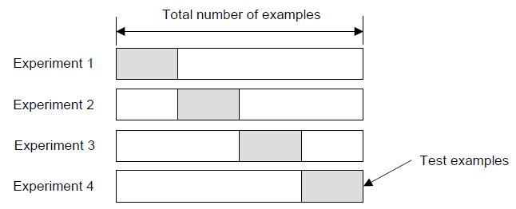
Cross - Validation
Create a K-fold partition of the dataset
For each of the K experiments, use K-1 folds for training and the remaining one for testing
4-fold cross validation example
Test set
Train
Test set
Test set
Test set

Slide 20

Cross - Validation
How do you summarize the performance?
Average: Usually average of performance between experiments
How many folds are needed?
Common choice: 5-fold or 10-fold cross validation (probably since these numbers sound nice)
Large datasets → even a 3-Fold cross validation will be quite accurate
Smaller datasets → we will prefer bigger K
Leave-One-Out approach (K=n). In this case the number of folds K is equal to the number of examples n. Used for smaller datasets

Slide 21
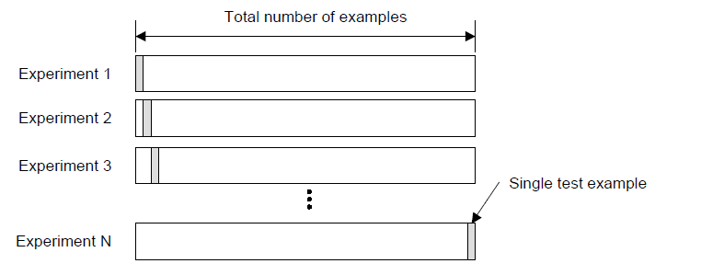
Leave-One-Out Cross Validation (LOOCV)
Leave-One-Out is the degenerate case of K-Fold cross validation, where K is chosen as the total number of examples

Slide 22
LOOCV in action
For k=1 to R, do:
1. Let (xk,yk) be the k’th record
2. Remove (xk,yk) from the dataset
3. Train on the remaining R-1 datapoints
4. Measure your error (xk,yk)
When you’ve done all points, report the mean error.
Error
y
x
I was left out ☹.

Slide 23
LOOCV in action
Small error
y
y
y
x
x
x
Big error
y
y
y
x
x
x
y
y
y
x
x
x
MSE_{LOOCV} = 2.12

Slide 24
Cross-Validation summary
Good news:
Good for small datasets - training on all the data
No need to plan hold-out dataset(s), which can be challenging sometimes
Drawbacks:
Partitioning is not always easy to do
Can be less believable than hold-out data (especially 3rd party holdout).

Slide 25
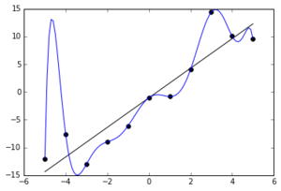
Over-fitting and under-fitting
The blue model has zero error!
The black model has error!
So which model is better : blue or black?

Slide 26
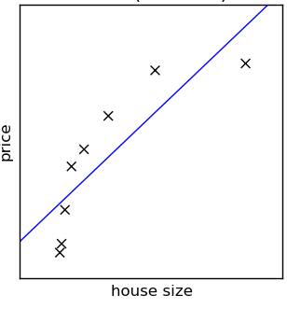
Under-fitting (high bias)
In under-fitting, the training error and test error are high
Caused by too ‘simple’ models
Too few features
Use of features is not ‘complex’
Examples
Can you accurately detect spam emails using only the word ‘free’?
Can you accurately predict housing prices using only the year it was built?
The blue line is not a great model
Probably not. More features (words) are needed)
Probably not - More features are needed: size, location, #windows, etc.

Slide 27
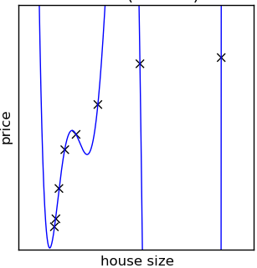
Overfitting (high variance) is when the model learns the noise and signal
If the model overfits
It cannot generalize well to new data
It memorizes the training data
It has a low training error, and high test error
The model has no error, but it does not seem to represent the data well

Slide 28

Overfitting is caused by:
Too much model complexity
Typically too many features
Little or not diverse data
Big data: The more data we have, the more complex a model we can use
Diversity: Redundant data does not add information and thus does not improve the model

Slide 29
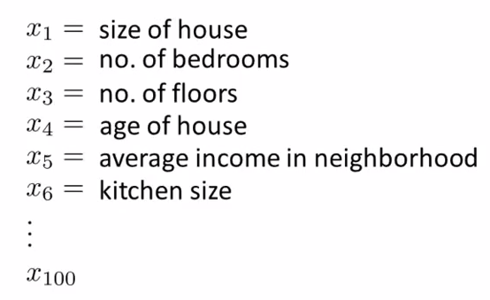
Overfitting due to the choice of too many features
We can use many features to try and predict the price of a house
Notes:
When we add feature we add noise, so it’s harder to find a model that doesn’t take it into account

Slide 30
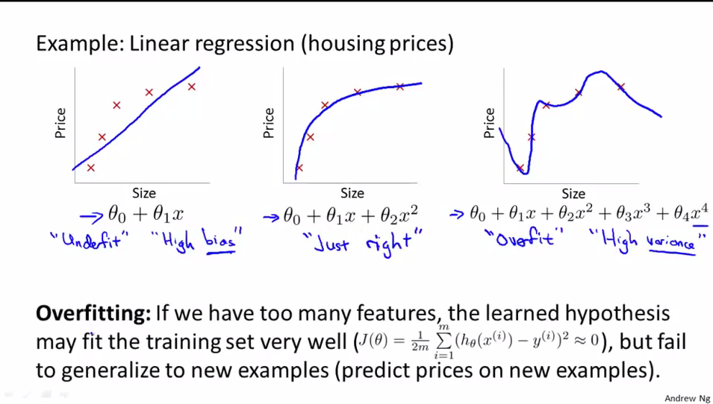
Overfitting due to poor model choice
Not many features
(only x1)
Too many features
(x1 to x4)
Notes:
Note that even the just right model is just an approximation

Slide 31
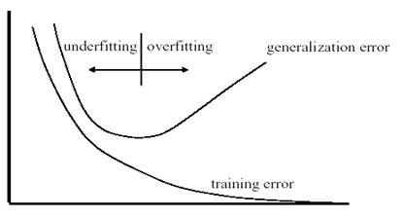
We can plot learning curves to spot overfitting
Training/test error
Overfitting
Underfitting
test
Optimum
Model complexity
Notes:
Come back to this slide later at the end

Slide 32
Addressing Overfitting
More data and more diverse data if possible
Reduce # of features/dimensionality
Regularization
Keep all the features but penalize some features/ values of parameters
This is particularly useful when we have a lot of features, each contributing a bit to the prediction
Notes:
Evaluation = Train \ Test \ Validation

