Slide 1

Antivirus engines
Paul A. GAGNIUC
Paul A. Gagniuc. Antivirus Engines: From Methods to Innovations, Design, and Applications. Cambridge, MA: Elsevier Syngress, 2024. pp. 1-656.

Slide 2
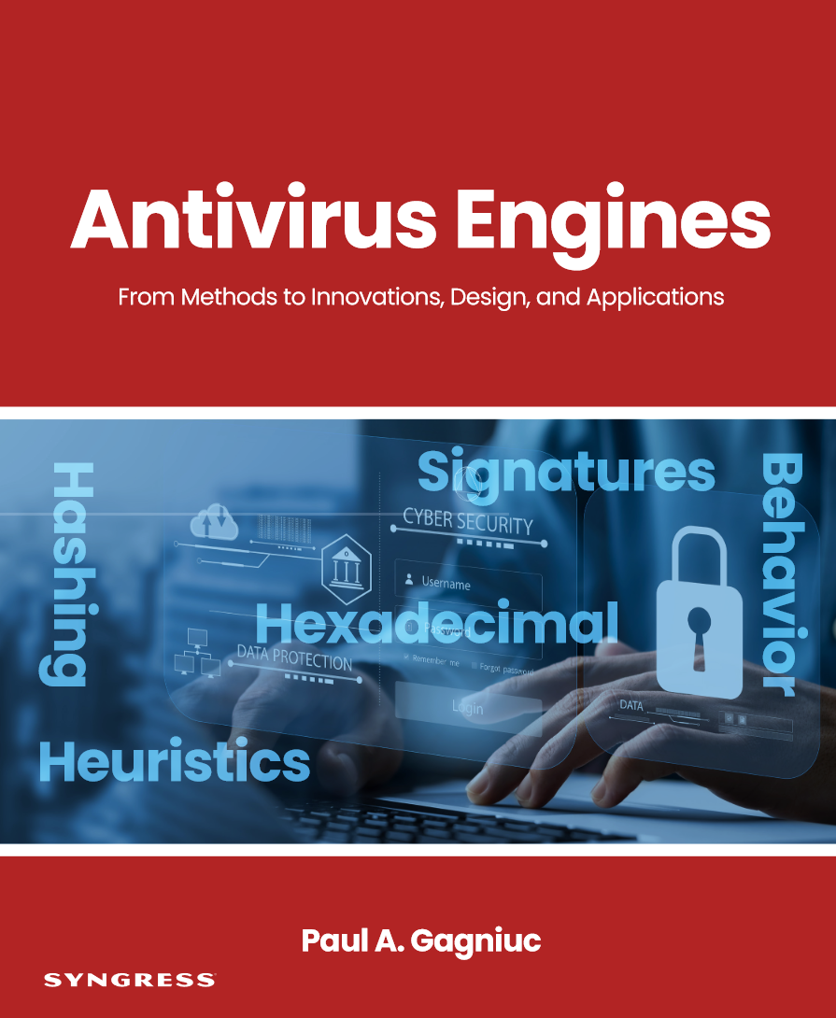



National University of Science and Technology Politehnica Bucharest
https://github.com/gagniuc/Antivirus-Engines
Military Technical Academy “Ferdinand I”
Paul A. Gagniuc. Antivirus Engines: From Methods to Innovations, Design, and Applications. Cambridge, MA: Elsevier Syngress, 2024. pp. 1-656.

Slide 3
Malware
Viruses
File infectors
Spyware
Keyloggers
Botnets
Rootkits
Logic Bombs
Adware
Backdoors
Ransomware
Macro Viruses
RAT
MBR
Bootkits
Exploits
Trojans
Worms
Malware
Viruses
File infectors
Trojans
Spyware
Keyloggers
Botnets
Rootkits
Logic Bombs
Adware
Backdoors
Macro Viruses
RAT
MBR
Bootkits
Worms
Exploits
Psyware
Ransomware
Scareware
Pornware
(A)
(B)
Paul A. Gagniuc. Antivirus Engines: From Methods to Innovations, Design, and Applications. Cambridge, MA: Elsevier Syngress, 2024. pp. 1-656.

Slide 4
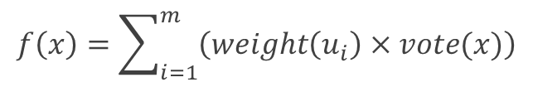

Is this malware?
Is this IP/link malicious?
U
S
U
…
U
U
S
U
…
U
yes
no
yes
no
no
no
yes
no
$$f\left(x\right)=\sum_{i=1}^{m}{\left(weight\left(u_{i}\right)×vote(x)\right)}$$
$$f\left(x\right)=\sum_{i=1}^{m}{\left(weight\left(u_{i}\right)×vote(x)\right)}$$
File x
IP
Malware DB
IP/Link DB
(A)
(B)
x1, x2, x3, … xn
x1, x2, x3, … xn
Paul A. Gagniuc. Antivirus Engines: From Methods to Innovations, Design, and Applications. Cambridge, MA: Elsevier Syngress, 2024. pp. 1-656.

Slide 5
non-polymorphic
Region Match
MD5 hash
signatures
db
Chunks Match
Hexadecimal signatures
db
Frequency Match
Heuristic
signatures
db
polymorphic
Paul A. Gagniuc. Antivirus Engines: From Methods to Innovations, Design, and Applications. Cambridge, MA: Elsevier Syngress, 2024. pp. 1-656.

Slide 6
MD5 signature
12Kb
file.exe
4a0d47050abcec1587248e8c174a748e : file.exe
Paul A. Gagniuc. Antivirus Engines: From Methods to Innovations, Design, and Applications. Cambridge, MA: Elsevier Syngress, 2024. pp. 1-656.

Slide 7
MD5 signature
12Kb
first
2Kb
file.exe
3Kb
last
3Kb
2Kb
931ea08b1f3c1df63413b128f4c46f66 : file.exe
Paul A. Gagniuc. Antivirus Engines: From Methods to Innovations, Design, and Applications. Cambridge, MA: Elsevier Syngress, 2024. pp. 1-656.

Slide 8
MD5 signature
12Kb
file.exe
3Kb
2Kb
f11e361f2242ffdd856d87a963d62821
b10106a5f905d23a7809e220ba67aa4d
9ce737722ce22903f61c83796e013fbf : file.exe
Paul A. Gagniuc. Antivirus Engines: From Methods to Innovations, Design, and Applications. Cambridge, MA: Elsevier Syngress, 2024. pp. 1-656.

Slide 9
MD5 signature
file.exe
3Kb
2Kb
931ea08b1f3c1df63413b128f4c46f66
9ce737722ce22903f61c83796e013fbf
7fa24b9db9b313523977d14b27a7a676 : 9ce737722ce22903f61c83796e013fbf : file.exe
Paul A. Gagniuc. Antivirus Engines: From Methods to Innovations, Design, and Applications. Cambridge, MA: Elsevier Syngress, 2024. pp. 1-656.

Slide 10
file 1.exe
3Kb
file 2.exe
3Kb
file 3.exe
3Kb
file 4.exe
3Kb
3Kb
3Kb
3Kb
3Kb
aa06d4dd7af1a739ecdce4630a2f7ed9
Paul A. Gagniuc. Antivirus Engines: From Methods to Innovations, Design, and Applications. Cambridge, MA: Elsevier Syngress, 2024. pp. 1-656.

Slide 11
(B)
200 bytes
200 bytes
…
.text
file1.exe
55 8B EC 6A FF 68 40 30 …
…
.text
file2.exe
55 8B EC 81 EC 80 00 00 …
…
.text
file3.exe
48 83 EC 28 48 89 5C 24 …
…
.text
file4.exe
40 53 48 83 EC 20 48 8B …
…
.text
file5.exe
55 8B EC 6A FF 68 40 30 …
(C)
(D)
…
.text
file(n).exe
55 89 E5 83 EC 28 8B 45 …
PWM (pwm.json)
(F)
Entry Point
 | 1 | 2 | 3 | … | 199 | 200
00 | 0 | 0 | 0 | … | 0 | 0
01 | 0 | 0 | 0 | … | 10 | 4
… | … | … | … | … | … | …
FE | 0 | 0 | 0 | … | 0 | 0
FF | 0 | 0 | 0 | … | 1 | 12
(E)
(infected samples)
(A)
Paul A. Gagniuc. Antivirus Engines: From Methods to Innovations, Design, and Applications. Cambridge, MA: Elsevier Syngress, 2024. pp. 1-656.

Slide 12
PWM
(E)
Score
 | 1 | 2 | 3 | … | 199 | 200
00 | 0 | 0 | 0 | … | 0 | 0
01 | 0 | 0 | 0 | … | 10 | 4
… | … | … | … | … | … | …
FE | 0 | 0 | 0 | … | 0 | 0
FF | 0 | 0 | 0 | … | 1 | 12
(D)
= 1507
200 bytes
(C)
55 8B EC 6A FF 68 40 30 64 00 68 CC 04 60 00 64 …
200 bytes
(B)
…
.text
file.exe
(A)
Entry Point
(file to be scanned)
Paul A. Gagniuc. Antivirus Engines: From Methods to Innovations, Design, and Applications. Cambridge, MA: Elsevier Syngress, 2024. pp. 1-656.

Slide 13
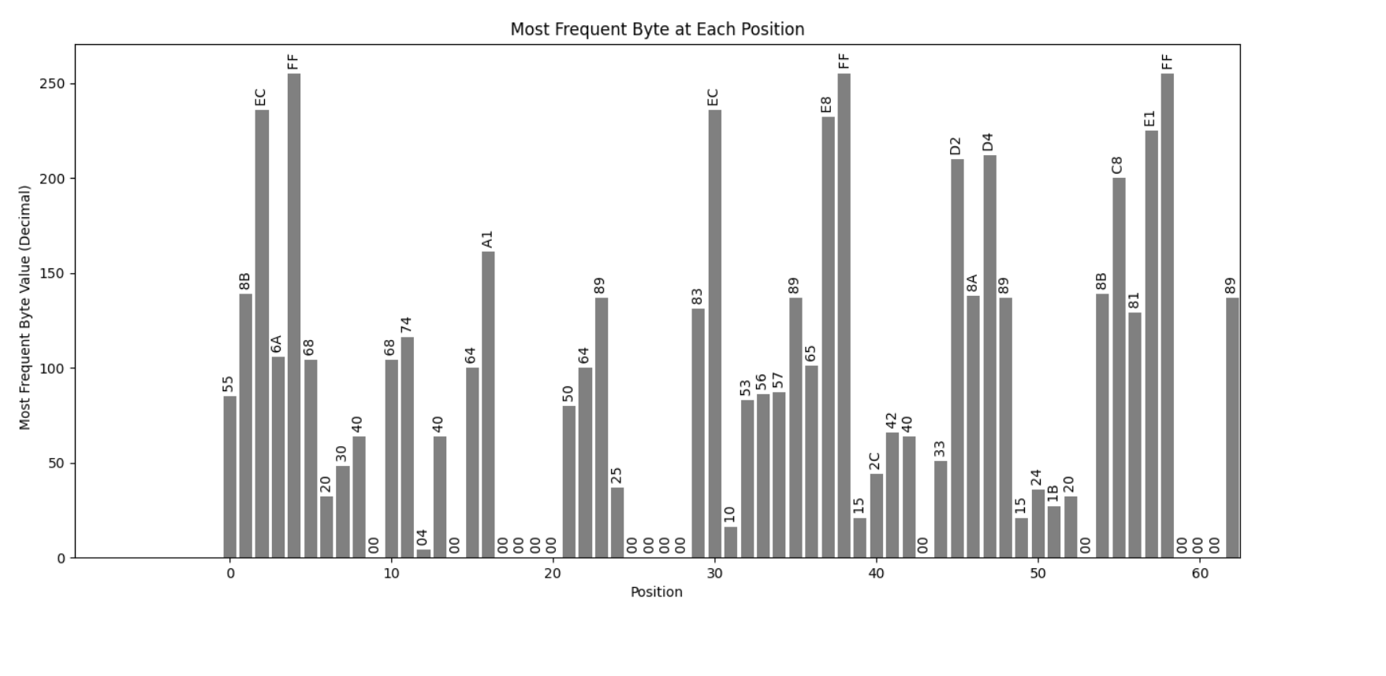


Paul A. Gagniuc. Antivirus Engines: From Methods to Innovations, Design, and Applications. Cambridge, MA: Elsevier Syngress, 2024. pp. 1-656.
(A)
Entry Point

Slide 14
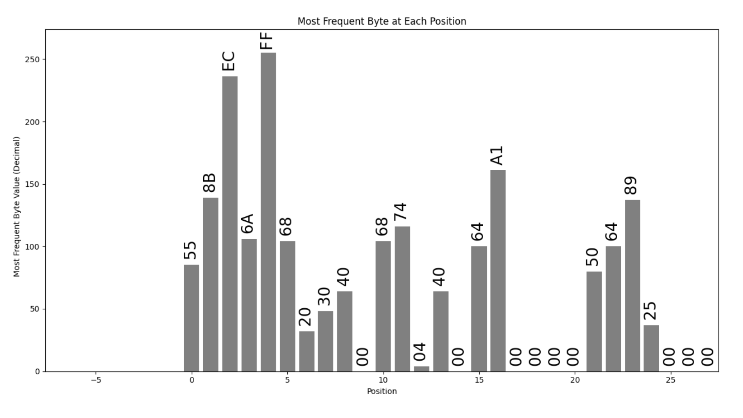


Paul A. Gagniuc. Antivirus Engines: From Methods to Innovations, Design, and Applications. Cambridge, MA: Elsevier Syngress, 2024. pp. 1-656.
(B)
Entry Point

Slide 15
infected_file.exe
…
4Kb
(A)
…
4Kb
(B)
…
300 bytes
disinfected_file.exe
4Kb
…
…
infected_file.exe
…
file.exe
4Kb
(C)
…
…
…
file.exe
virus
disinfected_file.exe
4Kb
…
…
file.exe
4Kb
…
…
…
4Kb
infected_file.exe
(E)
…
hex
JSON
record
4Kb
…
4Kb
(D)
…
…
4Kb
…
4Kb
disinfected_file.exe
…
…
Paul A. Gagniuc. Antivirus Engines: From Methods to Innovations, Design, and Applications. Cambridge, MA: Elsevier Syngress, 2024. pp. 1-656.

Slide 16
4Kb
…
file1.exe
4Kb
…
4Kb
…
file2.exe
4Kb
…
4Kb
…
file3.exe
4Kb
…
4Kb
…
file4.exe
4Kb
…
4Kb
…
file5.exe
4Kb
…
4Kb
…
file6.exe
4Kb
…
(A)
(B)
4Kb
4Kb
…
…
file(n).exe
Original executable files
JSON
Paul A. Gagniuc. Antivirus Engines: From Methods to Innovations, Design, and Applications. Cambridge, MA: Elsevier Syngress, 2024. pp. 1-656.

Slide 17
Temporary folder
file.zip
file1_js7hd.exe
file1.exe
file2_4fjiv.exe
file1.txt
(F)
file3_yus5d.exe
(C)
file1.pdf
file1_iry0u.zip
file2.exe
(A)
file3_pr4ew.exe
file3.exe
file1.doc
(D)
Delete
file1.zip
File
send
to
file1.xlsx
file3.exe
(E)
file1.sys
Malware scanner,
[if .exe]
Unpacker,
[if .zip]
file2.doc
(B)
file2.txt
Clean
[quarantine .zip]
Paul A. Gagniuc. Antivirus Engines: From Methods to Innovations, Design, and Applications. Cambridge, MA: Elsevier Syngress, 2024. pp. 1-656.

Slide 18
silent mode
Yes
Signature
exists?
Is archive?
Unarchive
Bloom
filter
Yes
(D)
(I)
No
AV engine
Scanner
Extension filter
Folder paths
(B)
(C)
Hexadecimal signatures
MD5 hash
signatures
Registry
No
Memory
(A)
Pro-active monitoring
Heuristic signatures
Process
behavior
User
behavior
Schedule (update & scan)
Infected?
No
(E)
Yes
(H)
Update
All safe !
(F)
Mitigation
Hex.db
MD5.db
(G)
Quarantine
Disinfection
Heuristic signatures
Binary JSON chunks
Paul A. Gagniuc. Antivirus Engines: From Methods to Innovations, Design, and Applications. Cambridge, MA: Elsevier Syngress, 2024. pp. 1-656.

Slide 19
World Wide Web
(B)
Web Server
(C)
Laboratory
Website GUI
AV Solution Design
(A)
AV on client
AV solution kit
Malware
bank
Suspicious files
Suspicious files
Statistics
Statistics
Malware analysis
Automatic signature extractor
Update
files.*
files.*
Hex.db
Hex.db
signatures
AV components
MD5.db
MD5.db
Heuristic.db
Heuristic.db
Update
Update
Paul A. Gagniuc. Antivirus Engines: From Methods to Innovations, Design, and Applications. Cambridge, MA: Elsevier Syngress, 2024. pp. 1-656.

Slide 20
RAM
(A)
Persistent processes
Temporary
Wach Dog
Wach Dog
Manual scan
Statistics
Wach Dog
Desinfection
Other tools
Pro-active
GUI
Wach Dog
Engine
SysTry
Update
HDD/SSD
other.non-exe.files
signature.sig
Pro-active
Other tools
Desinfection
GUI
Wach Dog
SysTry
Engine
Manual scan
Statistics
Update
Paul A. Gagniuc. Antivirus Engines: From Methods to Innovations, Design, and Applications. Cambridge, MA: Elsevier Syngress, 2024. pp. 1-656.

Slide 21
RAM
(A)
Persistent processes
Temporary
Wach Dog
Wach Dog
Manual scan
Desinfection
Statistics
Other tools
Wach Dog
GUI
Update
Pro-active
Wach Dog
Engine
SysTry
HDD/SSD
other.non-exe.files
signature.sig
Pro-active
Other tools
Desinfection
GUI
Wach Dog
SysTry
Engine
Manual scan
Statistics
Update
Paul A. Gagniuc. Antivirus Engines: From Methods to Innovations, Design, and Applications. Cambridge, MA: Elsevier Syngress, 2024. pp. 1-656.

Slide 22
RAM
(A)
Persistent processes
Temporary
Wach Dog
Wach Dog
Manual scan
Desinfection
Statistics
Other tools
Wach Dog
GUI
Update
Pro-active
Wach Dog
Engine
SysTry
HDD/SSD
other.non-exe.files
signature.sig
Pro-active
Other tools
Desinfection
GUI
Wach Dog
SysTry
Engine
Manual scan
Statistics
Update
Paul A. Gagniuc. Antivirus Engines: From Methods to Innovations, Design, and Applications. Cambridge, MA: Elsevier Syngress, 2024. pp. 1-656.

Slide 23





Paul A. Gagniuc. Antivirus Engines: From Methods to Innovations, Design, and Applications. Cambridge, MA: Elsevier Syngress, 2024. pp. 1-656.

