Slide 1
The Arithmetic Jump
Paul A. Gagniuc

Slide 2
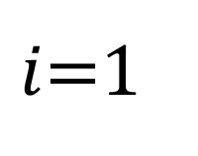


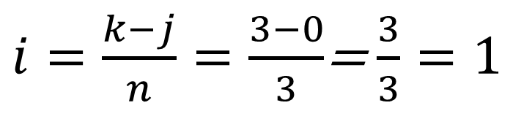
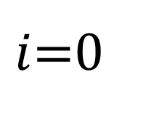
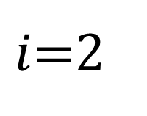


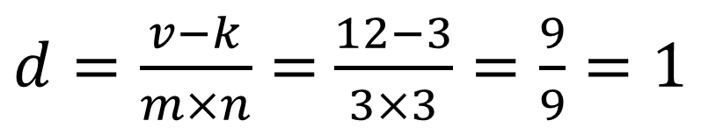
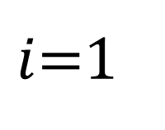


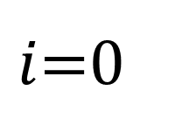
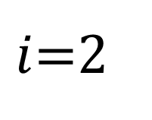

$$v=12$$
$k=v mod \left(m×n\right)$= $12 mod \left(3×3\right)$= $12 mod 9=3$
$i$=0
$i$=1
$i$=2
$i$=0
$i$=1
$i$=2
0
1
2
3
4
5
6
7
8
9
10
11
12
13
14
15
16
17
…
j=0
j=1
j=2
j=0
j=1
𝑑=0
𝑑=1
$$j$$
$$j$$
$i=\frac{k−j}{n}=\frac{3−0}{3}$= $\frac{3}{3}=1$
9
10
11
0
1
2
$$i$$
12
13
14
$j=v mod n$ $=$ $12 mod 3=0$
3
4
5
15
16
17
$$i$$
$d=\frac{v−k}{m×n}=$ $\frac{12−3}{3×3}=\frac{9}{9}=1$
6
7
8
𝑑=1
$$(i,j,d)=(1,0,1)$$
𝑑=0
Notes:
Decomposition of a linear index $v$ into coordinates $\left(i , j , d\right)$ in a three-dimensional array. The value $k=v mod \left(m×n\right)$ defines the intra-plane offset, while $d$identifies the layer index. The coordinates $i$ and $j$ are then recovered from $k$ using integer division and modulo operations.

Slide 3
$$v=12$$
$k=v mod \left(m×n\right)$= $12 mod \left(3×3\right)$= $12 mod 9=3$
$i$=0
$i$=1
$i$=2
$i$=0
$i$=1
$i$=2
A
B
C
D
E
F
G
H
I
J
K
L
M
N
O
P
Q
R
0
1
2
3
4
5
6
7
8
9
10
11
12
13
14
15
16
17
…
j=0
j=1
j=2
j=0
j=1
𝑑=0
𝑑=1
$$j$$
$$j$$
$i=\frac{k−j}{n}=\frac{3−0}{3}$= $\frac{3}{3}=1$
J
K
L
A
B
C
$$i$$
M
N
O
$j=v mod n$ $=$ $12 mod 3=0$
D
E
F
P
Q
R
$$i$$
$d=\frac{v−k}{m×n}=$ $\frac{12−3}{3×3}=\frac{9}{9}=1$
G
H
I
𝑑=1
$$(i,j,d)=(1,0,1)$$
𝑑=0
Notes:
Decomposition of a linear index $v$ into coordinates $\left(i , j , d\right)$ in a three-dimensional array. The value $k=v mod \left(m×n\right)$ defines the intra-plane offset, while $d$identifies the layer index. The coordinates $i$ and $j$ are then recovered from $k$ using integer division and modulo operations.

Slide 4
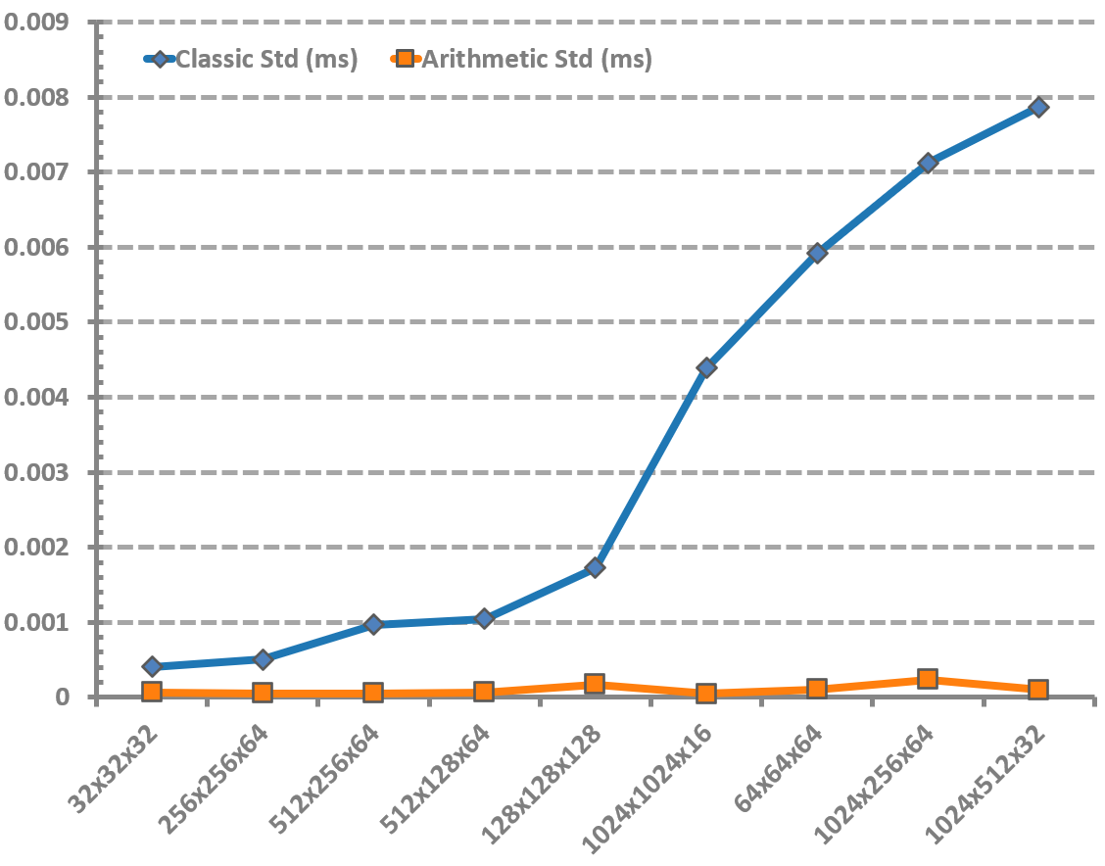
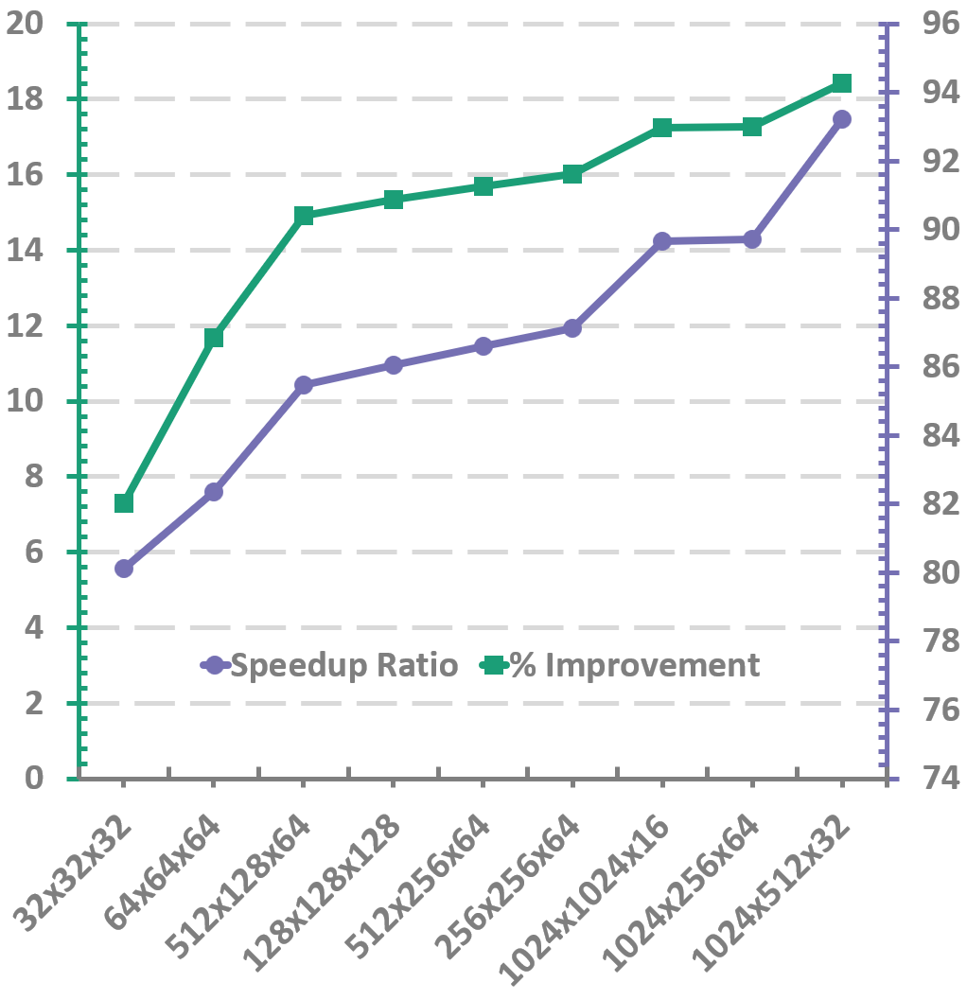
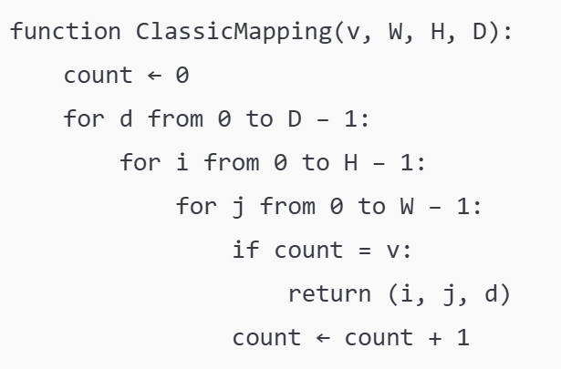
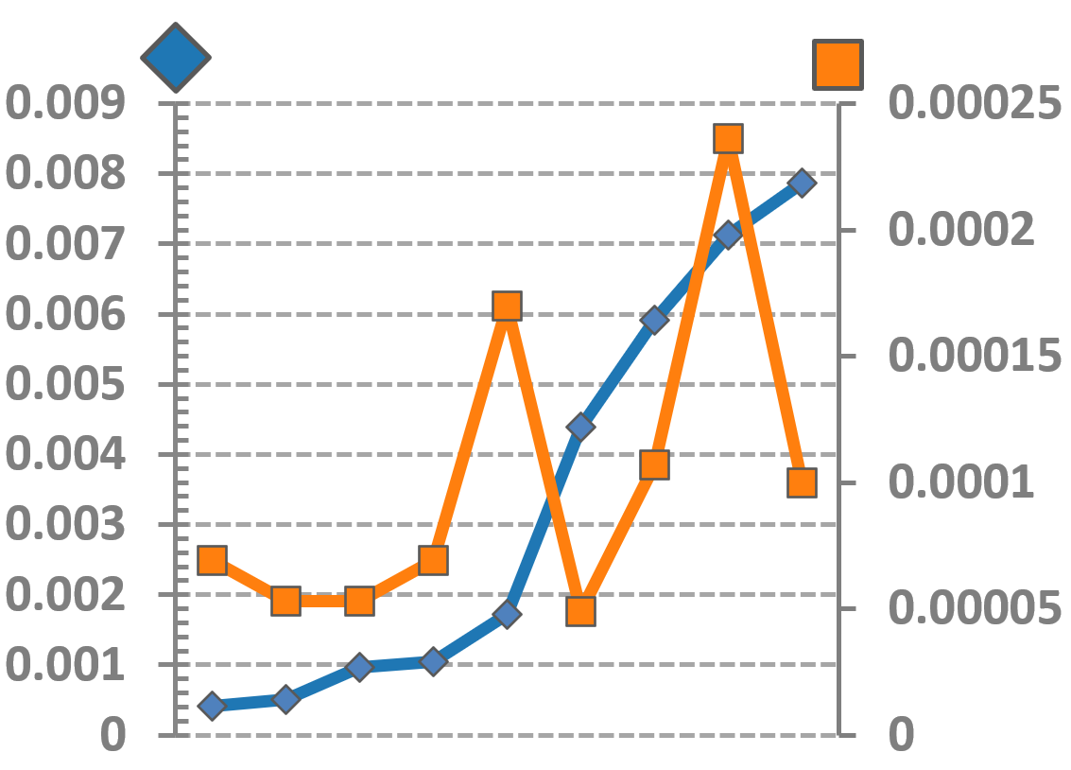
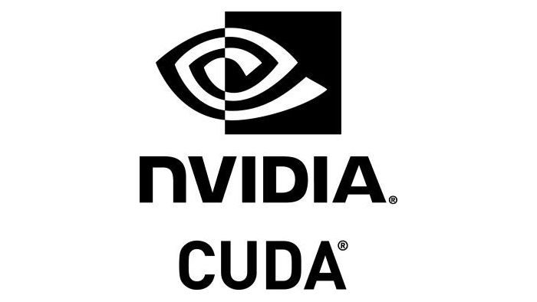
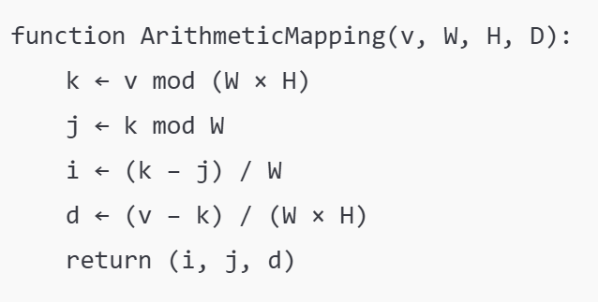
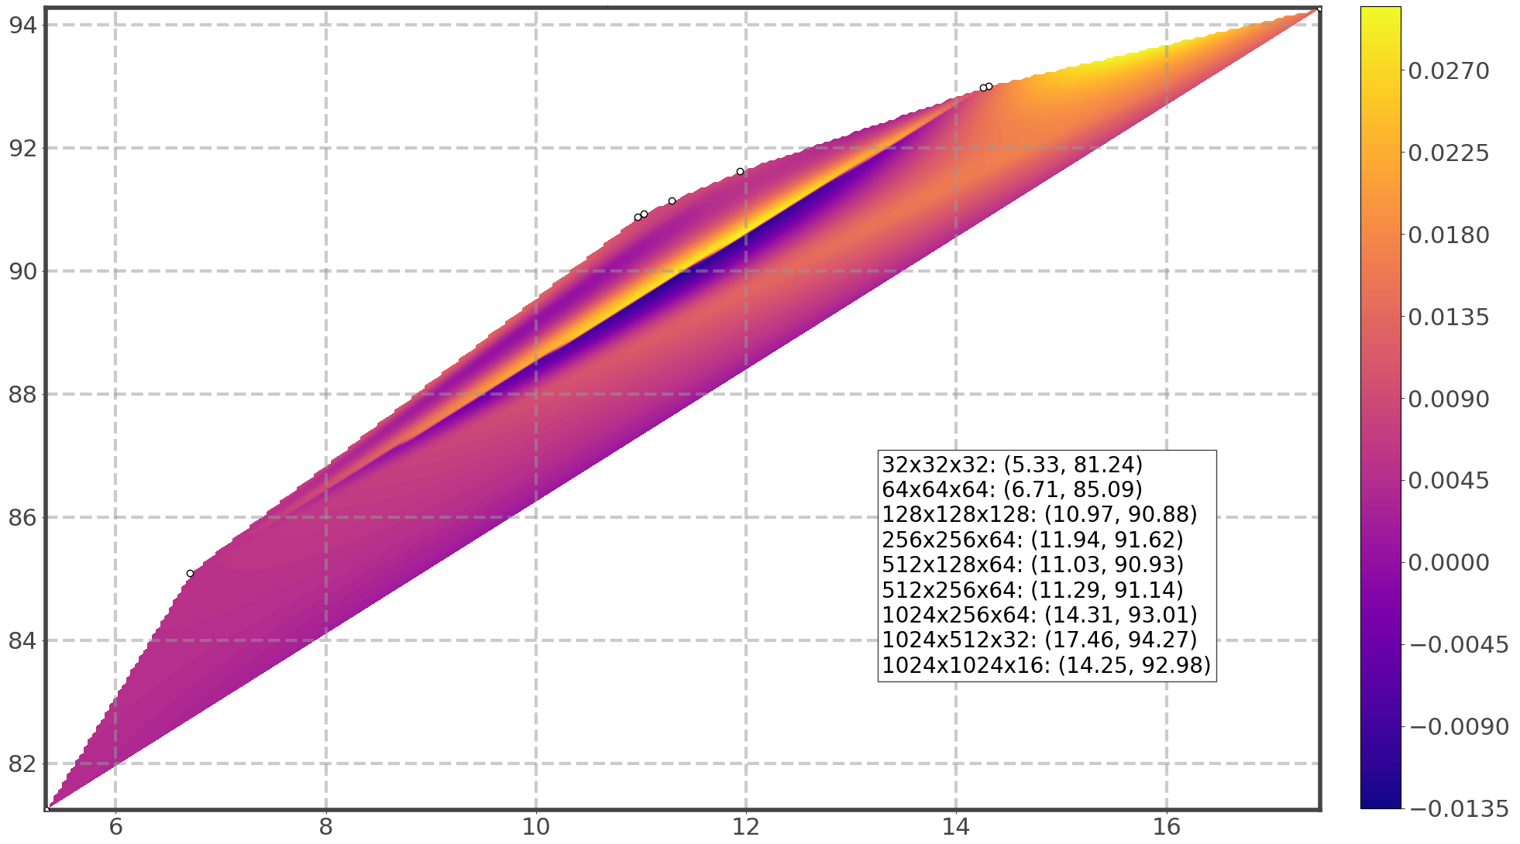
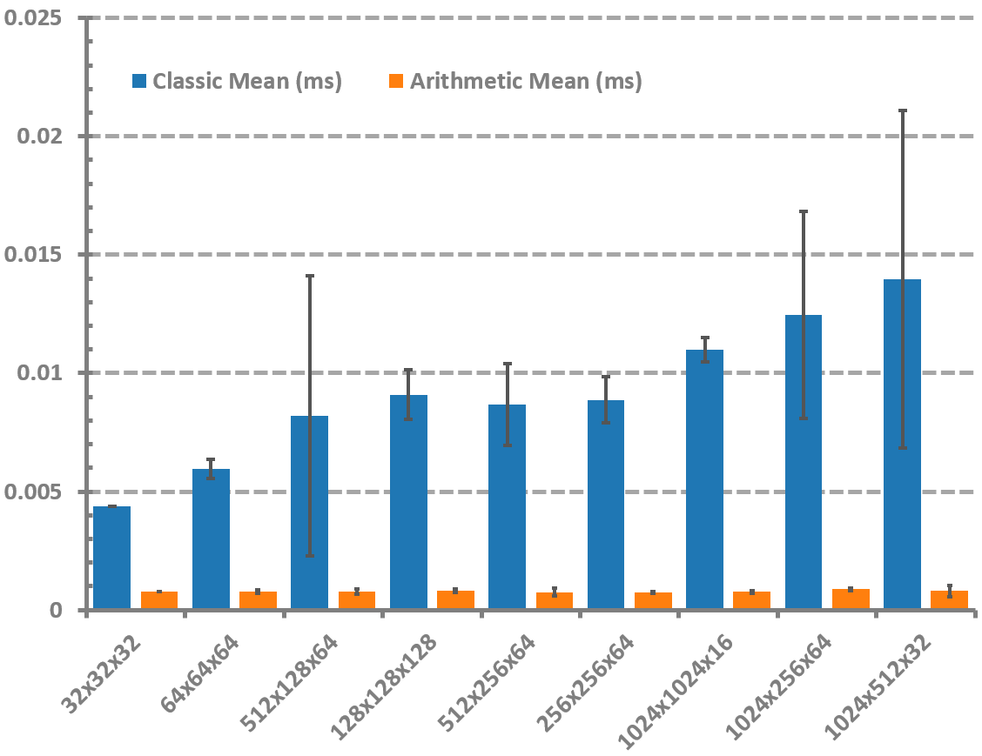

Classical variant
(a)
(d)
(b)
Arithmetic variant
(e)
9
7
8
5
6
4
(c)
% Improvement (Arithmetic)
3
CUDA Kernel
(f)
1
2
9
Classic Mean Time (ms)
Speedup Ratio (Classic / Arithmetic)
1
Notes:
Performance comparison between Classic and Arithmetic indexing methods for multidimensional mapping on GPU architectures. This multi-panel figure presents a comprehensive comparison between the Classic and Arithmetic mapping methods for multidimensional indexing within GPU-accelerated environments. In panel (a), the pseudocode for the Classic variant demonstrates an iterative approach based on triple-nested loops traversing the entire 3D search space to locate the coordinate corresponding to a linear index. This approach, though straightforward, is computationally expensive and scales poorly. In contrast, panel (b) illustrates the Arithmetic variant, where direct arithmetic operations (modulo and division) enable constant-time access to coordinates. This method eliminates the need for iteration and is inherently more suitable for massively parallel GPU execution. Panel (c) displays the average execution times (in milliseconds) for both methods across various input dimensions. The Classic method, represented by blue bars, consistently shows higher execution times and variability, while the Arithmetic method (orange bars) remains both faster and more stable. These trends are further emphasized in panel (d), which plots the standard deviation of execution time. The Classic variant exhibits significant fluctuations, particularly for mid-sized and larger datasets, whereas the Arithmetic variant maintains a near-flat deviation curve. An inset graph provides a magnified view of low-variance regions for both methods. In panel (e), the left Y-axis quantifies the speedup ratio (Classic divided by Arithmetic), and the right Y-axis reflects the percentage improvement of the Arithmetic method. Both metrics follow an upward trend with increasing dimensional size, reaching over 17× speedup and more than 94% time reduction for the largest input. This panel underscores the consistent and compounding performance advantages of the Arithmetic strategy. Panel (f) synthesizes these results in a contour heatmap that maps the speedup ratio (X-axis) against percentage improvement (Y-axis), with color gradients representing execution time (ms) of the Classic variant. The GPU icon highlights the parallel execution context, and numbered arrows (1–9) trace the trajectory of evaluated dimensions across the performance surface. This visual progression captures the Pareto-optimal growth in both speed and efficiency.

