Slide 1





Error uploading image.
Introduction to Integrated Banking Services
Streamline your financial management with our comprehensive integrated banking services. Experience a seamless, secure, and efficient way to handle all your banking needs in one place.

Slide 2


Comprehensive Financial Solutions
Diverse Portfolio Management
Integrated Wealth Planning
Receive personalized guidance on tax optimization, estate planning, and legacy building to secure your family's financial future.
Expertly tailor your investment portfolio to align with your financial goals and risk tolerance, leveraging a wide range of asset classes.
Business Banking Solutions
Streamline your company's financial operations with specialized banking products, commercial lending, and cash management tools.

Slide 3
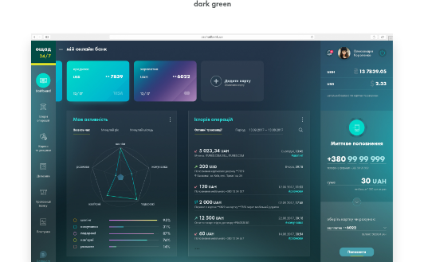
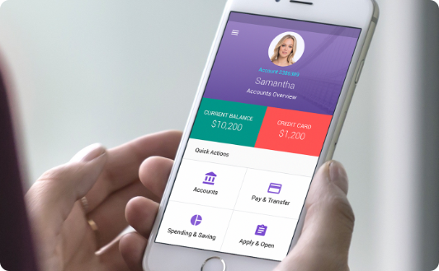
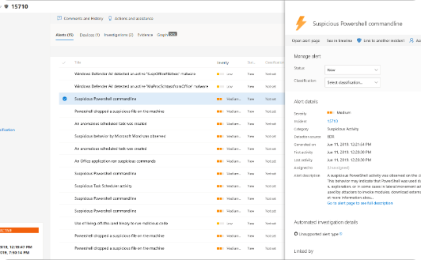
Seamless Account Management
Intuitive Dashboard
Mobile Access
Proactive Notifications
Manage all your banking activities in one centralized, user-friendly dashboard, providing a clear overview of your accounts, transactions, and financial standing.
Stay connected to your finances anytime, anywhere with our cutting-edge mobile banking app, enabling you to perform all essential banking tasks on the go.
Receive real-time alerts and notifications about your account activity, helping you stay on top of your finances and detect any suspicious transactions.

Slide 4

Personalized Wealth Planning
Our comprehensive wealth planning services are tailored to your unique financial goals and aspirations. We work closely with you to develop a personalized strategy that optimizes your investments, minimizes taxes, and safeguards your assets for the long term. Our experienced financial advisors will guide you every step of the way, ensuring your wealth is strategically managed to support your lifestyle and legacy.

Slide 5
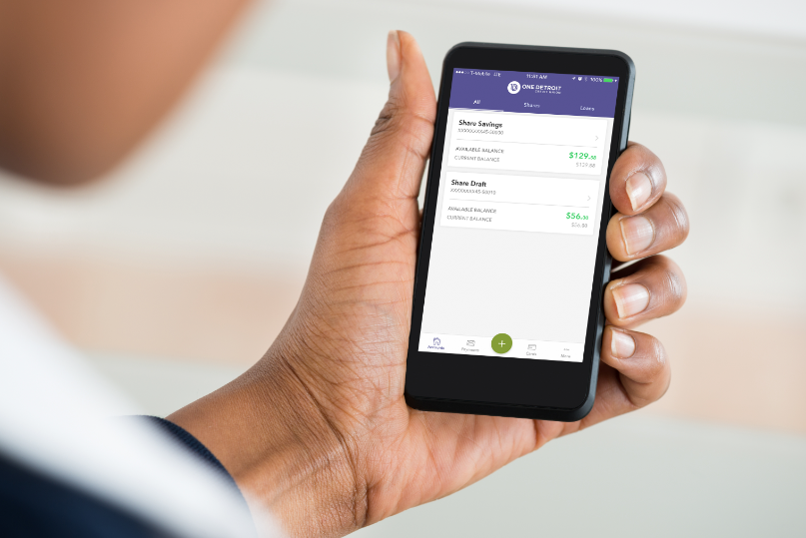
Innovative Digital Banking
Elevate your banking experience with our cutting-edge digital tools. Seamlessly manage your finances, make secure transactions, and access a suite of innovative features right at your fingertips.
Leverage the power of mobile banking, online account management, and intuitive digital platforms to stay in control of your financial life.

Slide 6
Secure Transactions and Data Protection
Safeguarding your financial well-being is our top priority. Our integrated banking services employ advanced encryption and multilayer security protocols to protect your sensitive data and ensure the confidentiality of your transactions. You can trust that your personal and financial information is secured with the latest industry-leading cybersecurity measures.
Encrypted Data Transfer: All communication and data exchange between you and our platform is encrypted using the highest industry standards, ensuring your information remains private and secure.
Biometric Authentication: Leveraging state-of-the-art biometric technology, we offer seamless and secure login options, such as fingerprint or facial recognition, to verify your identity and prevent unauthorized access.
Fraud Monitoring: Our robust fraud detection and monitoring systems constantly analyze your account activity, quickly identifying and flagging any suspicious transactions to protect you from financial fraud.

Slide 7
Dedicated Customer Support
Personalized Assistance
Multilingual Capabilities
Our team of knowledgeable and friendly representatives are dedicated to providing you with personalized support. We are here to address your queries, guide you through our services, and ensure your banking experience is seamless.
We understand the importance of being able to communicate in your preferred language. Our customer support is available in multiple languages, allowing us to cater to the diverse needs of our global clientele.

Slide 8




Streamlined Loan Application Process
Gather Documents
1
Prepare required paperwork and financial records.
Submit Application
2
Complete our simple online application.
Get Preapproved
3
Receive a quick decision and personalized loan options.
Close the Loan
4
Work with our team to finalize the loan details.
Our streamlined loan application process makes it easy to secure the financing you need. From gathering the necessary documents to finalizing the loan, our dedicated team guides you through each step, ensuring a seamless and efficient experience. With fast pre-approval decisions and personalized loan solutions, we're committed to helping you achieve your financial goals.

Slide 9
Integrated Retirement Planning
Our integrated retirement planning services help you prepare for a secure and comfortable future. We work closely with you to develop a personalized strategy that aligns with your financial goals and risk tolerance.
Comprehensive retirement needs analysis
Optimized investment portfolios for growth and income
Tax-efficient distribution strategies to maximize your savings
Seamless integration with your broader financial plan
Ongoing monitoring and adjustments to adapt to life changes

Slide 10


Conclusion and Next Steps
As you've seen, our integrated banking services provide a comprehensive solution for all your financial needs. From seamless account management to personalized wealth planning, we're dedicated to empowering you on your journey to financial success.

