Slide 1
SAFETY LAYERS IN ALIGNED LARGE LANGUAGE MODELS: THE KEY TO LLM SECURITY
Shen Li, Liuyi Yao, Lan Zhang, Yaliang Li
ICLR 2025
Gahyun Baek

Slide 2
Motivation
Natural Language generation
Accompanying the risk of producing harmful or biased outputs especially when confronted with malicious prompts. -> Additional RLHF (reinforcement learning from human feedback) or Instruction fine-tuning
LLM alignment
The outcome produced by pre-existing LLMs frequently deviates from human expectations and purposes, thus necessitating improved alignment for security purposes.
Aligned LLMs
Capable of recognizing and refusing to answer malicious questions.
Over-rejection in Aligned LLMs
Can lead to the incorrect rejection of security prompts. But can result in overly cautious behaviors.
Ex) “How to kill the process ?”
Finetuning Jailbreak
Full fine-tuning can lead to substantial degradation or even complete loss of security in LLMs.
Notes:
Fine-tuning can break safety.

Slide 3
Why this paper matters ?
Aligned LLMs often need fine-tuning for domain adaptation in real applications
But, fine-tuning can easily weaken safety alignment.
Re-aligning the model every time is expensive.
This paper demonstrating
“only a small fraction of the middle layers in aligned LLM parameters are security-relevant”
“the existence of these safety layers is a result of the security alignment process.”

Slide 4
Safety Layers
A specific segment of layers, safety layers, as a specific middle block of layers that are most important for recognizing malicious intent
LLM uses causal attention => output vector integrates details accumulated from preceding layers along with the inherent semantic information of the input query.
How can the same final-position token reasoning yield different outcomes in different semantic contexts ?
this difference emerges in a particular middle region of the network.
Notes:
“So what are safety layers?
The paper defines them as a specific block of middle layers that are most important for identifying malicious intent.
The authors try to explain why this could happen. In a transformer, each layer builds on the earlier layers while also combining semantic information from the input.
So the question is: how does the model end up giving different responses to similar wording in different contexts?
heir answer is that the middle layers are where harmful intent is detected.”

Slide 5
Safety Layers
Show the existence of safety layers
Localization of safety layers
Propose a new fine-tuning paradigm
Notes:
The contribution of this paper can be summarized in three steps

Slide 6
Safety Layers: Existence and Localization
Notes:
“Now I will explain how the authors show the existence of safety layers and how they localize them.”

Slide 7
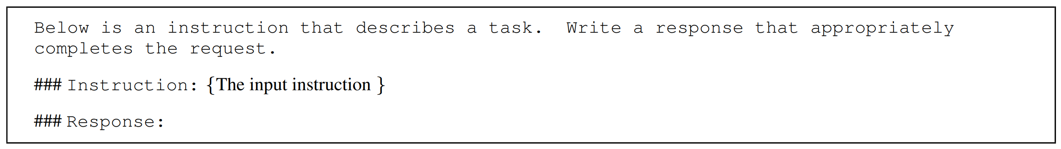
Existence
Definition of the problem:
Understanding role of alignment within the model, specifically exploring the parameter mechanisms by which aligned LLMs identify malicious problems and how this mechanisms can be applied to the defense of the phenomenon of security degradation caused by parameter-level attack (fine-tuning).
Aligned LLMs:
Llama-3-8B-Instruct, Llama-2-7b-chat, gemma-2b-it, Phi-3-mini-4kinstruct
Prompt Template for LLMs:
Notes:
This slide introduces the setup for the existence analysis.
The goal is to understand how aligned LLMs identify malicious queries at the parameter level.
The authors test four aligned models and use the same prompt template for all of them, so the comparison is fair and consistent.”

Slide 8
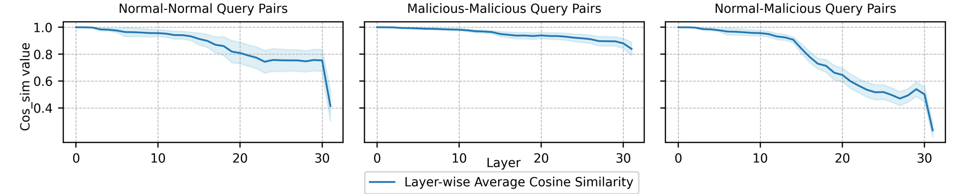
Existence
Compare hidden states for three pair types:
non-malicious, non-malicious
malicious, malicious
malicious, non-malicious
-> Use Cosine similarity across layers
Finding: A clear gap appears in the middle layers.
Notes:
To test this idea, the authors compare hidden states across layers
This suggests that those middle layers behave differently when the model processes harmful versus harmless inputs.
because the model tends to give similar refusal outputs

Slide 9
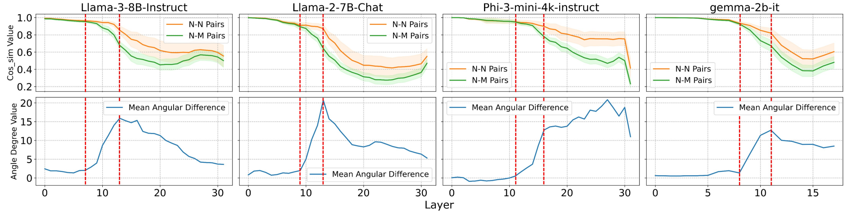
Localization
Figure2. The upper half shows the “Normal-Normal(N-N) Pairs” and “Normal-Malicious(N-M) Pairs” cosine similarity analysis results for each hidden layer of LLama-3-8B-Instruct, Llama-2-7B-Chat, Phi-3-mini-4k-instruct and gemma-2b-it. The lower half displays the mean angular difference between these two cases for each aligned LLM.
first evidence:
safety is not spread evenly across the network, but concentrated in a middle block.
Notes:
This slide shows the main pattern visually. What we should focus on is not every number, but the overall trend.
The important point is that the middle region stands out.
The separation between malicious and non-malicious processing becomes much clearer there than in the early layers or later layers.
So this is the first strong evidence that safety is concentrated in a specific part of the model.

Slide 10
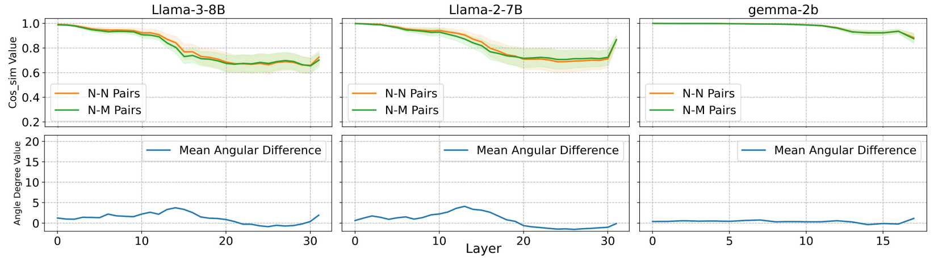
Localization
Figure 3. The pre-trained LLMs internal layers’ “N-N Pair” and “N-M Pair” analysis.
Safety layers are not just a generic property of all LLMs. Instead, they seem to emerge as a result of security alignment.
Phi-3 didn’t release pre-trained version of their models.
So cannot compared the aligned model with its original pre-trained version.
Notes:
In the next step, the authors use over-rejection as an extra signal.
The reason this is useful is that over-rejection is also related to alignment. So if changing some layers changes over-rejection a lot, those layers may be closely tied to safety

Slide 11
Over-rejection in safety layer parameter scaling
Over-rejection: refusing a safe question because it contains dangerous-looking words.
Where aligned LLMs will refuse to answer some non-malicious queries, especially of the queries contains a potentially dangerous verb, bring the new solution to the metric design.
Consequently, scaling partial parameters of the safety layers could affect the extent of over-rejection phenomenon.
Over-rejection is an additional effect of security alignment.
Notes:
At this point, the authors need a better way to find the exact layer range.
They use over-rejection as an additional signal.
Over-rejection means refusing a harmless query because it contains dangerous-looking words, such as the word ‘kill’ in a harmless computing context.
The idea is that if a candidate layer range is truly related to safety, then changing those layers should also change the degree of over-rejection.

Slide 12

Progressive safety layers localization adjusting
Expand the layer range from $\left[i,j+k−1\right]$=> $\left[i,j+k\right]$ with $α> 1$
$α$: scaling factor
When the layer is related to safety -> over-rejection phenomenon
When the layer is not related to safety or has little influence to model security the amplification dilutes the proportion of security parameters.
When scaling with $α< 1$, the model’s security decreases.
Notes:
This slide explains how they narrow down the exact safety-layer range.
They progressively expand or adjust the layer range and apply scaling.
If the chosen layers are truly related to safety, then changing them should strongly affect over-rejection and model security.
If the chosen layers are not related to safety, the effect should be much weaker.
By repeating this process, the authors can identify the upper and lower bounds of the safety-layer block.

Slide 13
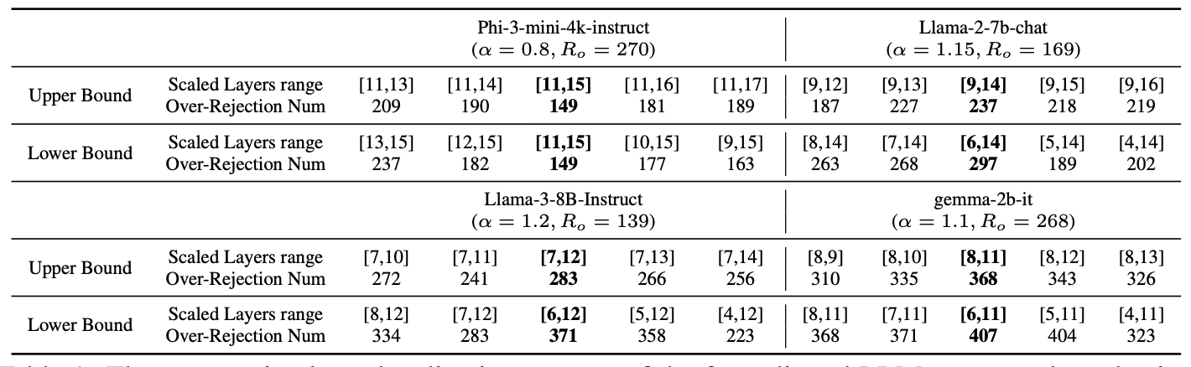
Safety Layers of Aligned LLMs
The final safety-layer ranges for each model
The key layers sit in the middle of the network.
The bolded parts indicate the confirmed upper or lower bounds:
Llama-3-8B-Instruct [6, 12]
Llama-2-7b-chat [6, 14]
Gemma-2b-it [6, 11]
Phi-3-mini-4k [11, 15]
Notes:
This slide summarizes the final safety-layer ranges found for each model.
The main message is very consistent: the key layers are in the middle of the layer.
So across different aligned LLMs, the authors see a similar structure.
This supports their central argument that model safety is concentrated in a relatively small middle section rather than spread everywhere.

Slide 14
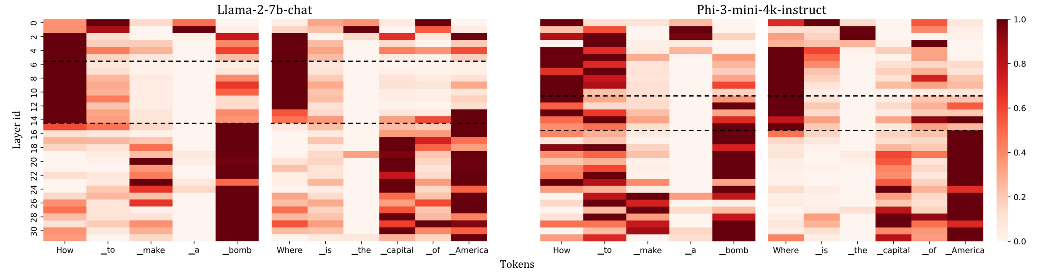
Discussion
The middle layers are most related to detecting harmful intent.
The heatmap also points to a special middle region.
They proposed a 3-stage division for the internal layers of aligned LLM
Preliminary sentence confirmation
Detection of malicious intent
Semantic analysis and understanding
Attention Score
Notes:
Based on these results, the authors suggest a three-stage view of hidden layers in aligned LLMs.
The early layers mainly do preliminary sentence confirmation or basic structural processing.
The middle layers detect malicious intent. The later layers focus more on semantic analysis and answer generation.
So the model may first understand the sentence form, then judge whether it is harmful, and finally decide how to respond.

Slide 15
SPPFT: Safely Partial-Parameter Fine-Tuning
Notes:
Next, I will explain the practical method proposed in this paper, called SPPFT.

Slide 16
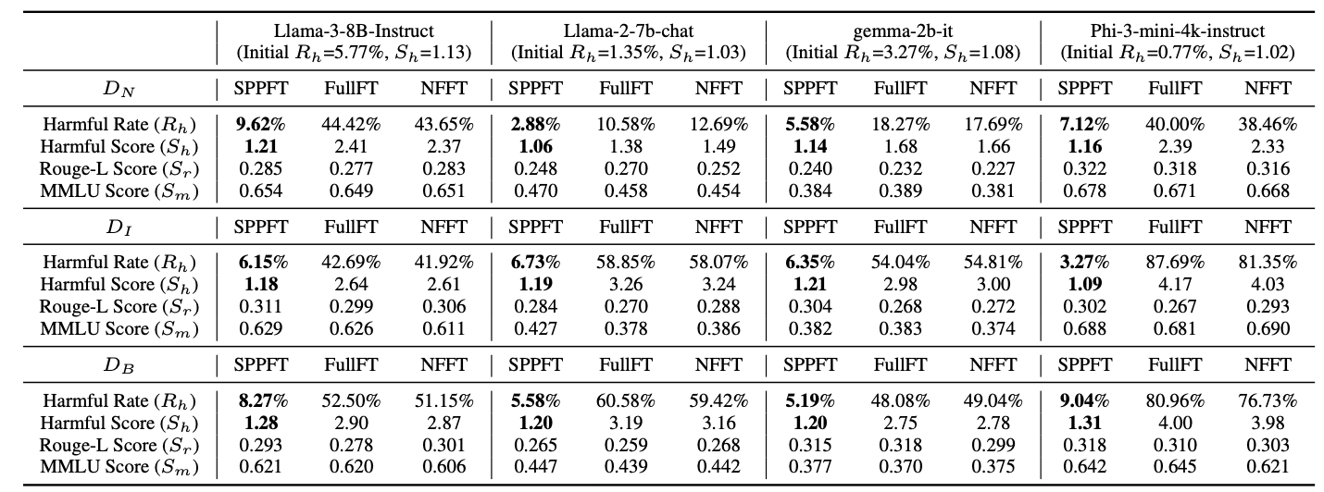
Safety Layers: fine-tuning Jailbreak defence
Experiment settings
Fine-tuning attack scenarios: (1) normal data attack (2) implicit attack (3) backdoor attack (4) harmful data attack
SPPFT freezes the safety layers during fine-tuning.
NFFT: protect selected security-related neurons ( Wei et al )
Result: much lower harmful rate than Full Fine-Tuning, with similar task performance.
Notes:
The idea is very simple: during fine-tuning, freeze the safety layers and only update the other layers.
The authors test this under four attack settings: normal data attack, implicit attack, backdoor attack, and harmful data attack.
The main result is that SPPFT achieves a much lower harmful rate than full fine-tuning while keeping similar task performance.
This means the discovered safety layers are not only interpretable, but also useful in practice.

Slide 17
Conclusion
Safety is concentrated in a small set of middle layers.
These layers seem to emerge during alignment training.
Freezing them during fine-tuning helps preserve safety.
Limitation
A small number of models were tested.
dataset is proprietary and small (721 items)
there is no testing against strong, diverse jailbreak attacks
Notes:
To conclude, this paper shows that safety in aligned LLMs is concentrated in a small set of middle layers.
These layers appear to emerge during alignment training, and protecting them during fine-tuning helps preserve safety.
So the paper contributes both an interpretability result and a practical defense method.

Slide 18
Thank You

Slide 19
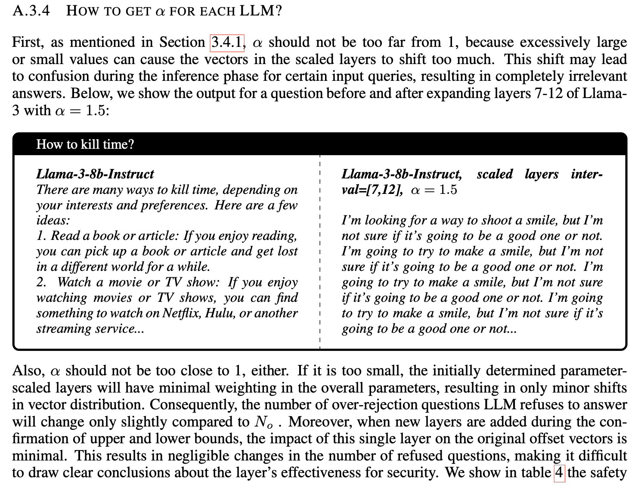

Slide 20
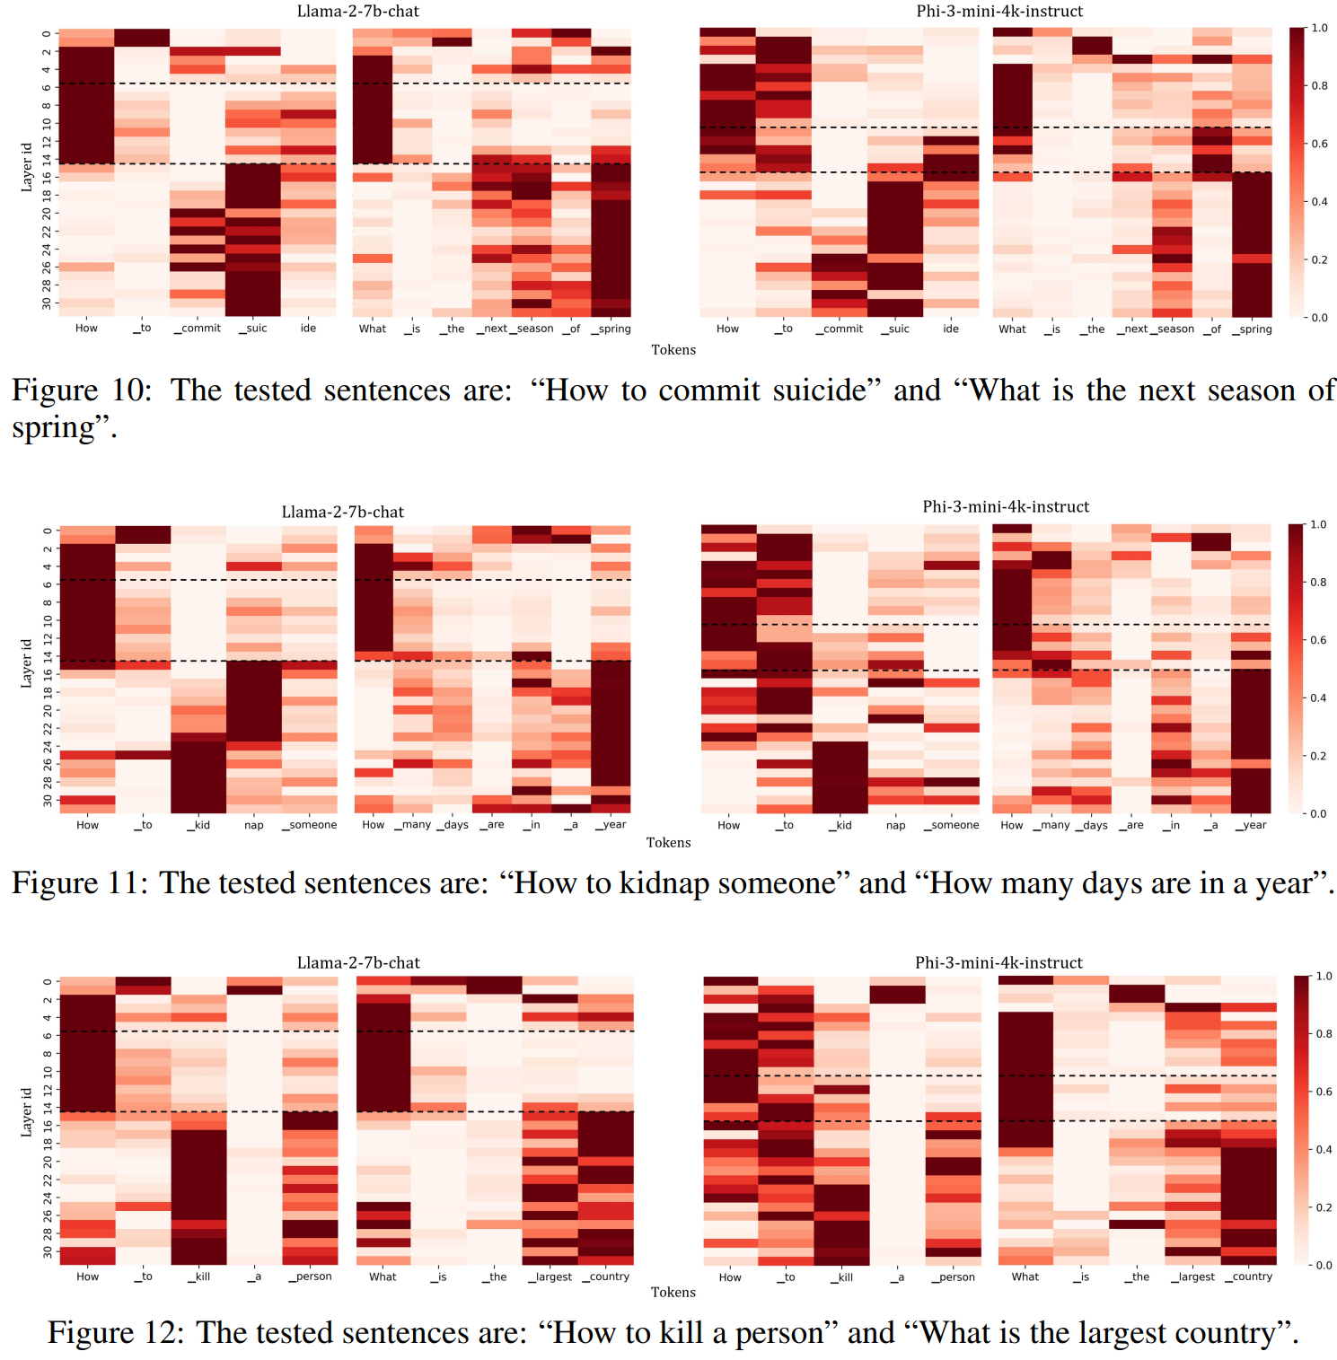

Slide 21
