Slide 1
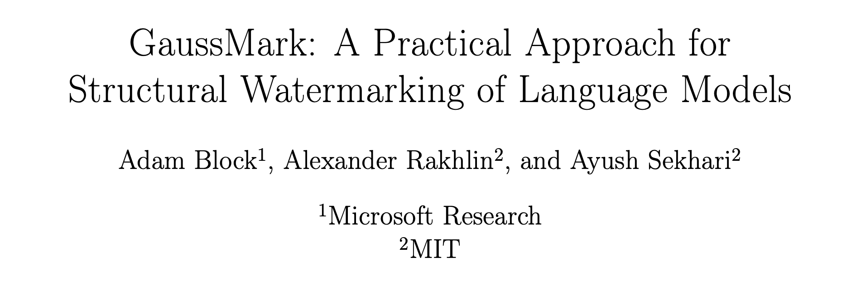
GaussMark:
A Practical Approach for Structural Watermarking of Language Models
Adam Block, Alexander Rakhlin, Ayush Sekhari
Gahyun baek
Source: Block et al., ICML 2025

Slide 2

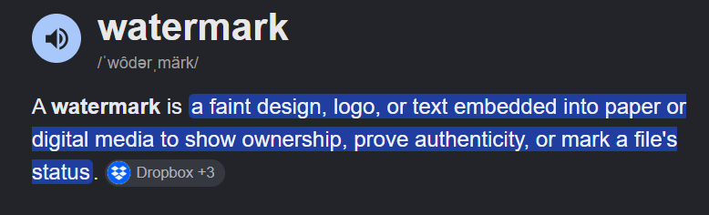


Introduction
LLM Watermarking
Watermark ?
The key requirements: Invisible signal in text
Source: Block et al., ICML 2025

Slide 3
Introduction
Why do we need LLM Watermarking ?
AI-generated content is widespread
Human-written vs. AI-generated text
Claim provenance, copyright
Can you guess which one was generated by AI ?
I attended the Red Teaming Challenge yesterday. At first, I solved the problems one by one. However, during the challenge, we noticed that other teams were solving the problems with automatic agents.
I was frustrated and almost lost motivation to solve the problems. I think the challenge rules should be changed to make it more fair.
Yesterday I went to a red teaming challenge.
We were solving every problem manually, one by one. But most other teams were using agents and automating everything. They could try way more prompts than us, so we were at a pretty big disadvantage.
It was a little frustrating, but next time I think we definitely need to prepare some automation too.
Source: Block et al., ICML 2025

Slide 4
Introduction
Why do we need LLM Watermarking ?
AI-generated content is widespread
Human-written vs. AI-generated text
Claim provenance, copyright
Can you guess which one was generated by AI ?
I attended the Red Teaming Challenge yesterday. At first, I solved the problems one by one. However, during the challenge, we noticed that other teams were solving the problems with automatic agents.
I was frustrated and almost lost motivation to solve the problems. I think the challenge rules should be changed to make it more fair.
Yesterday I went to a red teaming challenge.
We were solving every problem manually, one by one. But most other teams were using agents and automating everything. They could try way more prompts than us, so we were at a pretty big disadvantage.
It was a little frustrating, but next time I think we definitely need to prepare some automation too.
Gahyun
ChatGPT
Source: Block et al., ICML 2025

Slide 5


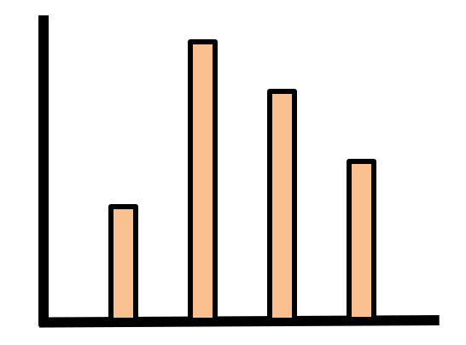
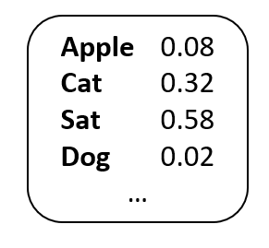
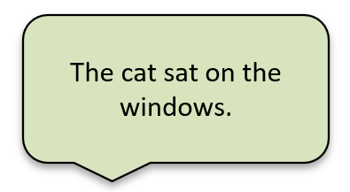
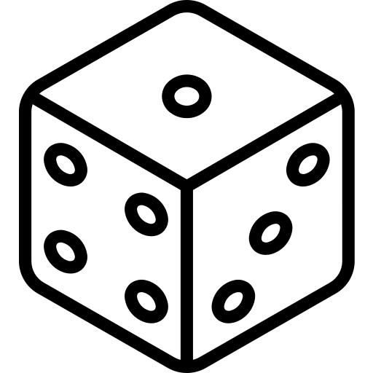
Background
From Token-Level Watermarking to Structural Watermarking
Input token
The
Cat
Sat
…
Token Embedding
token -> vector
Transformer Layers
Hidden states / semantic representations
Unembedding / LM Head
hidden state -> vocabulary logits
Token Selection / Decoding
Logit biasing / token sampling
Output
sampling
Token sampling
Model weights
Watermark -> logits -> sample
Appplied at every single token
The sampling pipeline must be rewritten
Latency grows with sequence length.
Weights + ξ-> ordinary generation
Applied once, before generation
The sampling pipeline is untouched
No additional generation latency
Source: Block et al., ICML 2025

Slide 6
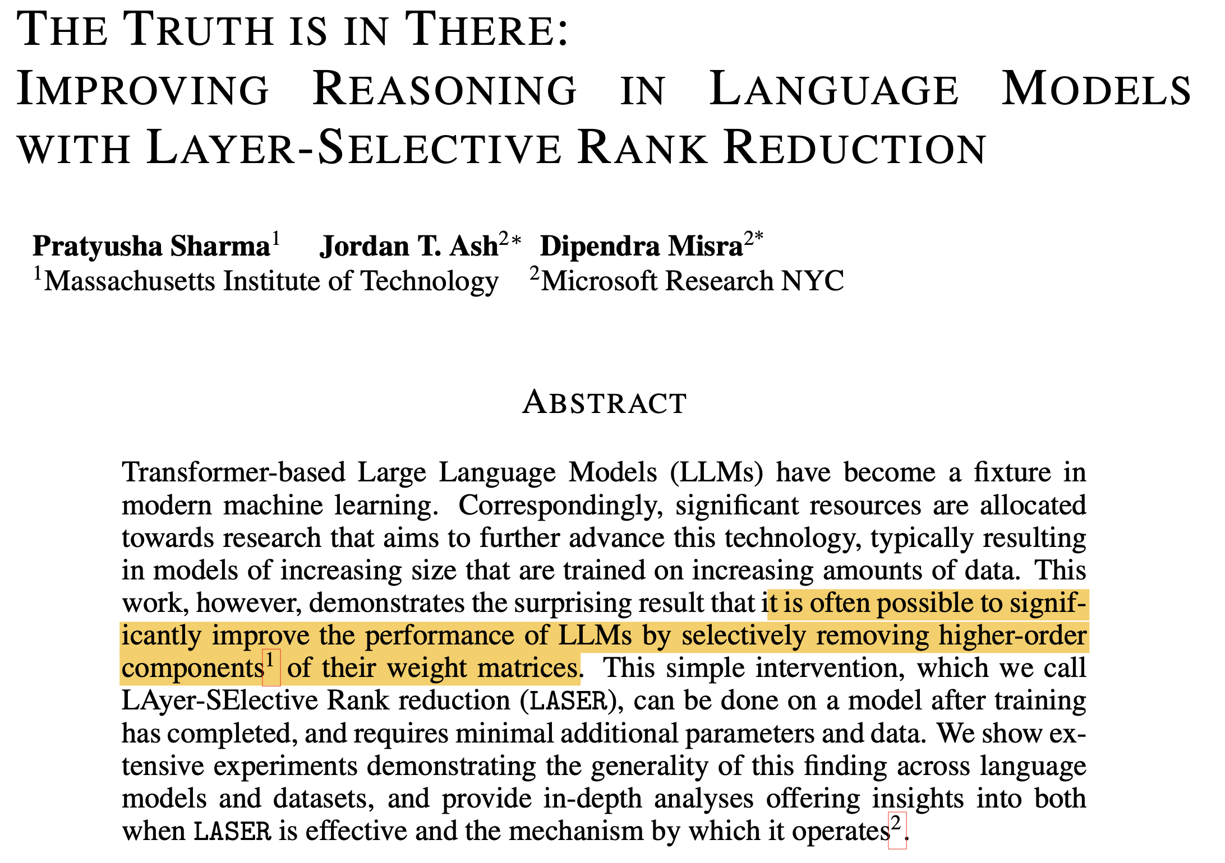
Introduction
Perturbation in some weights
=> Low components act as noise
=> Modifying selected weight components does not necessarily destroy model performance.
A small additive perturbation of model weights can instead be used as a watermark.
THE TRUTH IS IN THERE: IMPROVING REASONING IN LANGUAGE MODELS WITH LAYER-SELECTIVE RANK REDUCTION, Sharma et al., ICLR, 2024
Source: Block et al., ICML 2025
Notes:
The motivation comes from previous observations that modifying selected weight components does not necessarily destroy model performance.
This slide shows previous work on layer-selective rank reduction, where selectively removing components of weight matrices can preserve or even improve model performance.
This motivates GaussMark to ask whether a small additive perturbation of model weights can instead be used as a watermark.

Slide 7


Methodology
Hypothesis testing problem
Null hypothesis
This text is not related to the watermarking key.
Alternative hypothesis
This text is exactly from the weight perturbed model.
y: candidate text, ξ: secret key
Source: Block et al., ICML 2025

Slide 8
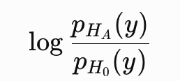
Methodology
Log-Likelihood Ratio
: A natural way to compare the null and alternative hypotheses
=> The larger the value is, the $H_{A}$ is more available
[LLR]
Compares the two competing hypotheses
A higher ratio favours the watermark
Source: Block et al., ICML 2025

Slide 9
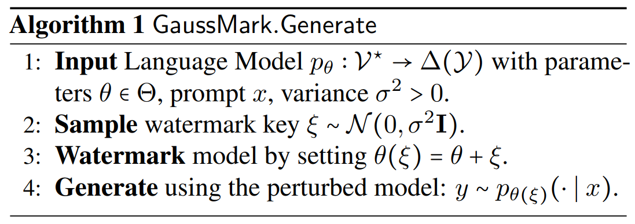
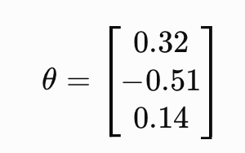
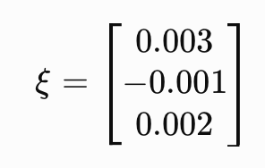
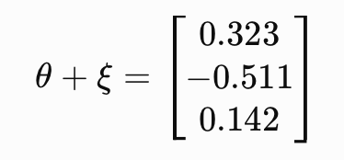
Proposed Scheme
GaussMark - generate
Structural inherent in model weights
Modifies model weights
Adds Gaussian perturbation
Generates normally afterward
No token-level biasing
θ: base model’s weights for a layer
ξ: secret key
θ′=θ+ξ
Source: Block et al., ICML 2025

Slide 10
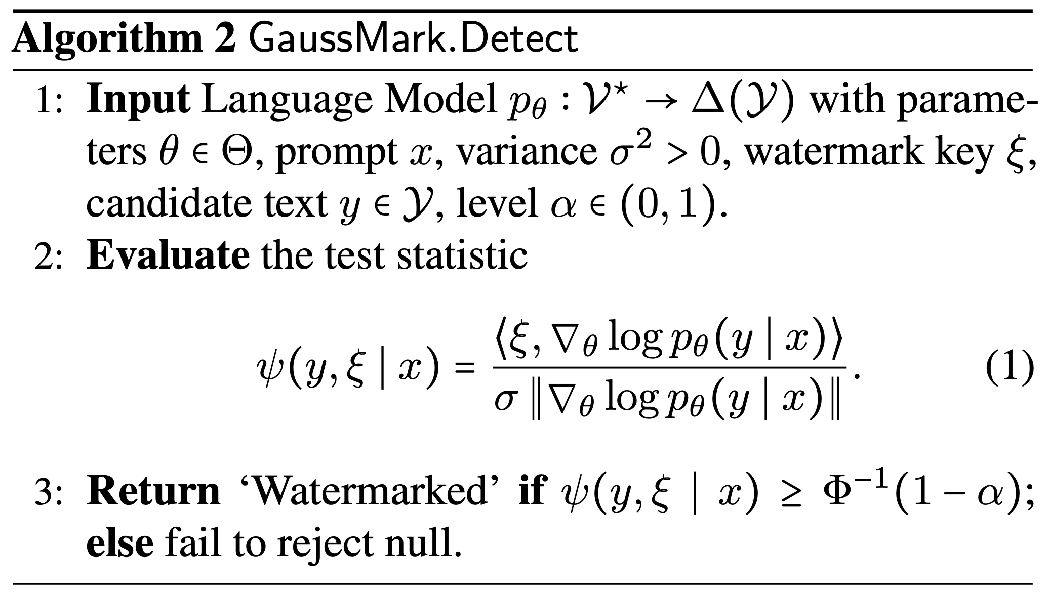
Proposed Scheme
GaussMark - detect
y: candidate text, ξ: secret key
Source: Block et al., ICML 2025

Slide 11
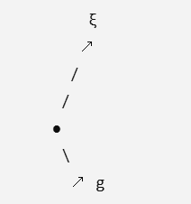
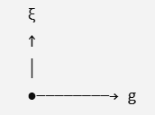




Proposed Scheme
GaussMark - detect
y: candidate text, ξ: secret key
Calculate text log-likelihood with base model
Backpropagation to obtain gradient g
3. Measure key–gradient alignment
watermarked
unwatermarked
Stronger alignment
No systematic alignment
Generation perturbs the model in direction ξ, and detection checks whether the generated text still contains evidence of that direction.
Source: Block et al., ICML 2025

Slide 12
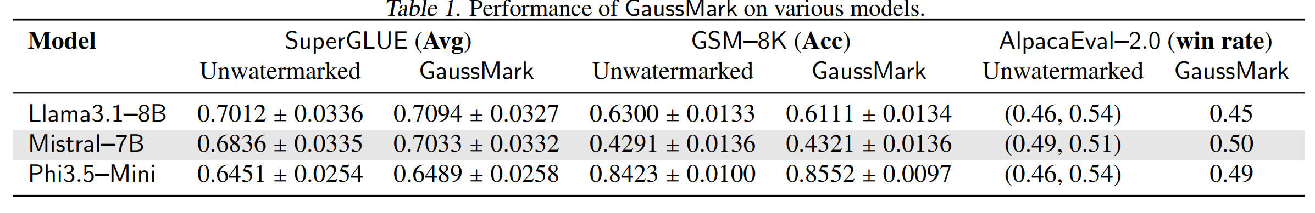
Experiments
The model’s performance is preserved
GaussMark is not distortion-free, so model quality has to be evaluated empirically:
quality has to be measured rather than guaranteed.
Source: Block et al., ICML 2025

Slide 13
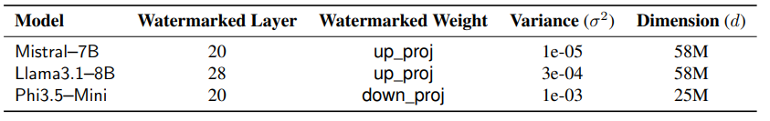
Experiments
The selected layer is different
Balancing detectability-text quality
Different layers have different sensitivity to perturbations
Source: Block et al., ICML 2025

Slide 14
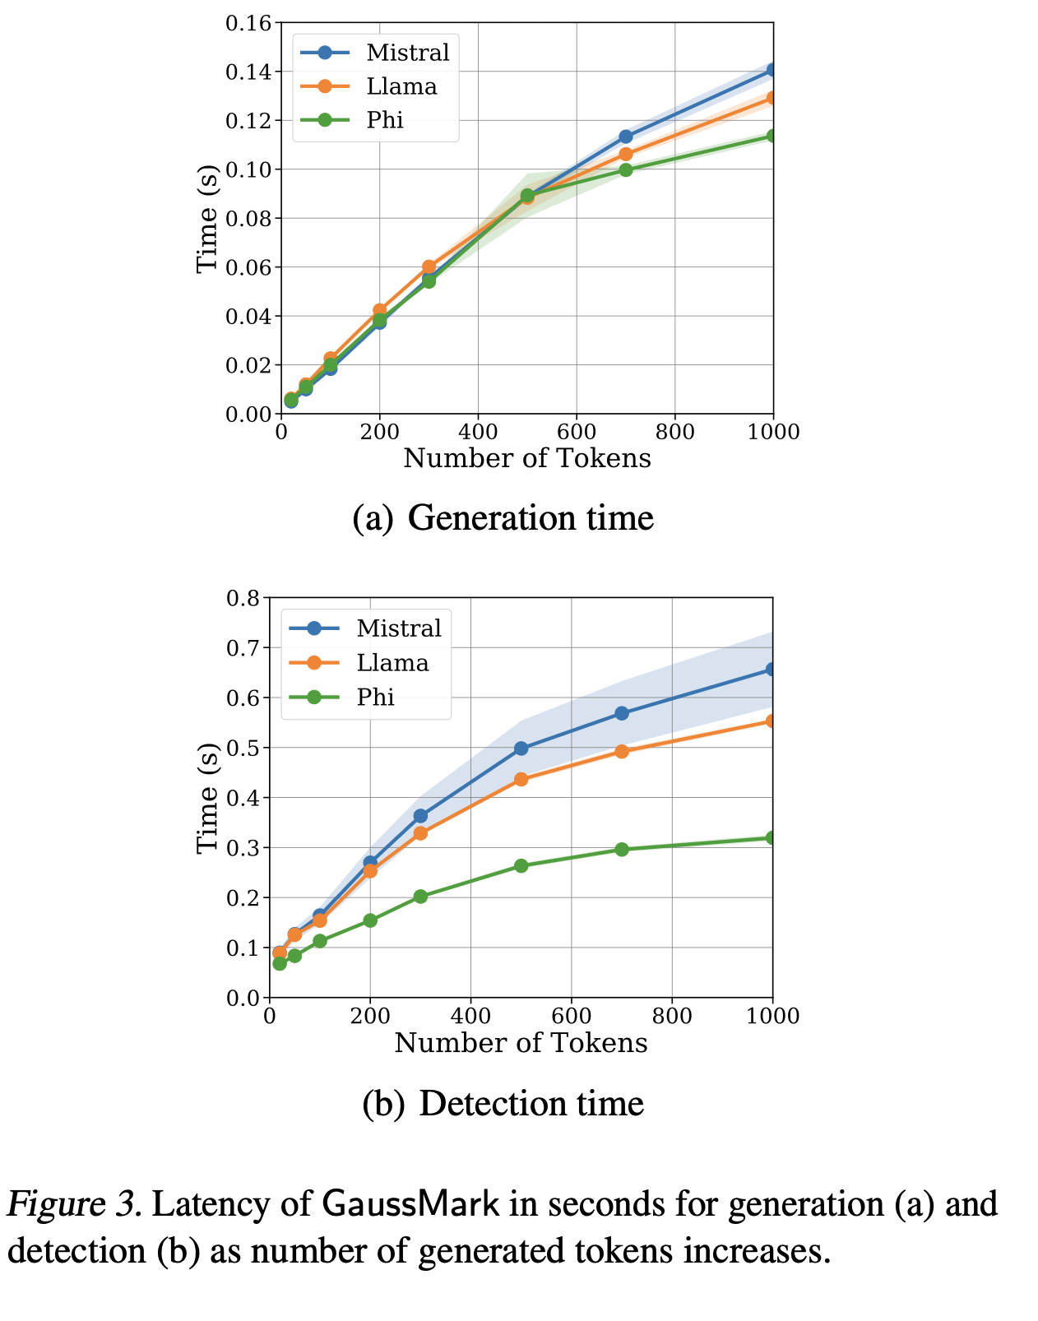
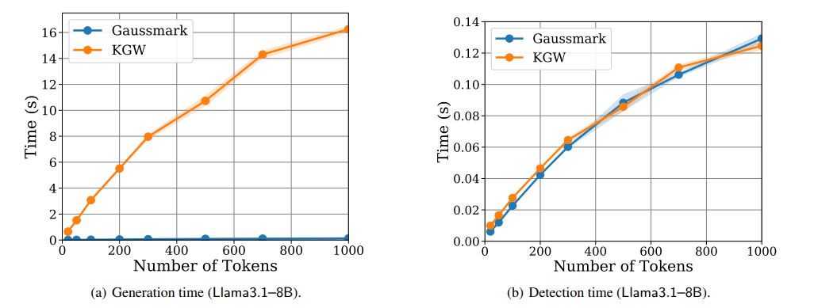
Experiments
Generation Adds No Watermarking Latency
Generation cost equals the base model
1K tokens detected in under a second
Orders of magnitude faster than KGW
Only the weights change -> no latency degradation
Source: Block et al., ICML 2025

Slide 15
Conclusion
Limitation and Future Work
Limitation
  Not multi-bit watermarking scheme
  Prompt is required when detection
  Base model is required
  No distortion free guarantee
  White-box access
  Requires more tokens
Personal thoughts
  Not token-level watermarking.
  Can this extend to multi-bit watermarking?
  The first try modifying weights to embed watermarking signals.
Source: Block et al., ICML 2025

Slide 16
Thank you
Source: Block et al., ICML 2025

