Slide 1
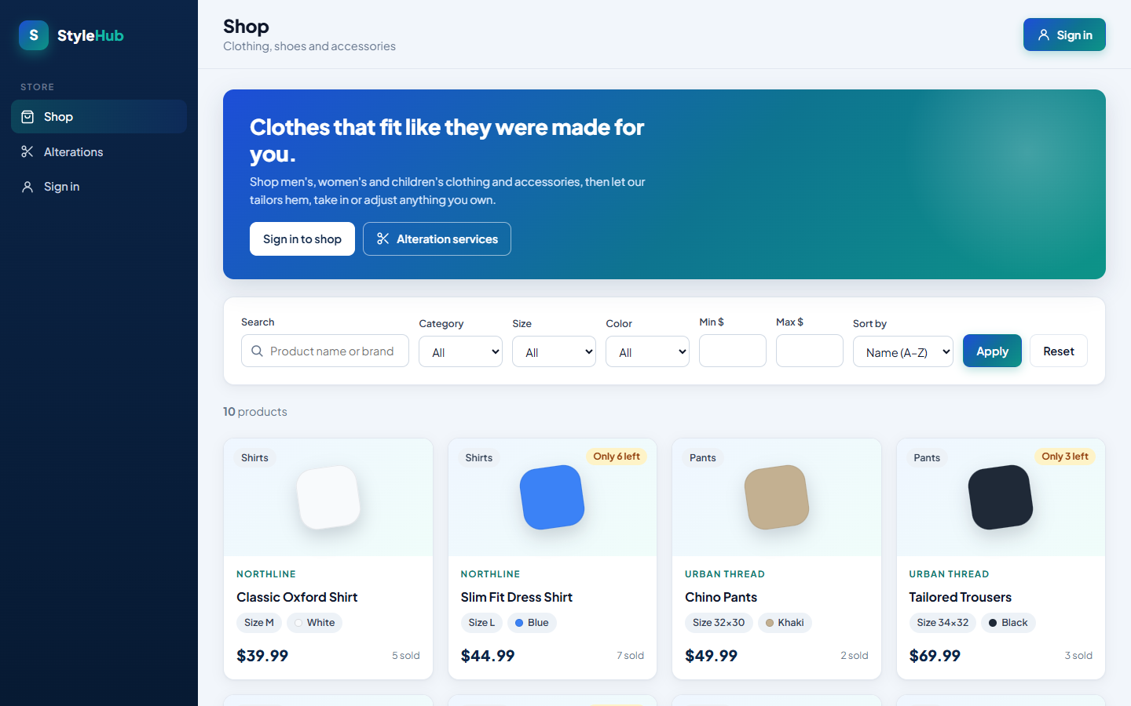
MIS 330 · GROUP PROJECT 1 · PROJECT #5
StyleHub
Clothing Retail & Alteration Management System
A MySQL database and Python web app that run StyleHub's sales, inventory and alteration services
Team
Garrett Harmon · Evan Dame · Kaden Couch
Notes:
Introduce the team: Garrett Harmon, Evan Dame and Kaden Couch. StyleHub is a locally owned clothing store that sells clothing, shoes and accessories and also offers alteration services. We built a MySQL database and a Python web app on top of it. The screenshot is our working shop page.

Slide 2

One database runs StyleHub's sales and alteration services
INTRODUCTION
Main objective: design and implement a MySQL database for customers, products, sales, alteration orders, employees and inventory, then connect it to a web app that uses it.
Business processes the system supports
Data we collect and store
1
Customers browse and purchase clothing and accessories
2
Employees process customer purchases
Customers & accounts
Employees & roles
3
Inventory updates after each sale
4
Customers request alteration services
Products & categories
Shopping carts
5
Employees manage alteration orders and update status
6
Customers view the status of their alterations
Orders & order items
Payments
7
The store receives products from suppliers
8
Managers analyze sales and alteration activity
Alteration services & orders
Suppliers & purchases
Notes:
The assignment's main emphasis is database design, implementation and integration with a front end, so that is the focus of this talk. These are the eight business processes from the StyleHub scenario; every one of them is supported by a table and a screen in our app. On the right is the data the database stores.

Slide 3
Nine steps took StyleHub from requirements to a working app
ROADMAP
1
Business requirements
2
Entities, attributes, relationships
3
Create an ERD
Business Requirements doc
12 entities, 9 relationships
ERD v2
4
Relational schema
5
Implement in MySQL
6
Sample data
Relational Schema v2
01_schema.sql
02_sample_data.sql
7
Web application
8
CRUD operations
9
Search & filtering
Python + Flask
Create · Read · Update · Delete
Shop search bar
Plus Task 2: SQL business reports for managers (03_reports.sql) · and a live demo of one complete business transaction
Notes:
This is the structure of our presentation: the nine tasks from the assignment, in order. After the nine steps we cover Task 2, the business reports, and then show the app live.

Slide 4








We grouped StyleHub's requirements into eight areas
1
STEP 1 · BUSINESS REQUIREMENTS COLLECTION
User management
Product listing
Search & filtering
Purchase management
Registration and login, customer profiles, employee accounts with roles
Add, edit, delete and view products with category, size, color, brand and price
Search name or brand; filter by category, size, color, price; sort by price or popularity
Shopping cart, order placement, confirmation, order history, payment recording
Inventory
Alteration services
Supplier management
Manager reports
Track quantities, update after sales, record incoming stock, flag items below reorder level
Request a service, record type and fee, assign a tailor, track status, record pickup
Keep supplier information, record purchases, add stock when shipments arrive
Analyze product sales and alteration-service activity (Task 2)
Notes:
We started from the Project #5 description and wrote our Business Requirements document. It splits the required functions into seven domains from the assignment, plus the manager reports. For each function the document says how we would implement it, which drove the entity list in Step 2.

Slide 5

Special requirements became rules the database enforces
1
STEP 1 · BUSINESS REQUIREMENTS COLLECTION
Business requirement | How MySQL enforces it
Each email identifies exactly one account | UNIQUE (Email) on Customer and Employee
Passwords are never stored as plain text | PasswordHash column; the app stores a salted hash
A tailor must be assigned before work starts | CHECK (Status = 'Received' OR EmpID IS NOT NULL)
Customers can have any garment altered | AlterationOrder has no FK to Orders; GarmentDescription
Past sales keep the price that was paid | OrderItem.UnitPrice is copied at the time of sale
Stock can never go below zero | CHECK (QuantityInStock >= 0) on Product
Each order records exactly one payment | UNIQUE (OrderID) on Payment
Card payments store only the last 4 digits | CardLastFour + CHECK for card methods
Why put rules in the database?
A rule stored in a constraint holds no matter which screen, script or person changes the data. The app only has to show MySQL's message when a rule is broken.
Notes:
The requirements document also lists special concerns. Each one became a constraint in MySQL, so the database itself refuses bad data. The tailor rule is one we demo live: moving an unassigned alteration to In Progress is rejected by the CHECK constraint.

Slide 6
Twelve entities cover people, sales, inventory and alterations
2
STEP 2 · IDENTIFY ENTITIES, ATTRIBUTES AND RELATIONSHIPS
Customer
Employee
Category
Product
Key: CustID
Name, Email (unique), Phone, PasswordHash, CreatedAt
Key: EmpID
Name, Email (unique), PasswordHash, Role, CreatedAt
Key: CategoryID
CategoryName, Size, Color
Key: ProductID
ProductName, Brand, PricePerUnit, QuantityInStock, ReorderPoint
CartItem
Orders
OrderItem
Payment
Key: CustID + ProductID
Quantity, AddedAt
Key: OrderID
OrderDate, CompletionDate, OrderAmount
Key: OrderID + ProductID
Quantity, UnitPrice
Key: PaymentID
PaymentMethod, CardLastFour, Amount, PaymentDate
Supplier
SupplierPurchase
Alteration
AlterationOrder
Key: SupplierID
SupplierName, Contact name, ContactEmail
Key: PurchaseID
PricePerUnit, Quantity, TotalCost (derived), PurchaseDate, ReceivedDate
Key: AlterationID
AlterationName, Description, AlterationPrice
Key: AlterationOrderID
GarmentDescription, ServiceFee, Status, RequestDate, PickupDate
People
Sales
Inventory
Alterations
Notes:
From the requirements we identified twelve entities, color-coded by business area. The key for each is underlined. CartItem and OrderItem use composite keys because they resolve many-to-many relationships. TotalCost on SupplierPurchase is a derived attribute: price times quantity.

Slide 7
Nine relationships connect the entities through foreign keys
2
STEP 2 · IDENTIFY ENTITIES, ATTRIBUTES AND RELATIONSHIPS
Relationship | Type | Stored as | Why the foreign key exists
Customer places Orders | 1 : M | Orders.CustID | Every order belongs to one customer
Orders include Products | M : N | OrderItem (OrderID, ProductID) | An order has many products; a product sells in many orders
Customer saves Products in a cart | M : N | CartItem (CustID, ProductID) | The cart is kept until checkout
Category groups Products | 1 : M | Product.CategoryID | Size, color and category drive filtering
Supplier supplies Products | M : N | SupplierPurchase (SupplierID, ProductID) | Purchase history and incoming stock
Orders are paid with a Payment | 1 : 1 | Payment.OrderID (UNIQUE) | One payment is recorded per order
Customer places AlterationOrders | 1 : M | AlterationOrder.CustID | Who requested the alteration
Alteration service is used by AlterationOrders | 1 : M | AlterationOrder.AlterationID | Which service and its list price
Employee completes AlterationOrders | 1 : M, optional | AlterationOrder.EmpID (NULL until assigned) | Which tailor is responsible
Notes:
Each relationship becomes a foreign key. One-to-many puts the foreign key on the many side. Each many-to-many becomes a junction table: OrderItem, CartItem and SupplierPurchase. The Orders-to-Payment link is one-to-one, enforced by a UNIQUE foreign key. EmpID on AlterationOrder can be NULL because a new request has no tailor yet.

Slide 8
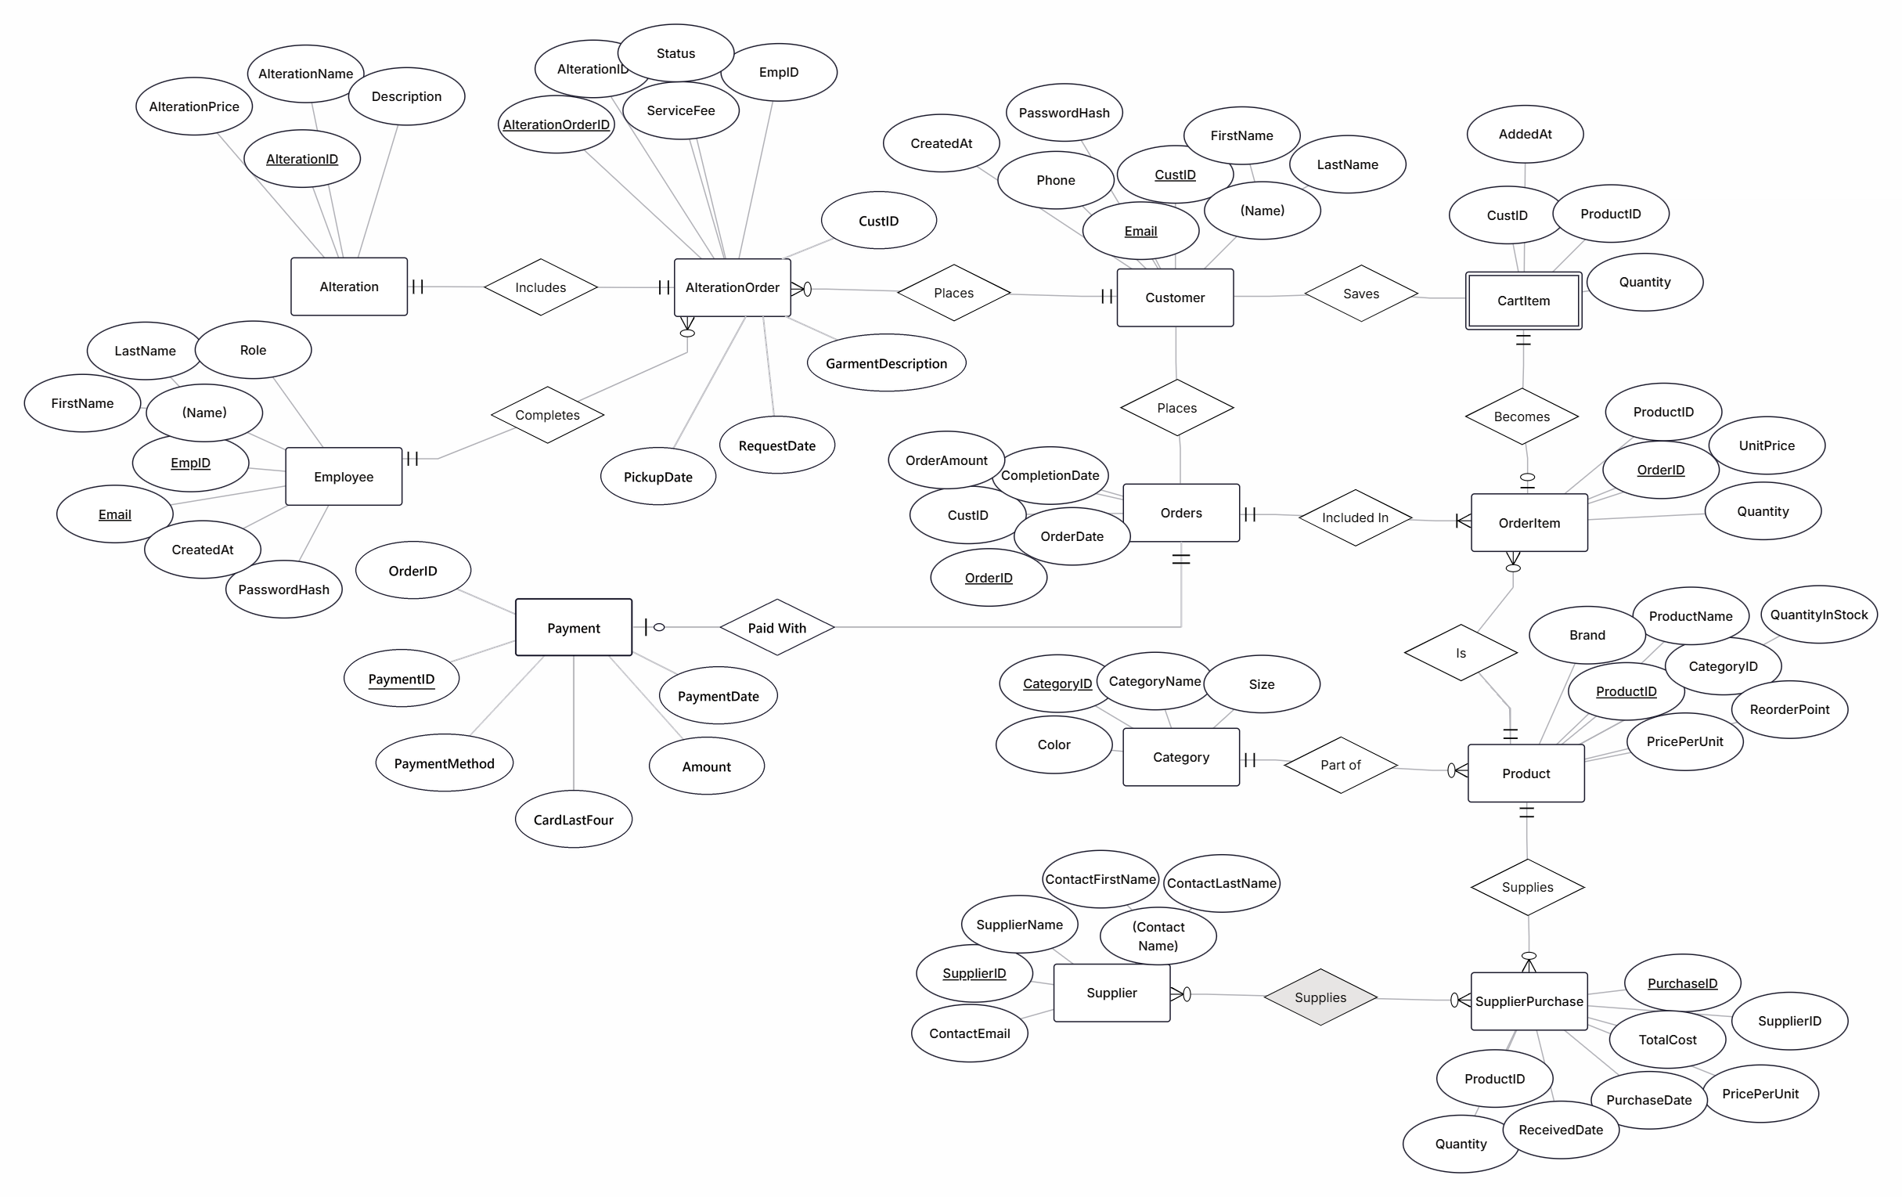
Our ERD shows every entity, attribute and relationship
3
STEP 3 · CREATE AN ERD
How to read it
Rectangle
Entity
Oval
Attribute
Underlined
Primary key
Diamond
Relationship
||
Exactly one
o|
Zero or one
crow's foot
Many
Double box
Weak entity (CartItem)
Notes:
This is our full ERD in Chen notation with crow's-foot cardinality. The next three slides zoom in so every attribute is readable: alteration services, customers and orders, and products and suppliers.

Slide 9
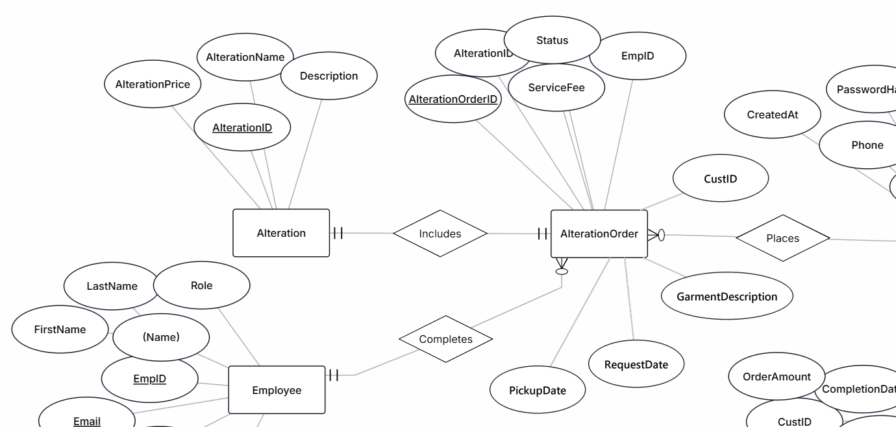
Alteration orders link a customer, a service and a tailor
3
STEP 3 · CREATE AN ERD · ZOOMED IN
Notes:
Zoom: AlterationOrder is linked to Customer (Places), Alteration (Includes) and Employee (Completes). The circle on the Completes side means a new order can start with no tailor. It has no link to Orders, which is our schema correction.

Slide 10
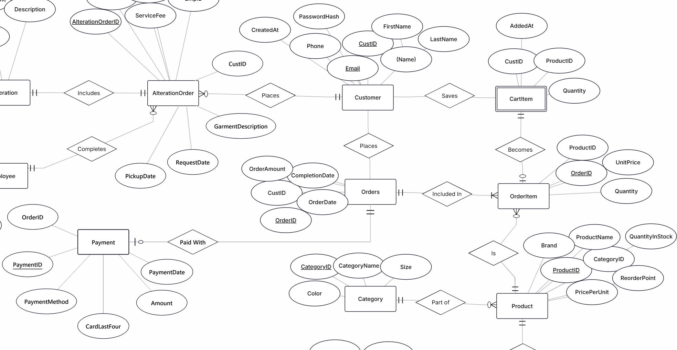
Customers build carts, place orders and pay for them
3
STEP 3 · CREATE AN ERD · ZOOMED IN
Notes:
Zoom: a Customer saves products in CartItem, places Orders, and each order includes products through OrderItem. Payment is new: each order is paid with exactly one payment.

Slide 11
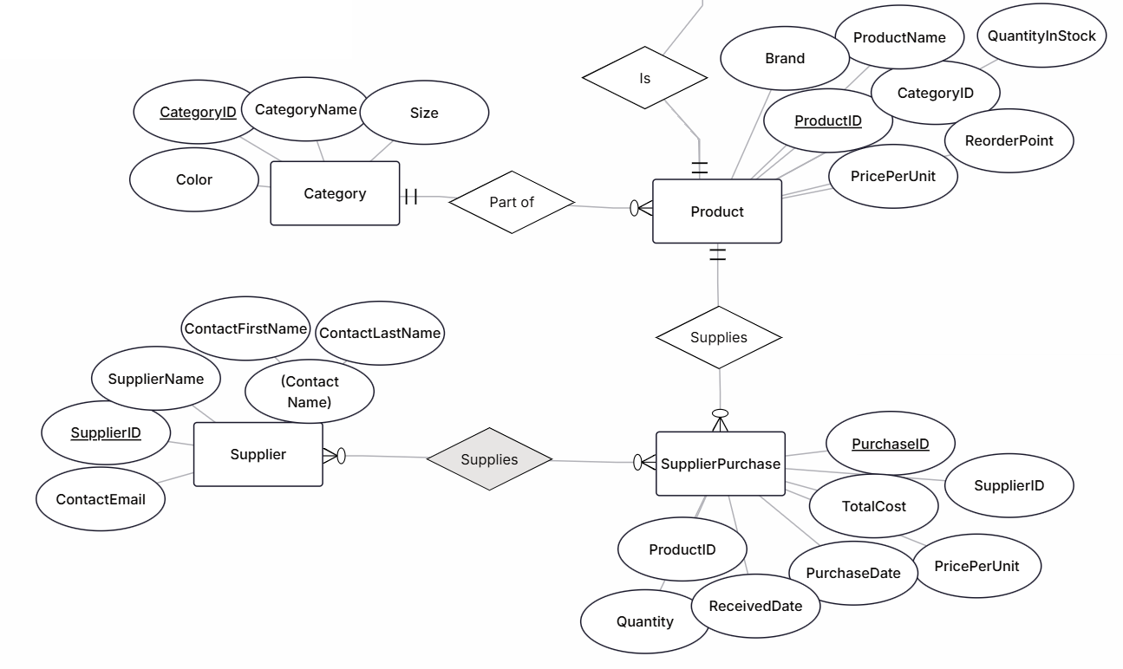
Categories group products; suppliers restock them
3
STEP 3 · CREATE AN ERD · ZOOMED IN
Notes:
Zoom: each Product is part of one Category, which holds size and color. Suppliers supply products through SupplierPurchase, which records price, quantity, the derived TotalCost, and when it was received.

Slide 12
We redesigned AlterationOrder to alter any garment
3
STEP 3 · CREATE AN ERD
BEFORE
AFTER
AlterationOrder pointed at a sales order (OrderAlteration)
Only items bought on a StyleHub order could be altered
No place to describe the garment
No request or pickup dates
Links Customer, Alteration (service) and Employee (tailor)
GarmentDescription describes the item, bought here or elsewhere
RequestDate and PickupDate track the job
No foreign key to Orders
Why: the scenario is a customer ordering an alteration to a piece of clothing, so the order must stand on its own.
Notes:
This is the one change we made after reviewing the requirements. Our first design tied an alteration to a product order. The scenario describes a customer ordering an alteration to a garment, so AlterationOrder now links to the customer, the service and the tailor, and describes the garment itself.

Slide 13
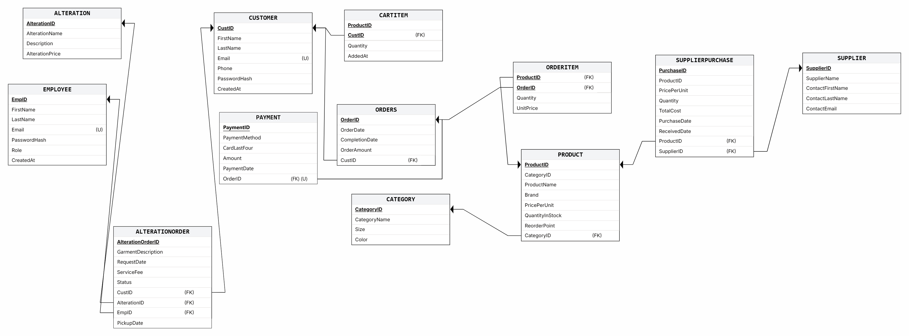
Each relationship became a key in the relational schema
4
STEP 4 · CONVERT THE ERD INTO A RELATIONAL SCHEMA
1 : M
Foreign key on the "many" side (Orders.CustID)
M : N
Junction table with a composite key (OrderItem, CartItem)
M : N + data
Associative table with its own key (SupplierPurchase)
1 : 1
UNIQUE foreign key (Payment.OrderID)
Notes:
The relational schema converts the ERD into tables. Arrows run from each foreign key to the primary key it references. The four cards at the bottom are the mapping rules we applied. The next two slides list every table in text so the columns are readable.

Slide 14
Relational schema: people, products and suppliers
4
STEP 4 · CONVERT THE ERD INTO A RELATIONAL SCHEMA
CUSTOMER
EMPLOYEE
CATEGORY
CustID PK
FirstName
LastName
Email (unique)
Phone
PasswordHash
CreatedAt
EmpID PK
FirstName
LastName
Email (unique)
PasswordHash
Role
CreatedAt
CategoryID PK
CategoryName
Size
Color
PRODUCT
SUPPLIER
SUPPLIERPURCHASE
ProductID PK
CategoryID FK → Category
ProductName
Brand
PricePerUnit
QuantityInStock
ReorderPoint
SupplierID PK
SupplierName
ContactFirstName
ContactLastName
ContactEmail
PurchaseID PK
SupplierID FK → Supplier
ProductID FK → Product
PricePerUnit
Quantity
TotalCost (derived)
PurchaseDate
ReceivedDate
Notes:
Primary keys are bold and underlined; foreign keys are italic with the table they reference. Product points to Category, and SupplierPurchase points to both Supplier and Product, which is how the many-to-many supply relationship is stored.

Slide 15
Relational schema: sales and alterations
4
STEP 4 · CONVERT THE ERD INTO A RELATIONAL SCHEMA
ORDERS
ORDERITEM
CARTITEM
OrderID PK
CustID FK → Customer
OrderDate
CompletionDate
OrderAmount
OrderID PK, FK → Orders
ProductID PK, FK → Product
Quantity
UnitPrice
CustID PK, FK → Customer
ProductID PK, FK → Product
Quantity
AddedAt
PAYMENT
ALTERATION
ALTERATIONORDER
PaymentID PK
OrderID FK → Orders (unique)
PaymentMethod
CardLastFour
Amount
PaymentDate
AlterationID PK
AlterationName
Description
AlterationPrice
AlterationOrderID PK
CustID FK → Customer
AlterationID FK → Alteration
EmpID FK → Employee
GarmentDescription
ServiceFee
Status
RequestDate
PickupDate
Notes:
OrderItem and CartItem have composite primary keys made of two foreign keys; that is how a many-to-many relationship is stored. Payment's OrderID is unique, which makes the relationship one-to-one. AlterationOrder has three foreign keys and none of them point to Orders.

Slide 16
01_schema.sql builds all 12 tables with keys and constraints
5
STEP 5 · IMPLEMENT THE DATABASE IN MYSQL
12
12
01_schema.sql · AlterationOrder
CREATE TABLE AlterationOrder (
AlterationOrderID INT AUTO_INCREMENT PRIMARY KEY,
CustID INT NOT NULL,
AlterationID INT NOT NULL,
EmpID INT NULL,
GarmentDescription VARCHAR(255) NOT NULL,
ServiceFee DECIMAL(10,2) NOT NULL CHECK (ServiceFee >= 0),
Status ENUM('Received','In Progress',
'Ready for Pickup','Completed'),
RequestDate DATETIME DEFAULT CURRENT_TIMESTAMP,
PickupDate DATETIME NULL,
FOREIGN KEY (CustID) REFERENCES Customer(CustID),
FOREIGN KEY (AlterationID) REFERENCES Alteration(...),
FOREIGN KEY (EmpID) REFERENCES Employee(EmpID),
CHECK (Status = 'Received' OR EmpID IS NOT NULL)
);
tables
foreign keys
9
4
CHECK constraints
UNIQUE rules
Parent tables are created before child tables
ENUMs limit Role, Status and PaymentMethod
TotalCost is a generated (derived) column
Indexes speed up the report queries
Notes:
01_schema.sql creates the database. Anyone can run it to rebuild StyleHub from scratch. On the right is our AlterationOrder table: three foreign keys, a CHECK on the fee, an ENUM for status, and the business rule that a job needs a tailor before it moves past Received.

Slide 17

02_sample_data.sql loads 114 rows across all 12 tables
6
STEP 6 · CREATE AND POPULATE SAMPLE DATA
Every table has at least 4 rows
Meets the deliverable's 4-5 row minimum
3 products below reorder point
So the reorder report returns real rows
1 supplier purchase still open
Demo: mark it received and stock goes up
2 unassigned alteration orders
Demo: the tailor CHECK rule on the work board
Loaded parents before children
Customers and products first, then orders, items and payments
Notes:
The sample data is written to exercise every feature and every report: low-stock products, an open supplier purchase, unassigned alterations, and garments brought in from elsewhere. It loads in foreign-key order, parents before children, the same rule the Scripting Data Loads deck teaches.

Slide 18




Each click goes browser → Python → MySQL and back
7
STEP 7 · DEVELOP A WEB APPLICATION THAT INTERACTS WITH MYSQL
Browser
app.py route
queries.py
db.py
MySQL
User clicks or submits a form
Picks the SQL and the values
Holds every SQL statement
Connection → cursor → commit
Runs SQL, enforces constraints
Rows come back as Python dictionaries and are rendered into the page
Connection → cursor → transaction
Parameterized queries
conn = mysql.connector.connect(**DB_CONFIG)
cur = conn.cursor(); cur.execute(sql, params)
conn.commit() # or conn.rollback() on error
conn.close() # always, in finally:
INSERT INTO CartItem (CustID, ProductID, Quantity)
VALUES (%s, %s, %s)
cur.execute(ADD_TO_CART, (cust_id, product_id, qty))
The same pattern as the Scripting Data Loads deck, using MySQL instead of SQLite.
Values are sent separately from the SQL, so form input can't inject SQL.
Notes:
This is how Python connects to SQL. The route in app.py decides what to do, queries.py holds every SQL statement, and db.py is the only file that talks to MySQL. It uses the connection, cursor, transaction pattern from class. All queries use %s placeholders, so user input is never pasted into SQL. We built two front ends, a Flask version and a JavaScript version, and both share these same files.

Slide 19
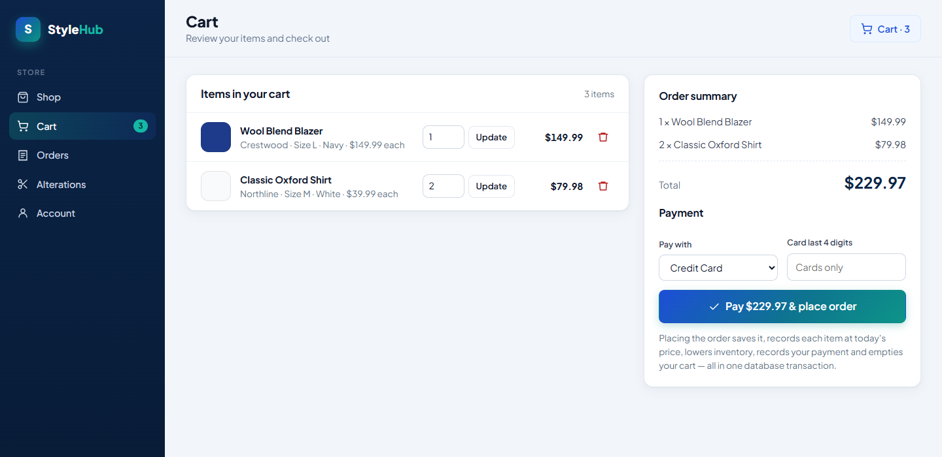
Placing an order is one complete business transaction
7
STEP 7 · DEVELOP A WEB APPLICATION THAT INTERACTS WITH MYSQL
1
Check stock for every cart item
CartItem ⋈ Product
2
Create the order (parent row)
INSERT Orders
3
Copy cart lines with today's price
INSERT OrderItem
4
Lower inventory
UPDATE Product
5
Set the order total with SUM()
UPDATE Orders
6
Record the payment
INSERT Payment
7
Empty the cart
DELETE CartItem
One connection, one commit()
If any step fails, rollback() undoes all seven. The order is either fully saved or not saved at all.
Notes:
This is our complete business transaction, db.place_order. Seven SQL statements touch five tables on one connection. The order is inserted first because OrderItem and Payment have foreign keys to it: parent before child. Everything is saved by a single commit, and any error triggers rollback, so we never end up with half an order. We will run this live in the demo.

Slide 20
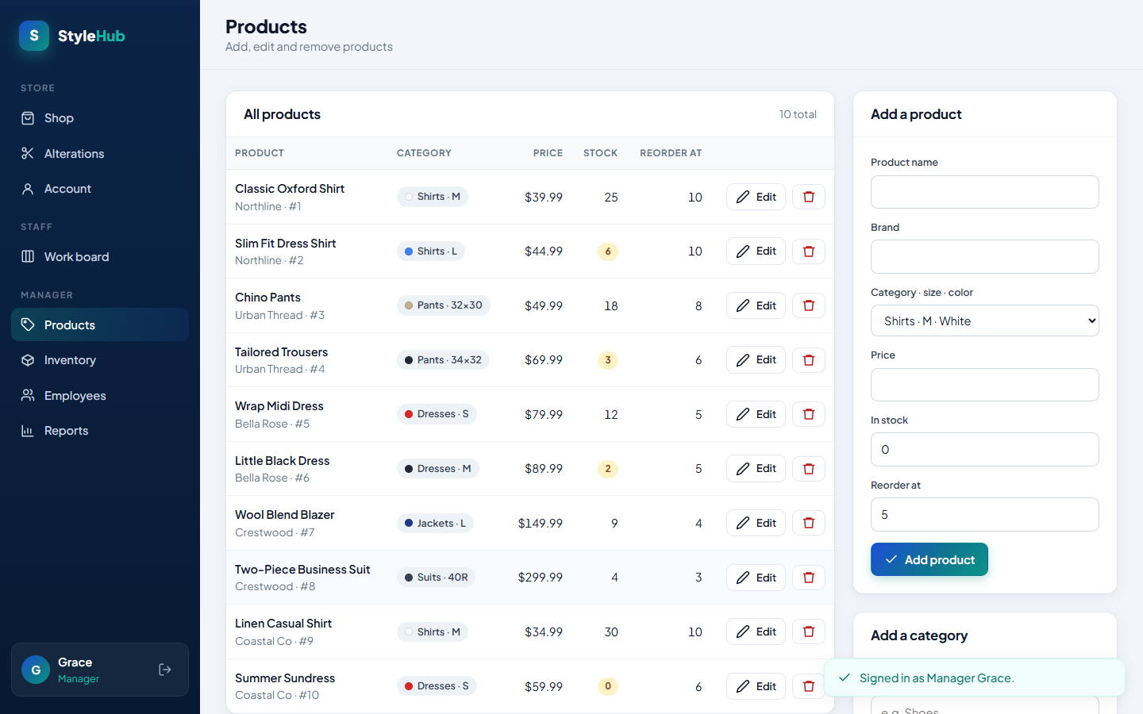
The app creates, reads, updates and deletes core data
8
STEP 8 · IMPLEMENT CRUD OPERATIONS
Table | Create INSERT | Read SELECT | Update UPDATE | Delete DELETE | Where in the app
Product | ● | ● | ● | ● | Products tab (manager)
Category | ● | ● | – | – | Products tab
Customer | ● | ● | ● | – | Register · Account profile
Employee | ● | ● | – | – | Employees tab
CartItem | ● | ● | ● | ● | Shop · Cart
Orders · OrderItem · Payment | ● | ● | ● | – | Checkout · Order history
AlterationOrder | ● | ● | ● | ● | Alterations · Work board
Supplier | ● | ● | ● | – | Inventory tab
SupplierPurchase | ● | ● | ● | – | Inventory: record and receive
Example: Products
INSERT_PRODUCT
PRODUCT_BY_ID / SEARCH_PRODUCTS
UPDATE_PRODUCT
DELETE_PRODUCT
A product that is in an order can't be deleted: the foreign key protects order history.
Notes:
All four CRUD operations are implemented. The manager has full create, read, update and delete on products. Customers create and update cart items, and create and cancel alteration requests. Deleting a product that appears on an order is blocked by the foreign key, and the app explains why instead of crashing.

Slide 21

One parameterized query handles search, filters and sorting
9
STEP 9 · IMPLEMENT SEARCH AND FILTERING
queries.py · SEARCH_PRODUCTS (excerpt)
WHERE (%(text)s IS NULL
OR p.ProductName LIKE %(like)s
OR p.Brand LIKE %(like)s)
AND (%(category)s IS NULL OR c.CategoryName = %(category)s)
AND (%(size)s IS NULL OR c.Size = %(size)s)
AND (%(min_price)s IS NULL OR p.PricePerUnit >= %(min_price)s)
ORDER BY
CASE WHEN %(sort)s = 'price_asc' THEN p.PricePerUnit END,
CASE WHEN %(sort)s = 'popular'
THEN SUM(oi.Quantity) END DESC
Search
Filter
Sort
Blank = all
Name or brand, partial match with LIKE
Category, size, color, min and max price
Price low/high, or popularity from units sold
An empty filter is NULL, so its condition is skipped
Notes:
Search and filtering is one SQL statement with named parameters. Each filter is written as 'parameter IS NULL OR condition', so a blank box turns into NULL and that filter is skipped. Search matches either the product name or the brand with LIKE. Sort by popularity uses SUM of units sold from OrderItem, joined to Product and Category.

Slide 22
Six SQL reports answer the questions a manager asks
TASK 2 · BUSINESS REPORTS
# | Report (view) | Business question | JOIN | Aggregates | HAVING
1 | Product Sales Performance | Which products earn the most, and which aren't selling? | ● | SUM · COUNT · AVG | –
2 | Low-Stock Reorder ★ | What should we reorder, from whom, and at what cost? | ● | SUM · MAX | –
3 | Repeat Customer Value | Who are our repeat customers and how much do they spend? | ● | COUNT · SUM · AVG · MIN · MAX | ●
4 | Tailor Workload & Revenue | How many jobs has each tailor completed, and what did they earn? | ● | COUNT · SUM · AVG | ●
5 | Monthly Revenue | How does monthly revenue split between products and alterations? | ● | COUNT · SUM · AVG | –
6 | Alteration Service Demand | Which alteration services are requested most often? | ● | COUNT · SUM · AVG | –
6 of 6
6 of 6
2
★
use JOINs (need 3)
use aggregates (need 3)
use GROUP BY + HAVING (need 1)
manager decision report
Notes:
Task 2 asks for five SQL reports with at least three JOINs, three aggregates, one GROUP BY with HAVING, and one manager decision. We wrote six, saved as views in 03_reports.sql. Report 6 matches the instructor's alteration service performance example. The app's Reports tab runs SELECT star from each view.

Slide 23
The reorder report tells the manager what to buy today
TASK 2 · MANAGER DECISION REPORT
Product | In stock | Reorder at | On order | Last supplier | Suggested qty | Est. cost
Slim Fit Dress Shirt | 6 | 10 | 0 | Northline Apparel Wholesale | 14 | $294
Little Black Dress | 2 | 5 | 0 | Bella Rose Fashions | 8 | $320
Tailored Trousers | 3 | 6 | 15 | Urban Thread Distributors | 0 | $0
vw_LowStockReorder on our sample data
What it tells the manager
Business action
SQL behind it
Three products are at or below their reorder point. Tailored Trousers already has 15 units on order, so ordering more would double-buy.
Order 14 Slim Fit Dress Shirts from Northline and 8 Little Black Dresses from Bella Rose: about $614 in total.
JOINs Product, Category, SupplierPurchase and Supplier; subqueries with SUM and MAX find open orders and the last supplier.
Notes:
This is the report built for a manager decision. It lists every product at or below its reorder point, who we last bought it from, what is already on order, and a suggested quantity and cost. Today the action is to order 14 shirts and 8 dresses, about $614, and to skip the trousers because 15 are already on the way.

Slide 24

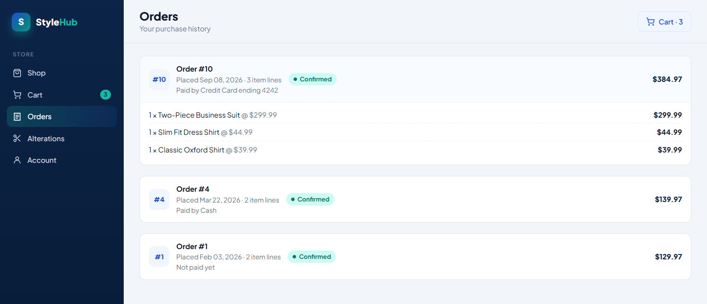
Live demo: follow one order from the browser into MySQL
LIVE DEMO
1
2
3
4
Guest
Customer
MySQL Workbench
Manager
Search "Northline", filter by size and price, sort by popularity
Add to cart, pay and place the order, then view order history
Show the new Orders, OrderItem and Payment rows with a JOIN
Work board CHECK rule, receive a supplier shipment, run reports
Verification query (Workbench)
SELECT o.OrderID, o.OrderAmount, p.PaymentMethod
FROM Orders o JOIN Payment p
ON p.OrderID = o.OrderID
ORDER BY o.OrderID DESC LIMIT 1;
Notes:
For the demo we follow one request end to end. Search as a guest, then sign in as Ava, add to cart and place the order. Then switch to MySQL Workbench and run the verification query to show the new order and its payment really are in the database. Finally sign in as Grace, the manager, to show the CHECK rule on the work board, receive a supplier shipment, and the reports.

Slide 25
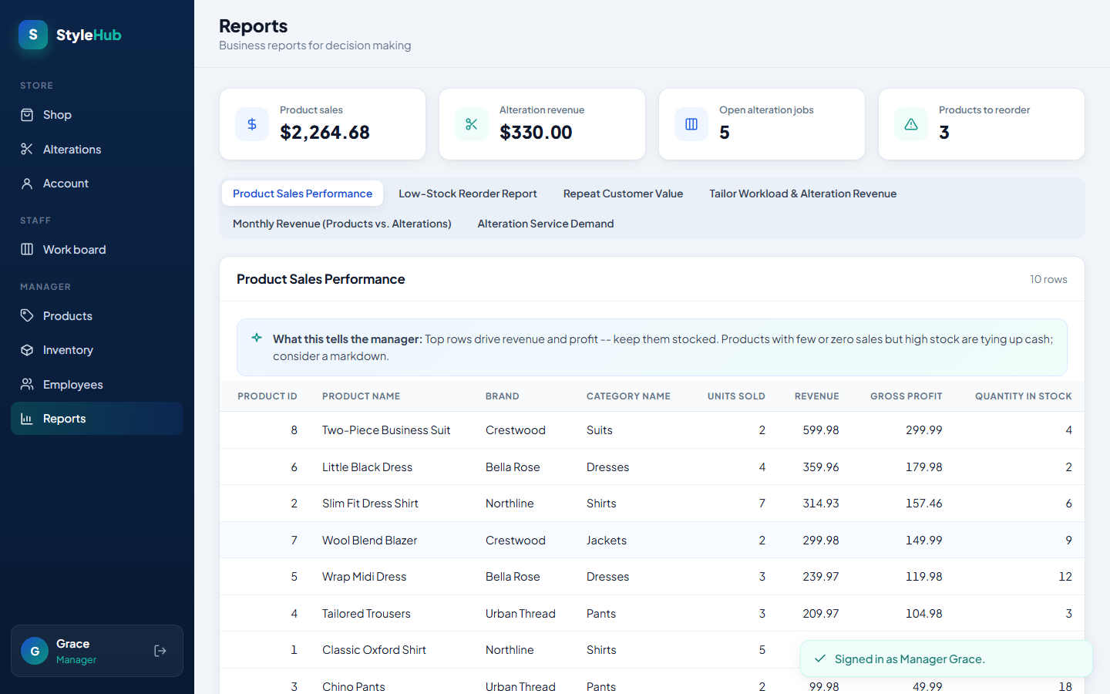
THANK YOU
Questions?
Garrett Harmon · Evan Dame · Kaden Couch
A 12-table MySQL database designed from StyleHub's requirements, with keys and constraints that enforce its rules
A Python web app with full CRUD, search and filtering, and a complete order transaction
Six SQL reports that turn sales and alteration data into manager decisions
Notes:
To wrap up: we designed a twelve-table database from StyleHub's requirements, connected it to a Python web app that covers every required function, and wrote SQL reports a manager can act on. Thank you; we're happy to take questions.

